Slide 1
DANGER OF COMPROMISE IN THE CHURCH

Slide 2

TEXT: Revelation 2:12-17
MEMORY VERSE:
“Repent; or else I will come unto thee quickly, and will fight against them with the sword of my mouth” (Revelation 2:16)

Slide 3

INTRODUCTION
Special messages was sent by Jesus to the seven churches in Asia through Apostle John.
In this study, the message was sent to the church in Pergamos and we will examine the content and significance.
Pergamos was a very wealthy city and centre of cultism and idol worship, a place where Satan’s seat is and the church there was also persecuted.
The Christians in Pergamos tried to remain faithful, but a few people within the church were teaching errors like Balaam in the old testament who taught Balak to entice the children of Israel to commit sin.

Slide 4
INTRODUCTION CONT’D.
False teachers introduced worldliness to the church, which made Christ unhappy and he sent strong warnings for them to quickly retrace their steps, repent and escape God’s judgment.
The situation in our world today is similar to that of the church in Pergamos if not worse.
Many bad things are happening , but amidst all these, Jesus expects His friends to remain steadfast and not to compromise with the world.
Great reward awaits overcoming, uncompromising friends of Jesus who are faithful.

Slide 5
INTRODUCTION CONT’D.
We will consider the study under three sub-headings in this study.
WARNING AGAINST COMPROMISE IN THE CHURCH
CALL TO REPENT AND BE STEADFAST IN THE FAITH
REWARDS FOR THE UNCOMPROMISING AND FAITHFUL BELIEVERS

Slide 6


PT. 1: WARNING AGAINST COMPROMISE IN THE CHURCH- Rev. 2:12-17; Romans 2: 2:8,9; Heb. 10:26-31
What is compromise?
Compromise means to reduce the quality, value or degree f something such as one’s ideals or faith.
A friend of Jesus is said to have compromised when he begins to accept and to do the things he once rejected.
There was a time when Christians boys and girls stood their ground against some cultural practices or games in the school, refusing to exposed their nakedness.
Some prefer to study the word of God rather than playing games or watching videos and movies.

Slide 7
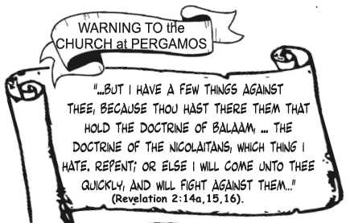
PT. 1: WARNING AGAINST COMPROMISE IN THE CHURCH CONT’D.
But this is not so any more with many boys and girls who claim to be friends of Jesus.
Some friends of Jesus are no more doing quiet time, evangelism, attending fellowship or interested in rendering acceptable service to God.
Some even join sinful children to cheat in examination, sing worldly songs, make jest of God’s word and do things that does not glorify God.
Others prefer games/sports, movies, parties, and other activities than building relationship with God.
This was the case in Pergamos; Jesus himself had to send the warning directly to the head of that church.
The warning about the danger of compromise is coming to us too.

Slide 8
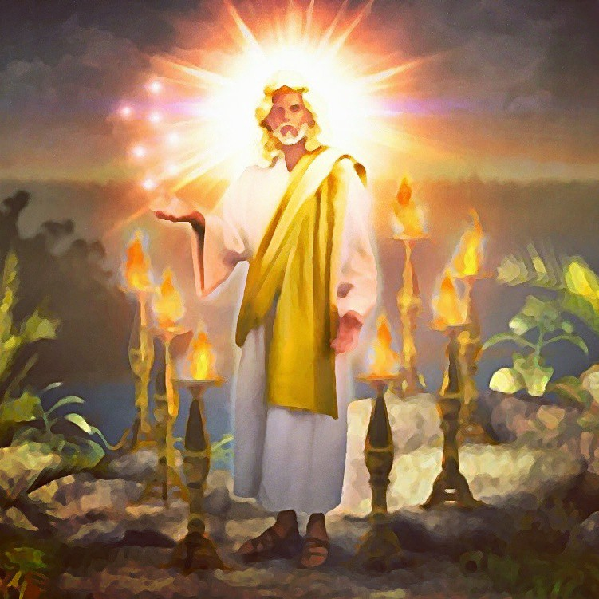
PT. 1: WARNING AGAINST COMPROMISE IN THE CHURCH CONT’D.
Do not reject Christ’s warning because Judgment will start from the house of God.
Examine yourself and see whether your love for Jesus is diminishing or increasing.
Just as Satan used the serpent to tempt Adam and Eve, he is using human beings today to make children of God compromise and miss their heavenly home.
All those who compromise their faith will spend eternity in hell fire with Satan who deceived them.
Friends of Jesus must give serious attention to this warning against compromise in the church.

Slide 9

PT. 2: CALL TO REPENT AND BE STEADFAST IN THE FAITH Revelation 2:15-17; Isaiah 1:16-18; 2Corinthians 6:14-17;Ephesians 4:14
After repenting and accepting Jesus as our Lord and personal Saviour, we need to continue in the faith as the coming of the Lord is fast approaching.
Satan is using various means to discourage and win over friends of Jesus to himself.
Therefore, remember to hold firmly unto Christ without wavering by:
Reading the Bible and praying every day
Engaging in purposeful studying of the word of God
Striving to live holily and righteously
Being an encouragement to one another
Attending fellowship regularly
Setting our affections on things on the earth.

Slide 10
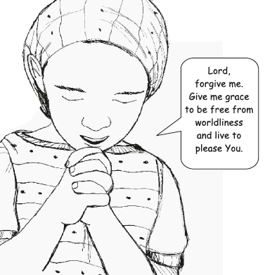
PT. 2: CALL TO REPENT AND BE STEADFAST IN THE FAITH CONT’D.
We are in the last days already and many have compromised due to bad influences from the world, but the Lord is saying “Hold that fast which thou hast, that no man take thy crown” (Revelation 3:11)
Therefore, examine yourself and repent of any compromise with the world.
Tell God to forgive you and give you grace to be free from worldliness and live to please Him always.

Slide 11
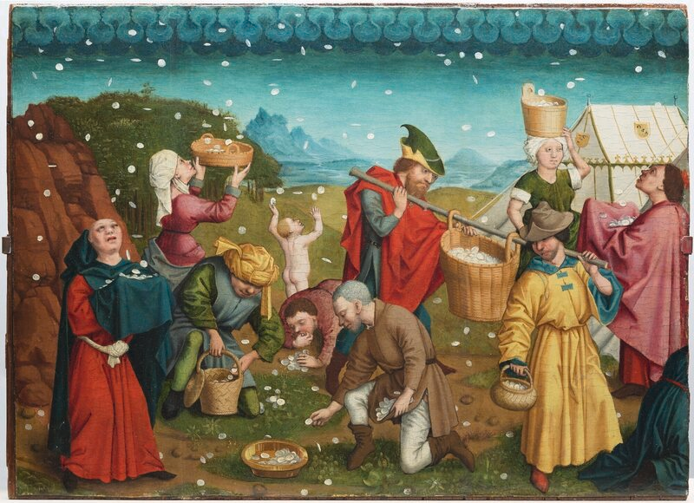
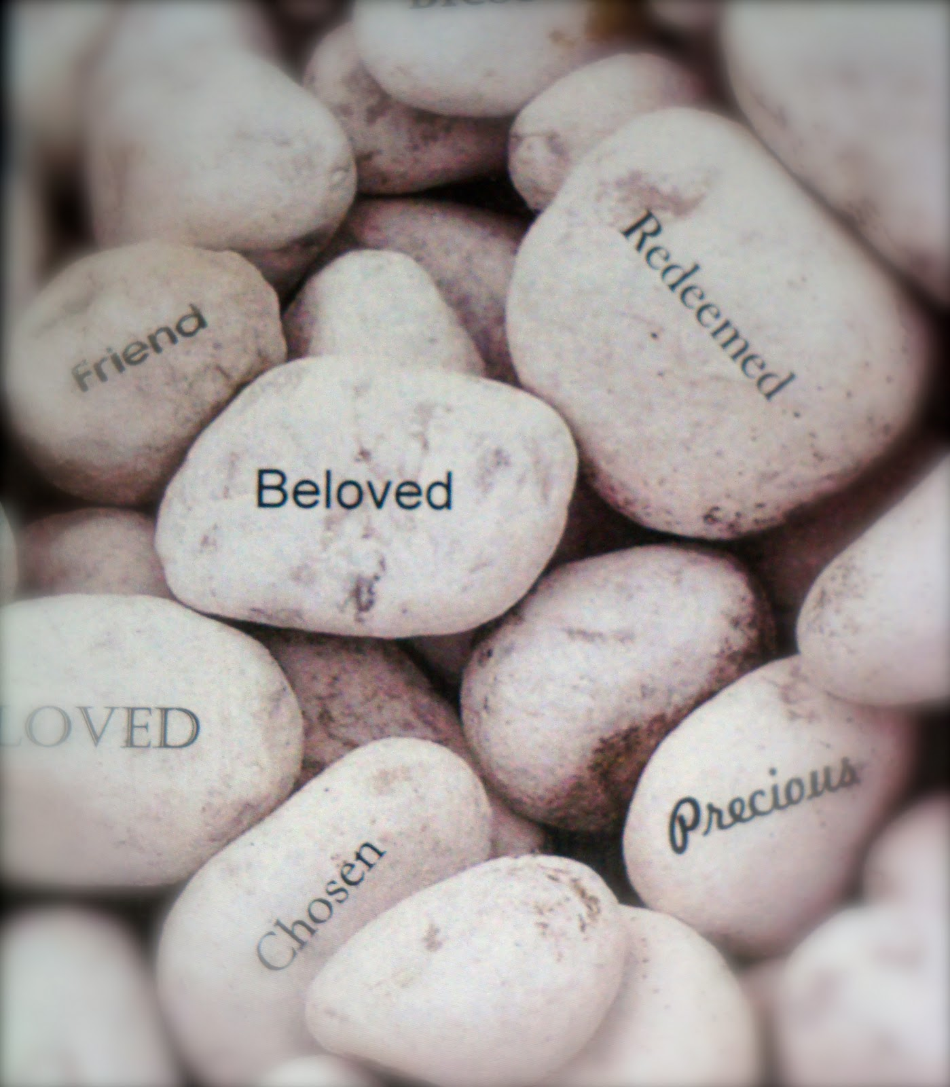
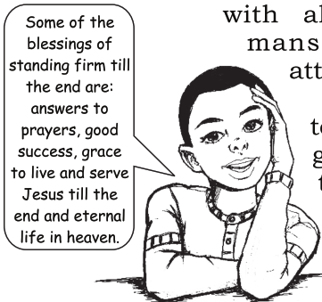
PT. 3: REWARDS FOR THE UNCOMPROMISING AND FAITHFUL BELIEVERS- Revelation 2:15-17; 26-29; 3:5, 12, 21; Hebrews 6:10
Friends of Jesus who stand firm to the end will enjoy great blessings as follows:
Hidden manna- means divine provision and sustenance
A white stone with a new name written-signifies purity of life that guarantees partaking in the marriage supper of the Lamb with all heavenly blessings like mansions, crowns with stars attached to it.
Other blessings are answers to prayers, good success and grace to live and serve God till the end.
To enjoy these blessings, a sinful child must become a friend of Jesus by repenting and turning away from sins, and living a holy life.

Slide 12
QUESTIONS:
Jesus sent special message to the church in __________
Why did Jesus send the message to the church?
What were the evidences which showed that the church was compromising with the world?
In what ways are friends of Jesus compromising with the world today?
What should believers do to avoid compromise?
What are the rewards for overcomers?

Slide 13
LESSON & THOUGHT
LESSON:
Compromise will lead to loss of fellowship with God and eternal punishment in hell fire.
THOUGHT:
I must love Jesus till the end so as to escape eternal punishment.

Slide 14
REFERENCES
https://www.atlasobscura.com/articles/is-manna-real
https://christianleadershipalliance.org/blog/2016/01/13/jesus-names-his-stewards-by-howard-rich/#/program/e0610f3c5a66d2aceff81924beeccd70
https://www.macworld.com/article/232870/why-use-both-text-message-forwarding-and-messages-in-icloud.html
https://www.shutterstock.com/search/children+cultural+dance
https://www.pcmag.com/how-to/play-video-games-without-going-broke
https://medium.com/@benn29/as-for-the-mystery-of-the-seven-stars-that-you-saw-in-my-right-hand-and-the-seven-golden-9d3944d3b438
https://valeriewritenow.com/2012/01/01/read-your-bible-pray-every-day/

