Slide 1
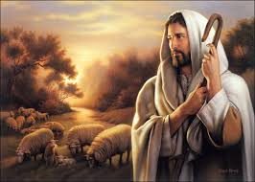
THE SHEEP’S CRY AND THE SHEPHERD’S CONCERN AND SUPREME AUTHORITY

Slide 2
TEXT: Psalm 22:1-31; 23:1-6;24:1-10
MEMORY VERSE:
“The earth is the LORD'S, and the fulness thereof; the world, and they that dwell therein.” Psalm 24:1.

Slide 3
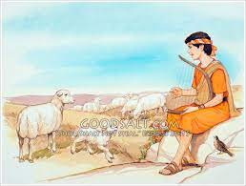
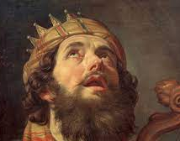
INTRODUCTION
Psalm 22 narrates David, the shepherd boy, and king of Israel, experience and suffering at the hands of wicked people.
It also reveals David's show of confidence in the power of God to deliver him.
Psalm 23 tells the story of David's confession of faith in God as the Great Shepherd who cares so much for His sheep
Finally, Psalm 24 is a call to everyone to come with clean hands and holy hearts into a loving relationship with God.

Slide 4
INTRODUCTION CONT’D.
Prophetically, Psalms 22, 23, and 24 gave divine revelation about Jesus as the Messiah.
The Psalmist reveals how Jesus would suffer as our substitute in order to bring us as sheep into His shepherd fold, nurture and make us qualify for eternal fellowship with Him as King of kings and Lord pf lords.
Our study therefore, focus on the prophetic meaning of the Psalms.

Slide 5
INTRODUCTION
THE STUDY IS DIVIDED INTO THREE PARTS
1.THE CRY OF OUR SACRIFICIAL LAMB
2. THE CONCERN OF OUR LOVING SHEPHERD
3. CHRIST SUPREME AUTHORITY OVER ALL

Slide 6
POINT 1: THE CRY OF OUR SACRIFICIAL LAMB: Psalm 22:1-31; Isaiah 53:1-12; Mathew 27:27-60
Psalm 22 is one of the most quoted in the New testament, called “the Psalm of the cross”.
This is because it accurately predicts in details, Christ’s suffering on the cross. There are three parts to this Psalm is as follows
The complaints of discouragement – verse 1-10.
The first part talks about the cry of pain and agony from the sinless, righteous Son of God.
It shows that Jesus our Saviour identifies with our suffering and pains .
Therefore, whenever we in suffering, we should always call on God just as Jesus did.

Slide 7
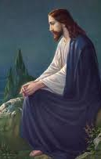
POINT 1: THE CRY OF OUR SACRIFICIAL LAMB CONT’D.
(ii) Prayer for deliverance: Verses 11-21 reveals that Jesus prayed to His heavenly Father not for His own deliverance but for ours.
For Christ sacrifice not to be in vain, sinful children should repent and become friends of Jesus.
Friends of Jesus should follow Christ’s example and pray whenever he is afflicted.
God will answer our prayers.

Slide 8
POINT 1: THE CRY OF OUR SACRIFICIAL LAMB CONT’D.
Praises for mercies and redemption- verse 22-31.
Jesus death, burial and resurrection resulted in salvation for sinners, sanctification for the saved, provision of help for the afflicted, eternal life for all believers and final exaltation and glory.
All these made Christ to offer thanksgiving and praises to God

Slide 9
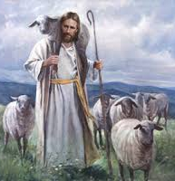
POINT 2: THE CONCERN OF OUR LOVING SHEPHERD
Psalm 23 is the most “memorised” in the Bible. David as a shepherd, knew what a shepherd does.
Prophetically, he explained the character of Jesus our loving and caring Shepherd through this Psalm.
We can learn three important truths
Supremacy and sovereignty of the Shepherd- verses 1,3.
Security and safety in the shepherd – verses. 4, 5.
Satisfaction and surety in the Shepherd – verse 2, 6.
TEXT: Psalm 23:1-6; Isaiah 40:11; John 10:11

Slide 10
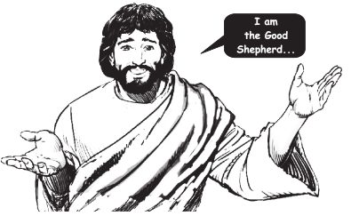
POINT 2: THE CONCERN OF OUR LOVING SHEPHERD CONT’D.
Supremacy and sovereignty of the Shepherd - verse 1,3. Jehovah, Shepherd of the Old Testament is manifested as Jesus the Shepherd of the New Testament. What kind of Shepherd is Jesus?
He is the Good Shepherd who died to pay the penalty of sin (John 10:11)
He is the great Shepherd (Heb. 13:20,21)
He is the Seeking Shepherd, who has come to seek and save the lost
He is the Concerned Shepherd (Luke 15:4-6)
He is the Comforting Shepherd (2 Corinth. 1:4)
He is the Chief Shepherd who is coming again to take us to our heavenly mansion (1 Peter 5:4).

Slide 11
POINT 2: THE CONCERN OF OUR LOVING SHEPHERD
(ii) Security and safety in the shepherd – vss. 4, 5.
Jesus as our loving Shepherd knows all His sheep by names. In addition, He is a Shepherd who is compassionate, caring and displays much courage.
David did not worry or fear the ‘valley of the shadow of death’ because he knew who his Shepherd was and His ability.
A Christian child may encounter some problems or dangers. He should not fret but be comforted of Gods promises.
Jesus’ rod and staff reassure us of His love, protection, and preservation of our lives

Slide 12
POINT 2: THE CONCERN OF OUR LOVING SHEPHERD CONT’D.
(iii) Satisfaction and surety in the Shepherd – verse 2, 6.
The knowledge of the Shepherd’s care and love for us gives us a deep sense of satisfaction. For “He maketh me to lie down in green pastures…” is a picture of contentment and satisfaction.
Learn to cultivate the art of quietness and meditation on Gods word because therein shall we find satisfaction and sure promises of Gods presence all the days of our lives

Slide 13
POINT 3: CHRIST SUPREME AUTHORITY OVER ALL: 2 Psalm 24:1-10; 97:1-6; 15:1-5; 1 Timothy 6:14-16; Revelation 17:14; 19:11-16
This chapter proclaimed Jesus as the King of glory. He is supreme, strong and mighty in battle. We can identify three parts in this chapter
(i) Recognising Christ’s supreme authority – verses 1, 2, 7-10. The Psalmist recognised that Jesus is the King of Kings who owns heaven, earth and everything therein. If you accept and surrender to Him now, He will reign in your life and you will also reign with Him.
(ii) Receiving the King of Kings – verses 3,4.
Those who desire to ascend to Gods holy hill and reign with Him must have clean hands free from external sins like stealing, fighting, cursing, lying disobedience etc.

Slide 14
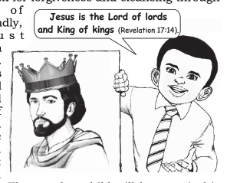
POINT 3: CHRIST SUPREME AUTHORITY OVER ALL CONT’D.
You must also possess a pure heart that is cleansed from the inward adamic nature through sanctification.
Such a child will be pure in his actions and intentions.
(iii) Received by the King of Kings – verse 5,6. The rapture will soon take place.
We need to be prepared for His appearance and glory.

Slide 15
QUESTIONS
Psalm 22-24 are prophetic songs written by ________________
Prophetically the psalms are divine revelation about ______________
___________is our sacrificial Lamb
What kind of Shepherd is Jesus?
Jesus is the Supreme King who rules over all Yes/No?
How can a (i) sinful (ii) saved child reign with Jesus?

Slide 16
LESSON THOUGHT, and ACTIVITY
LESSON: Jesus is our Saviour, Shepherd and coming King
THOUGHT: I will obey and follow Jesus my Shepherd and King all the days of my life
ACTIVITY: Draw the picture of Jesus as our Shepherd. Color and make it beautiful. List out how He cares for us and our responsibilities to Him.

Slide 17
CHORUSES
Jesus died on the cross, saving me…
Messiah is the King of Kings
Little David played on the harp, halleluyah

Slide 18
REFERENCE
https://www.google.com/search?q=David+the+shepherd+boy
https://www.google.com/search?q=images+of+a+shepherd&tbm=isch&ved=2ahUKEwiNvKTa-4L0AhXfBTQIHcAKBwsQ2-cCegQIABAA&oq=images+of+a+shepherd&gs_

