Slide 1
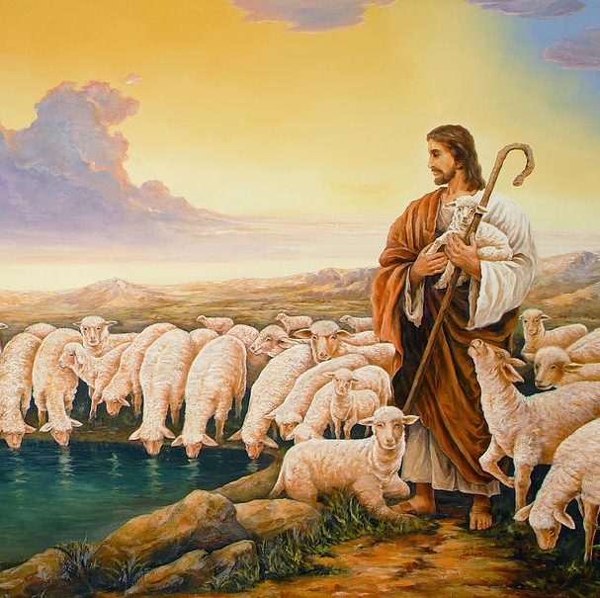
THE SHEEP’S CRY AND THE SHEPHERD’S CARE AND REIGN OVERALL

Slide 2
MEMORY VERSE: ‘’The LORD is my shepherd; I shall not want’’, Psalm 23:1
TEXT: Psalm 22: 1-3, 23:1-6.24:1-10.

Slide 3
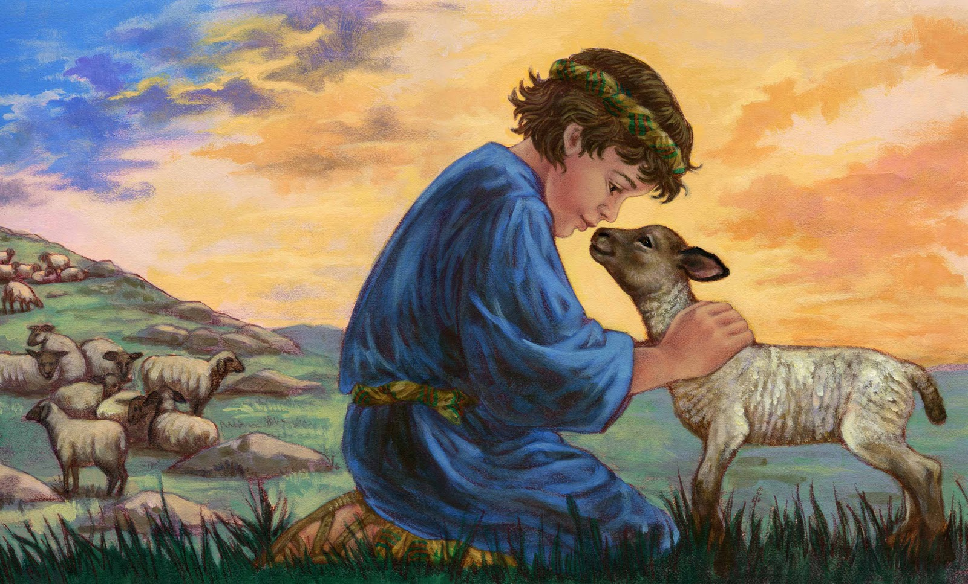
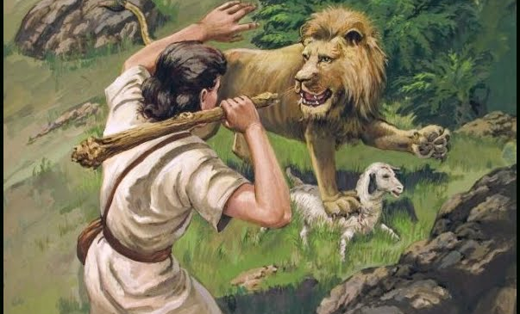
INTRODUCTION
Once upon a time, there lived a little boy in Israel named David.
His father was a shepherd ,he had many sheep.
David was put in charge of his father’s sheep to take care of them
One day, a Lion and a Bear came to kill the sheep, but David was courageous, he ran after the lion and bear and killed them.
He delivered the sheep from both the lion and the bear.
Years later, God chose David to become king in Israel and he reigned as king in Israel for years.

Slide 4
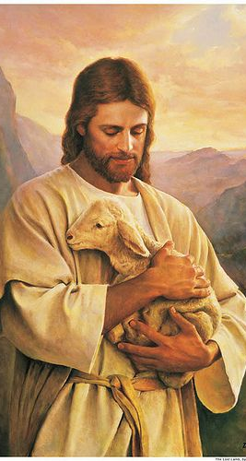
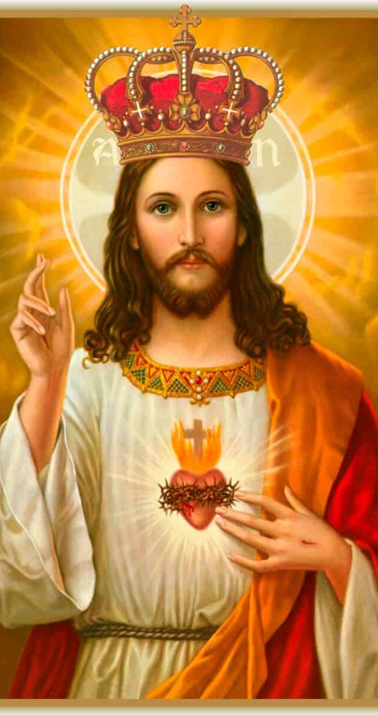
INTRODUCTION CONT’D.
It was David that wrote the Psalm we are learning about in this study.
He described Jesus who is also called the Son of David as the Lamb of God who suffered for us.
Jesus is the Shepherd who cares for us and the king who reigns in glory in our lives.

Slide 5
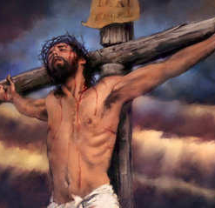
Psalm 22 speaks about the suffering and death of our Lord Jesus Christ on the cross.
The Psalm states:
God would forsake Him on the cross because of our sins
People would mock and look down on Him.
He would die on the cross.
His garments(clothes) would be shared.
All these came to pass as it was written.
The death of our Lord Jesus Christ on the cross brought salvation to all mankind.
This good news of redemption is for you, repent of all your bad ways and accept Jesus as your Lord and Saviour.

Slide 6
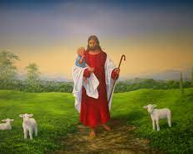
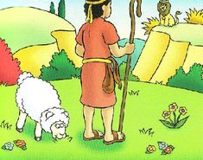
Psalm 23 describes the Lord Jesus Christ as our shepherd. A shepherd takes care of the sheep.
The Lord Jesus cares for His Friends in the following ways
He provides
He leads them in the path of peace and righteousness
He protects us from all evil
He comforts us when we are sad
His presence drives fear away.

Slide 7
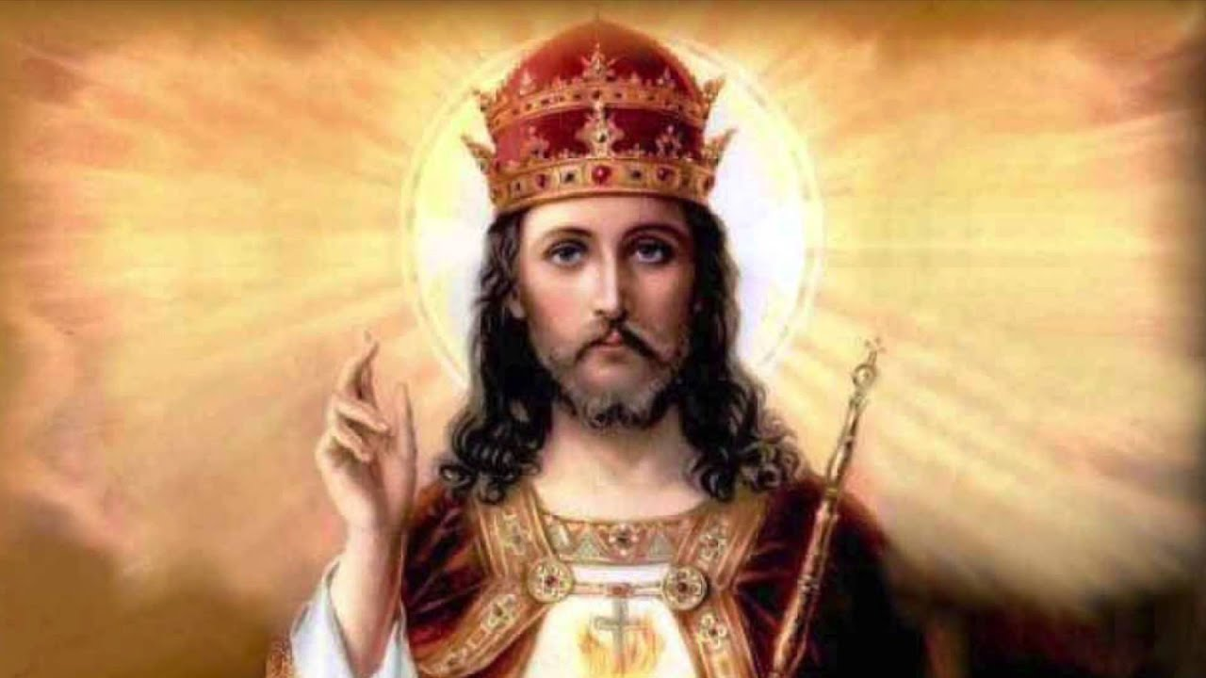
Psalm 24 describes our Lord Jesus Christ as the King that owns the earth and its fulness.
His dwelling place now is in heaven, one day we will see Him.
Only those who have clean hands and pure hearts will live with him forever and those who accept him as a king
Those who refuse to accept Him as a king will be punished
Only the sheep of Jesus can enjoy His care
Are you, His sheep? My sheep hear my voice, and I know them, and they follow me’’(John 10:27)

Slide 8
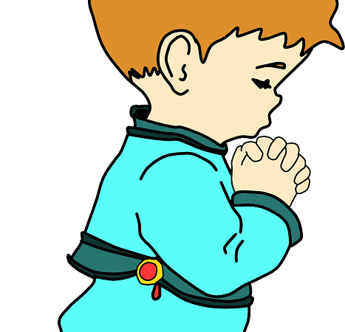
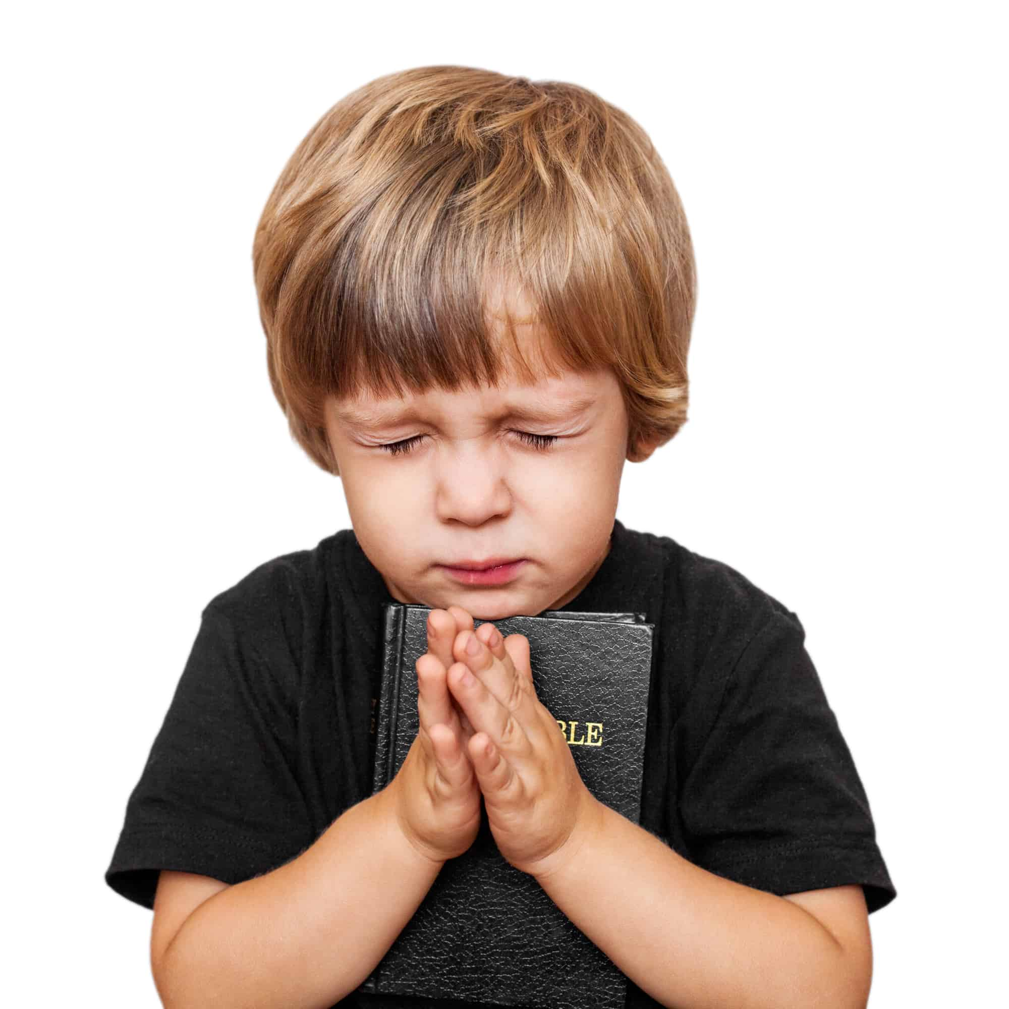
SURRENDER YOUR LIFE TO JESUS
Surrender your life to Jesus the shepherd, repent from all your sinful ways.
Confess them , ask for forgiveness and wash you in His precious blood.
Promise Him never go back to your sin, continue to follow Him to the end.
His true Sheep obeys His voice ,follows Him and abides with Him Forever.

Slide 9
QUESTIONS
Why was our Lord Jesus referred to as ‘’the Lamb od God?’’
Jesus was mocked and insulted on the cross. Yes, or No?
My sheep _______ my voice and they ______me?
List three ways Jesus cares for His friends as a Shepherd.
(a) Who is the king of glory?
(b) How can a sinful child surrender his or her life to the king of glory?

Slide 10
CHORUSES:
Jesus died on the cross, saving me ….
Messiah is the King of kings
Little David played on the harp, halleluiah
LESSON: Jesus is our Saviour, Shepherd and coming King.
THOUGHT: I will obey and follow Jesus my Shepherd and king all the days of my life.
ACTIVITY: Draw the picture of Jesus as the king of kings.

Slide 11
REFRENCES
Good Shepherd Painting by Bryan Ahn (fineartamerica.com)
https://www.amormeus.org/en/blog/solhttps://www.pinterest.ca/emilade1/vbs-the-heart/emnity-of-christ-the-king
https://www.pngwing.com/en/free-png-xkzaw
https://www.joemckinneymurals.com/church-murals--paintings.html
https://creazilla.com/nodes/70146-praying-child-clipart

