Slide 1
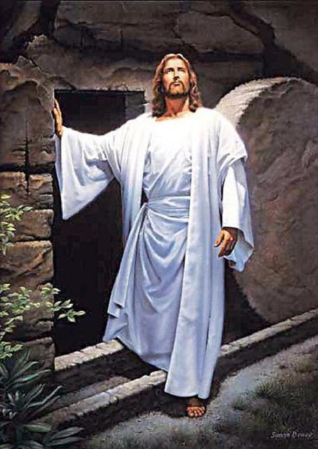

THE DEAD SHALL RISE AGAIN

Slide 2

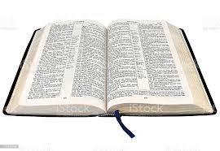
MEMORY VERSE
“But now is Christ risen from the dead and become the firstfruits of them that slept”. 1 Corinthians 15:20
TEXT: 1 Corinthians 15 : 3 – 57; 1 Thessalonians 4 : 13 - 16

Slide 3
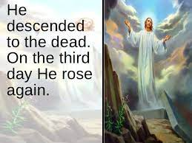
INTRODUCTION
Jesus rose from the dead on the third day
This is why it is possible for everyone who believes and trust in His name to have life after death.
When a sinner dies, his soul goes immediately to hell
For example, the rich man died and went to hell.
On the other hand, when a friend of Jesus dies, his soul goes immediately to heaven like Lazarus (Luke 16:19-31).

Slide 4
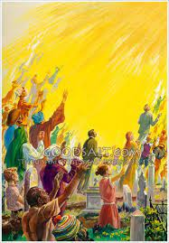
INTRODUCTION CONT’D.
The gospel is being preached every time because;
Every soul that lived on earth since the time of Adam to the end of the world will rise again.
The plan and will of God is that everybody should know Him through Jesus His begotten Son.
He is the Saviour of the world. He suffered, shed His blood and died for our sins. He rose the third day and now in heaven.

Slide 5
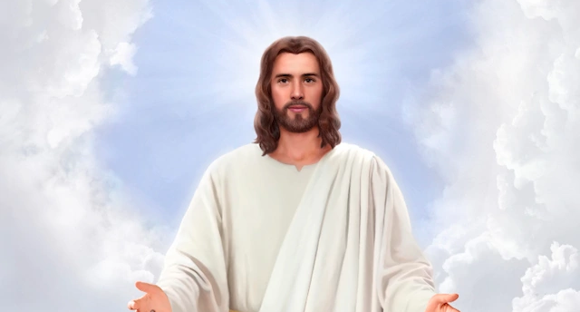
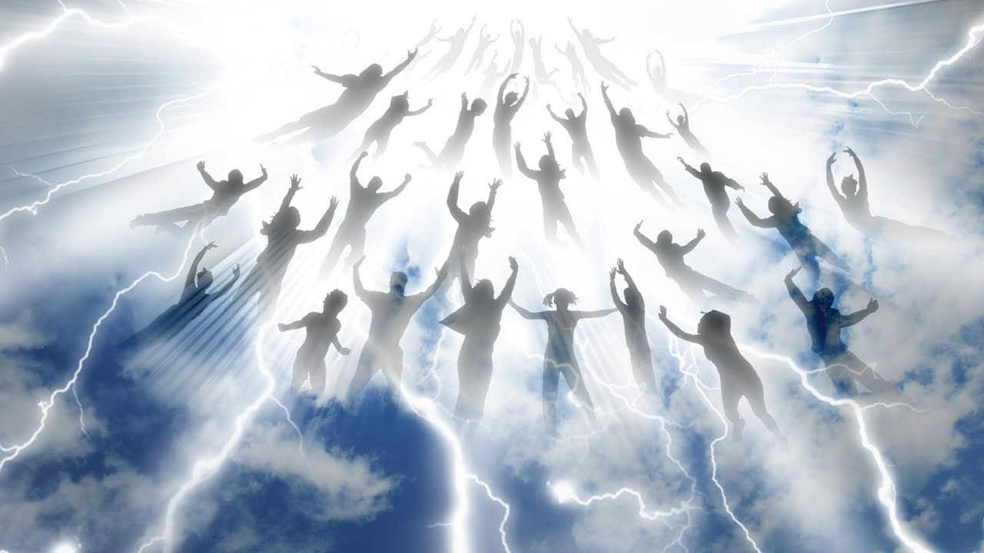
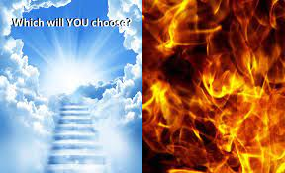
WHICH WILL YOU CHOOSE?
One day, Jesus will come to take His friends both dead and alive to live with Him in heaven.
Those who died without becoming friends of Jesus will rise to everlasting punishment in hell fire.
But those who died as friends of Jesus, will rise to reign and live with Jesus forever in Heaven. Will you be among them?

Slide 6
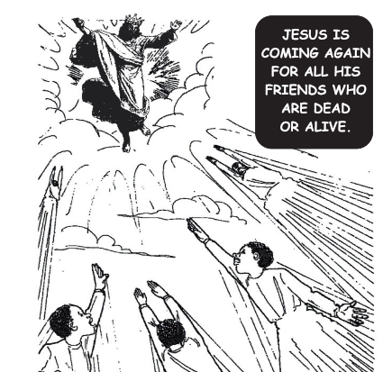
PREPARATION TO MEET THE LORD
To answer the question where you will be, a sinner must:
Be truly sorry for all his or her bad ways,
Confess them to God and ask for pardon and cleansing through the blood of Jesus.
Ask Jesus to come into your heart to be your Saviour and Friend.
Continue to follow Jesus as you pray every day, read and obey His word, watch and be holy.
Also, be ready always for the coming of the Lord

Slide 7
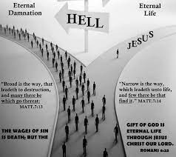
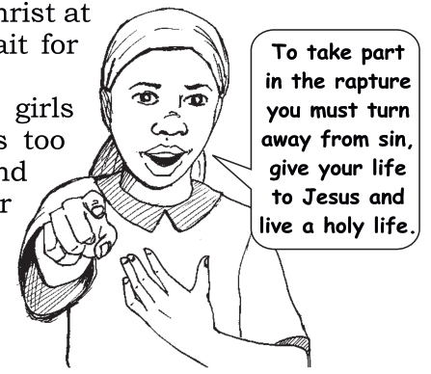
PREPARATION TO MEET THE LORD CONT’D.
Jesus is coming soon.
At His coming, He will separate the sinners from His friends.
Be among His friends

Slide 8

QUESTION
Jesus died and rose the _________ day
Boys and girls that lived on earth will rise from the dead. Yes/No?
Where will sinners who rise from the dead be?
Friends of Jesus will rise and go to ______________________________.
What should a sinful child do to go with Jesus at the rapture?

Slide 9

LESSON, THOUGHT & PRAYER
LESSON: It is certain that the dead will rise again.
THOUGHT: I must be holy every day so as to partake in the resurrection to life.
PRAYER: Pray that you will be ready for the coming of the Lord.

