Slide 1
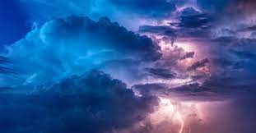
THE MYSTERY OF GOD AND ITS FULFILMENT
Revelation 10:1-11

Slide 2
Memory verse:
“But in the days of the voice of the seventh angel, when he shall begin to sound, the mystery of God should be finished, as he hath declared to his servants the prophets,” Revelation 10:7

Slide 3
Meaning OF MYSTERY
Mystery means something that is difficult to understand or explain.
For example, no one can explain how water enters the coconut, neither can anyone explain how the sky remains firm without falling.
It is beyond human understanding.

Slide 4
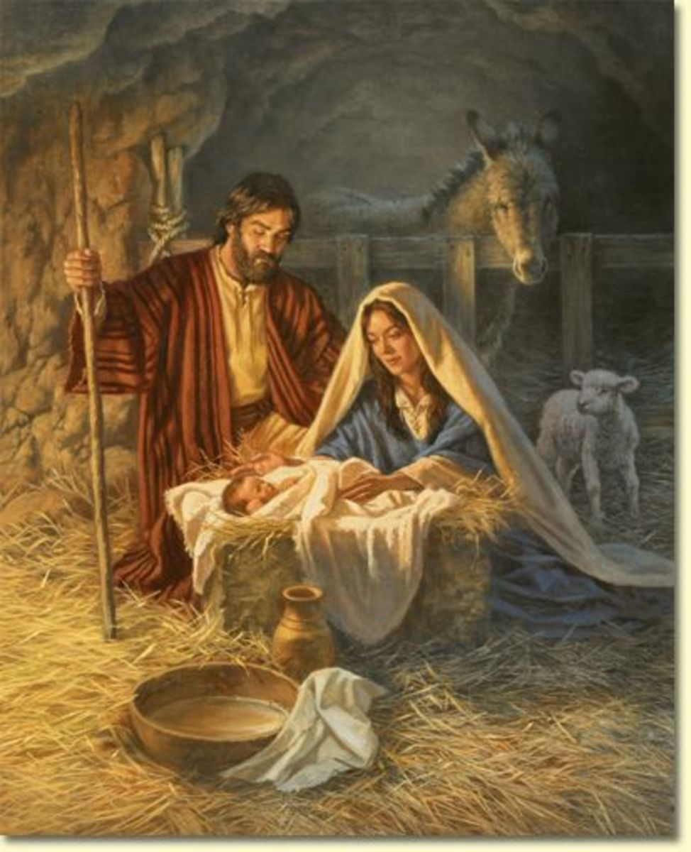
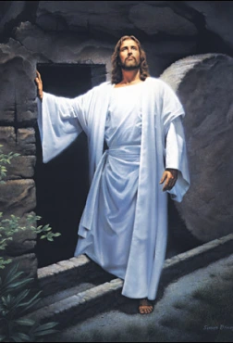
INTRODUCTION
One of the greatest mysteries in the world is the conception and resurrection of Jesus.
No one can fully understand how it happened.
The secret of all things is with God.
Apostle John received many visions right from the book of Revelation Chapter One. God showed him things that will happen in the future.

Slide 5
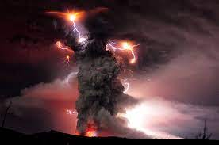
INTRODUCTION CONT’D.
Chapter 9 closes with a verse that states the unrepentant attitude of the ungodly people even after a third part of all the people that live on earth die from the fire of God’s punishment (Revelation 9:21).
Whenever God calls and people refuse to answer, or God warns, and people refuse to heed the warning, what often follows is God’s judgment.

Slide 6
INTRODUCTION CONT’D.
Chapter 10 focuses on a mighty angel who will bring the mystery of the secret of God’s final judgment on the remaining people in the world.
His appearance speaks of his mission. His voice heralds the end of the mysteries of God (Revelation 10:7).
The mystery is hard to understand or explain. It is a spiritual truth that can be known only through revelations and cannot be fully understood by ordinary people.
The mystery of God stands for the truth that has been hidden for a long time but is now made known. Every prophecy in the Bible will be fulfilled in God’s appointed time.

Slide 7
INTRODUCTION CONT’D.
Our study is divided into three parts:
1. THE MIGHT OF THE ANGEL FROM HEAVEN
2. THE MYSTERY OF GOD, THE CREATOR
3. THE MESSAGE FROM THE LITTLE BOOK

Slide 8
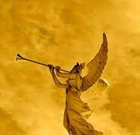
1. THE MIGHT OF THE ANGEL FROM HEAVEN: Revelation 10:1-3
Angels, no matter how mighty or powerful, are messengers of God. It is, therefore, a sin to pray to or worship angels.
The Mighty angel here was sent by the Lord Jesus Christ to bring a message to John the Beloved, of the things that will happen in the future to the people on earth, in the days that God will bring this world to an end.

Slide 9
1. THE MIGHT OF THE ANGEL FROM HEAVEN CONT’D.
The Bible refers to this angel as ‘mighty’ because:
He came down from heaven
He wears the cloud as his clothing and his crown is the rainbow, showing that He is a covenant keeping God
His face shines like the sun and his legs are like pillars of fire
His right leg stands on the sea while the left leg stands on the earth.

Slide 10
1. THE MIGHT OF THE ANGEL FROM HEAVEN CONT’D.
The appearance of this angel makes him to resemble our Lord Jesus Christ in some ways:
Jesus returned to heaven in the cloud and will come again from heaven in the cloud (Psalm 104:3; Acts 1:9-11)
Jesus, being the King of kings, wears crowns of glory and honor (Hebrews 2:9; Revelation 6:1-2)
As this angel stands on the earth and sea, so also Jesus is the ruler and has authority over the earth and the sea (Psalm 72:8; 1 Corinthians 10:26)
Jesus will pronounce and bring the final judgment on the whole world (John 5:22).
The Father has committed the judgment of the whole world to the Lord Jesus Christ. Therefore, you must love Him, fear Him, and surrender to Him so that you will not come under His judgment.

Slide 11
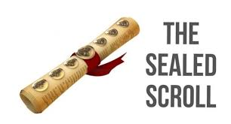
2. The mystery of god, the creator revelation 10:4-7
John the Beloved was forbidden to write what the voice of the seven thunders uttered. It was to be sealed up and remain a mystery.
The mystery of God concerns His program and plan for mankind. His plan is for all sinners to be saved and come to the knowledge of the Truth.
This was the reason He sent His only begotten Son, Jesus Christ, to come into the world to die for us.
Anyone who repents and accepts Christ as his personal Lord and Savior shall be saved and set free from the judgment to come.

Slide 12
2. The mystery of god, the creator CONT’D.
On the other hand, the program of God is about all that will happen from now till the end of the world when God will judge the unrepentant sinners and destroy the world.
The time is short, even as the might angel has declared. The end of all things is at hand. Sinners must not waste time.
Repent now, ask for forgiveness and cleansing of your sins with the blood of Jesus. Invite Jesus to come into your heart and reign as your Savior and Lord, Friend and King.
Then live a holy life and be prepared for His Second Coming.

Slide 13
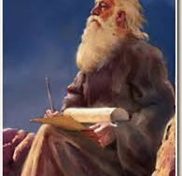
3. The message from the little book: revelation 10:8-10; Ezek. 2:8-10; 3:1-4
As the revelation continued, Apostle John heard a voice from heaven asking him to go and take the little book from the mighty angel.
He obeyed, went to the angel and asked for the book, the angel gave him the book and told him to eat it.
He was made to understand that the book will be sweet in his mouth but bitter in his belly. This is a great mystery.

Slide 14
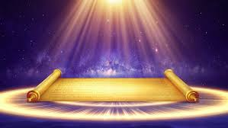
3. The message from the little book CONT’D.
The ”little book” tasting as sweet as honey but becoming bitter in John’s stomach, refers to the content’s mixture of blessings and curses.
There are blessings for the obedient and curses for the disobedient and unrepentant sinners. God’s word is sweet both to hear and to obey for children who are friends of Jesus (Psalm 19:9, 10; Jeremiah 15:6).
However, the word of God is bitter to sinners because it pronounces judgment and destruction on them if they fail to repent.

Slide 15
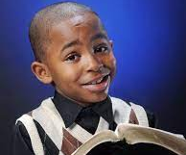
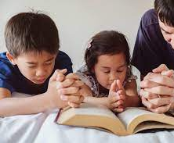
3. The message from the little book CONT’D.
THE LESSONS FOR US HERE ARE:
i. Friends of Jesus must always delight in God’s word, read it ever day, think on its message, believe it, obey it and share it with others (Joshua 1:8).
ii. Sinners should, as a matter or urgency, believe the word that is being preached, repent and accept Jesus as Lord and Savior. This is the only way they can escape the wrath to come, “Neither is there salvation in any other: for there is none other name under heaven given among men, whereby WE MUST BE SAVED” (Acts 4:12).
iii. Saved children must take the preaching of the Gospel with all the seriousness it deserves, warn sinners of the judgment and show them the way of escape (Mk 16:15, 16).

Slide 16
Questions
Explain the word ‘mystery’.
Describe the appearance of the mighty angel.
Mention three ways this angel resembles our Lord Jesus.
What was the angel holding in his hand?
What was the instruction given to Apostle John about the little book?
What lessons did you learn from the bitter-sweet experience of Apostle John?

Slide 17
All the mysteries in God’s word will surely come to pass.

Slide 18
Thought
I will obey all that God has revealed for me to be saved and have eternal joy.

Slide 19
Activity
With the help of the teacher and a Bible concordance, children should read, search out and write in their church notebooks, five verses in five other books of the New Testament where the word ‘mystery’ appears. They should explain the significance of the word.

Slide 20
Homework
Read Colossians 1:27. Write in your homework book, what God’s mystery among the gentiles is and show it to your teacher.

