Slide 1
CHRIST EXALTS GOD'S COMMANDMENTS OVER TRADITIONS

Slide 2
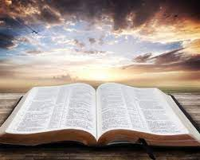
TEXT: Matthew 15:1-39
MEMORY VERSE:
“But he answered and said unto them, Why do ye also transgress the commandment of God by your tradition? (Matthew 15:3).

Slide 3
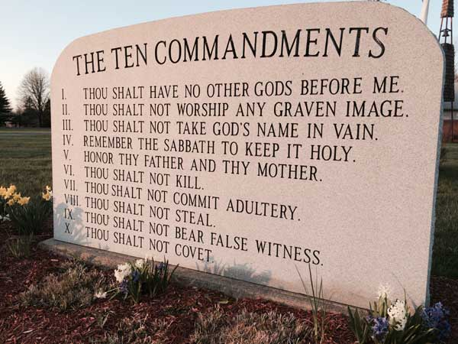
INTRODUCTION
To exalt is to honour, hold in high esteem or to be raised in rank or status.
People usually honour whom they love in the society.
As a friend of Jesus and a child of God, we are to exalt God more than anything or anyone in this world.
Commandment is a rule to be strictly observed.

Slide 4
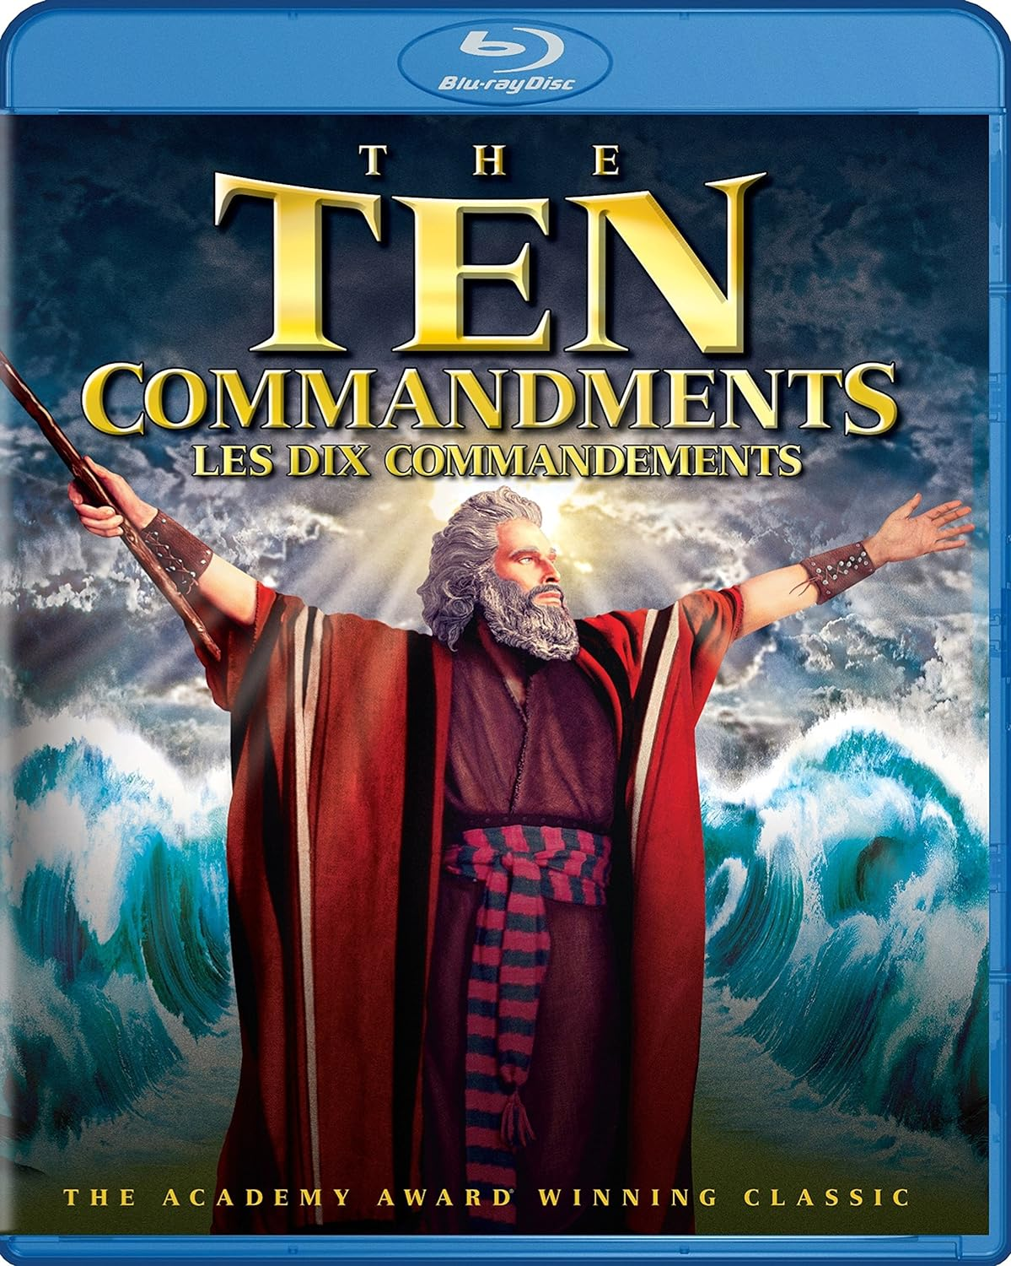
INTRODUCTION CONT’D.
The Ten Commandments were given to the children of Israel at Mount Sinai by God when they journeyed from Egypt to the Promised Land under the leadership of Moses.
The commandments were to control their behaviour and relationship with God and with one another.

Slide 5
INTRODUCTIONS CONT’D
Tradition is a part of culture that is passed from person to person or generation to generation.
It could also refer to an inherited pattern of thought or action which may not be in line with the word of God.

Slide 6
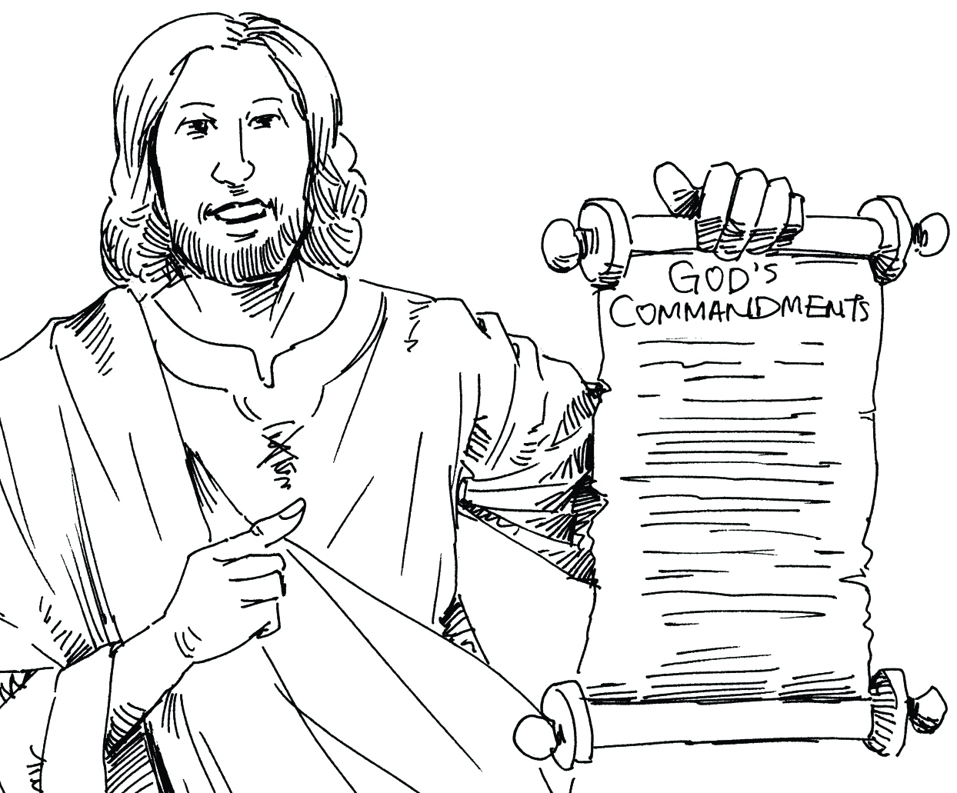
INTRODUCTIONS CONT’D
Jesus Christ, our Saviour, the Son of God, highly exalted His father's commandments above the traditions of men to fulfill the purpose of His coming to this world.
As a child of God, you must follow His footsteps by obeying the commandments of God in every area of life so as to give God the glory.

Slide 7
The study is in 3 parts:
GOD’S COMMANDMENTS
CHRIST EXALTS GOD'S COMMANDMENTS OVER TRADITION
BENEFITS OF EXALTING GOD'S COMMANDMENT OVER TRADITION
1
2
3

Slide 8
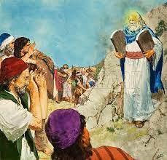
1. GOD’S COMMANDMENTS: Matthew 15:1-9; Exodus 20:1-17; Luke 10:25-28
Our loving God knows what is best for His children,
He has given us some commandments (rules) to obey so as to live a life that will exalt His name.
His love and care for His people made Him to give the children of Israel the Ten Commandments in the wilderness at Mount Sinai through Moses.

Slide 9
PT.1: GOD’S COMMANDMENTS CONT’D.
Thou shalt not take the name of the Lord thy God in vain,
Remember the Sabbath day to keep it holy,
Honour thy father and thy mother,
Thou shalt not kill,
Thou shalt not commit adultery (immorality of any kind),
Thou shalt not steal,
Thou shalt not bear false witness against thy neighbour,
Thou shalt not covet.
These commandments are:
Thou shalt have no other gods before me,
Thou shalt not make unto thee any graven image,

Slide 10
GOD’S COMMANDMENTS CONT’D.
Children who are friends of Jesus have been given the grace by the Spirit of God to keep God's commandments.
For a sinner to be able to keep them, he/she must repent from sins through the saving grace of God.
He must confess all his sins and accept Jesus as personal Lord and Saviour.
It is only then that he can receive grace to obey the commandments of God (Rom. 8:2).

Slide 11
GOD’S COMMANDMENTS CONT’D.
Knowing these commandments and reciting them do not earn your salvation.
As you come out of your sin of lying, stealing, cursing, disobedience, immorality, wickedness etc., God will give you the grace to live in obedience to His word (Deut. 28:1-2).
The commandments of God are given to help children to live holy and abstain from every form of hypocrisy.

Slide 12
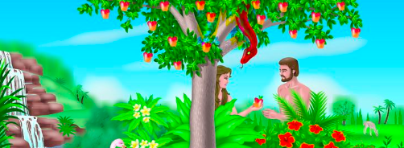
2. CHRIST EXALTS GOD'S COMMANDMENTS OVER TRADITION: Matthew 15:1-9; Exodus 20:1-17; Luke 10:25-28
After the fall of man, God drove Adam and Eve out of the beautiful garden of Eden; but because of God's love for us,
He sent His only begotten son to die for us and bring us back to Himself (Rom. 5:8).
Therefore, Angel Gabriel announced the coming of Jesus to this sinful world through the Virgin Mary (Matt 1:21).

Slide 13
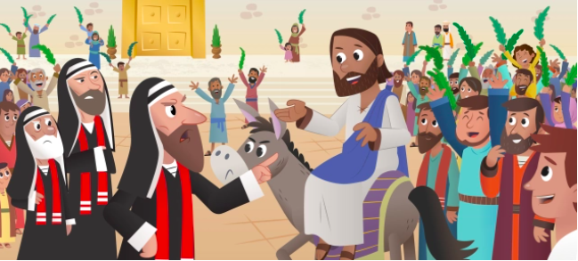
2. CHRIST EXALTS GOD'S COMMANDMENTS OVER TRADITION CONT’D.
According to the promise of God, Jesus Christ was born to save us from our sins.
In obedience to His heavenly father, He went about doing good and preaching the word of God to people in the temple and everywhere, Jesus:
healed the sick,
raised the dead,
restored sight to the blind,
made the lame to rise and walk.

Slide 14
2. CHRIST EXALTS GOD'S COMMANDMENTS OVER TRADITION CONT’D.
As Jesus went about His earthly ministry, He saw things in the life of the religious leaders that is not according to God's commandment.
He frowned at such things and corrected the errors.
The Pharisees’ habit of living a double standard life and polluting the temple of God were corrected.
The Pharisees and the teachers of the law placed human tradition above. God's written revelation.

Slide 15
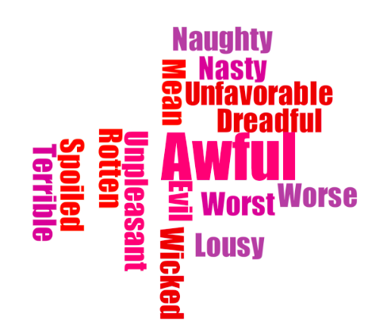
2. CHRIST EXALTS GOD'S COMMANDMENTS OVER TRADITION CONT’D.
Jesus Christ does not condemn all traditions but only those that are against God's word.
The law of the land must be subject to the word of God. Tradition is from men and it allows:
Fear in man's heart
Hypocrisy
Waywardness
Lack of faith in God
Disobedience to God's word.
Traditions does not exalt God therefore, observing it without repentance will lead to destruction in hell fire.

Slide 16
2. CHRIST EXALTS GOD'S COMMANDMENTS OVER TRADITION CONT’D.
Biblical examples of those who exalted God's commandment are:
Abraham – God called him out of an idolatrous nation, and he obeyed (Genesis 12:1-4).
Moses – God sent him to Pharaoh to deliver the children of Israel in the land of bondage and he obeyed (Exodus 4:19-20). He also received the commandments from God and gave it to the people
Joseph – exalted God's commandment and refused to commit immorality with his master's wife (Genesis 39:7-9).

Slide 17
2. CHRIST EXALTS GOD'S COMMANDMENTS OVER TRADITION CONT’D.
Biblical examples of those who exalted God's commandment cont’d:
Phinehas – the son of Eleazar – He stood against immortality in the camp of Israel in the wilderness (Numbers 25:7-13).
Micaiah – he did not fear king Ahab but boldly delivered the message that God had sent him (1 Kings 22:14).
The disciples of our Lord Jesus Christ - they we re all obedient to God’s commandment and exalted God in their lives.

Slide 18
2. CHRIST EXALTS GOD'S COMMANDMENTS OVER TRADITION CONT’D.
As a friend of Jesus Christ, how can you exalt God's commandment?
(i) Live a holy life (ii) Read your Bible daily (iii) Meditate on the word of God (iv) Share the word of God with others (v) Do your quiet time regularly (vi) Visit the sick (vii) Share your substance with the needy (viii) Pay your tithes and offering regularly (ix) Obey God's word, do not add or remove from it (x) Continue to follow Jesus till the end.

Slide 19
3. BENEFITS OF EXALTING GOD'S COMMANDMENT OVER TRADITION: Matt. 14:21-31; Numbers 25:12-13
Faith and obedience to God's word will attract God's abundant blessings into your life.
The Canaanite woman exercised faith in Christ who is the word of God. She received a miracle as her daughter was made whole.
A lot of benefits await those who exalt God's commandment over tradition in this world and in the world to come.

Slide 20
3. BENEFITS OF EXALTING GOD'S COMMANDMENT OVER TRADITION CONT’D.
Some of these benefits are:
Experience of God's presence
Answers to prayers
Divine help and provision
Protection and preservation from evil
Good success
Healing and divine health
Eternal life in heaven with God and crown with stars.

Slide 21
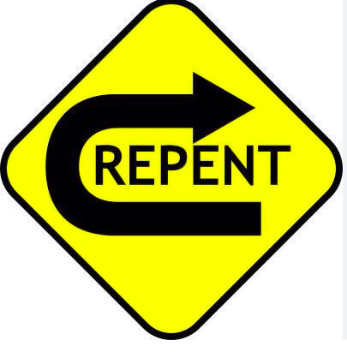
3. BENEFITS OF EXALTING GOD'S COMMANDMENT OVER TRADITION CONT’D.
It is only those who exalt the Name of God through their lifestyle that will enjoy these benefits.
If you are still doing bad things, why don't you surrender your life to Jesus now, by repenting and forsaking your sins and accepting Jesus as your personal Lord and Saviour.
It is then that you can exalt God and enjoy the blessings of God.

Slide 22
State the fifth commandment __
Which should be placed higher tradition or God's commandments? _________
Mention two people in the Bible that exalted God's commandment. ____________
How should a Christian exalt God's word? _____________
Mention any two benefits of exalting God's commandments
A sinner can exalt God's commandment. Yes/No?

Slide 23
LESSON, THOUGHT, ACTIVITY: & CHORUSES:
LESSON: God has exalted His word above everything.
THOUGHT: I must exalt God's word in my life so as to enjoy God's favour and blessings.
ACTIVITY: Two children should be called out to explain how friends of Jesus can exalt God's commandment over tradition.
CHORUSES: (i) Blessings and honour and glory and praise (ii) Immortal God, invincible God (iii) We bring the sacrifice of praise.

