Slide 1
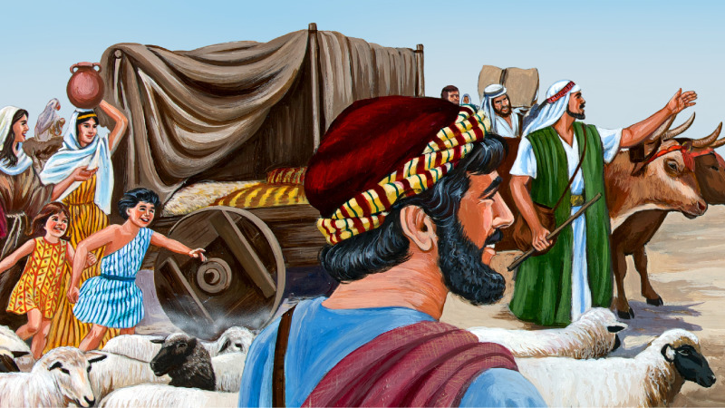
JACOB MOVES TO EGYPT

Slide 2
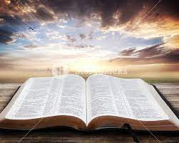
MEMORY VERSE
“And he said, I am God, the God of thy father: fear not to go down into Egypt; for I will there make of thee a great nation” (Genesis 46:3).
TEXT: Genesis 46:1-34; 47:1-31

Slide 3
INTRODUCTION
Joseph was blessed with uncommon wisdom by God because he obeyed God.
After his encounter with his brothers, he sent them to bring his father and the entire family down to Egypt.
It was good news for Jacob to learn that his son was still alive. He was happy and longed to be united with his favorite “dead but living son.”

Slide 4
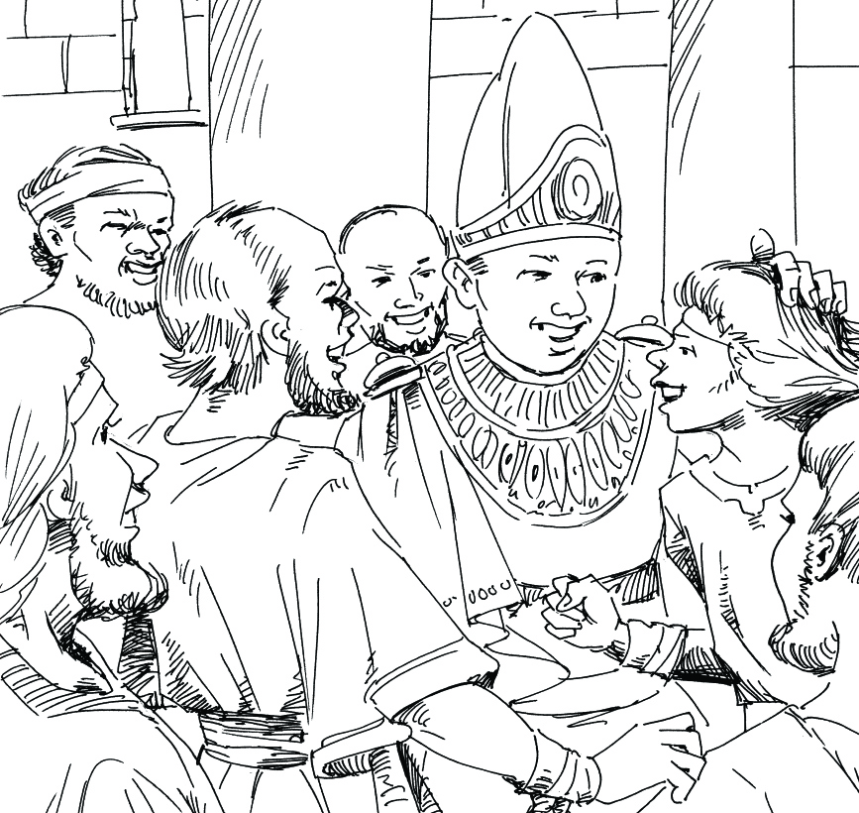
INTRODUCTION CONT’D.
Though Jacob was happy that his son was still alive and that there would be enough provision to keep his family through the years of famine,
yet he asked the Lord to be sure that Egypt was where God wanted him to go.
After receiving the go-ahead from the Lord, Jacob moved all his family to Egypt.
It was a glorious reunion and the beginning of 400 years of sojourn for the descendants of Abraham.

Slide 5
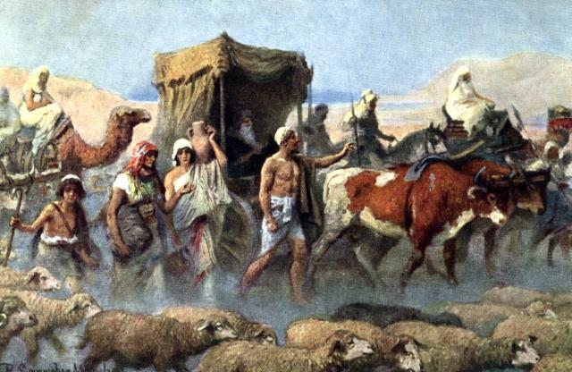
INTRODUCTION CONT’D.
God had told Abraham about 200 hundred years earlier that he would be blessed with children and that his descendants would live in a foreign land for 400 years.
God is great, mighty, and accurate in His dealings with His children.
Whatever He says He will do, He will accomplish.

Slide 6
INTRODUCTION CONT’D.
The children of Abraham would still inherit Canaan, but at the moment, they had to leave so they would not be corrupted and scattered through intermarriage and friendship with the idol-worshippers that were still in Canaan.
Going to Egypt was an excellent opportunity to preserve Israel and his descendants.
In Egypt, they lived in a separate land Called Goshen. The Egyptians would never mingle with any other tribe.
This was God's plan to help Israel as one holy and separated people unto God.
This world in which we live is like Egypt.

Slide 7
INTRODUCTION CONT’D.
The Bible acknowledges the fact that though we are living in the world, yet we are not of the world.
As you live in the world, do not associate with the sinful habits and corruption of the people.
Be separate and live a holy life.
God is preparing our Canaan land, which is heaven, any moment from now, Christ will appear to take us out of “Egypt” to heaven, our “Canaan Land.”

Slide 8
THREE POINTS TO CONSIDER
1. JACOB'S PRAYER
2. THE JOURNEY TO EGYPT
3. A HAPPY FAMILY REUNION

Slide 9
1. JACOB'S PRAYER: Genesis 46:1-3
Though Egypt had plenty of food during the famine, Jacob saw the need to still pray.
He was a prayerful man. He had prayed at Jabbok and Bethel, where he encountered God and had his name changed.
Prayer is very important in everything that we do. Learn to pray by praying.
Pray before going out to school, on errands, or to do one activity or another.
Pray in the morning and at night. Prayer is never too much

Slide 10
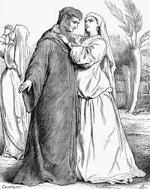
1. JACOB'S PRAYER CONT’D.
Naomi and her husband did not ask God for direction at the time of famine.
They left the place of blessing to a strange land. All they saw then was the temporary provision of food.
That trip cost Naomi the life of her husband and children (Ruth 1:1-7).
Therefore, you must be careful. Always commit your ways to God in prayers.

Slide 11
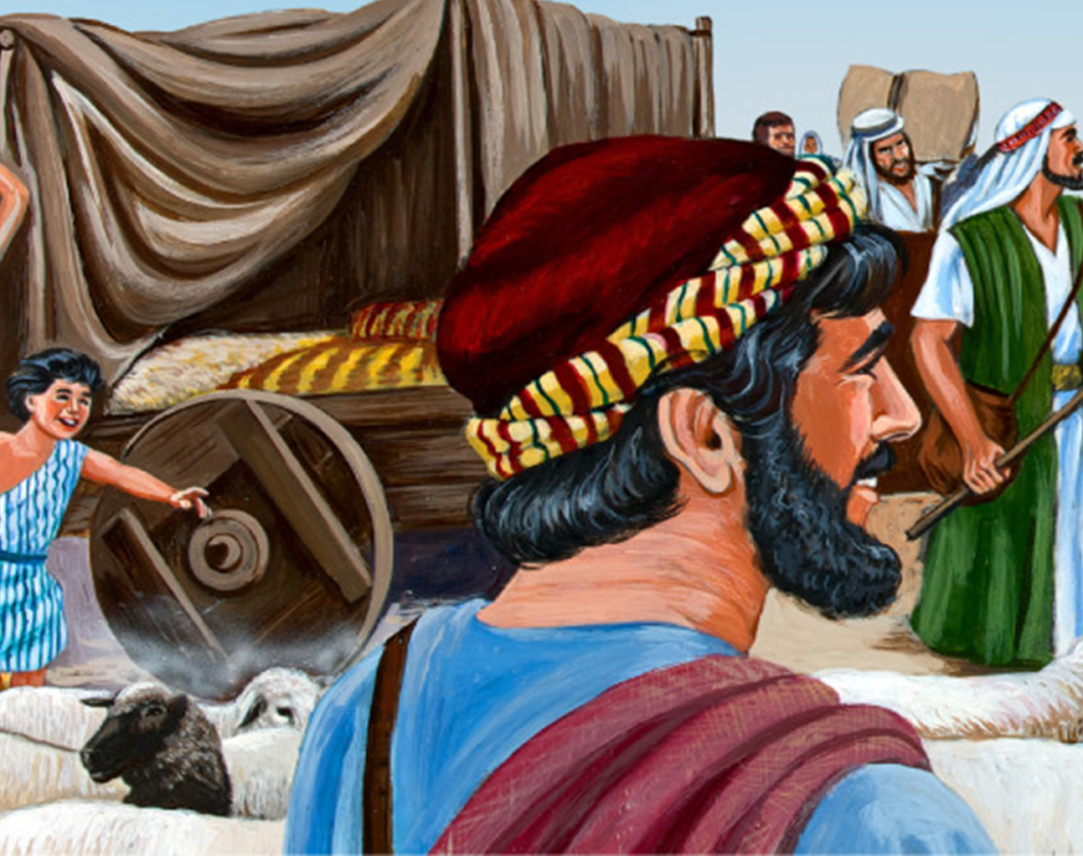
2. THE JOURNEY TO EGYPT: Genesis 46:5-7; Matthew 25:1-13
From the story of Jacob's family, it is clear that it was God's plan for Jacob and his family to move to Egypt.
They packed their belongings and proceeded to Egypt.
They were a distinctive family in their mode of worship, dress, language, and general outlook.
They were God's chosen race.

Slide 12
2. THE JOURNEY TO EGYPT CONT’D.
The number of people in Jacob's family who made the trip from Canaan to Egypt was 67.
Joseph and his two sons made the total to be seventy.
God has a Book of record where all the names of His sons and daughters are registered.
Is your name there? Are you a child of God? If no, you must repent and surrender your life to Jesus.
Then your name will be written in the Book of Life.
When Jesus comes, He will take us to be with Him in heaven

Slide 13
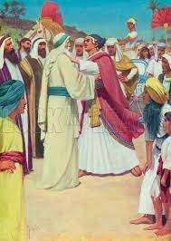
3. A HAPPY FAMILY REUNION: Gen. 46:28-34; 47:1-26
When Jacob and his family got closer to Egypt, Joseph hurried out to meet them.
What a happy moment it was for Joseph and his father!
They hugged each other and cried for a long time. It was tears of joy.
Joseph then presented his father to king Pharaoh.
They were all given a warm reception

Slide 14
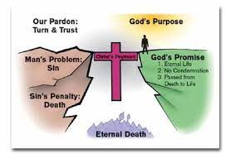
3. A HAPPY FAMILY REUNION CONT’D.
There will be a greater, happier, sweeter welcome for all friends of Jesus when we get to heaven.
But for sinners, the story will be different. It will be a time of shame, regret, and sorrow.
Why not repent now and surrender to Jesus, your Saviour and Lord?
He will change your life, and you will live with Him in heaven at last.

Slide 15
QUESTIONS
Who invited Jacob and his family to Egypt?
What did Jacob do before he moved to Egypt?
Why is it important to pray?
What was the total number of people in Jacob's family that moved to Egypt?
Where is the eternal home of friends of Jesus?
What should a sinful child do to get to the eternal home?

Slide 16
LESSONS, THOUGHT & CHORUSES
LESSON: Obedience to God's leading brings success.
THOUGHT: I will be obedient to God's word.
CHORUSES: (i) I know there is another fellowship in heaven. (ii) I will be what the Lord says I will be. (iii) Will you be ready when the Lord shall come?

Slide 17
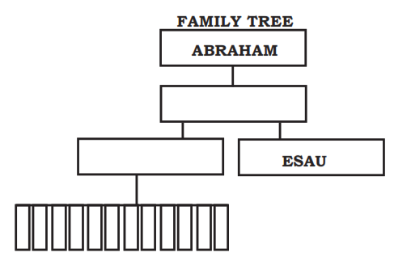
Complete this family tree.

Slide 18
REFERENCES
https://www.google.com/search?q=FREE+JACOB+MOVES+TO+EGYPT+IMAGES&tbm
https://dwellingintheword.files.wordpress.com/2014/11/gen46-jacob-moves-to-egypt.jpg
https://www.lookandlearn.com/history-images/M811233/Jacob-and-Joseph-Meet

