Slide 1
JACOB'S STAY IN LABAN’S HOUSE

Slide 2
MEMORY VERSE
TEXT:
Genesis 29:1-35; 30:1-43; 31:1-55
‘And the LORD said unto Jacob, Return unto the land of thy fathers, and to thy kindred; and I will be with thee’’ Genesis 31:3

Slide 3
INTRODUCTION
Jacob deceived Isaac his father through bad counsel from Rebekah his mother.
He betrayed Esau, his twin brother, and deceitfully took his blessings.
Because of this, Esau was angry and planned to kill his brother.
Jacob then fled from home and went to his uncle in another country.
It was meant to be a short stay to allow his brother to be pacified. However, he had to spend twenty years there, labouring for his uncle.

Slide 4
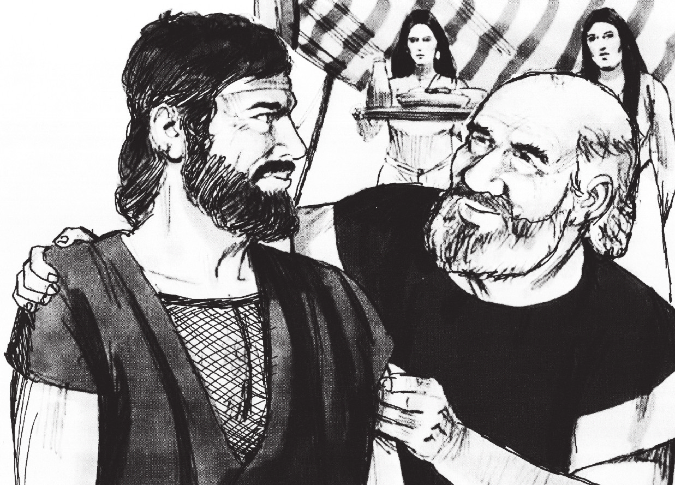
INTRODUCTION CONT’D.
God, in His mercy, did not forget His covenant with Abraham and Isaac.
He showed mercy and unmerited favour to Jacob.
Though he suffered, yet he was incredibly blessed by God.
After twenty years, God told him to leave Laban’s house and return to Bethel.

Slide 5
INTRODUCTION CONT’D.
Remember that the steadfast love of the Lord never ceaseth; they are new every morning, for great is His faithfulness.
Wherever you are, whether at home or in a faraway country, God is always with you.
Only be sure you are doing His will. He will even bless those around you because of your presence.
And if you are living with people that are not your direct parents, be obedient and faithful to God's word.
Do not cheat or do wrong to them; do not compromise your faith. Stand for the truth as Daniel and His friends did in Babylon

Slide 6
INTRODUCTION CONT’D.
Our study is divided into three parts:
JACOB IN LABAN’S HOUSE
GOD BLESSES JACOB IN LABAN'S HOUSE
JACOB'S FLIGHT FROM LABAN'S HOUSE
1
2
3

Slide 7
1. JACOB IN LABAN’S HOUSE Genesis 29:1-35; Hosea 12:1-14
Jacob ran away from home to the house of Laban, his uncle. He did this for many reasons:
He was running away from his brother, whom he had cheated.
He had deceived his father.
He did not want to marry from among the heathens around them.
It was a divine arrangement from God to fulfill His plan for his life.

Slide 8
1. JACOB IN LABAN’S HOUSE CONT’D.
Some children are like Jacob. They do bad things at home and then run away to another place.
God is not happy with such children. His plan for you is that you live to glorify Him and make your younger brother happy.
You must not cheat your younger brothers and sisters; neither should you deceive your parents or cause quarrels between them.
Jacob cheated his brother and deceived his father.
In the same way, his uncle deceived and cheated him.

Slide 9
1. JACOB IN LABAN’S HOUSE CONT’D.
God, who is loving and gracious, worked through the weakness, struggles, and failures in Jacob's family to accomplish His own purpose.
Jacob was not lazy, neither did he take advantage of his uncle's daughters.
He served faithfully as it was required of him.
Whatever you find yourself doing presently, do not be lazy, work hard like Jacob.
Also, live a transparent and holy life. Then God will be gracious to you and bless you.

Slide 10
2. GOD BLESSES JACOB IN LABAN'S HOUSE: Genesis 30:1-43
Jacob was a hard-working young man. He was dedicated and faithful to his work in his uncle's house.
He did not steal but cared for Laban's animals as if they were his own. In return, God blessed Jacob in all areas.
God began to fulfill the promise of multiplication to Abraham through Jacob. He married and had eleven sons and one daughter (Reuben, Simeon, Levi, Judah, Dan, Naphtali, Gad, Asher, Issachar, Zebulon, Joseph, and Dinah).
Jacob had many animals and great riches.
Laban's family was blessed because of Jacob's presence.

Slide 11
2. GOD BLESSES JACOB IN LABAN'S HOUSE CONT’D.
It is the will of God that His children should have and enjoy good things (school fees, good education, shoes, dresses, food, houses, books, and others).
God has promised that when you obey, you will enjoy His blessings (Deuteronomy 28:1-13).
If you are a friend of Jesus, God will bless and make you a blessing to your family, school, nation, and the Church.

Slide 12
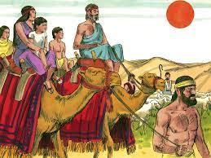
3. JACOB'S FLIGHT FROM LABAN'S HOUSE: Genesis 31:1-55
God had greatly blessed Jacob in Laban's house.
The sons of Laban then became jealous and accused him of stealing all that their father had.
God then told Jacob to return to Canaan because Laban was no more happy with him.
Jacob rose up and took all that he had, his sons, wives, and animals and ran away.

Slide 13
3. JACOB'S FLIGHT FROM LABAN'S HOUSE CONT’D.
When Laban knew that Jacob had run away, he followed after him.
His plan was to harm Jacob, but God warned him in the dream not to harm, Jacob.
When Laban met with Jacob, they made peace with one another.
Friends of Jesus have nothing to fear if they are in the will of God.
He has promised to make your enemy to be at peace with you (Proverbs 16:7).

Slide 14
3. JACOB'S FLIGHT FROM LABAN'S HOUSE CONT’D.
If you are not yet a friend of Jesus, you can choose to be His friend today.
Repent of all the bad things you have done, forsake those bad things, and accept Jesus as your Saviour and Lord.
The presence of God will be with you always, He will bless and give you the grace to live in peace with other people (Romans 12:18).

Slide 15
QUESTIONS
Why did Jacob run away from his father's house?
How many years did Jacob spend in Laban's house?
God ____________ Laban because of Jacob.
How many children did Jacob have while in Laban's house? Mention their names.
Why did Jacob run from Laban's house?
What should (a) a sinner (b) saints do to enjoy God's blessings?

Slide 16
LESSON, THOUGHT, & ACTIVITY
LESSON: The presence of God is always with all friends of Jesus
THOUGHT: I will live for Jesus both day and night so as to enjoy His blessings.
ACTIVITY: Write out in your notebook the names of the children Jacob had
in Laban's house. Write them in the order of seniority.

Slide 17
REFERENCES
https://www.google.com/search?q=hell
https://www.google.com/search?q=ROMAN+ROAD+TO+soul+winning
https://www.google.com/search?rlz=1C1CHBF_enCA891CA891&source=univ&tbm=isch&q=A+KID+soul-+winner

