Slide 1
JOSEPH'S ENCOUNTER WITH HIS BROTHERS
TEXT: Genesis 42:1-38; 43:1-34; 44:1-34; 45:1-2

Slide 2
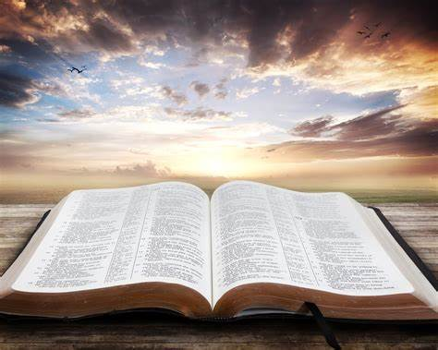
MEMORY VERSE:
“And when Joseph came home, they brought him the present which was in their hand into the house, and bowed themselves to him to the earth” (Genesis 43:26).

Slide 3
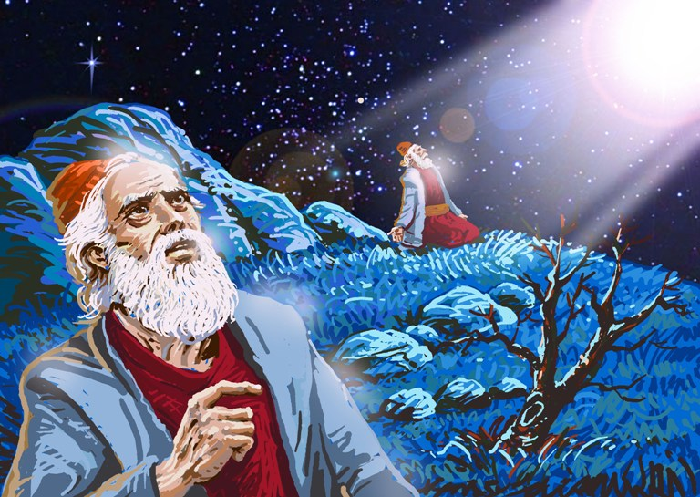
INTRODUCTION
The Story of Joseph is a testimony that confirms God’s love, care, mercy, and faithfulness in fulfilling His promises to His children.
Joseph, his father’s beloved, was sold into slavery by his envious brothers, but God was with him.
At the appointed time, God promoted Joseph, and he became the governor of Egypt.

Slide 4
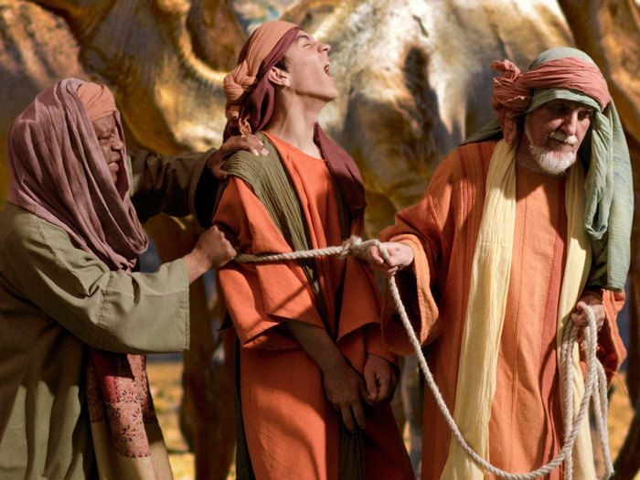
Now, the first phase of fulfilling the prophecy was fulfilled.
God had said that Abraham's seed would live in a strange land where they would suffer.
The story unfolds to show Joseph, a seed of Abraham already been planted in Egypt
God will now work through a difficult situation in the whole earth to actualize the second phase of the prophecy.
This difficult situation is the famine that Pharaoh saw in his dreams.
INTRODUCTION CONTD

Slide 5
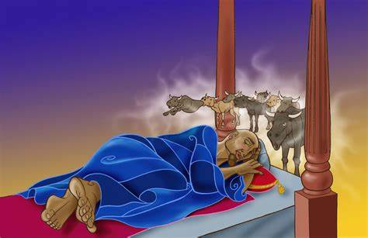
This bad situation brought Joseph's brothers to have a face-to-face encounter with him.
This divine arrangement was the work of God. He alone can do all things.
Jesus knows the end of a thing even before it begins.
As a friend of Jesus, do not be afraid. Believe God's word because all He has promised you will surely come to pass.
INTRODUCTION CONTD

Slide 6
Three Points for Our Consideration
1 FAMINE IN THE LAND
2 JOSEPH'S ENCOUNTER WITH HIS BRETHREN
3 LESSONS FROM JOSEPH'S ENCOUNTER WITH HIS BROTHERS

Slide 7
1: FAMINE IN THE LAND: Gen. 42:1,2; 43:1,2; 41:53-57
Famine is when there is a shortage of rainfall, scarcity of food, and sicknesses or malnutrition, especially among children.
The famine at the time of Joseph was all over the world. Jacob's family was not left out.
There was no other way to survive such a difficult situation except to look for food wherever it could be found.
Times of famine are times of severe lack, hardship, and hunger.
The famine in the whole earth was a fulfilment of the two dreams which king Pharaoh dreamt in Egypt.
The famine was to last for seven years.

Slide 8
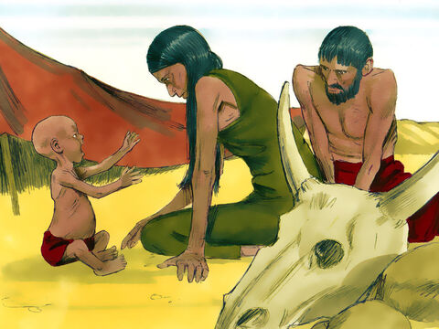
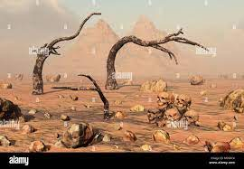
1: FAMINE IN THE LAND CONT’D.
In the world today, we still experience famine in many parts of the world.
In these situations, children are subjected to pain, hunger, thirst, and severe malnutrition.
You should be concerned for children in places where there is famine.
Remember to pray for them that God would make way for them as He did for Jacob's family.

Slide 9
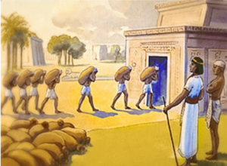
1: FAMINE IN THE LAND CONT’D.
Also, there is a spiritual famine in the land. There are many children all over the world who do not have knowledge of the word of God.
We must, as a matter of urgency, spread the gospel of truth to the world (Mark 16:15).
God has raised His friends up to spread the Truth so as to remove spiritual famine in the Land. Be counted among obedient children

Slide 10
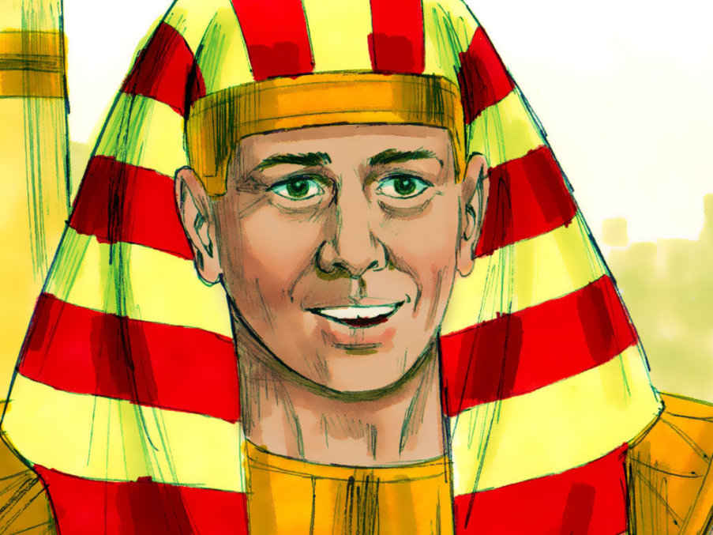
2. JOSEPH'S ENCOUNTER WITH HIS BRETHREN: Genesis 42:3-38; 43:15-34; 44:1-34; 45:1-24
Joseph as the governor in Egypt, was the one managing the activities during the years of plenty and the years of famine. The famine was all over the earth.
In Canaan, where Jacob and his remaining eleven sons lived, there was also famine.
Therefore, Jacob had to call all his children to go to Egypt and buy food.

Slide 11
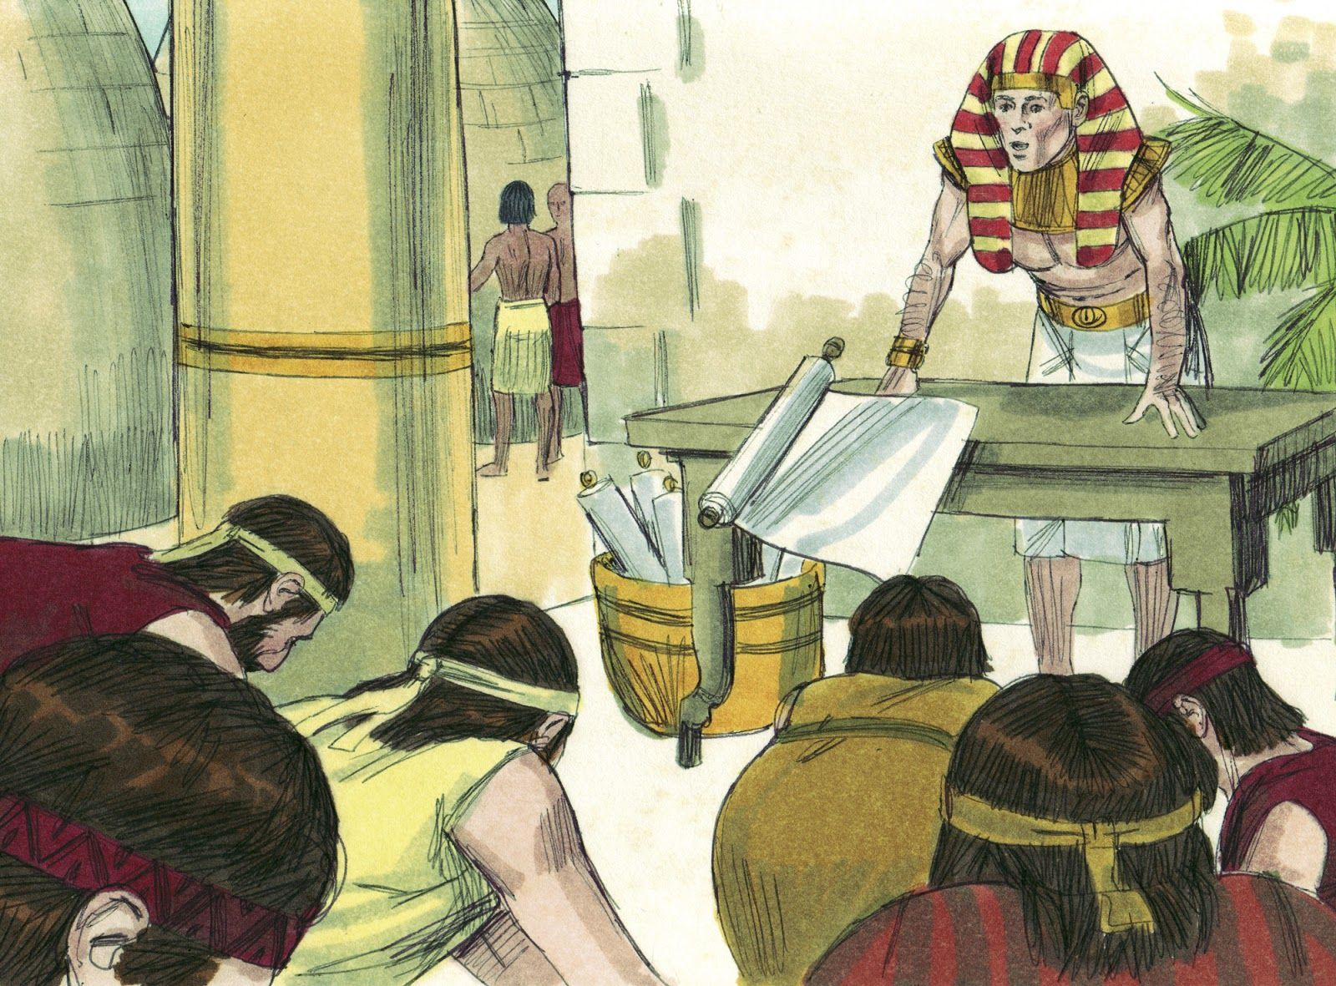
POINT 2 CONT’D.
They all obeyed their father’s instructions and went to Egypt.
As Joseph's brothers got to Egypt, they could not recognize Joseph again.
However, Joseph recognized them and remembered his dreams.
It was during their second trip that Joseph made himself known to his brothers.
During this unforgettable encounter and reunion, Joseph spoke to them roughly.
What is encounter: Encounter is to confront someone face to face

Slide 12
2. JOSEPH'S ENCOUNTER WITH HIS BRETHREN CONT’D.
Joseph tested his brethren; he needed to know if they had changed from their wicked ways.
He, however, discovered that they had changed.
How did Joseph know they had changed?
They refused to forsake their younger brother Benjamin; they were also concerned about their aged father at home.
How do we know that Joseph dream came through?
His brothers bowed to him as revealed through his dreams. Joseph wept out of pity for his brothers. He then revealed his identity to them.
Did Joseph make his brethren feel guilty?

Slide 13
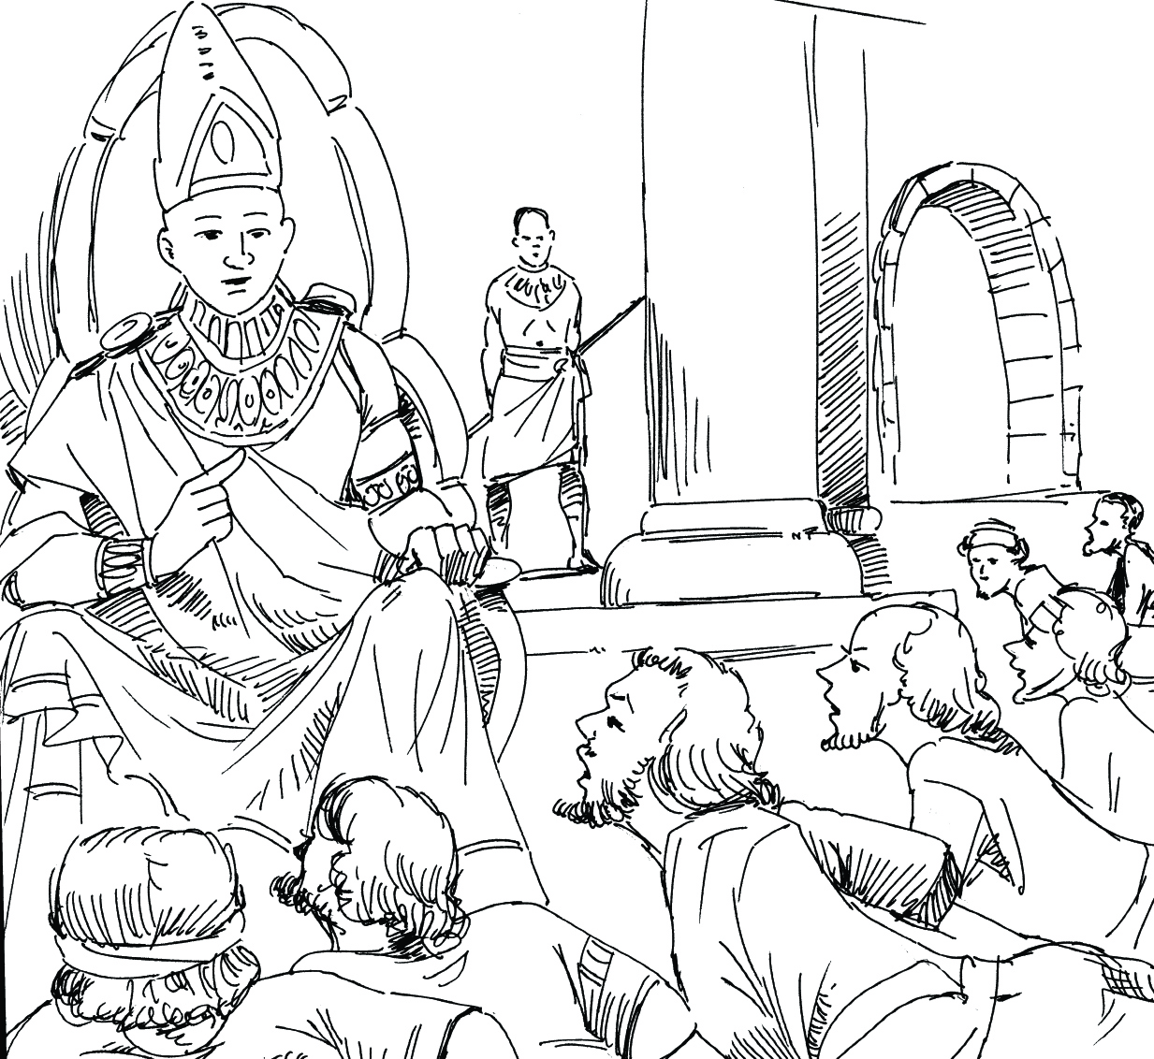
2. JOSEPH'S ENCOUNTER WITH HIS BRETHREN CONT’D.
He did not make them feel guilty but accepted and treated them well.
Joseph showed uncommon love and humility in dealing with his brothers.
He acknowledged that his brothers’ actions and the troubles he passed through were divinely arranged to fulfil God's purpose.

Slide 14
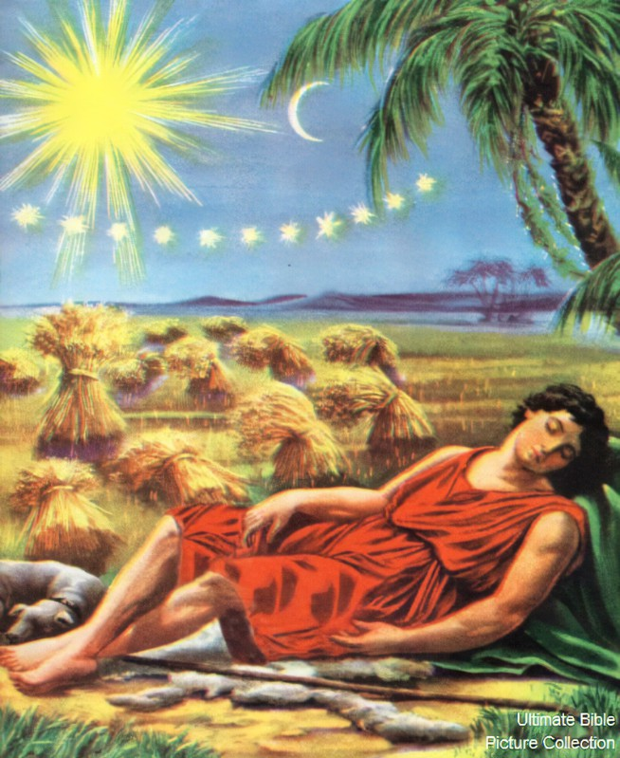
There is a purpose of God for our life. You have a part to play for that purpose to be fulfilled. Recognize that part and play it well.
Do not allow grudges and desire for revenge to stop God's purpose for your life.
Love your brothers, sisters, parents, friends, and those who hate and persecute you.
God will promote you and make you have good success.
2. JOSEPH'S ENCOUNTER WITH HIS BRETHREN CONT’D.

Slide 15
3. LESSONS FROM JOSEPH'S ENCOUNTER WITH HIS BROTHERS: Matthew 5:9-16, 38-48; Romans 12:14
Lessons we must take note of in this study.
Repentance: Joseph’s brothers had truly repented their wicked ways. All sinners must repent and turn from their sins to receive God's mercy.
Love: Joseph showed love to his brothers, who once hated him. A true friend of Jesus must show love to God and others around him. You must show love even to those who hurt you

Slide 16
3. LESSONS FROM JOSEPH'S ENCOUNTER WITH HIS BROTHERS CONT’D.
Forgiveness: as Joseph's brethren came to Egypt to buy food, it was in his power to punish them for the evil they did to him. Yet, he did not because he feared God.
The fear of the Lord is the beginning of wisdom. Do not repay evil with evil; rather, forgive those who do bad to you.
Hospitality/Generosity: Joseph provided more than enough for his brothers. If your enemy is hungry, give him food and share what you have with the needy. God will always work through every situation to fulfill His will.

Slide 17
IN CONCLUSION
We may not know why some things happen, but God has a purpose for everything concerning all His children.
This following step will bring you into a personal encounter with Jesus Christ, our Lord and Saviour.
If you are not a friend of Jesus, you will suffer in the hands of Satan. Therefore, you must repent, confess your sins, and ask for forgiveness and cleansing of your sins through the blood of Jesus.
Determine not to go back to your bad ways again.

Slide 18
QUESTIONS:
At what point did Joseph become a governor in Egypt?
What led to the face-to-face encounter of Joseph with his brethren?
______ recognized his _______ brothers when he saw them.
In his encounter with his brothers, why did Joseph speak to them roughly at first?
What lessons did you learn from the encounter of Joseph with his brethren?

Slide 19
LESSON, THOUGHT, & CHORUSES
LESSON: God's ways are past finding out
THOUGHT: I will trust and obey God all the days of my life
CHORUSES: (i) The God of Abraham, Isaac and Jacob. (ii) Immortal God, Invisible God. (iii) He has promised, He will never fail

Slide 21
REFERENCES
https://th.bing.com/th/id/OIP.ObIYQ2nOTSUOAtHC9pN-TQAAAA?pid=ImgDet&rs=1
https://www.freebibleimages.org/illustrations/joseph-ruler/
https://4.bp.blogspot.com/-D7xSWmFsw_Q/WTxy8-jm29I/AAAAAAAARTc/q0bAqTwZg8ozJ2RLpHlROQMnUnKrHngYgCEw/s1600/Story22.PNG

