Slide 1
POWER IN THE NAME OF JESUS
TEXT: Philippians 2:5-11; Ephesians 1:17-23

Slide 2
MEMORY VERSE
“That at the name of Jesus every knee should bow, of things in heaven, and things in earth, and things under the earth;” (Philippians 2:10)

Slide 3
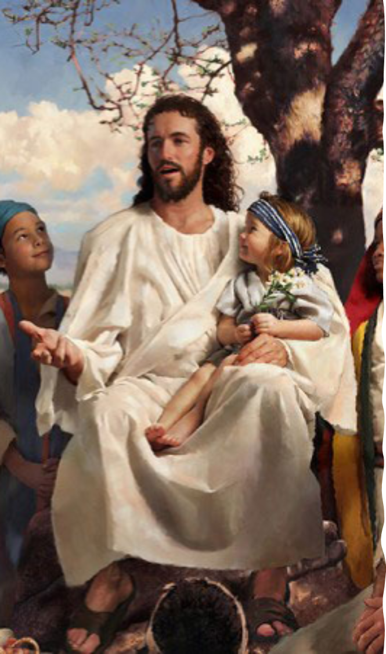
INTRODUCTION
Everyone in the world has a name.
Names are given to us to serve some purposes, such as:
To identify individual as a boy or girl. Names help us to know who is who.
Complete the following sentence, Michael is a _____ and Angela is a ________.
Names can help us to know the story surrounding someone’s birth e.g., Samuel, which means ‘asked of the Lord’.
Name carries authority and power.
However, there is a name that is above all other names. It has the supreme authority and power. It is the Name of JESUS.
Today, we are going to study the power in the name of Jesus.

Slide 4
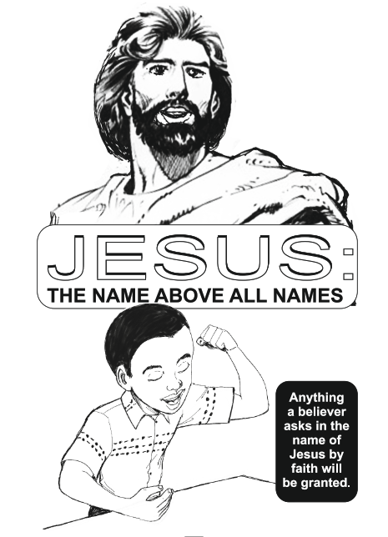
JESUS: THE NAME ABOVE ALL NAMES
Jesus is the name above every other name in heaven, on earth and under the earth.
Do you believe in the name of Jesus?
Many children are fond of just shouting Jesus without recognizing the power behind the name.

Slide 5
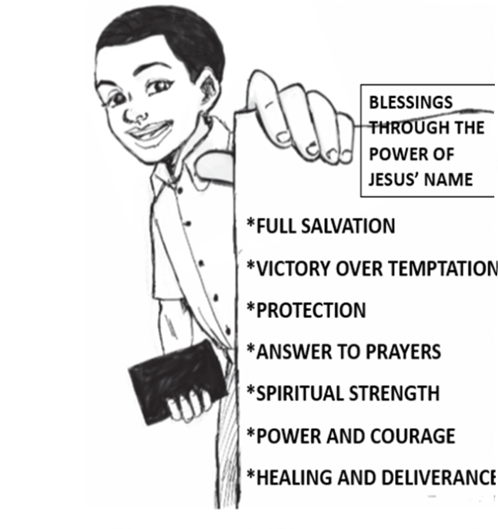
POWERFUL NAME OF JESUS
The name of Jesus is powerful and will do the following things in the lives of boys and girls:
Salvation- Acts 4:12
Healing- Mark 16:17-18
Protection and preservation-Philippians 2:10, Proverbs 18:10
Long life- Psalm 91:1-16
Eternal life in heaven at last- John 3:16

Slide 6
JESUS’ OBEDIENCE
Jesus surrendered Himself to God by agreeing to die on the cross.
He shed His blood to save sinners from everlasting punishment in hell-fire.
It was His obedience that made God to lift Him high, giving Him a Name that is above every name.
You must give your life to Jesus now so that the Name of Jesus can work in your life and in the lives of others through you.

Slide 7
QUESTIONS
Everyone has name. Yes/No?
Why do we have names?
_____________ is the only Name that has supreme power and authority.
Mention two things the Name of Jesus can do in your life.
What should a sinful child do to enjoy the power in the Name of Jesus?

Slide 8
LESSON & THOUGHT
LESSON: The name of Jesus delivers and sets free from every problems of life.
THOUGHT: I will trust in the Name of Jesus to protect me in times of trouble

Slide 9
CHORUSES
Jesus is the sweetest name I know.
That wonderful name.
He is Lord, He is Lord.

Slide 10
REFERENCES
https://onlybyprayer.com/four-words-of-jesus-that-change-everything/
https://fcfamily.org/blog/2021/10/14/supremacy-of-christ
https://www.indiaparenting.com/life-of-jesus-christ.html

