Slide 1
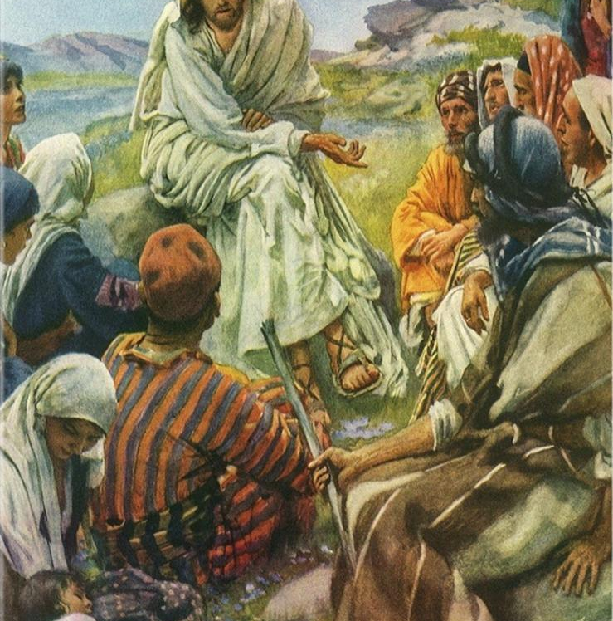
Topic: SERMON ON THE MOUNT
TEXT:
Matthew Chapters 5 - 7, Luke 6: 17-49, 13: 22-30

Slide 2
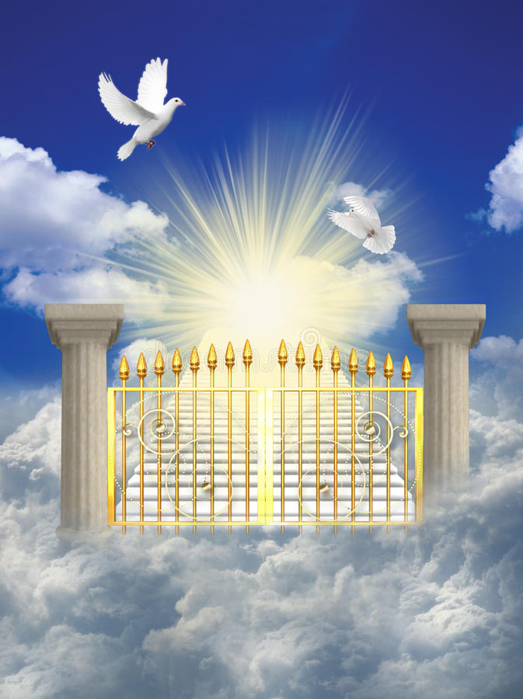
MEMORY VERSE:
“Blessed are the pure in heart: for they shall see God”. (Matthew 5:8)

Slide 3
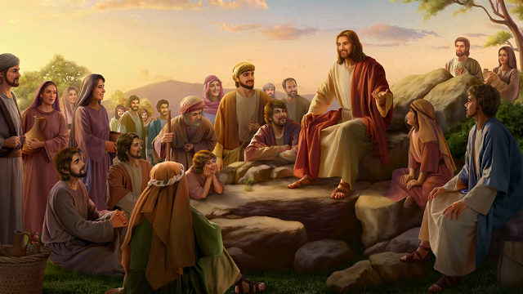
introduction
Matthew Chapters 5 to 7, is commonly referred to as Sermon on the Mount
It is the longest recorded sermon of Christ.
The Sermon contains everything that pertains to life and godliness.
It is a timeless message and unique in presentation.
It gives us detailed instructions on how to become a Christian, the way to live in order to please God and get to heaven at last.
What God demands from us is to obey all instructions not just reading and listening.
This is the only way the sermon can be of benefit to you.

Slide 4
INTRODUCTION CONT’D.
CHARACTERISTICS OF KINGDOM CITIZENS
CONDUCT AND DUTIES OF HEAVEN-BOUND SAINTS
CALL TO BE A MEMBER OF GOD’S KINGDOM
1
There are three(3) sub-topics:
2
3

Slide 5
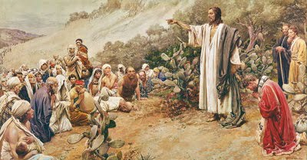
CHARACTERISTICS OF KINGDOM CITIZENS: Matt. 5: 3-16, Luke 6: 20-23
The first part of Christ’s sermon on the mount is known as Beatitudes.
These spelt out what the attitude of Christians ought to be.
These characteristics include:
Being poor in Spirit: A person that is ‘poor in spirit’ willingly admits his spiritual needs, repent and receive Jesus as Lord and personal Saviour . To be poor in the Spirit is also the secret of Christian living as we are wholly dependent on God in all things.
Mournfulness: A sinful child is expected to mourn for his sins and be comforted

Slide 6
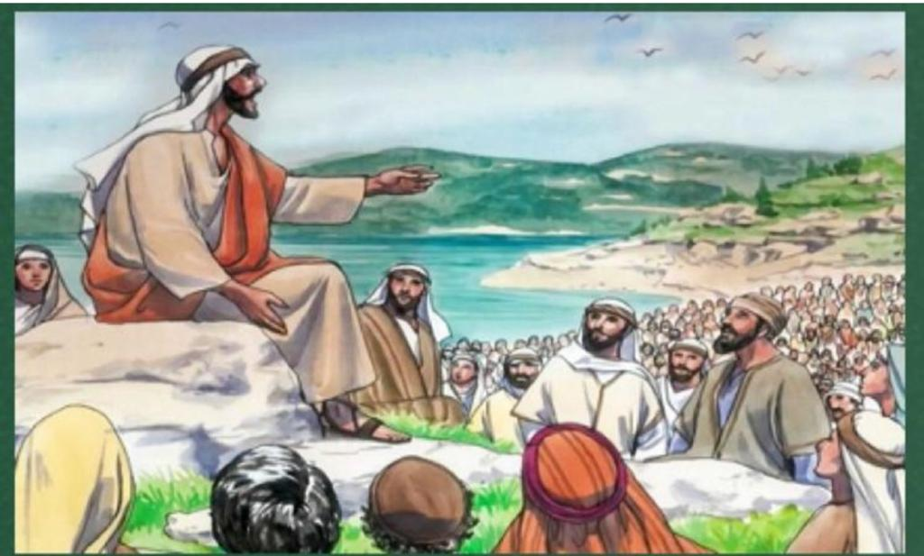
CHARACTERISTICS OF KINGDOM CITIZENS CONT’D.
Meekness: This means being mild, gentle, submissive, quiet and willing to do what God wants without complaining. It will enable us to develop warm satisfying relationship, with others and free us to enjoy a special inheritance from God, who owns all things.
Hunger and thirst for righteousness: This means to desire to be holy. The central theme of the sermon on the mount is “be ye therefore perfect even as your Father which is heaven is perfect”. (Matt. 5: 48). This means completeness, wholeness, maturity-being all God wants us to be. Thirsting after righteousness will make you to experience holiness and perfection.

Slide 7
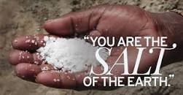
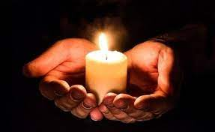
v. Merciful: The merciful are those who forgive others and show them kindness they did not deserve. The merciful unselfishly reach out to help others in need.
The kingdom citizens are also called to have an impact on the world around them.
You are to be ‘salt’ creating spiritual thirst and influencing others through your pure life.
You are also to ‘shine as light’ by doing works that will turn sinners to the Saviour.

Slide 8
2. CONDUCT AND DUTIES OF HEAVEN-BOUND SAINTS: Matthew 5: 17- 48; 6: 1-34; 7:1-12; Luke 6:24-49
As we daily demonstrate the characteristics of the children of the kingdom, we are to be busy preparing ourselves and others for the heaven.
When we do this, we exhibit true righteousness in our relationship with others.
You do not just hunger and thirst for it, your life must be pure, loving, blameless and godly.
As friends of Jesus, you must seek first the kingdom of God and its righteousness, this include acceptable giving, fasting, life free of offence(s) and worry and a life given to sincere prayers.
When you do all these, all other things that will make you a blessed child will be added unto you.

Slide 9
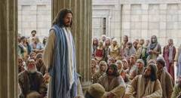
3. CALL TO BE A MEMBER OF GOD’S KINGDOM: Matt. 7:13-29; Luke 13:22-30
Having explained to us the principles of the kingdom life, Jesus concludes His Sermon by calling the attention of everyone to how to enter into the kingdom.
The sure way to God’s kingdom is the “narrow way”.
Jesus declares “Enter ye in at the straight:… Because straight is the gate, and narrow is the way, which leadeth unto life, and few there be that find it”, (Matthew 7: 13-14).
Be a wise child and enter into to join the few on the narrow way.

Slide 10
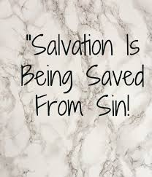
3. CALL TO BE A MEMBER OF GOD’S KINGDOM CONT’D.
If you are a sinner, repent of all your sins- stealing, fighting, lying, cheating, witchcraft, stubbornness and many others.
Ask for forgiveness and cleansing of your sins with the blood of Jesus.
Turn away from all sins and ask Jesus to be your Saviour and Lord.
Thirst and pray for the sanctification of your heart.
Believe that God has answered your prayer.
Live in newness of life and daily follow the kingdom life principles.

Slide 11
QUESTION TIME
Jesus’ teaching on the mount is also referred to as _______________
Explain the different characteristics of kingdom citizens.
Heaven-bound saints are called to seek the kingdom of God and ________ (Matthew 6:33).
What are the duties of Christians as outlined in the sermon?
How can a sinful child answer the call to be a member of God’s kingdom?

Slide 12
Lesson, thoughts & activity
LESSON:
Jesus thought us the principles of kingdom life to prepare us for heaven
THOUGHT:
I will abide by the principles of kingdom life so as to be blessed and qualified for heaven.
ACTIVITY:
Memorise and recite all the beatitudes in the sermon on the mount- Matt. 5:3-12

Slide 13
HOMEWORK, CONGREGATIONAL SONG AND CHORUSES
HOME-WORK:
Draw Jesus sitting on the mountain and the people he taught. Show it to your teacher
CONGREGATIONAL SONG:
GHS 49: LET OTHERS SEE JESUS IN YOU
CHORUSES:
I’m so glad I belong to Jesus
Give me that old time religion
I have chosen the way…the way of holiness

Slide 14
REFERENCES
Great Big Canvas- https://www.greatbigcanvas.com/view/sermon-on-the-mount,1935780/?size=12x16&coupon=RSVIN&coupon=RSVIN&country=CA&gclid=CjwKCAjwscGjBhAXEiwAswQqNA69gvFBSkNEqSJMhfXSdwEm_lGd6aIjC7DkCCTJbjZlkaPLYc_f6BoCcMEQAvD_BwE
Images for heaven: https://www.google.com/search?q=picture+of+heaven&oq=picture+of+heaven&aqs=chrome..69i57j0i512l9.3889j0j7&sourceid=chrome&ie=UTF-8#imgrc=6WXJfC-2qjiklM
Picture of believers as salt of the earth https://www.google.com/search?sxsrf=APwXEdcyA8Vm78Fp1f70yjfg4CnYDk9NEQ:1685152668763&q=picture+of+believers+as+salt+of+the+earth
Picture of believers as light of the world https://www.google.com/search?q=picture+of+believers+as+light+of+the+world&tbm=isch&ved=2ahUKEwic24yOs5T_AhWTE1kFHYklDTIQ2-cCegQIABAA&oq=picture+of+believers+as+light+of+the+world&gs_lcp=CgNpbWcQAzoECCMQJ1DcBVjWOGDtPWgAcAB4AIABhwGIAbsdkgEEOC4yOJgBAKABAaoBC2d3cy13aXotaW1nwAEB&sclient=img&ei=2GNxZJyPEpOn5NoPicu0kAM&bih=512&biw=1280#imgrc=Kbtq0FD-byJ9tM
Images of Bible open https://www.google.com/search?q=picture+of+bible+open&oq=picture+of+bible&aqs=chrome.1.69i57j0i512l3j0i20i263i512l2j0i512l4.10408j0j9&sourceid=chrome&ie=UTF-8#imgrc=NpGaYxx_eqXLKM
Images for references: https://www.google.com/search?q=images+for+references&oq=images+for+referenceS&aqs=chrome..69i57j0i390i650l2.5421j0j9&sourceid=chrome&ie=UTF-8#imgrc=yzGf11bA0OTTwM

