Slide 1
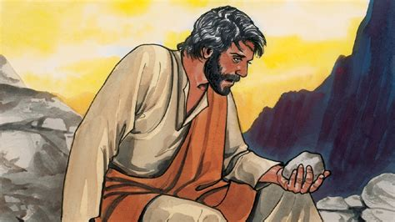
TEMPTATION AND BEGINNING OF JESUS’ MINISTRY

Slide 2
MEMORY VERSE & TEXT
MEMORY VERSE:
"From that time Jesus began to preach, and to say, Repent: for the kingdom of heaven is at hand" (Matthew 4: 17).
TEXT: Matt. 4:1-25; Luke 4:1-44

Slide 3
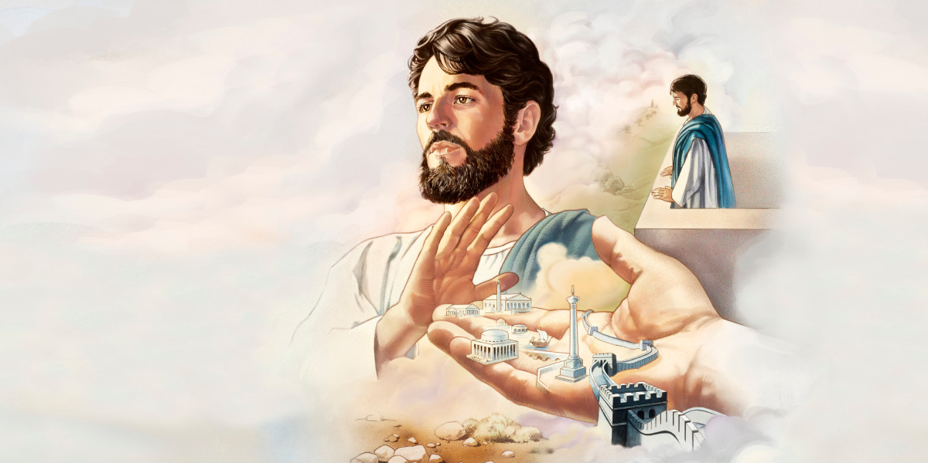
INTRODUCTION
Jesus came into the world to carry out some special assignments.
He was the only one qualified to do such work.
He came to pay the price for our salvation, redeem and reconcile us back to God, deliver the oppressed, set the captives free, heal the broken hearted and the sick, make provisions for all that we need in life and
finally provide the way for saved souls to enter heaven at last.

Slide 4
INTRODUCTION CONT’D.
To begin His multiple-fold mission on earth, Jesus had to undergo some preparations. To this end, He:
Submitted Himself for water baptism in order to identify with the ministry of John the Baptist and the sinners whom He had come to save.
Fasted for forty days and nights to receive divine strength and direction for the work ahead.
Was tempted by the devil.
This is to serve as example and encouragement to those who would become His friends.

Slide 5
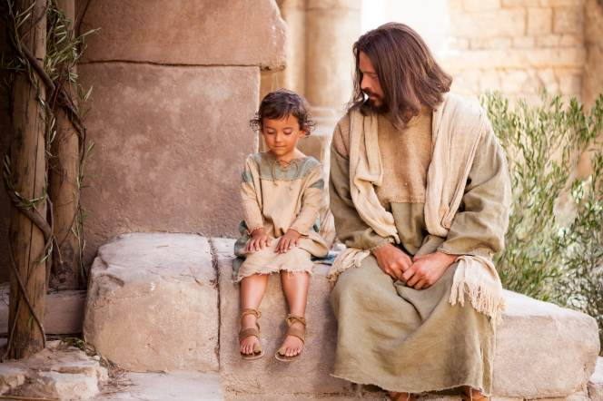
INTRODUCTION CONT’D.
They will understand that temptation is real and that there is grace available to help us overcome whatever trials or temptation that may come our way.
After this preparation, Jesus started His ministry in earnest.
The first assignment was to preach and call sinners to repentance.
He also taught the people the word of God, healed the sick, and declared publicly the purpose of His coming into the world as captured in Luke 4:18,19.

Slide 6
INTRODUCTION CONT’D.
If you are a sinner, Jesus has come to save you. Repent, believe His word and become His friend.
If you are saved already, remember that there is grace for you to overcome temptations and obstacles to the work He has called you to do.
Trust in Jesus and He will help you to have total victory and make it to heaven at last.

Slide 7
WE SHALL CONSIDER THE FOLLOWING SUB-HEADINGS:
1
JESUS’ TEMPTATION AND VICTORY
2
THE BEGINNING OF JESUS' MINISTRY ON EARTH
3
CHRISTIANS MINISTRY IN THE WORLD

Slide 8
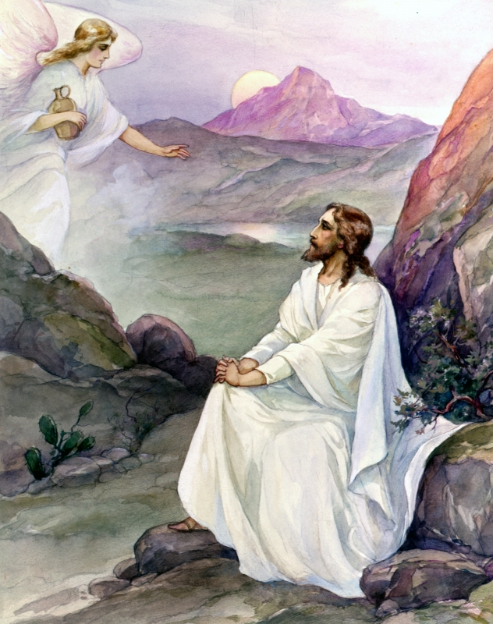
1. JESUS’ TEMPTATION AND VICTORY: Matthew 4:1-11; Luke 4:1-13; 22:46; Mark 1:12,13
Jesus Christ our Lord and Saviour experienced series of trials and temptation while on earth.
After being baptized in water, Jesus was led by the Holy Spirit into the wild mess where He fasted for 40 days.
It was here that Satan tempted Him. He was able to overcome him by the word and trust in the Almighty God.

Slide 9
1. JESUS’ TEMPTATION AND VICTORY CONT’D,
Every believer on earth will at one time or the other pass-through trials or temptations, we are not to be afraid or fear but rely on the Almighty God who will give us the power and grace to overcome. John 16:33
Temptation is not sin but yielding to it becomes sin.
To overcome trials and temptation you must:
Be saved from sin.
Be prayerful and watchful.
Study the word of God regularly and meditate on it.
Watch and run from objects of temptations.
Put your trust in God for victory.
As you do all these things, you will surely be victorious over every form of temptation.

Slide 10
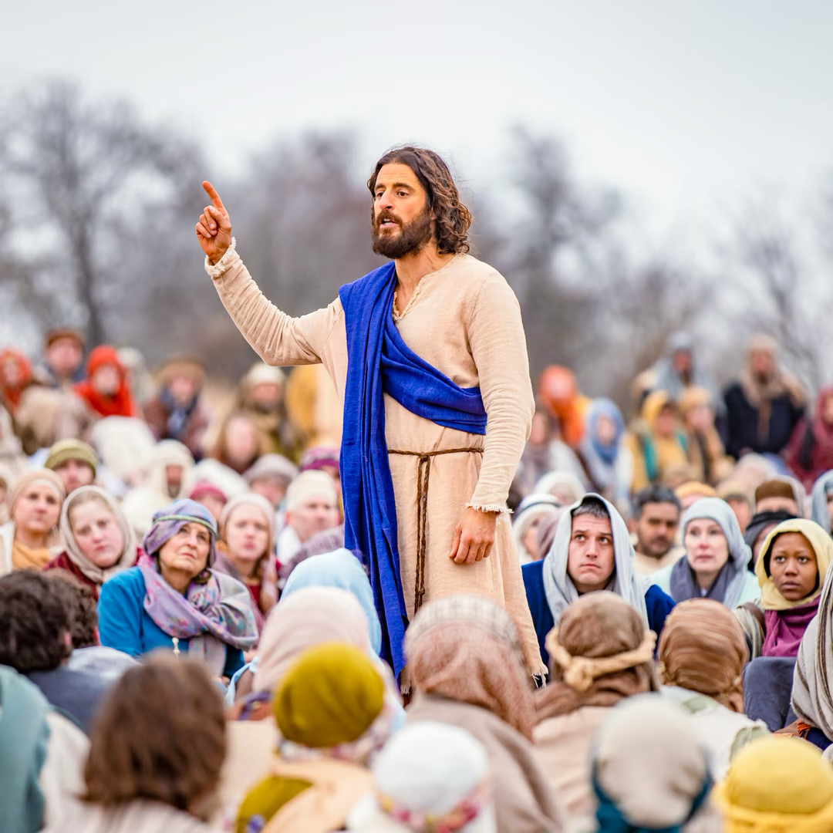
2. THE BEGINNING OF JESUS' MINISTRY ON EARTH: Matthew 4:12-17, 23-25; Luke 4:14-44; Isaiah 61:1-3
Jesus started His ministry as soon as the temptations ended.
He did not waste time because He knew that the time is short, and sinners are dying and going to hell.
The ministry of Jesus in the world is in four-fold:
To preach the gospel to the poor, the outcast, the afflicted, the humble, the poor in spirit, the broken hearted, the rich and those who would listen and tremble at His word.

Slide 11
2. THE BEGINNING OF JESUS' MINISTRY ON EARTH CONT’D.
Healing and binding up the spiritually and physically sick and broken hearted.
Breaking the bondage of evil and proclaiming freedom from sin and satanic dominion.
Opening the spiritual eyes of the lost that they might see the light of the gospel and be saved.
This four-fold mission characterized the entire ministry of Jesus Christ.
All children who are saved and filled with the Holy Spirit are called to share and continue with Jesus' ministry.

Slide 12
2. THE BEGINNING OF JESUS' MINISTRY ON EARTH CONT’D.
Friends of Jesus must fulfill their ministry in these present times.
They must go out and preach the gospel everywhere - at home, in the school, in the neighbourhoods, buses, playgrounds, etc.
They should Pray for those who are sick and comfort the discouraged.
Jesus fulfilled His ministry on earth and as His followers, you must walk in His footsteps.

Slide 13
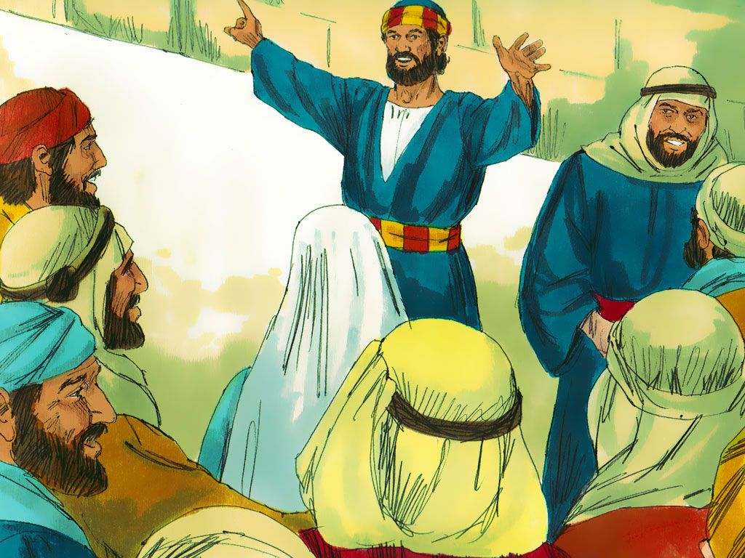
3. CHRISTIAN'S Ministry IN the WORLD: Matthew 4:18-22; Mark 1:15-20; Luke 10:1-17
"As thou has sent me into the world, even so have I also sent them into the world' (John 17:18).
This is the message from Christ that confirms the assignment He has given to His friends. Christians are special friends of Jesus.
They are chosen by Christ to do His work on earth (Matthew 28: 18-20).
Jesus said, "occupy till I come." Preaching, teaching, and healing are the believers’ ministry.

Slide 14
3. CHRISTIAN'S Ministry IN the WORLD CONT’D.
Souls are perishing. "For the Son of man is come to seek and to save that which was lost" (Luke 19: 10).
The reason why friends of Jesus are still alive is to bring others to Christ.
God will bless you mightily as you obey the Father's will by spreading the good news.
Such blessings include salvation, healing, promotion, protection, preservation, and success in all you do.

Slide 15
3. CHRISTIAN'S Ministry IN the WORLD CONT’D.
A crown of righteousness and eternal life with Jesus are additional blessings.
The mandate for you today as friends of Jesus is to go and preach the gospel to every soul.
Therefore, preach the gospel, teach new converts, pray for the sick and the oppressed.
God will help you to fulfil your ministry as Christ did.

Slide 16
questions
Christ came to the world to _____________
Jesus overcame all His temptations. Yes/No?
Temptation is not sin. Yes/No?
Identify three things to do in order to overcome temptation.
Mention the four-fold ministry of Jesus on earth.
What must a sinner do to be able to preach the gospel?

Slide 17
Lessons, thought & activity
LESSON: Jesus has shown us how to overcome temptation and to do His work.
THOUGHT: I will always say no to temptation to sin and be involved in preaching the gospel.
ACTIVITY: Children should mention the four-fold ministry of Christ. Then discuss various ways friends of Jesus can carry on the ministry.

Slide 18
CONGREGATIONAL SONG & CHORUSES
CONGREGATIONAL SONG: GHS 6: YIELD NOT TO TEMPTATION.
CHORUSES
Satan will never, ever, conquer me
Go tell it on the mountain
I am not alone
HOMEWORK: Children should spend quality time at home to seriously pray against temptations and go out to preach the gospel in their neighborhoods.

Slide 19
https://encryptedtbn0.gstatic.com/images?q=tbn:ANd9GcQNQsqUCGoEgzUKe3uqUdBfiBAZooPCCWoz-Q&usqp=CAU
https://tvaraj.files.wordpress.com/2012/02/an-angel-ministers-to-jesus-after-his-temptation.jpg
https://cdn.theatlantic.com/thumbor/GNTaACb6TDuBY26ANuvBCDCsZ0o=/460x0:2460x2000/1080x1080/media/img/mt/2021/06/Cho_S2_press_image_3_1/original.jpg
https://externalcontent.duckduckgo.com/iu/?u=https%3A%2F%2Fi.pinimg.com%2Foriginals%2Fe3%2F7f%2F1d%2Fe37f1d46b3bc3414bc09c1335bc85bca.jpg&f=1&nofb=1&ipt=d63502853140e404dce2f9a9242d41f1e135a5f300a85ba6b6cf82a42e93ea73&ipo=image
https://thumbs.dreamstime.com/b/writing-note-showing-lessons-learned-business-photo-showcasing-experiences-distilled-project-should-actively-taken-man-165073936.jpg
https://qph.cf2.quoracdn.net/main-qimg dcf97ad2014e145869cf8b02bc063b3c-lq

