Slide 1
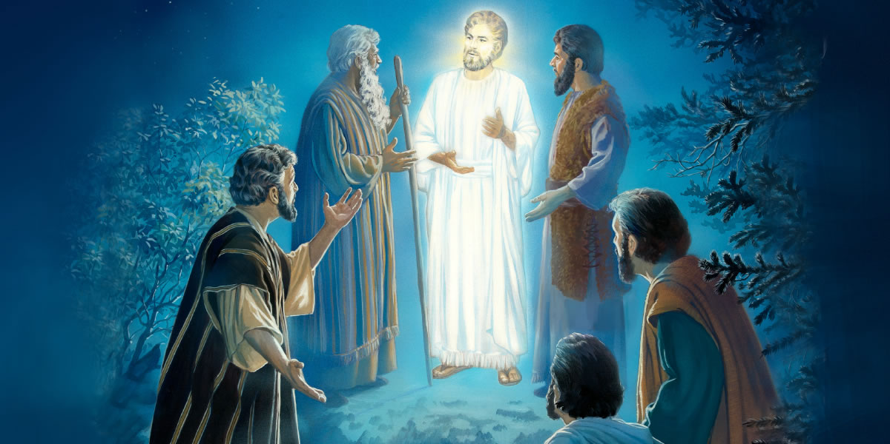
TRANSFIGURATION OF CHRIST

Slide 2
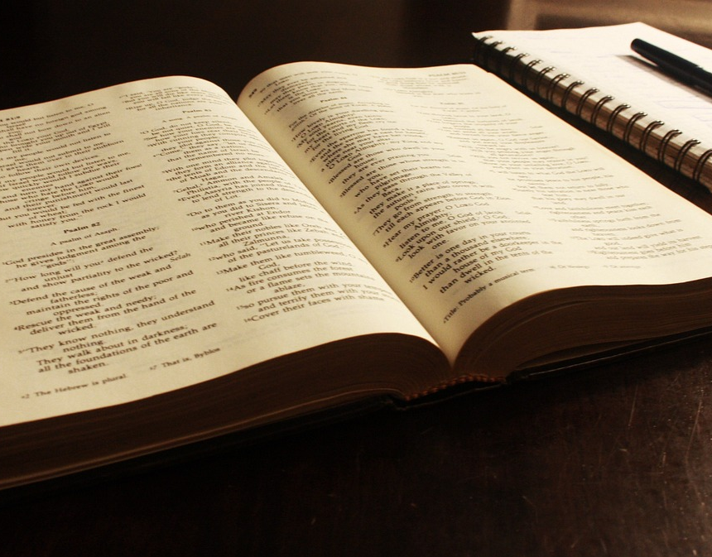
MEMORY VERSE: “And after six days Jesus taketh with him Peter, and James, and John, and leadeth them up into an high mountain apart by themselves: and he was transfigured before them” (Mark 9:2).
TEXT: Matthew 17:1-27; Mark 9:1-29; Luke 9:28-45

Slide 3
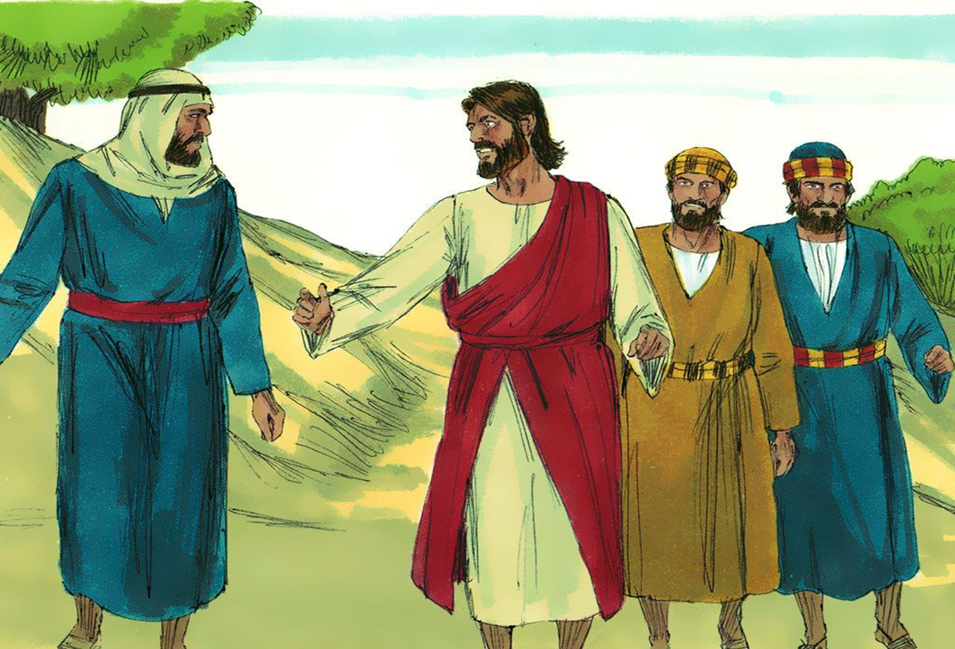
INTRODUCTION
Jesus took three of his closest disciples to a mountain to pray, these three were Peter, John and James.
He wanted them to see His glory. Suddenly, His appearance changed. His clothes became whiter, very beautiful and His face shone with brightness and great glory.
Moses and Elijah appeared by His side and spoke with Him on His forthcoming suffering and death for the salvation of humanity.
Then a cloud came around them (showing the presence of God the father) and a voice spoke out of the cloud “This is my beloved son, hear ye him.”
The change was so glorious that Peter wanted them to stay back and live there forever.

Slide 4
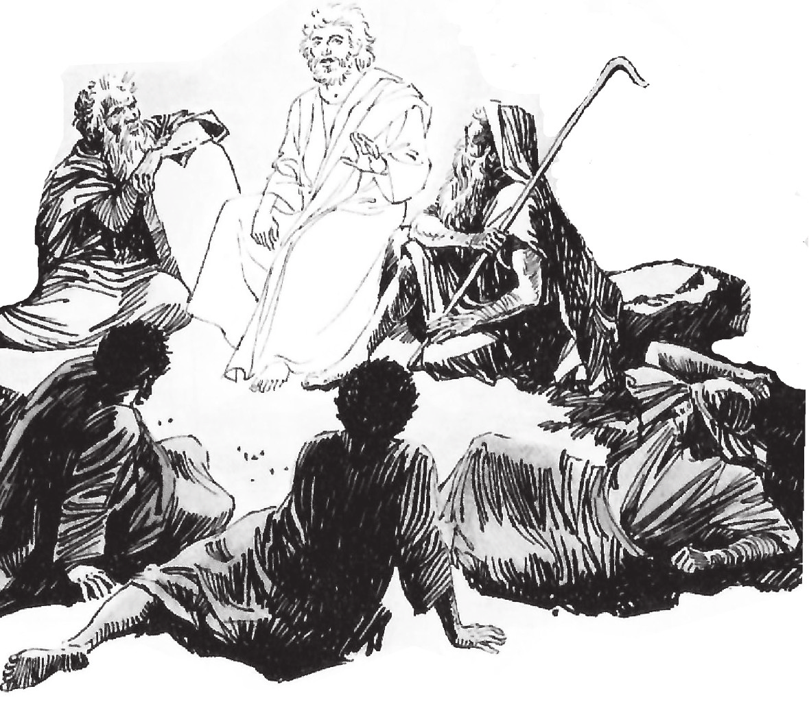
INTRODUCTION CONT’D
When they lifted their faces, they did not see Moses and Elijah again.
Jesus asked them not to tell anyone about what they had seen.
This experience was a great miracle to the three disciples; they saw Christ’s heavenly glory as He really is - God in human flesh.
One day, all His friends shall be changed and fly to meet Him in the air.
We shall behold His glory and see Him as He is.
This will be the most glorious and wonderful experience for every believer.
You must strive to be among those that will make it.
The disciples fell on their faces afraid, but Jesus touched them and assured them not to be afraid.

Slide 5
Points to Consider
MEANING AND PURPOSE OF THE TRANSFIGURATION OF CHRIST
THE MESSAGE AND INSTRUCTION ON THE MOUNT OF TRANSFIGURATION
MIRACLES AND WONDERS THROUGH GOD’S BELOVETH SON
1
2
3

Slide 6
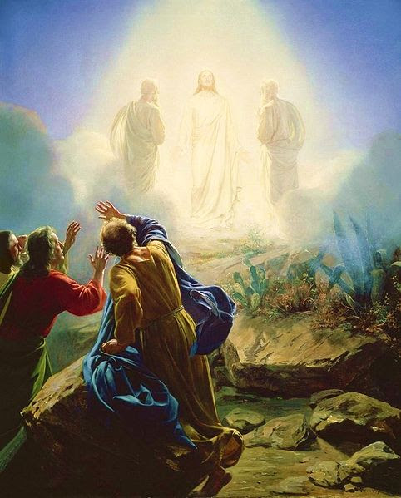
1. MEANING AND PURPOSE OF THE TRANSFIGURATION OF CHRIST: Matthew17:1-14; Mark 9:1-6; Luke 9:28-34
Transfiguration means a change in appearance; making a person more beautiful, important and more glorious than people know him to be.
Christ was transfigured while He was praying. This is to teach us as His friends the importance of praying.
The disciples were sleeping while Jesus was praying.
This is not the only occasion that the disciples slept while Jesus was praying. They slept also in the garden of Gethsemane (Mark 14:37).

Slide 7
1. MEANING AND PURPOSE OF THE TRANSFIGURATION OF CHRIST CONT’D.
Most children today are in the habit of sleeping or playing while their parents are praying.
We should join others during prayer time at home or in the church.
It is only through prayer that we can experience spiritual transformation and receive other blessings from God.
Transfiguration of Jesus happened in the presence of His friends so that they could become witnesses of all that they had seen and heard.

Slide 8
1. MEANING AND PURPOSE OF THE TRANSFIGURATION OF CHRIST CONT’D.
The purposes of Jesus' transfiguration are to:
Encourage Jesus as He got nearer to His death on the cross.
Announce to the disciples that Jesus must truly suffer and die for our sins.
Prove to the disciples that Jesus is the Son of God who alone had the power to die for our sins
Reveal a little part of the glory that friends of Jesus would enjoy in heaven.
“Beloved, now are we the sons of God and it does not yet appear what we shall be; but we know that when he shall appear we shall be like him; for we shall see him as he is” (1 John 3:2).

Slide 9
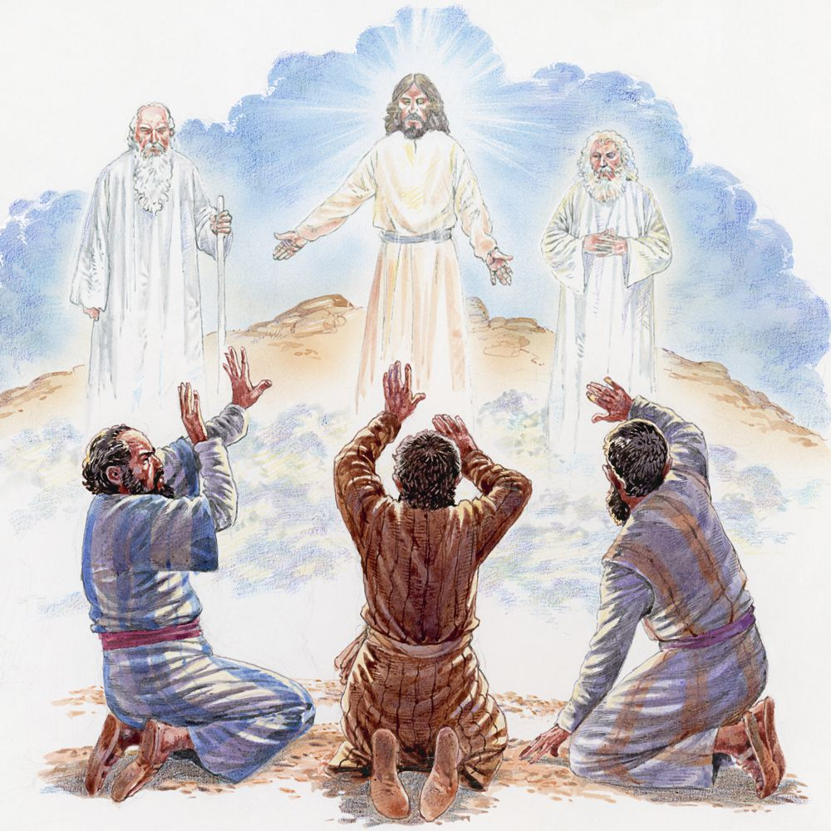
1. MEANING AND PURPOSE OF THE TRANSFIGURATION OF CHRIST CONT’D.
Are you prepared for heaven?
As the body of Jesus was transfigured, so also the body of all friends of Jesus would change at the time of rapture.
We shall not go to heaven with our present bodies. The body you have now will be removed and a new one would be given (1 Corinth, 15:49-52)
The privilege is only for friends of Jesus and if you are yet to become one, ask for forgiveness and cleansing in the blood of Jesus

Slide 10
2. THE MESSAGE AND INSTRUCTION ON THE MOUNT OF TRANSFIGURATION: Matt. 17:5-13; Mark 9:7-13; Luke 9:35,36; Matt. 3:17
“And there came a voice out of the cloud, saying; this is my beloved son: hear him” (Luke 9:35).
God the father spoke from heaven instructing every child to listen to Jesus and obey Him.
There are lots of benefits to be enjoyed when you listen to God’s word and do them.
Jesus told the disciples to keep the transfiguration story secret until He rose from the dead.

Slide 11
2. THE MESSAGE AND INSTRUCTION ON THE MOUNT OF TRANSFIGURATION CONT’D.
We can learn the following lessons from this:
There is time to speak and time to be silent.
Many children make noise in school and in the church. As a friend of Jesus, you must not make noise lest you talk out the power of God in you, become empty and lose the favour of God.
It is also a mark of the Lord's humble nature.
Humility is a Christian virtue which makes a child not to think of himself better than others.
We are what we are by the grace of God. Therefore, you must follow Christ example in everything.

Slide 12
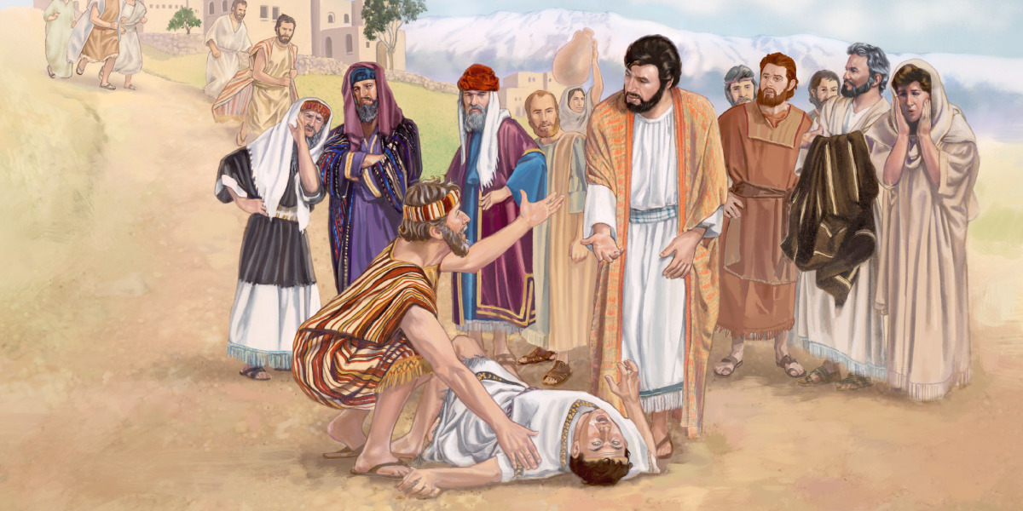
3.MIRACLES AND WONDERS THROUGH GOD’S BELOVETH SON: Matt. 17:14-27; Mark 9:14-29; Luke 9:37-45
As soon as Jesus and His three disciples came down from the mount of transfiguration, they encountered some challenges that needed immediate solution.
Jesus immediately provided solution to those problems. He demonstrates His power and authority over sicknesses, diseases, demonic affliction and evil powers.
He delivered a boy that was possessed by evil spirit.
The boy had been brought earlier by his father to the remaining disciples. They could not help him because of their lack of faith.
By the word of authority from Jesus, the devil came out of the boy.

Slide 13
3. MIRACLES AND WONDERS THROUGH GOD’S BELOVETH SON CONT’D.
Jesus has given us power to cast out all demons, tread upon serpents and scorpions and over all the powers of the enemy.
All we need to do is to have faith in Him and His holy word. Our trust and obedience to His word are the source and secret of faith.
(ii) Jesus sent peter to bring money out of the fish’s mouth to pay for tax.
He demonstrated His power over all things so that the religious leaders would know that the earth and everything in it belongs to Him.
To be able to work wonders and miracles, a child must surrender his life to Jesus. He must repent, turn away from all sins and accept Jesus as Lord and Saviour
Then he will be transformed and given power to follow Jesus and do all that the Saviour did. If you are still a sinner, you must repent now and receive Jesus into your heart.

Slide 14
QUESTIONS:
What is transfiguration?
Mention the three friends of Jesus who followed Him to the mountain of transfiguration.
Who are the two Old Testament saints that appeared on the mountain with Jesus?
What was the message received on the mount of transfiguration?
At what time will the bodies of friends of Jesus be changed and what can a sinful child do to partake of the change that will take him to heaven?

Slide 15
LESSON, THOUGHT AND CHORUSES
LESSON: Friends of Jesus will be transfigured like Jesus at the rapture.
THOUGHT: I will live a prayerful and holy life by the grace of God in order to partake in the rapture.
CHORUSES: (1) Jesus shall reign forevermore (2) Heaven is full of joy (3) He is the Lord He changeth not

Slide 16
ACTIVITY
Children should search the following Bible passages and discover the instructions of Jesus to His friends.
Luke 18:1;
John 15:4;
Hebrews 12:14;
Mark 16:15

