Slide 1
SUNDRY LAWS OF PURIFICATION
TEXT:
Leviticus 11:1-47; 12:1-8

Slide 2

MEMORY VERSE
“For I am the Lord your God: ye shall therefore sanctify yourselves, and ye shall be holy; for I am holy: neither shall ye defile yourselves with any manner of creeping thing that creepeth upon the earth.” Leviticus 11:44

Slide 3
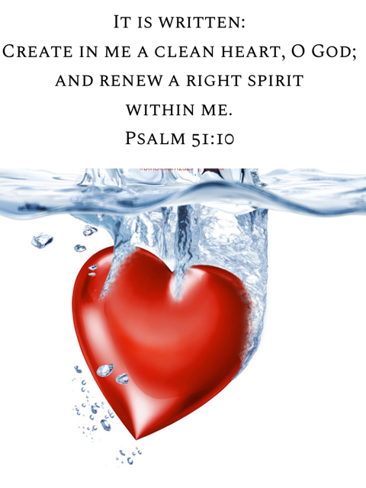
introduction
Purification means to make clean and pure.
It involves total cleansing of a thing or person.
In this case, the laws refer to the total sum of instruction given directly by God to help His people to live a clean and holy life.
God is holy and anyone that would serve Him acceptably must be holy.
The demand for holiness in our life runs through the Bible.

Slide 4
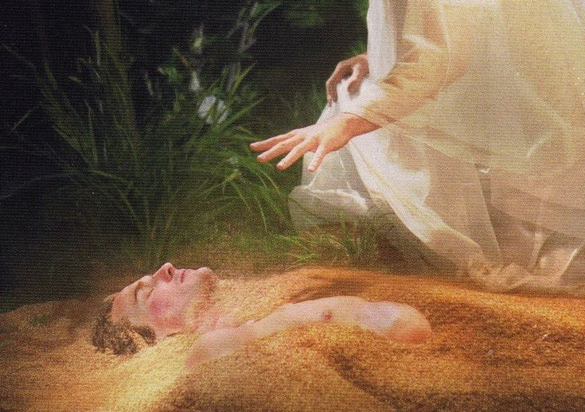
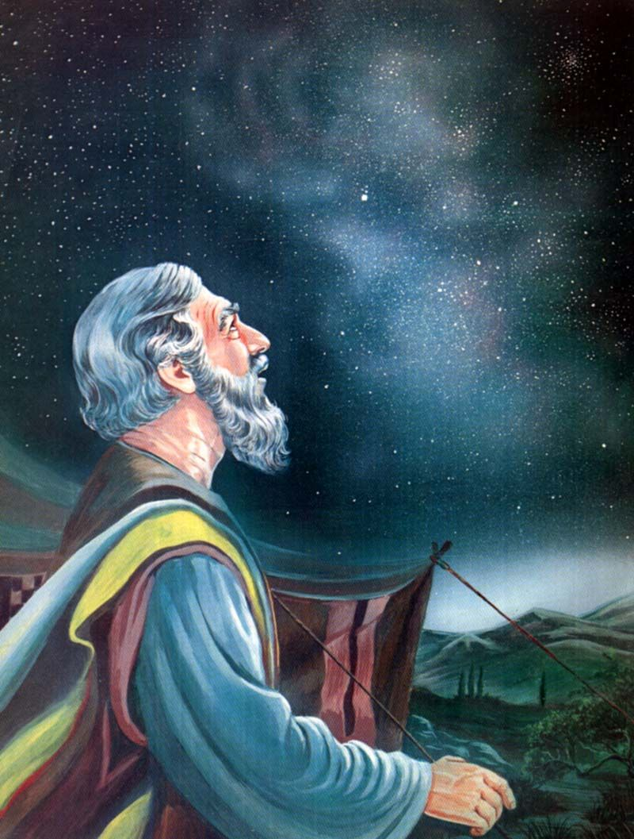
Introduction cont’d.
Right from the time of creation, God made man in His own image (Holiness) and expects him to remain in that state.
However, when sin entered, corruption set in, and man became separated from the holy God.
Notwithstanding, God still made provision for man to possess His image of holiness.
Therefore, He sought for a people, who would serve Him and show forth His holiness.
For this He called Abraham and promised to make out of him a great nation and a people separated unto Him.

Slide 5
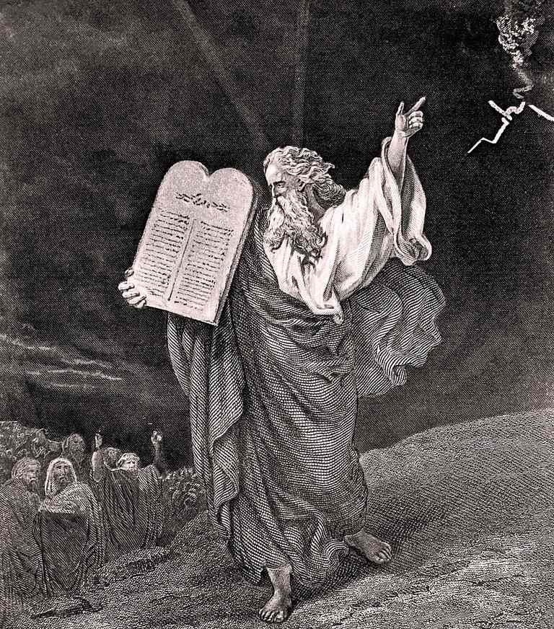
Introduction cont’d.
Having redeemed Israel who were descendants of Abraham from Egypt, God gave them many laws to guide and build them up to be a holy nation and peculiar people unto Him.
This was the reason for all the laws given to Israel through Moses.
Today, we have the complete Bible as the word of God to guide and help us to serve God acceptably and become a holy and peculiar generation unto Him.
In this study, we shall examine the various laws in relation to physical and spiritual purification of Israel and all God’s children.

Slide 6
Our study is in three parts:
1
SUNDRY LAWS OF PURIFICATION
2
SIGNIFICANT LESSONS FROM THE LAWS OF PURIFICATION
3
SANCTIFY YOURSELF AND BE HOLY

Slide 7
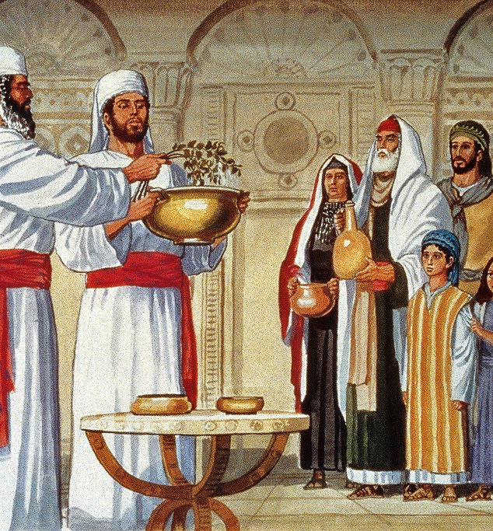
PT 1: SUNDRY LAWS OF PURIFICATION: Lev. 11:1-47; 12:1-8
Sundry means different or various.
In this case we are looking at various laws about purification.
The laws given in our Bible passage concern both physical cleanliness and spiritual cleansing.
This shows that our outward appearance is closely related to our inward cleansing especially our heart.
The laws of purification are in two parts.
Dietary and ceremonial cleansing after childbirth.

Slide 8
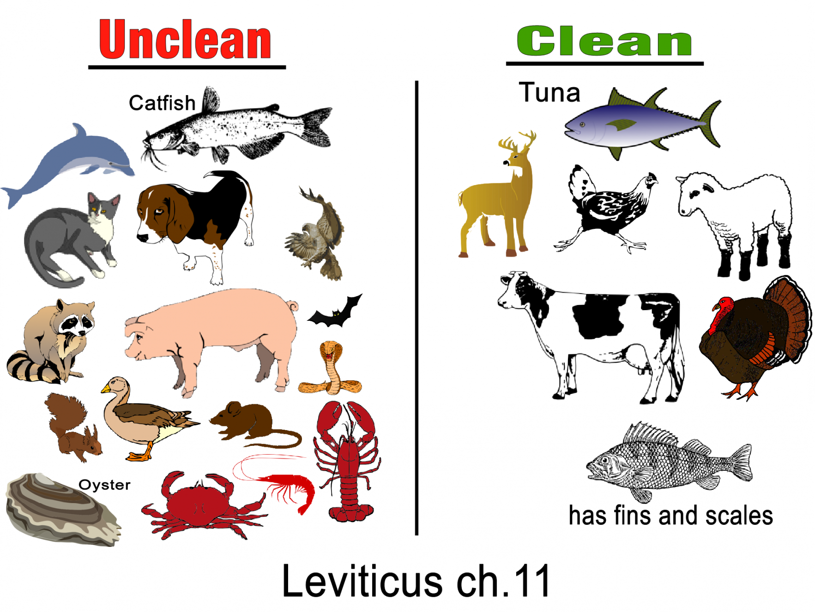
PT 1: SUNDRY LAWS OF PURIFICATION cont’d.
Dietary laws help to identify clean or healthy food and unclean or unhealthy food.
God who is the creator of all things knows those things that are fit for human consumption and those that are not good for our physical wellbeing.

Slide 9
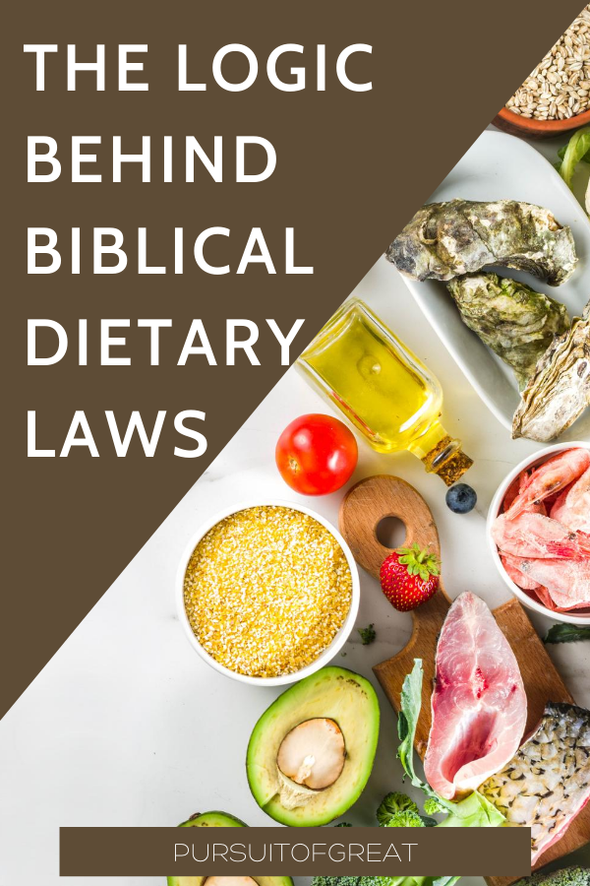
PT.1: SUNDRY LAWS OF PURIFICATION cont’d.
God gave those laws in order to:
Keep the children of Israel healthy physically.
Help them to exercise control over their appetite.
Set them apart from other nations that were worshipping idols.
Prevent them from eating animals used for sacrifice to those idols.
Show that God is interested in both our physical and spiritual wellbeing

Slide 10
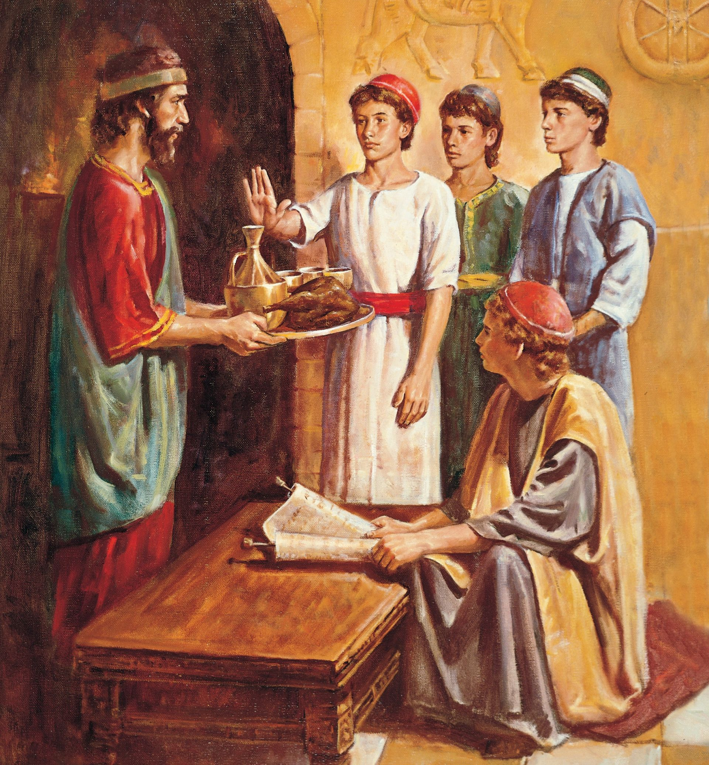
PT. 1: SUNDRY LAWS OF PURIFICATION cont’d.
Daniel and his friends were guided by these laws when they were taken as captives to Babylon.
Their parents were not with them.
Yet, because they loved to obey God’s word, they separated themselves from food sacrificed to idols.
Children must learn to control their appetite.
Eat moderately and do not beg for food or take alcohol and dangerous drugs.
Eat balanced diet to maintain healthy lifestyle.
In whatever you do, let God be glorified.
Remember, “the kingdom of God is not meat and drink; but righteousness, and peace, and joy in the Holy Ghost.” Romans 14:17

Slide 11
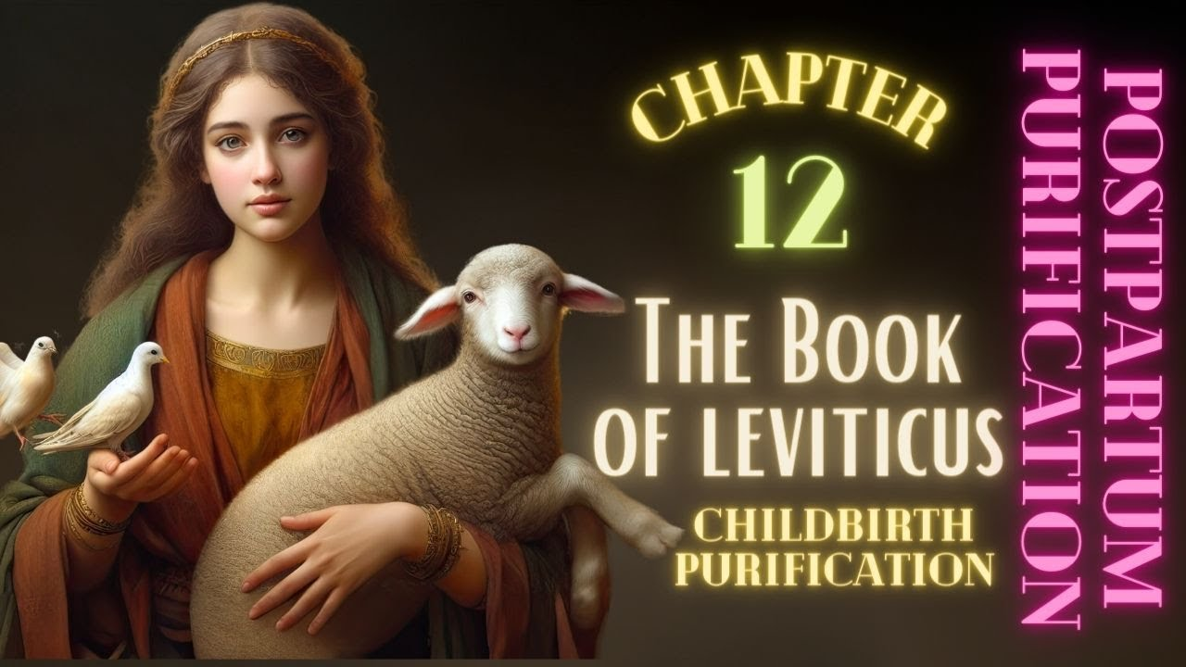
Pt. 2: significant lessons from the laws of purification: Leviticus 11:44-45; 12:1-8; 18:1-5; Luke 2:21-24; 1 Peter 1:14-16
The second set of laws concern cleansing of mothers after childbirth.
These laws involve ceremonial cleansing of both the mother and the newborn baby.
Observance of these laws is also important for both physical and spiritual health of the mother and the new baby.
Separation after childbirth will enable the mother to regain her strength and energy and help her to have enough time to care for the baby.

Slide 12
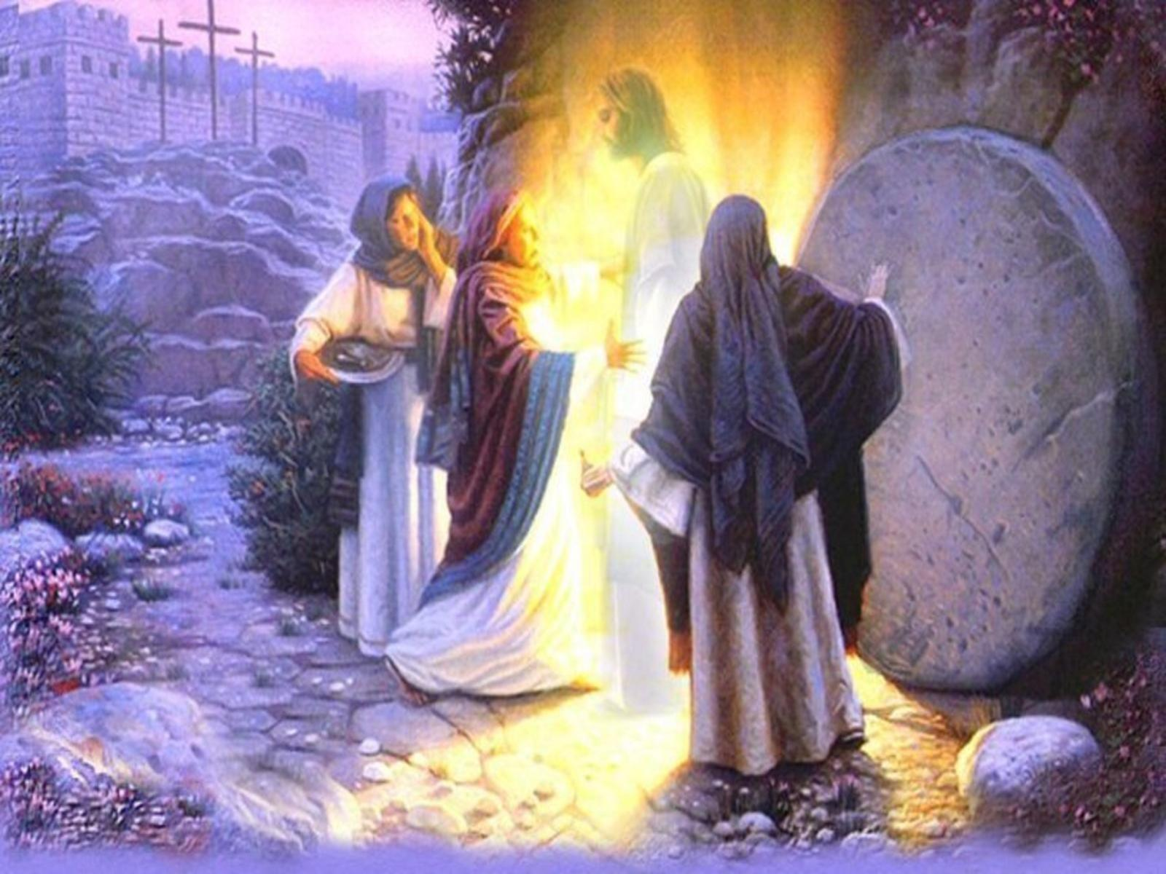
Pt. 2: significant lessons from the laws of purification cont’d.
These specific laws are no longer binding upon friends of Jesus today, since Christ fulfilled their significance and purpose.
However, there are still some principles in those laws that are still relevant to us today.
Friends of Jesus must be different from the world in their eating, drinking, and dressing so as to glorify God with their body. 1 Cor. 6:20; 10:31

Slide 13
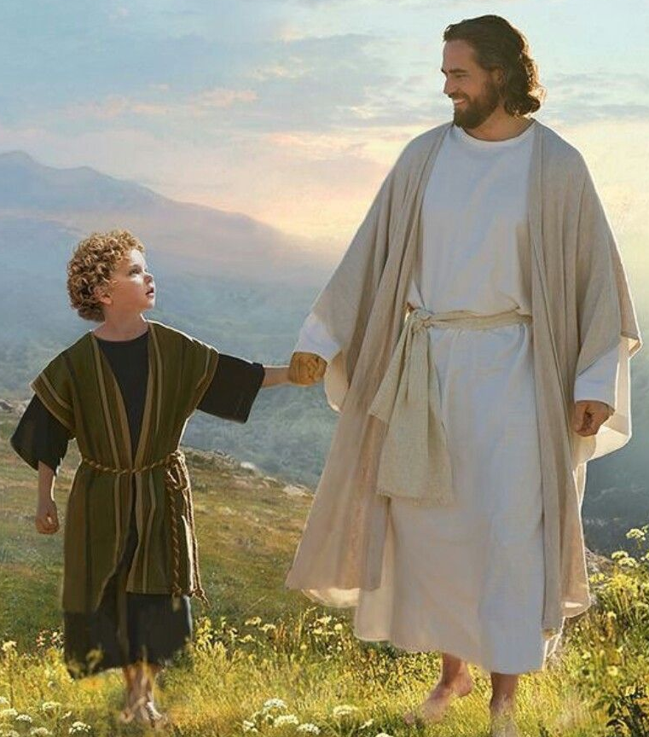
Pt. 2: significant lessons from the laws of purification cont’d.
We are to also reject and run away from all ungodly social customs of the world and to remain holy in all manner of conversation. 1 Peter 1:15
All aspects of our lives must be regulated and controlled by the will and word of God. 1 Cor. 10:31
The uncleanness associated with labour and childbirth symbolized the result of the fall of man. Children therefore are born with sinful nature. Psalm 51:5
This truth shows that every child born into the world needs the Saviour.
Today, a mother does not need to make sacrifices to purify her newborn child.
Jesus has fulfilled the condition for our salvation and purification.
All a child needs to do is to humbly come to Jesus, repent and receive forgiveness and cleansing through the blood of Jesus.

Slide 14
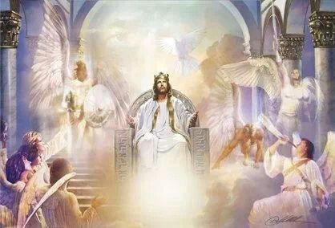
Pt 3: SANCTIFY YOURSELF AND BE HOLY: Lev. 11:43-45; 19:2; 20:7,26; Exod. 19:6; Matt. 5:48; 1 Thess. 4:7; 1 Pet. 1:14-16
“For I am the Lord your God: ye shall therefore sanctify yourselves, and ye shall be holy; for I am holy: neither shall ye defile yourselves with any manner of creeping thing that creepeth upon the earth.” Lev. 11:44
The above passage is the key verse and central message of this study.
All the laws about clean, unclean animals, and ceremonial cleansing were to make the people of God clean, holy, and fit for heaven.

Slide 15
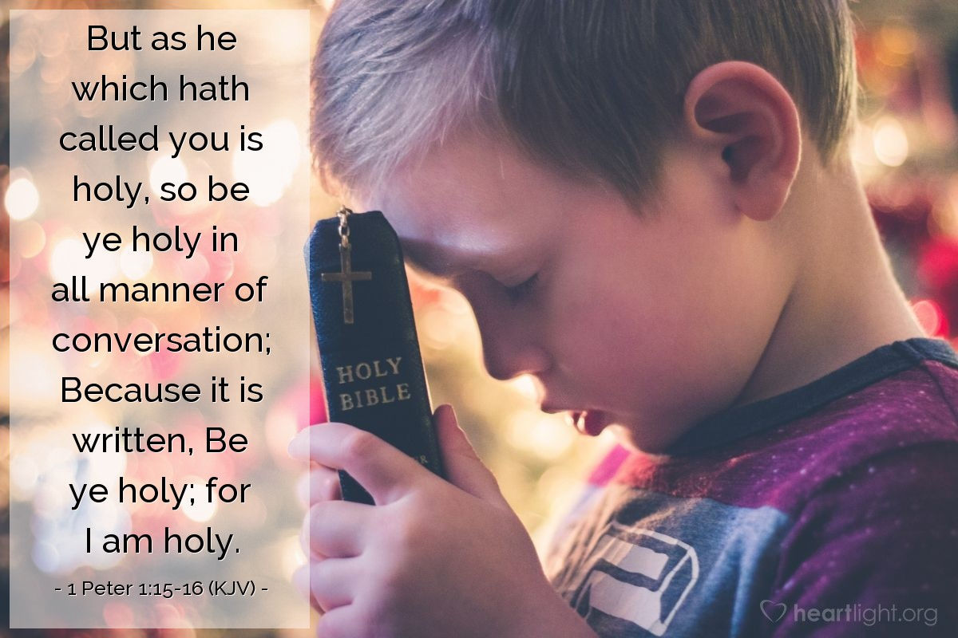
Pt 3: SANCTIFY YOURSELF AND BE HOLY cont’d.
This same message is to all believers today as expressed in 1 Peter 1:15-16. “But as he which hath called you is holy, so be ye holy in all manner of conversation; Because it is written, Be ye holy; for I am holy.”
The call to holy living is a special call from God unto His children.
For a Christian to reflect the image of God, he must be holy.

Slide 16

Pt 3: SANCTIFY YOURSELF AND BE HOLY cont’d.
To be holy therefore, a believer must…
Humble himself before God and develop strong desire to be sanctified.
Obey God’s command by sincerely seeking and praying to experience the second work of grace.
Lean on God’s promise, believing that He will sanctify and make him holy.
Yield himself completely to God’s will, pray and wait patiently until he is sanctified and made holy.

Slide 17
Pt 3: SANCTIFY YOURSELF AND BE HOLY cont’d.
Sanctification will produce in a Christian the following Christian virtues:
Humility
Obedience
Love
Integrity
New nature
Endurance
Saintliness
Submission
Are you sanctified?
If no, do not remain at the same level.
Pray now so that you will be sanctified, made holy, and fit for heaven.

Slide 18

questions
What is purification?
Mention the two parts in the laws of purification.
What are the reasons for dietary laws?
Mention the significant lessons from the laws of purification.
What should (i) a sinner (ii) a friend of Jesus do to be sanctified and made holy?

Slide 19


Lesson, thought & ACTIVITY
LESSON: Holiness of life sets a believer apart for God’s use.
THOUGHT: I will pray earnestly to be sanctified and made holy.
ACTIVITY: Search your Bible and write out ten (10) verses that reveal God’s desire for His children to be made holy.

Slide 20

Choruses & CONGREGATIONAL SONG
CHORUSES:
Holiness, holiness, the kingdom of God is holy.
I want to be more holy as the day goes by.
There is power mighty in the blood.
CONGREGATIONAL SONG:
GHS 190 - “CALLED UNTO HOLINESS”

Slide 21
References
https://as1.ftcdn.net/jpg/00/76/38/46/220_F_76384645_vnAmxmoZDxsc0fxJVppQ3BwETVhWUQoG.jpg
https://i.pinimg.com/originals/27/3f/9d/273f9d67e44978a040ec6248ea00bf8f.png
https://i.pinimg.com/736x/22/ab/be/22abbed2ac95305f6dec41f0af412b1f.jpg
https://i.pinimg.com/originals/06/8d/b4/068db4bec9fb6d9e00e020745928f3be.jpg
https://www.thoughtco.com/thmb/9cl9uKUFtH-htKL-LjPzusD8rt0=/768x0/filters:no_upscale():max_bytes(150000):strip_icc()/MosesAndLaw1539x1747-58b5cb2e3df78cdcd8bc4758.jpg
https://i.pinimg.com/originals/f3/0b/27/f30b276bbd181222a8368ed5f13d4735.jpg
https://www.oraclesofjesus.com/wp-content/uploads/2018/06/Dietary-Law.png
https://i.pinimg.com/originals/b3/e5/78/b3e578be511550dd663e150fddf4ea97.png
https://assets.ldscdn.org/39/f6/39f62e88f7d99f30567cdc502806ffd65eebe6c6/daniel_refuses_kings_food_wine.jpeg

Slide 22
References cont’d.
10. https://i.ytimg.com/vi/9AydGfftoRU/maxresdefault.jpg
https://i.pinimg.com/originals/29/db/e6/29dbe69b322dad16d44e63d877003ef5.jpg
https://4.bp.blogspot.com/-Qm2tr3jitdw/WB_pLQhEjsI/AAAAAAAAR_s/Af34HAT0Ly86O0T_g7_-DPJcOt472IxfwCLcB/s1600/Jesus%2BHigh%2BPriest%2B3.jpg
https://img.heartlight.org/overlazy/creations/4504.jpg
https://i.pinimg.com/originals/fd/cb/86/fdcb862db3760bc12f5806e5e6c42c94.jpg
https://www.parliament.nz/media/4552/question-mark-istock.Dt7oUA.jpg
https://positivepsychology.com/wp-content/uploads/2021/02/Positive-Thinking-Toolkit.jpg
https://www.churchmediaworship.com/wp-content/uploads/2021/06/WM-Open-Bible-With-Sunset-Christian-Worship-Loop-Video.jpg
https://png.pngtree.com/png-clipart/20221006/original/pngtree-music-notes-png-image_8660757.png

