Slide 1
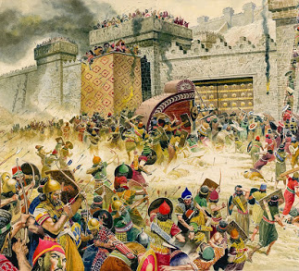
DEFEAT OF THE MIDIANITES AND DEATH OF BALAAM
TEXT: Numbers 31:1-54

Slide 2

MEMORY VERSE:
“And they slew the kings of Midian, beside the rest of them that were slain, namely, Evi, and Rekem, and Zur, and Hur, and Reba, five kings of Midian: Balaam also the son of Beor they slew with the sword” (Numbers 31:8)

Slide 3
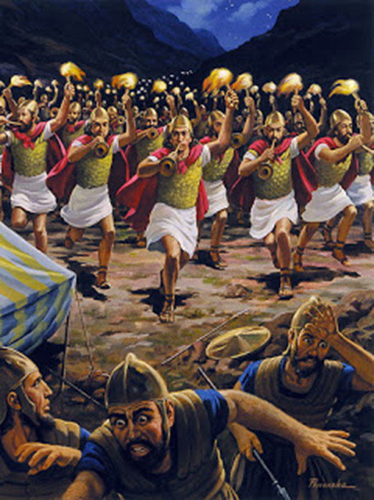
INTRODUCTION
Defeat means to overthrow an army in battle or beat an opponent in a contest.
The Midianites were the descendants of Abraham and Keturah.
Abraham married another wife after the death of Sarah.
“Then again Abraham took a wife, and her name was Keturah. And she bare him Zimran, and Jokshan, and Medan, and Midian, and Ishbak, and Shuah” (Genesis 25:1 2)
The Midianites made themselves enemies of the children of Israel.

Slide 4
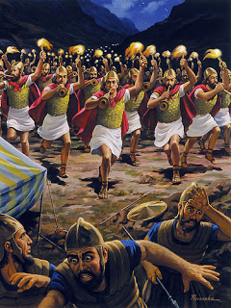
INTRODUCTION-CONT’D
They were close friends of the people of Moab and joined forces with the Moabites to fight against the children of Israel (Numbers 22:6,7).
Similarly, they conspired with the king of Moab to hire a soothsayer called Balaam to help them curse the children of Israel.
When their plan failed, Balaam gave evil counsel that led the children of Israel into idolatry and sexual immorality.
Many of the children of Israel died because of this.

Slide 5
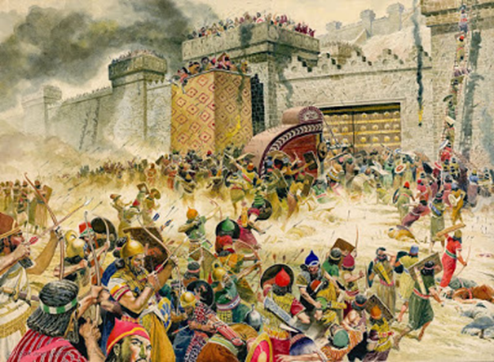
INTRODUCTION CONT’D
God was not happy with the Midianites because of their hatred for the children of Israel, who were their relations
God will not allow sinners to go without punishment.
He, therefore, commanded Moses to destroy them completely.
God always waits for a long time to see if evildoers will repent.
It is only when they refuse that His judgment will come upon them.
If you are still a sinner, you must repent and turn from your wicked ways.

Slide 6
POINTS TO CONSIDER
DIVINE INSTRUCTIONS TO FIGHT AGAINST THE MIDIANITES
DEFEAT OF THE MIDIANITES AND DEATH OF BALAAM
DUE REWARDS FOR FAITHFUL MEN OF WAR
1
2
3

Slide 7
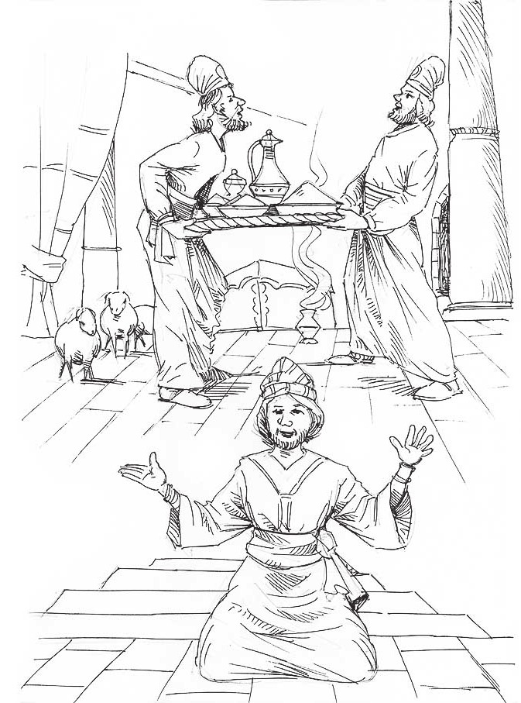
DIVINE INSTRUCTIONS TO FIGHT AGAINST THE MIDIANITES: Num. 31:1-7; 22:1-6; Nehemiah 13:1,2
The Lord commanded Moses to punish the Midianites for all the evils they did against the children of Israel.
The Midianites, in agreement with the Moabites, invited Balaam to curse the Israelites.
They planned with Balaam to lure the children of Israel into sexual immorality.
This was Moses’ last assignment on earth before his death.

Slide 8
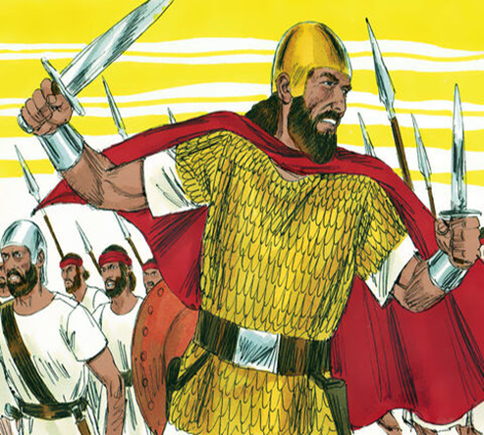
DIVINE INSTRUCTIONS TO FIGHT AGAINST THE MIDIANITES CONT’D.
Moses obeyed God completely. He chose one thousand soldiers from each of the tribes of Israel, making a total of twelve thousand soldiers to fight against the Midianites
The soldiers of Israel were obedient and faithful to carry out God's assignment.
This is not the only time that God gave such instruction to them.
Later, God instructed Saul, who was the first king of Israel, to utterly destroy the Amalekites (1 Samuel 15:1-3).

Slide 9
DIVINE INSTRUCTIONS TO FIGHT AGAINST THE MIDIANITES CONT’D.
This was because the Amalekites did not show the children of Israel kindness on their way to the Promised Land.
Unlike Moses, Saul did not fully obey God and therefore, he was rejected.
God will always give us victory over our enemies and bless us if we obey all His instructions.

Slide 10
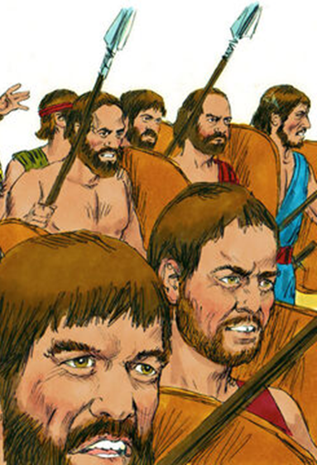
2. DEFEAT OF THE MIDIANITES AND DEATH OF BALAAM: Num. 31:8-24; 22:4-12; 25:16-18; Joshua 13:22; Jude 1:11
Twelve thousand faithful soldiers and their leaders only were armed for battle with the Midianites.
As they got to the battlefield, God proved Himself as the mighty Man in battle.
He fought on behalf of the children of Israel and defeated the Midianites. They slew all the kings of Midian.
During the course of the battle, Balaam also died (Numbers 31:8).

Slide 11
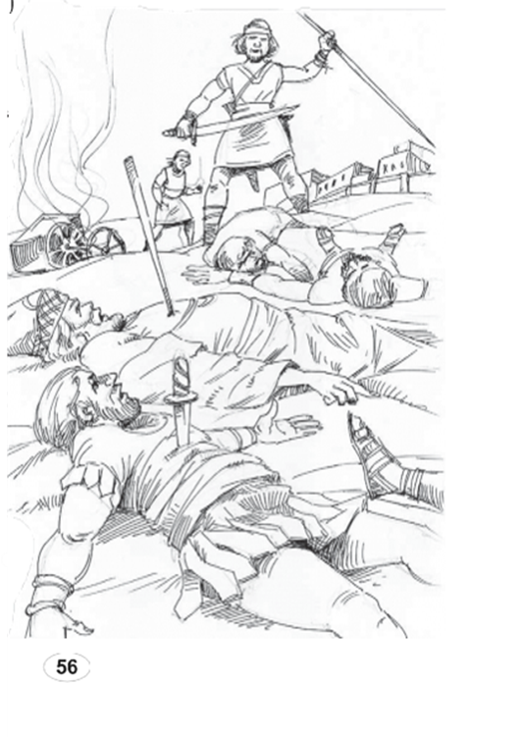
2. DEFEAT OF THE MIDIANITES AND DEATH OF BALAAM CONT’D.
Balaam was the soothsayer invited by the Moabites in agreement with the Midianites to curse the Israelites.
At the end of the battle, no single soldier of Israel died during the war (Numbers 31:49).
This is the proof that God was truly the One who fought for Israel and that He made the curse of Balaam on Israel to be of no effect.

Slide 12
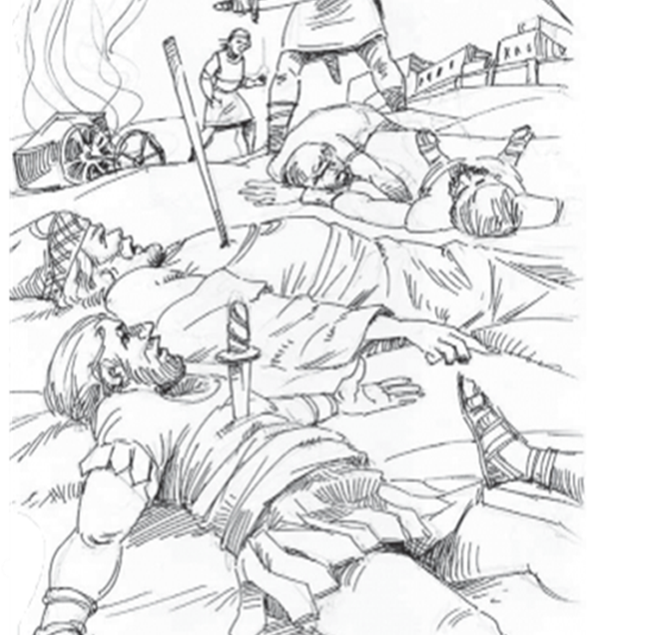
2. DEFEAT OF THE MIDIANITES AND DEATH OF BALAAM CONT’D.
If you trust in Jesus today, He will cancel every curse on you and turn it into a blessing.
Children of God are, however, not expected to fight physically with one another.
Physical fight against our brothers, sisters, neighbours and schoolmates is a sin against God.
Our fight today is against Satan, demons, sin and all sinful pleasures.
We are to fight with the weapons of prayers, holy living and the sword of the Spirit, which is the word of God (2 Corinthians 10:3-5).

Slide 13
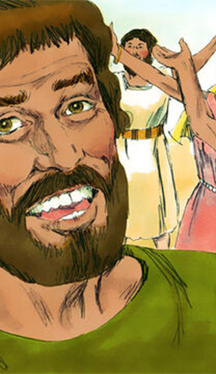
3. DUE REWARDS FOR FAITHFUL MEN OF WAR: Numbers 31:24-27,49-54
The men of war were obedient to the instructions God gave them through Moses.
They did not delay but went out to fight the enemies of God.
They willingly surrendered the spoils, animals, gold and silver they brought for the benefit of everyone.
They even gave part of the spoils of war to appreciate and thank God for keeping all of them alive in the battle (Num. 31:49-54).

Slide 14
3. DUE REWARDS FOR FAITHFUL MEN OF WAR CONT’D.
God counts purity of heart and holiness very important in our relationship with Him.
It is the only way we can remain useful to Him and keep our victory.
God rewarded them by keeping every one of them during the battle.
We have important lessons to learn from these men:
Victory comes from God; therefore, we must trust Him for help in all life battles.
We should give glory to God for every victory we have and
Give to Him willingly out of what He has given to us.

Slide 15
3. DUE REWARDS FOR FAITHFUL MEN OF WAR CONT’D.
All friends of Jesus are soldiers in the army of the Lord (2 Timothy 2:3,4).
God will give us victory over every temptation, sin and Satan; He will reward us with blessings here on earth and eternal home with Jesus in heaven if we obey His word daily.

Slide 16

QUESTIONS
Who were the Midianites?
What was their offence, which made God punish them?
What is the name of the soothsayer?
God will give us victory over all temptations, sin and Satan. Yes/ No
How can a sinful child have victory in all battles of life?

Slide 17
LESSON, THOUGHT & ACTIVITY
LESSON: God hates every act of wickedness and will punish disobedient and wicked children.
THOUGHT: I will turn away from every sin and be kind to others.
ACTIVITY: Mention three things you will do to have victory in Jesus.

Slide 18

CHORUSES:
In the name of Jesus
Keep me through Lord Jesus
There is mighty power in the blood.

Slide 19
REFERENCES
https://godswarplan.com/destruction-of-midian-numbers-31-balaams-donkey-vengeance-on-the-midianites-and-moabites
https://pixabay.com/illustrations/question-mark-question-response-1019993/
https://www.freebibleimages.org/illustrations/saul-amalekites/
https://www.freebibleimages.org/illustrations/moses-amalekites/
https://teachsundayschool.com/i/memoryverse/

