Slide 1
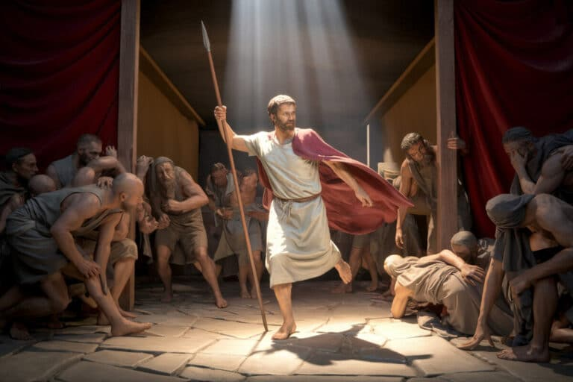
ISRAEL'S SIN AND THE ZEAL OF PHINEHAS TEXT: Numbers 28: 1-18

Slide 2

MEMORY VERSE
“But Jesus said unto them, A prophet is not without honour, but in his own country, and among his own kin, and in his own house. Mark 6:4

Slide 3
INTRODUCTION
The children of Israel were special people loved by God. They were descendants of Abraham, Isaac and Jacob.
God had special love and respect for them because of the uncommon obedience and the love Abraham showed to Him.
Abraham was even called a friend of God. As born-again children are called friends of Jesus today.
“And the scripture was fulfilled which saith, Abraham believed God, and it was imputed unto him for righteousness: and he was called the Friend of God” (James 2:23).
Are you a friend of Jesus?

Slide 4
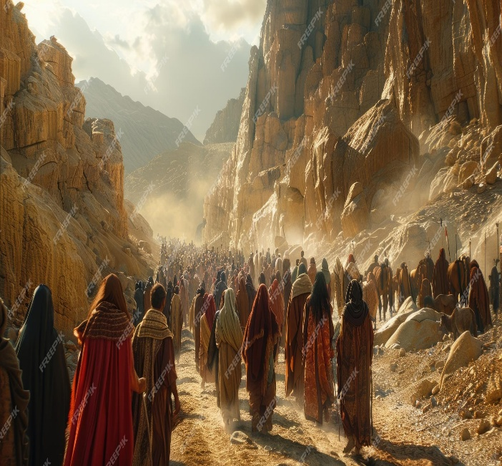
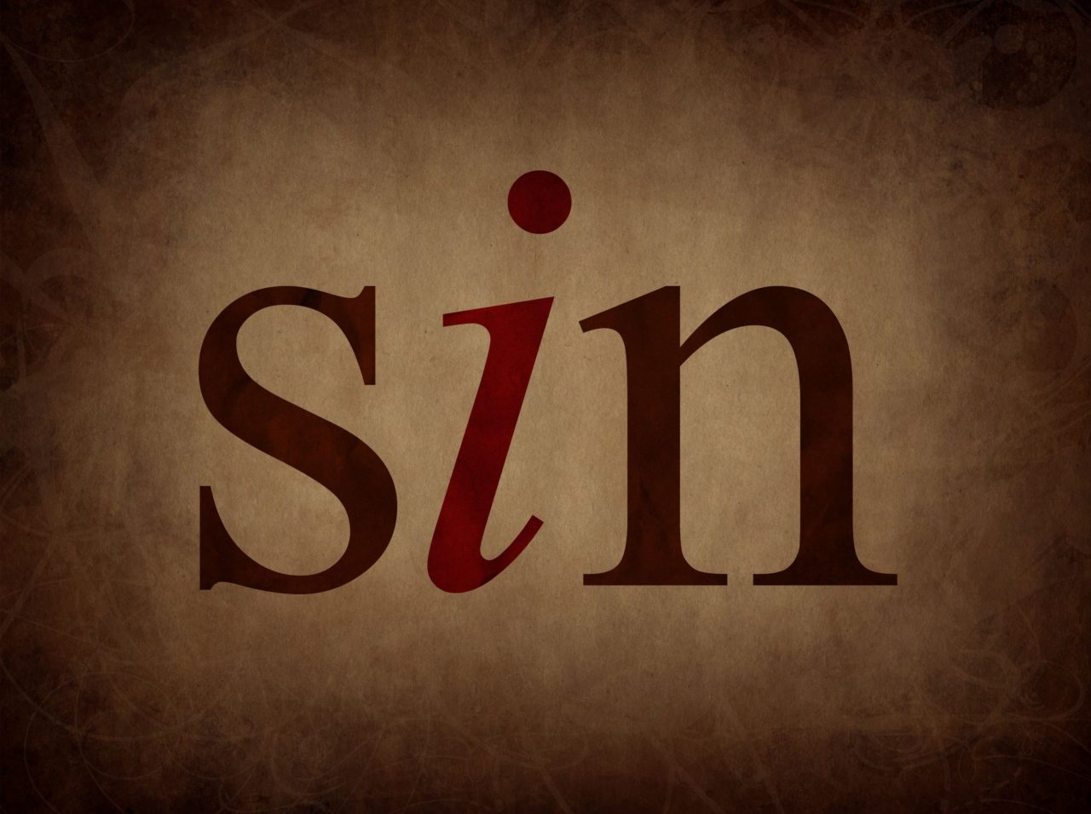
INTRODUCTION CONT’D.
As the children of Israel continued in their journey to the land of promise, where God was taking them to give them the best of everything, they were not like their father, Abraham.
Many times, they disobeyed and sinned against God. Their sin was so this time was so bad and disappointing.
They committed double sin of immorality and idolatry. However, there was a man who stood against the evildoers.
He defended God's righteous standard and was honoured. You, too, must stand against sin in your immediate environment.

Slide 5
Our study is in three parts:
1. ISRAEL’S DISOBEDIENCE TO GOD’S COMMANDMENT
2. INSTANT JUDGMENT ON THE DISOBEDIENT
3. IMPORTANT LESSONS FROM PHINEHAS’S EXAMPLARY ZEAL

Slide 6
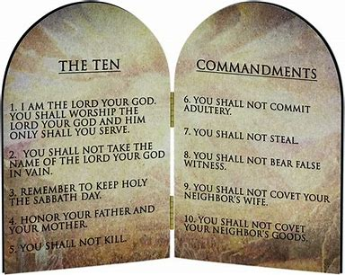
ISRAEL’S DISOBEDIENCE TO GOD’S COMMANDMENT: Num. 25:1-3,6; Exodus 20:14,3-5; 1 Corinthians 10:7,8
“Thou shalt not bow down thyself to them, nor serve them: for I the LORD thy God am a jealous God, visiting the iniquity of the fathers upon the children unto the third and fourth generation of them that hate God. me; Thou shalt not commit adultery" (Exodus 20:3,5,14).
These commandments were the direct words from God, which He wrote on two tablets of stone that He gave to Israel through Moses, their leader.
It was a very clear instruction that was repeated over and over in other books of the Bible.

Slide 7
ISRAEL’S DISOBEDIENCE TO GOD’S COMMANDMENT CONT’D.
Not long after receiving the commandments, the children of Israel forgot about it and went into immorality and idol-worship.
Immorality includes: fornication, adultery, prostitution or harlotry, Idolatry on the other hand is worshipping of man-made gods like carved woods, stones, images and evil spirits.
God hates these two sins. Anyone who commits immorality defiles and destroys his/her own body, which is the temple of God.
“Flee fornication. Every sin that a man doeth is without the body; but he that committeth fornication sinneth against his own body" (1 Cor. 6:18).
Idol worship is a mark of rebellion against the authority and the ownership of God over our lives.

Slide 8
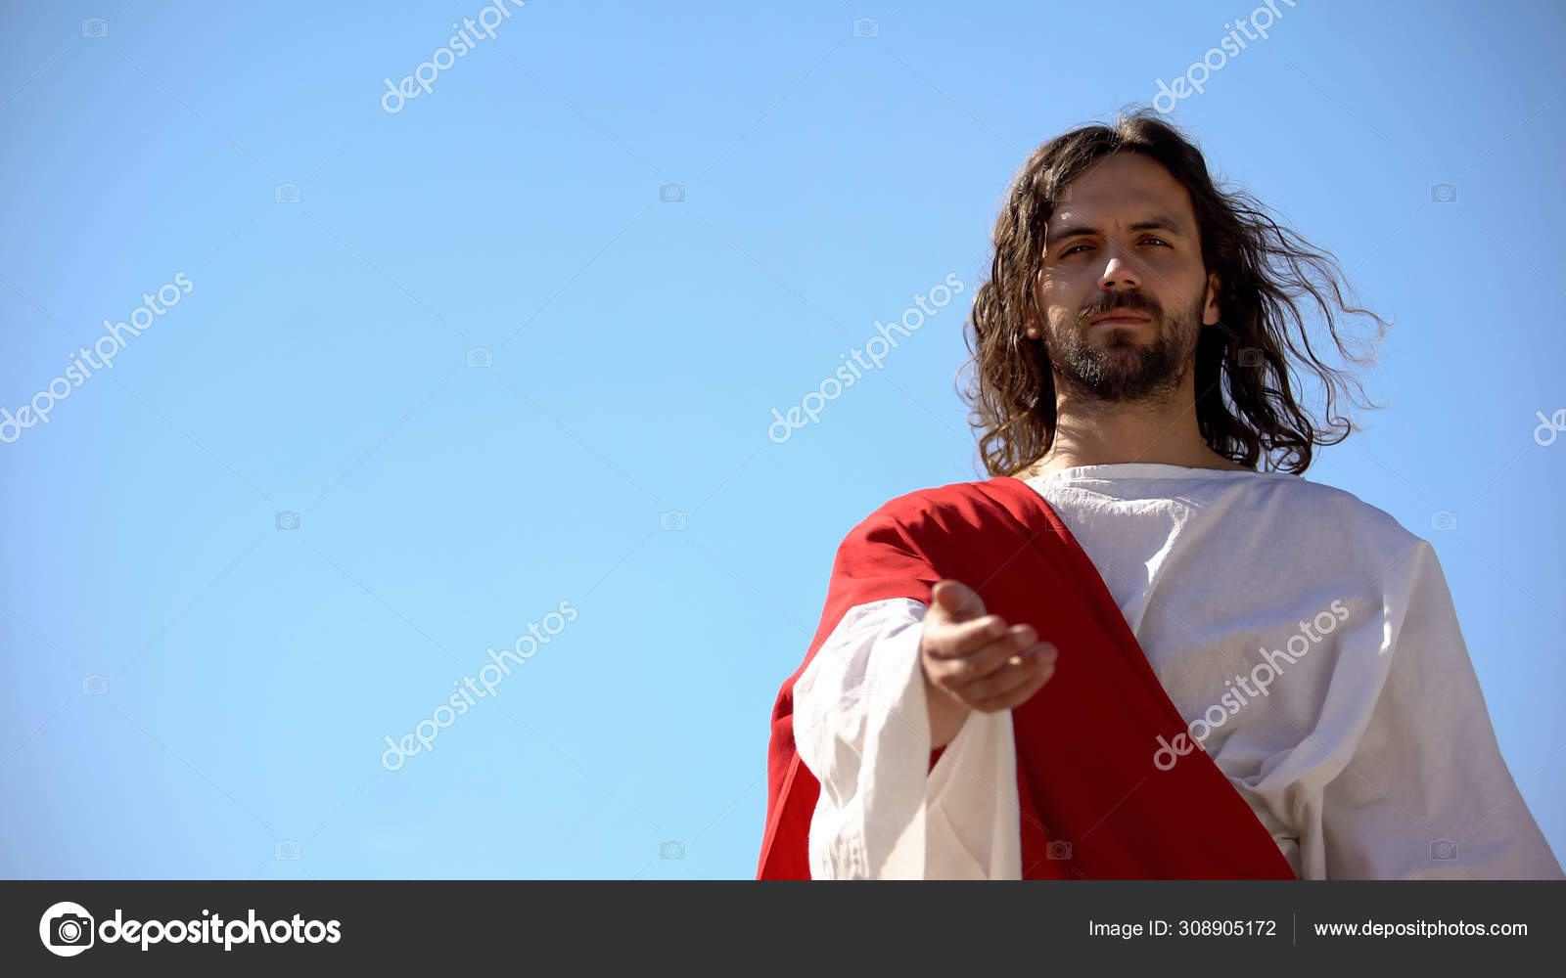
ISRAEL’S DISOBEDIENCE TO GOD’S COMMANDMENT CONT’D.
As Israel journeyed to the Promised Land, they came to Shittim, where they needed to stay for some time before they continued their journey.
There, they started committing immorality with the daughters of Moab.
They also joined those people to worship their idols, ate food sacrificed to those idols and bowed down to the idols of the people.
It was a very bad and grievous sin in the sight of God.

Slide 9

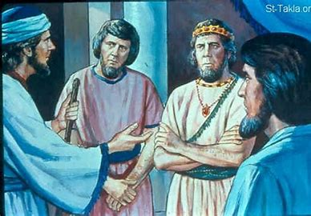
ISRAEL’S DISOBEDIENCE TO GOD’S COMMANDMENT CONT’D.
Before this time, Balaam had tried to curse the children of Israel, but he could not because God was with them. God protected them from the curses of Balaam.
So, Balaam counselled Balak, the king of Moab, to send the daughters of the land to entice the children of Israel to commit immorality. Israel yielded to the temptation and committed a great sin against the Lord.
A songwriter counselled, "Yield not to temptation, for yielding is sin."
The Bible says, "My son, if sinners entice thee, consent thou not" (Proverbs 1:10).

Slide 10
2. INSTANT JUDGMENT ON THE DISOBEDIENT: Numbers 25:3-9,14-18; 1 Corinthians 10:5-13; Jude 1: 5,11
Our God is a jealous God (Exodus 20:5). He hates sin, especially the sin of sexual immorality.
When Israel committed immorality, God was very angry with them.
“And the LORD said unto Moses, Take all the heads of the people, and hang them up before the LORD against the sun, that the fierce anger of the LORD may be turned away from unto the Israel. And Moses said judges of Israel, Slay ye every one his men that were joined unto Baalpeor” (Numbers 25:4,5).
Immediately, a plague (epidemic or mass death) broke out, and twenty-four thousand people died, apart from the two that were pierced through with the sword by Phinehas.

Slide 11
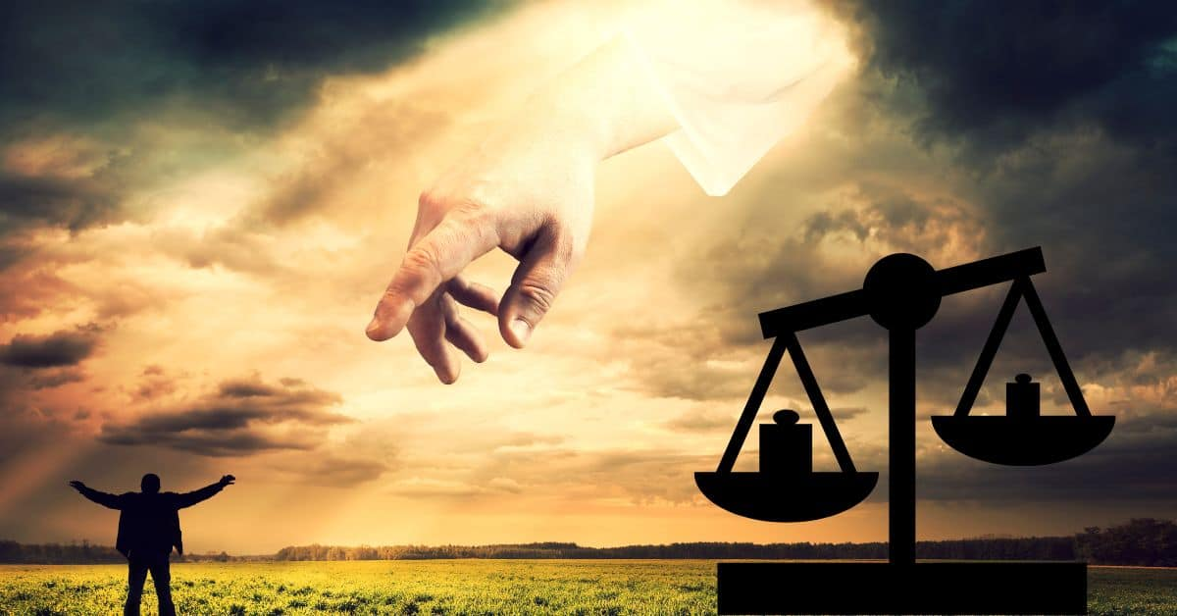
2. INSTANT JUDGMENT ON THE DISOBEDIENT CONT’D.
God always mete out judgment on sin wherever it is found. There are many cases and examples of God's judgment against sin in the Bible.
The ungodly and unbelieving people in the days of Noah (Genesis 6:6,7,12,13);
The people of Sodom and Gomorrah who were destroyed with fire because of the sin of immorality.
When the children of Israel spoke against God, He sent fiery serpents among them to bite them, and many people died (Numbers 21:5,6);

Slide 12
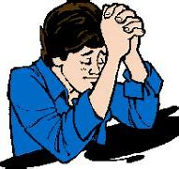
2. INSTANT JUDGMENT ON THE DISOBEDIENT CONT’D.
iv. Ananias and Sapphira sinned against God by lying and deceiving Apostle Peter; they fell down and died immediately (Acts 5:5,10).
All these examples of God's judgment are to warn us never to play with sin.
The only way to escape is to repent sincerely and give your heart to Jesus.
Such people cannot become friends of Jesus except they repent of their sins.

Slide 13
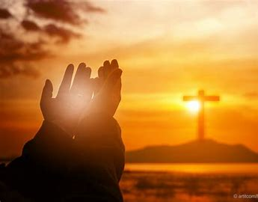
2. INSTANT JUDGMENT ON THE DISOBEDIENT CONT’D.
Are you one of those children that engage in practice, boyfriend and girlfriend, watching pictures of naked people on the internet or on the handset, allowing boys to touch your body in a sinful way, exposing your body for men and women to lust after you, wearing short skirts or short knickers to show your nakedness?
Repent today before it is too late. Pray and ask God for forgiveness and cleansing through the blood of Jesus.
Turn away from all sins and accept Jesus Christ as your personal Saviour and Lord.

Slide 14
3. IMPORTANT LESSONS FROM PHINEHAS' EXEMPLARY ZEAL: Numbers 25:7-13
Zeal is the passion, eagerness, enthusiasm or interest to do something.
Phinehas was the son of Eleazar the priest and grandson of Aaron (Exodus 6:25).
He later became a priest like his father (Joshua 22:13,30,31). Phinehas loved God and hated sin. Are you like that?
When he saw one of the children of Israel who brought in a strange woman in the sight of Moses and all the congregation to commit sexual immorality with her, he could not bear it.
Phinehas was angry against sin (Ephesians 4:26). He took a javelin in his hand, went after that man of Israel and the woman of Midian and pierced them both through.

Slide 15
3. IMPORTANT LESSONS FROM PHINEHAS' EXEMPLARY ZEAL CONT’D.
Then God's anger was taken away from the people.
But today, we are not to kill sinners; we are to preach the gospel to them and pray for them to be saved.
That man of Israel and his girlfriend were so bold and corrupt to continue in their sin even in the presence of Moses, the man of God, while other Israelites were weeping.
There are many children like that today. They are not afraid to do evil, fight, tell lies or even abuse an adult to his/her face.
Be very careful. God's judgment can come at any time as it came to those people.

Slide 16
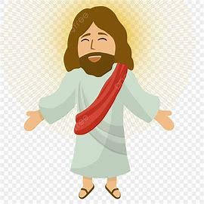
3. IMPORTANT LESSONS FROM PHINEHAS' EXEMPLARY ZEAL CONT’D.
God rewarded Phinehas for his heroic deed. God was happy with him (Numbers 25:11).
The plague stopped immediately. God gave Phinehas a covenant of peace. "Wherefore say, Behold, I give unto him my covenant of peace" (Numbers 25:12).
This is the kind of peace God gives a child that genuinely turns away from wickedness and bad lifestyle and receives Jesus Christ as his/her personal Saviour (Romans 5:1).

Slide 17

3. IMPORTANT LESSONS FROM PHINEHAS' EXEMPLARY ZEAL CONT’D.
Do you want the peace of God like a river in your heart?
Many children have no peace. They have bad dreams, fear of hell, fear of death and fear of Satan.
But you can receive the peace Jesus gives today. "Peace I leave with you, my peace I give unto you: not as the world giveth, give I unto you. Let not your heart be troubled, neither let it be afraid" (John 14:27).
You can have this peace of God if you truly turn away from all your wicked and sinful ways and invite Jesus Christ into your heart now.

Slide 18
3. IMPORTANT LESSONS FROM PHINEHAS' EXEMPLARY ZEAL CONT’D.
In many other villages, cities, or countries that Jesus entered, He performed many more miracles, and He continues to do the same today.
The greatest miracle you can receive is the salvation of your soul. His power has not changed.
Hebrews 13:8 says, “Jesus Christ same yesterday, and today and forever”.
If you are not saved yet, come to Jesus now, believe His word, repent and surrender your life to Him.

Slide 19

QUESTIONS
(a) What is immorality? (b) Anybody who commits sexual immorality defiles and destroys ______________________________
Why did Balaam counsel Balak, the king of Moab, to send the daughters of the land to entice the children of Israel?
How did God punish the children of Israel for their sin?
Who was the priest that defended God's righteous standard in our study?
What should a sinful child do to escape God's judgment?

Slide 20
LESSON, THOUGHT, ACTIVITY & CHORUSES
THOUGHT: I will not sin against God.
ACTIVITY: Search the scripture and write out five (5) places in the Bible where God warned His children not to commit immorality
CHORUSES:
I will never let the devil win the battle
My body is the temple of the Holy Spirit
One day be one day.
LESSON: Sin is dangerous and destructive.

Slide 21
REFERENCES
https://pluspng.com/ten-commandments-png-hd-7501.html
https://www.freepik.com/premium-ai-image/moses-leads-jews-through-desert-biblical-journey-promised-land-sinai-religious-historical-escape-narrated-bible-showcasing-moses-leadership-divine-intervention-israelite-exodus_150437664.htm
https://i.ytimg.com/vi/28UzzKrwDpQ/maxresdefault.jpg
https://st-takla.org/Gallery/var/albums/Bible/Illustrations/Bible-Slides/OT/04-Numbers/www-St-Takla-org--Bible-Slides-numbers-495.jpg?m=1419425495
https://png.pngtree.com/png-clipart/20190515/original/pngtree-jesus-god-god-crucifixion-png-image_3966930.jpg
https://i.ytimg.com/vi/5esaAShEOt4/maxresdefault.jpg

