Slide 1
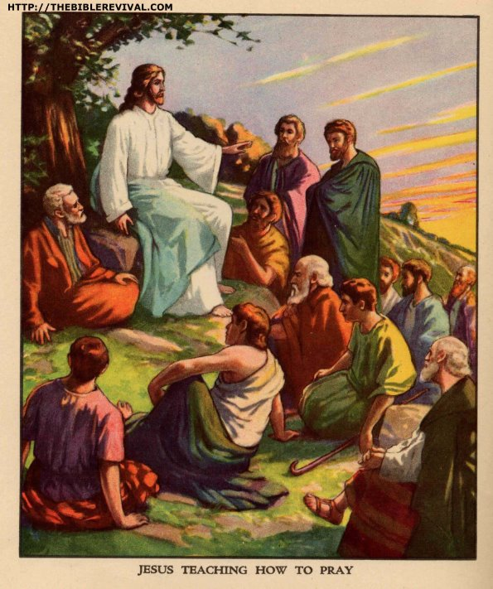
JESUS TEACHING ON FORGIVENESS, FAITH AND GRATITUDE

Slide 2
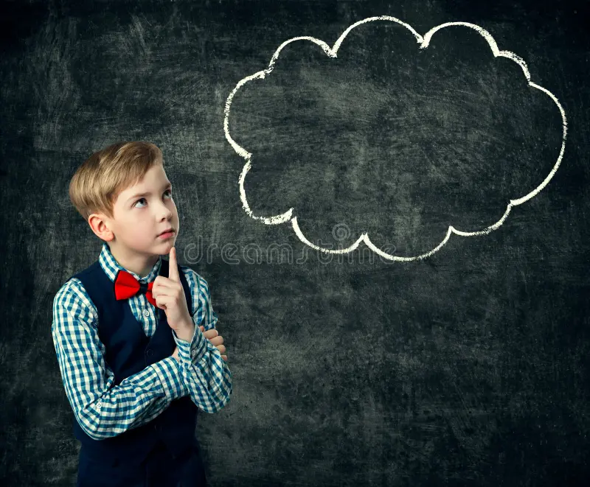
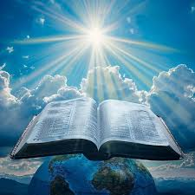
MEMORY VERSE:
“Take heed to yourselves; if thy brother trespass against thee, rebuke him; and if he repent, forgive him” (Luke 17:3)
TEXT: Luke 17:1-19

Slide 3
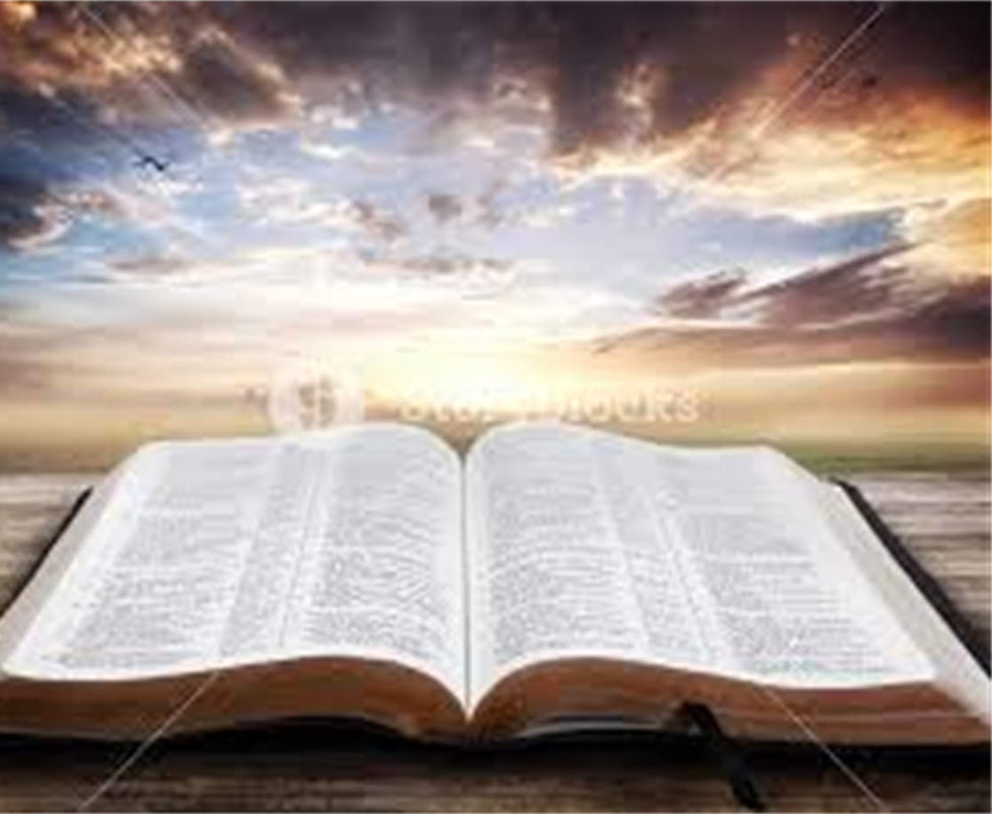
INTRODUCTION
Our main Bible passage for this study reveals Christ’s command on three areas of the Christian life
They are important virtues that we must cultivate in order to maintain a close walk with God and good relationship with one another.

Slide 4
INTRODUCTION CONT’D.
These three arears are:
Forgiveness — This is the act of forgiving an offender. It is to let go of offences in order to enjoy peace and maintain a conscience free of offence toward God and men (Acts 24:16).
Faith — This is defined as the substance of things hoped for the evidence of things not seen. It simply means trust in God a word (Hebrews 11:1).
Gratitude — It is a show of appreciation for favour received.

Slide 5
OUR STUDY IS IN THREE PARTS:
1
CHRIST'S COMMAND ON FORGIVENESS OF OFFENCES
2
CALL TO HAVE FAITH IN GOD
3
COMMITMENT TO A LIFE OF GRATITUDE TO GOD

Slide 6
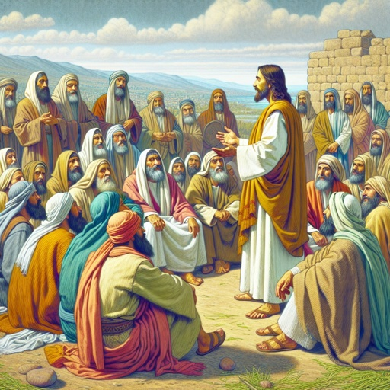
CHRIST’S COMMAND ON FORGIVENESS OF OFFENCES: Luke 17:1-4; Genesis 50:17-21; Matthew 6:12,14,15; Mark 11:25,26
In normal human relationships, there is bound to be occasions where we offend one another
There are times of misunderstanding and disagreements on some issues
Jesus commands that we learn to forgive one another. However, He cautioned that offences should not be deliberate

Slide 7
CHRIST’S COMMAND ON FORGIVENESS OF OFFENCES CONT’D.
You must not make others angry and then expect forgiveness because it is commanded.
When somebody offends you and becomes sorry for what he has done, you must make peace by forgiving such an offender.
Always remember that we can only receive grace to forgive when we receive forgiveness from God
He sent Jesus Christ, His only begotten son to die on the cross for our offences

Slide 8
CHRIST’S COMMAND ON FORGIVENESS OF OFFENCES CONT’D.
If you are still a sinner, you must first seek forgiveness from God.
Repent and ask for pardon and cleansing of your sins with the blood of Jesus;
your cleansed heart will now receive grace to forgive those who will offend you.
We are commanded to forgive as many times as possible. His grace is sufficient to help us.

Slide 9
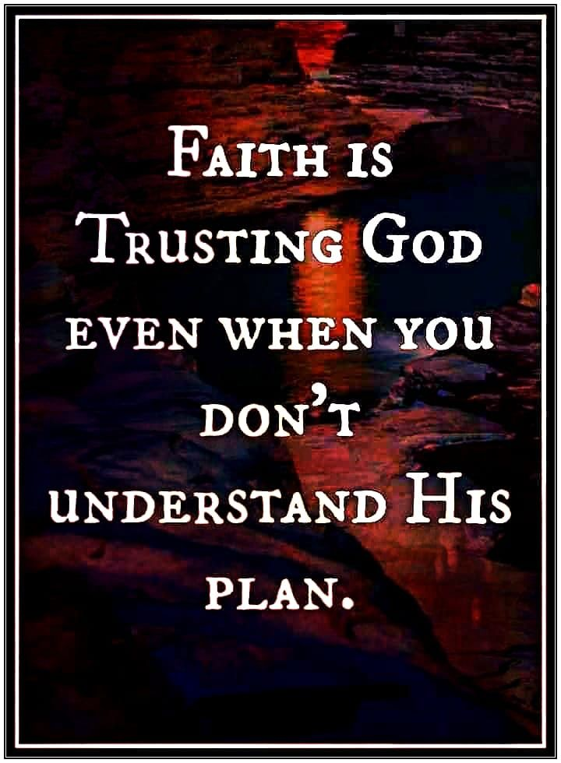
2. CALL TO HAVE FAITH IN GOD: Luke 17;5-10; Mark 11:20-24; Hebrews 11;1-6
Faith has been described as Forsaking All I Trust Him (Christ)
To have faith in God, you must forsake all negative thoughts like fear, doubts and unbelief, and put your trust in Christ alone
The Bible confirms that without faith it is impossible to please God

Slide 10
2. CALL TO HAVE FAITH IN GOD CONT’D.
Those who seek Him must believe He is real and a Rewarder of those who diligently seek Him
Faith is the basis of our relationship with God
This is why Jesus encouraged us to have faith in God

Slide 11
2. CALL TO HAVE FAITH IN GOD CONT’D.
Jesus makes it so simple for us by emphasising the fact that :
Even if our faith is as tiny as a grain of mustard seed, it will achieve great things
A little faith is all you need to move mountains and root out every stubborn problem
To develop faith in God, you must make His word your companion

Slide 12
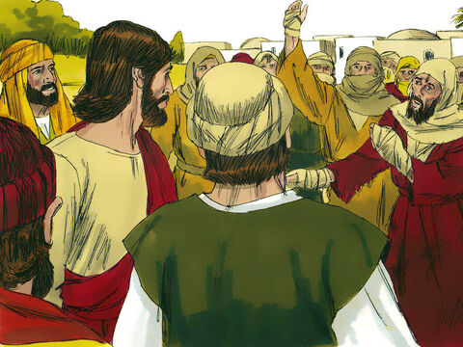
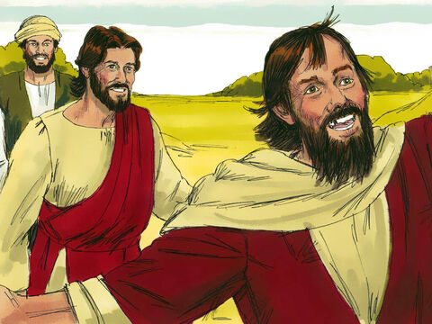
3. COMMITMENT TO A LIFE OF GRATITUDE TO GOD: Luke 17:11-19; Ps 103; 1, 2; 105:1-3; 107:1,2
In the last part of our Bible passage, Jesus came across a group of ten lepers. He sent them to the priest even before they were healed and they went.
They responded in faith and Jesus healed them on the way.
Is your trust in God strong enough for you to act on what He says even before you see the evidence? Have faith in God.

Slide 13
3. COMMITMENT TO A LIFE OF GRATITUDE TO GOD CONT’D.
The lesson here is not so much about the healing, but about the expected attitude of gratitude from the healed lepers.
One of the ten lepers seeing that he had been healed, retuned to Jesus and thanked him and showed his gratitude
Jesus was happy for appreciating Him and He confirmed his healing to be permanent (Luke 17:17-19)

Slide 14
3. COMMITMENT TO A LIFE OF GRATITUDE TO GOD CONT’D.
Children must always appreciate the kindness and love people show to them, no matter how little it may be.
You must show love, kindness and appreciation to people who help in providing your necessary needs
Jesus will always affirm and confirm His blessings in your life
Always remember that gratitude produces a deeper and greater form of blessings and healing

Slide 15
3. COMMITMENT TO A LIFE OF GRATITUDE TO GOD CONT’D.
Super abundant blessings await boys and girls who obey willingly and live by the teaching of the holy word of God from the heart.
Supernatural blessings of salvation, sanctification- holy living, Spirit-filled, inspired and controlled life, power from above to do exploits, great and wonderful things will be showered upon you.

Slide 16
LESSON, THOUGHT, ACTIVITY
LESSON: Clear conscience with show of gratitude are open doors to greater and higher blessings
THOUGHT: I must forgive wholeheartedly and show gratitude to God
ACTIVITY: Children should spend some time to praise and thank God for the blessings they have received so far

Slide 17
CHORUSES
Give me love for my brethren
Have faith in God, all things are possible
I am saying thank you Jesus, thank you, my Lord

Slide 18

QUESTIONS!
What do you learn from Jesus’ teaching on forgiveness?
What is faith?
Can your little faith do great things for Jesus? Yes/No
What can you learn from the leper who showed appreciation to Jesus?
Name at least three blessings for children who forgive

