Slide 1
JOHN’S WITNESS CONCERNING CHRIST
TEXT: John 1:1-34

Slide 2
MEMORY VERSE
“The next day John seeth Jesus coming unto him, and saith, Behold the Lamb of God, which taketh away the sin of the world“ (John 1:29).

Slide 3


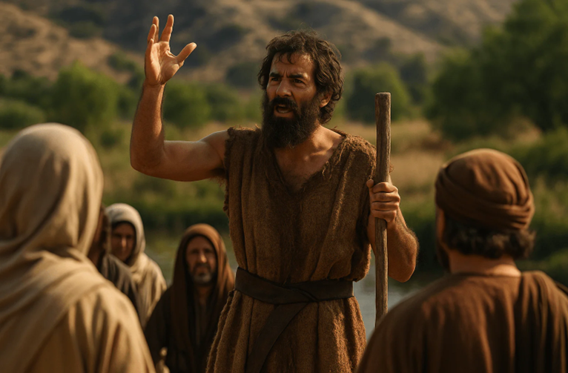

INTRODUCTION
“There was a man sent from God, whose name was John. The same came for a witness, to bear witness of the Light, that all men through him might believe” (John 1:6,7).
This Bible passage speaks about John the Baptist, the forerunner of Jesus Christ.
A forerunner is someone who prepares the way, lays the foundation or announces the work of another person who is greater than him.

Slide 4
INTRODUCTION CONT’D.
For over 400 years, between Malachi and the New Testament, the nation of Israel had not heard the voice of a prophet. Then John appeared.
The Old Testament prophet Isaiah had prophesied about his coming.
“The voice of him that crieth in the wilderness, Prepare ye the way of the LORD, make straight in the desert a highway for our God” (Isaiah 40:3).

Slide 5
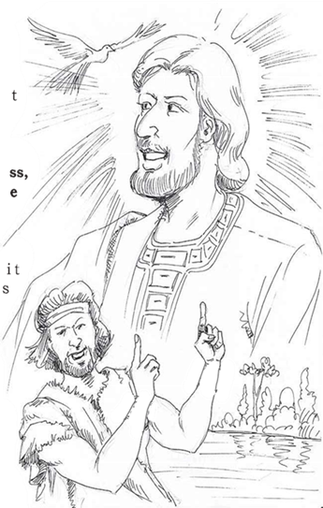
INTRODUCTION CONT’D
In ancient times, when it was known that a king was coming, an effort was made to ensure that the road was smooth, so that the king could travel easily and quickly.
In a spiritual sense, John the Baptist, as the true witness for the Messiah, was ordained to prepare the way for the Lord through the message of repentance.

Slide 6
INTRODUCTION CONT’D
Those who responded to John's call for repentance humbled themselves, confessed their sins, gave up their wicked ways, and spiritually opened “the way” for the Messiah to take hold of their hearts and lives.
Today, friends of Jesus are called and commissioned to be witnesses of Christ's power to save and set free from sin and its consequences.

Slide 7

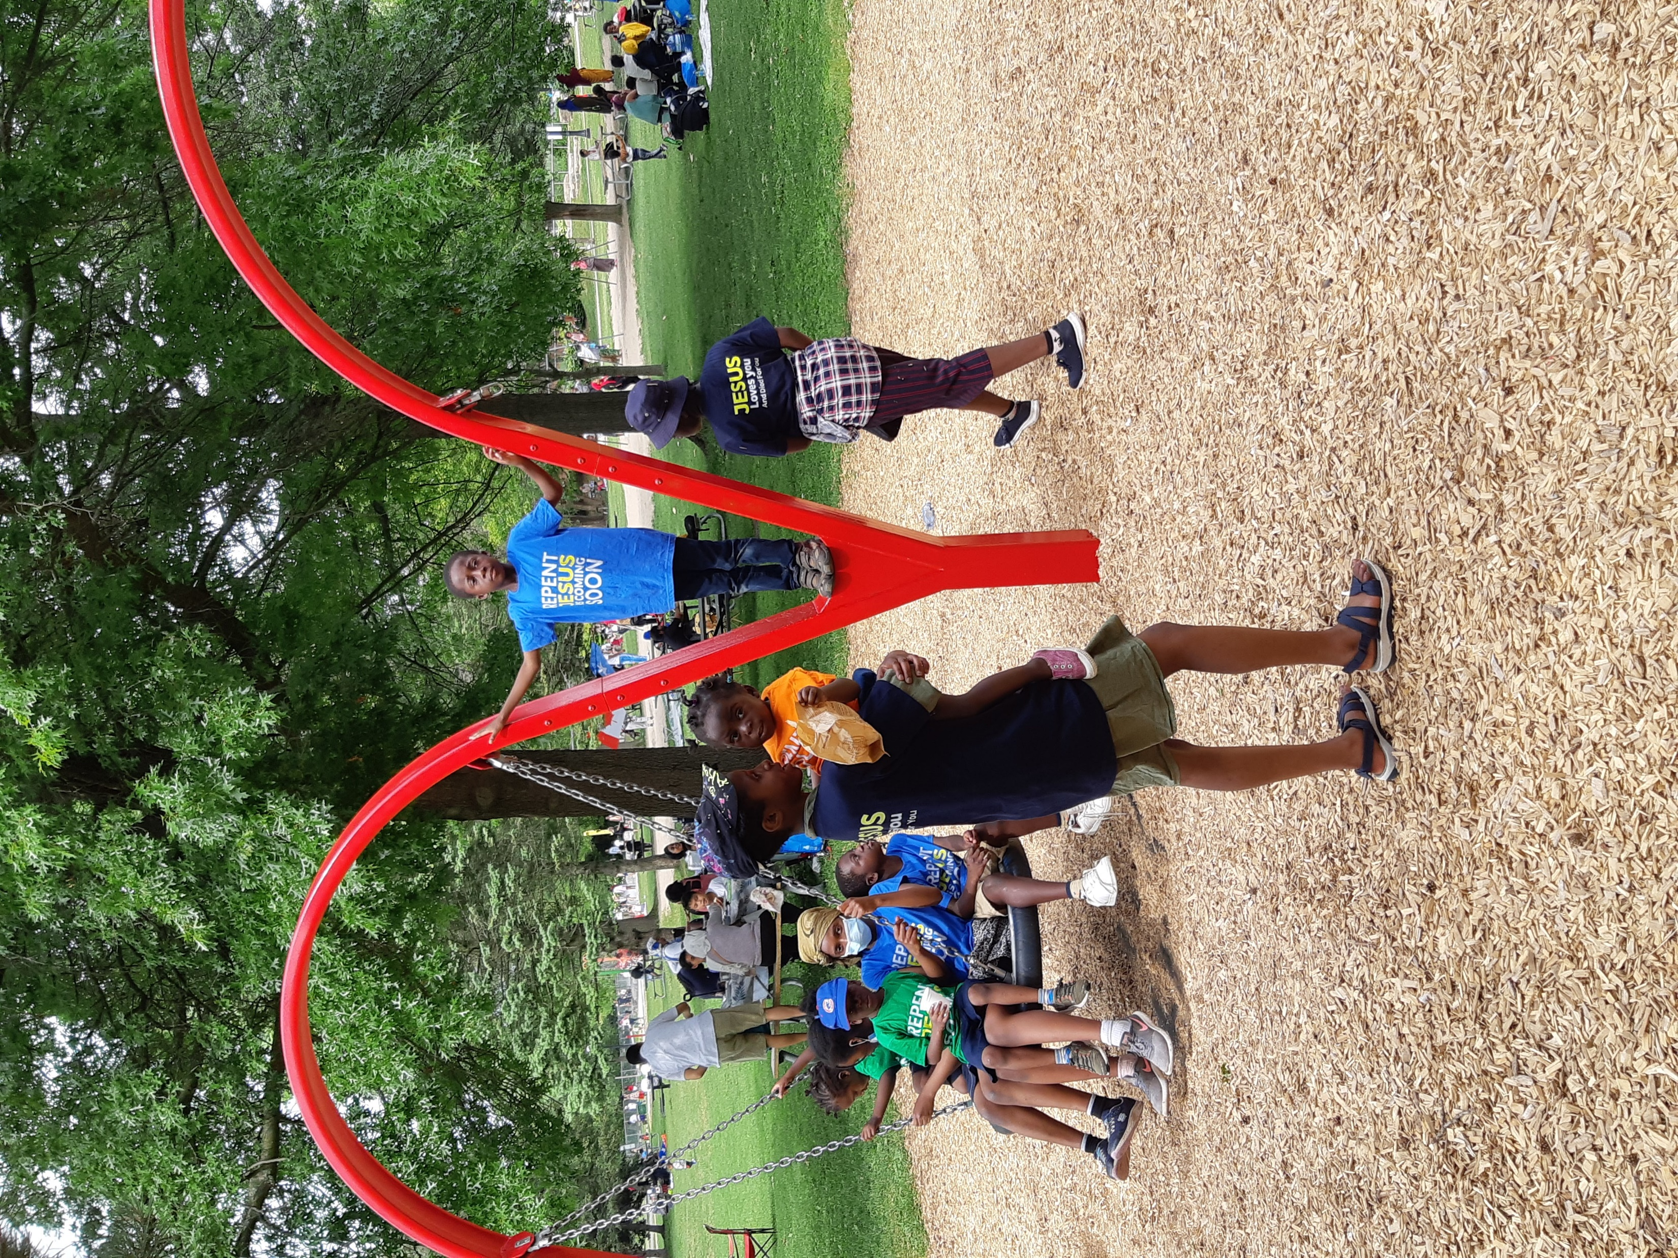
INTRODUCTION CONT’D
Jesus' coming is very near. We are to go out and preach the gospel of repentance so that sinners will be prepared for the rapture.
Follow the example of John the Baptist by becoming a true witness for Christ.
If you are still a sinner, repent, turn from your bad ways and accept Jesus Christ as your personal Saviour and Lord.
Our passage reveals some important truths about Jesus Christ, the focal point of John's ministry and the entire gospel message.

Slide 8
The three (3) points to consider are:
1. THE WORD BECAME FLESH
2. THE WITNESS AND FORERUNNER OF JESUS CHRIST
3. THE WAY TO JESUS, THE LAMB OF GOD

Slide 9
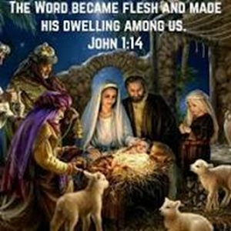
Point 1. THE WORD BECAME FLESH:
John 1:1-5, 9-14
"And the Word was made flesh, and dwelt among us, (and we beheld his glory, the glory as of the only begotten of the Father,) Full of grace and truth” (John 1:14).
In John's gospel, Jesus is called the Word.
This Word of God is the living and active Agent of God, which existed before creation and was the means by which God created everything.

Slide 10
THE WORD BECAME FLESH CONT’D.
He is not just with God; He is God. Though distinct from the Father, He is inseparably One with Him (John 1:1-3).
He is the Source, not only of physical life but also of the full and spiritual life that God desires people to have.
He brings the light of God unto the world, which the darkness caused by sin cannot put out (John 1:4,5).
When a person writes or speaks, the words he uses are really part of himself.
They may have been in his mind for years, but they remain unknown unless he writes or speaks them.

Slide 11
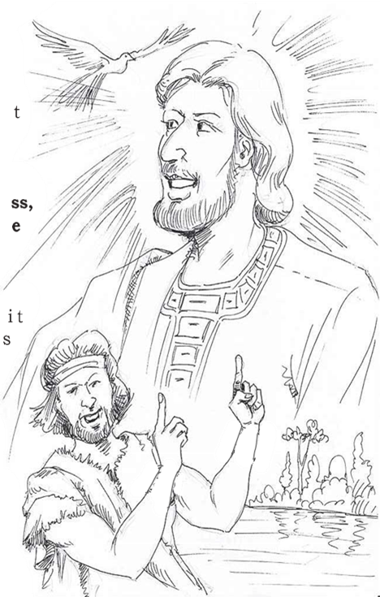
THE WORD BECAME FLESH CONT’D.
As long as the eternal Word remained with God, it was hidden and unknown; but when God became a human being in the person of Jesus Christ, the Word could be seen and heard by all (John 1:14).
Although John was born before Him, Jesus existed before John because He is the eternal Word.
The One who has always existed as God now took upon Himself the human form and made God known to humankind by supplying grace and truth to meet all their needs (John 1:15-18).

Slide 12

THE WORD BECAME FLESH CONT’D.
Jesus Christ, the eternal Word, humbled Himself, came into the world to save us from our sins and restore us to fellowship with God the Father.
As many that will receive Him will become children of God.
Are you a child of God?
As a sinner, you must repent, confess your sins to Him, ask for forgiveness and cleansing through the blood that He shed on the cross at Calvary.
When you sincerely take these steps, you become a friend of Jesus and a child of God.
Then you must step out and share the love of Jesus with sinners around you as a true witness of His saving power.

Slide 13
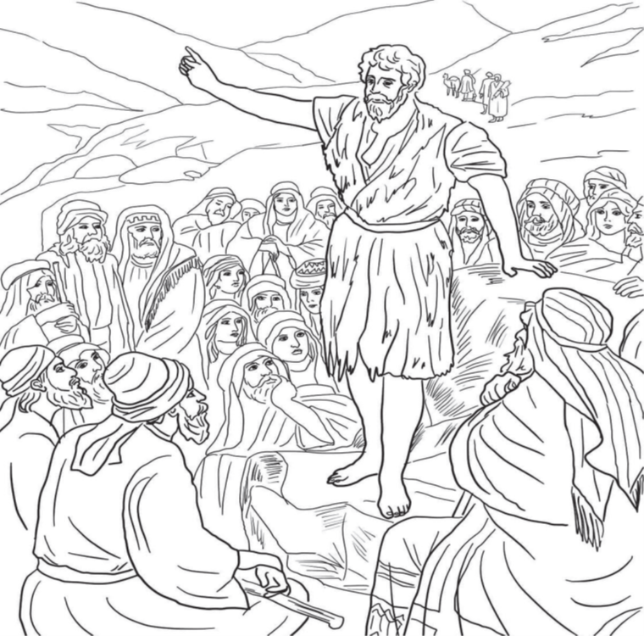
2. THE WITNESS AND FORERUNNER OF JESUS CHRIST: John 1:6-8,15-34; Matthew 3: l- 12; Luke 1:5-17; 3:1-17
John the Baptist was the forerunner of Jesus Christ and a preacher of righteousness.
John lived in the wilderness before God called him to preach the message of repentance.
John's message of repentance and baptism was God's way of preparing Israel for the coming of the Messiah — the Lord Jesus Christ.

Slide 14
2. THE WITNESS AND FORERUNNER OF JESUS CHRIST CONT’D.
He preached in the wilderness of Judea (Matthew 3:1), and a measure of revival began to take place.
People from surrounding villages were affected by John's preaching, and many were baptized in the Jordan River.
There are some significant lessons in the life of John the Baptist as a true witness of our Saviour.
  He was fearless, sharp and clear in his preaching. His boldness in preaching was much like the approach of Elijah.
  As friends of Jesus, we must preach the gospel with boldness and the power of the Holy Spirit.

Slide 15
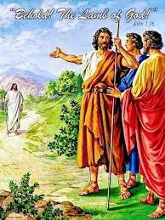
PT 2 CONT’D.
  ii. He was humble and holy. He rejected and separated himself from all worldly influences.
  He consecrated his life to fulfil the purpose of his birth.
  To serve God acceptably, Christian boys and girls must run away from sin and worldly affairs, live a holy life and be determined to serve God all through their lives.
  ii. He made Jesus Christ the central focus of his life and ministry.
  He did not allow the people to equate him with the Messiah.
  He declared that Jesus would come to save us as the Lamb of God and baptize with the Holy Ghost.

Slide 16
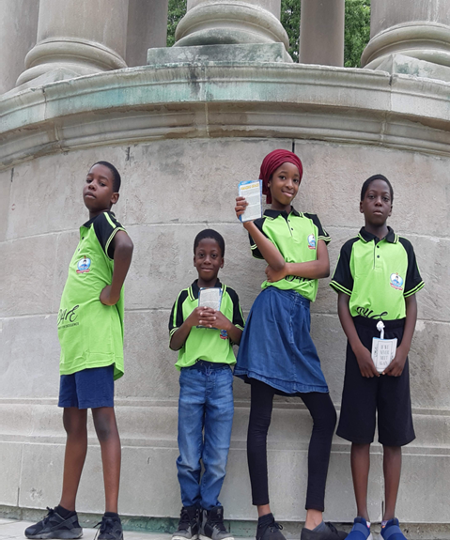
2. THE WITNESS AND FORERUNNER OF JESUS CHRIST CONT’D.
The word of God commands us to preach the gospel to every creature.
We must obey this important command and spread the love of Jesus to sinners, starting from our immediate environment.

Slide 17

3. THE WAY TO JESUS, THE LAMB OF GOD: John 1:35-51; 14:6
Through John's witness and proclamation, some of his disciples followed Jesus and became His friends.
Jesus is the Lamb who was sacrificed in place of sinners.
By His death, Jesus provided for the removal of the guilt and power of sin and opened the way to God for everyone

Slide 18
3. THE WAY TO JESUS, THE LAMB OF GOD CONT’D.
The disciples did not sit back; they took the step of faith to go to Jesus.
One by one, they all came, accepted His message of love and were saved.
Thereafter, they worked with Him and became the foundation of the New Testament church. Now they are in Heaven

Slide 19
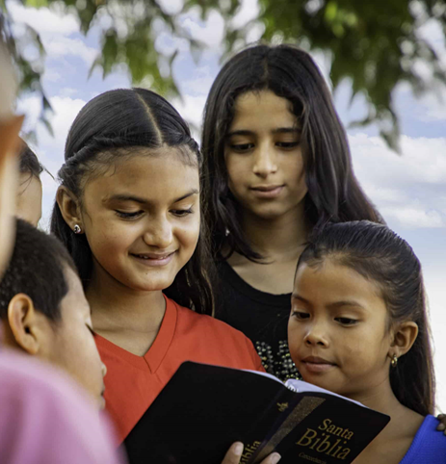
3. THE WAY TO JESUS, THE LAMB OF GOD CONT’D.
The way is still open for every boy/girl who would come.
Jesus is the Way, The Truth and the Life.
Come to Him now, repent and accept Him as your personal Saviour and Lord.
Then commit your life to His service.
Abundant rewards await you both here on earth and in heaven.

Slide 20

QUESTIONS:
Who is the Word that became flesh?
What is the purpose of Christ's coming into the world?
What should a sinner do to benefit from Christ's sacrifice?
Who was the forerunner of Jesus?
How should forerunners of Jesus witness for Him?

Slide 21

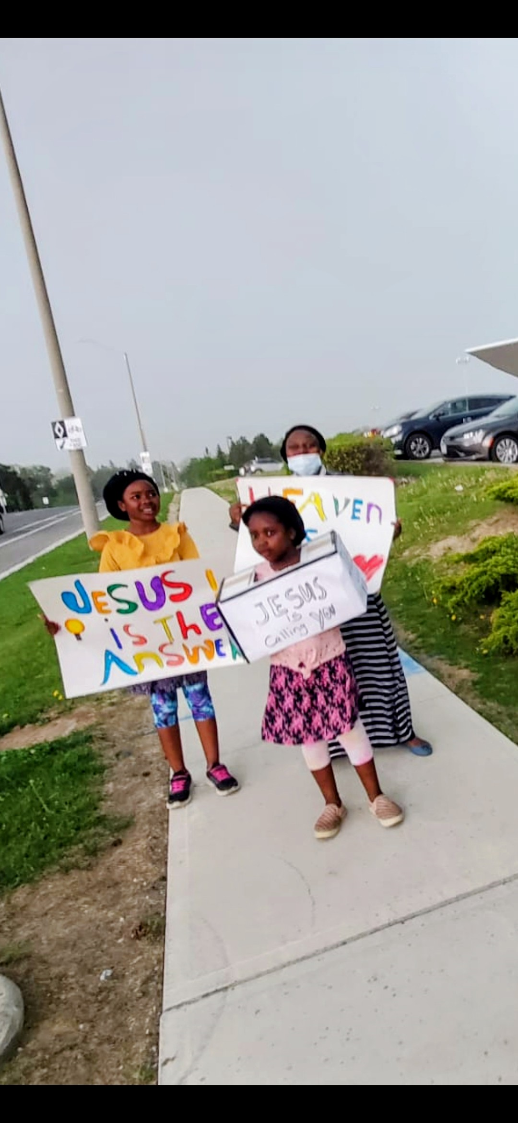
LESSON, THOUGHT & ACTIVITY
LESSON: God loves true witnesses.
THOUGHT: I will tell others about Jesus.
ACTIVITY: Children should be encouraged to go out during the week and witness about Christ

Slide 22
CHORUSES & HOMEWORK
CHORUSES
HOMEWORK
Jesus the Way, the Truth and the Life
Come to J.E.S.U.S, J.O.Y will follow
It is good to serve the Lord.
Write in your homework notebook the names of John the Baptist's parents.

Slide 23
REFERENCES
https://watermarkwaves.com/blogs/explore-the-bible/10-interesting-facts-about-john-the-baptist-in-the-bible
https://www.facebook.com/groups/cowboysforchrist/posts/24459312536987853/
https://blog.compassion.com/quotes-about-sharing-the-gospel/
https://learningiscreated.org/product/sharing-the-gospel/
https://unashamedofjesus.org/2015/12/09/word-became-flesh-2/
https://www.lightstock.com/photos/boy-praying-to-god-at-home-world-day-of-prayer-international-day-of-7781e630-80a9-4f80-9d37-e7c4c32ed802
https://www.mvmediation.org/blog/conflict-resolution-ideas-day-44

