Slide 1
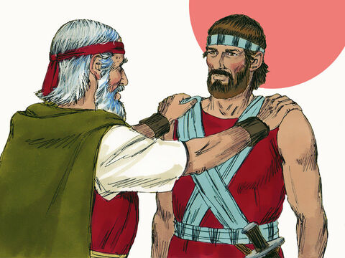
LAW OF INHERITANCE AND THE APPOINTMENT OF JOSHUA
TEXT: Numbers 27:1-23; 36:1-13
MEMORY VERSE
“And they said, The LORD commanded my lord to give the land for an inheritance by lot to the children of Israel: and my lord was commanded by the LORD to give the inheritance of Zelophehad our brother unto his daughters” (Numbers 36:2).

Slide 2

INTRODUCTION
Inheritance refers to properties, especially landed properties, passed on from parents to their children.
The first part of our Bible passage shows a very important aspect in God's relationship with His chosen people - Israel.
In ancient times, the law permitted only male children to inherit the properties of the family
This is because the male children are regarded as those who would remain in the family to continue the family name and legacy.

Slide 3
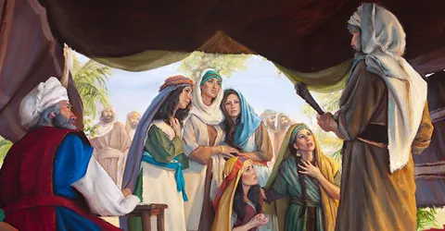
INTRODUCTION CONT’D
The female child was expected to grow up and marry, becoming a member of another family.
As the children of Israel were about to enter the Promised Land, there were preparations to share the land among the male children of the various families and tribes.
Now, there was a case of a man named Zelophehad who had no sons but five (5) wonderful daughters. This meant that there would not be any inheritance to his name.
This was the reason the daughters took the matter to Moses, their leader.

Slide 4
INTRODUCTION CONT’D
They did not question God or gossip about their leader. They humbly made their request known to Moses, who in turn took everything to God in prayer
Whenever you are confused about a matter or confronted with any problem, share it with your godly parents, teachers and pastors. Then pray and believe God for a solution.
The latter part of the passage was the revelation of the soon-coming death of Moses and the need to choose a capable leader.
God spoke directly to Moses, and all the matters were settled to the glory of God and to the growth of His work.
The important lesson here is the need to obey God in all matters of life. Obedience is the key to God's blessings as we journey through this life

Slide 5
We shall consider the following:
1. GENUINE REQUEST OF ZELOPHEHAD'S DAUGHTERS
2. GOD’S ANSWER TO MOSES’ PRAYER
3. GUIDANCE ON THE CHOICE OF A WORTHY LEADER

Slide 6
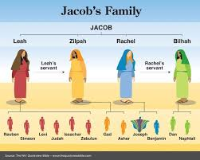

GENUINE REQUEST OF ZELOPHEHAD'S DAUGHTERS: Num. 27:1- 5; 36:1-13; Joshua 17:3-6; Matthew 7:7-11
Zelophehad was from the tribe of Manasseh, the descendants of Joseph.
He had five daughters whose names were Mahlah, Noah, Hoglah, Milcah and Tirzah. Their father had died during the wilderness journey.
Now, the Promised Land before them to be possessed. Therefore, the daughters of Zelophehad became concerned about their father's family losing out on the inheritance.
They were very thoughtful and concerned about preserving their family name and values.

Slide 7
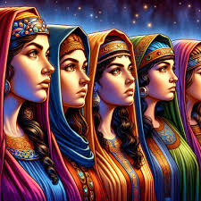
GENUINE REQUEST OF ZELOPHEHAD'S DAUGHTERS CONT’D.
This is a lesson for all children of God who have been brought up with the word of God. They must seek to preserve their spiritual heritage and stand for holiness and godly standards.
The daughters of Zelophehad did not go to seek the opinion of people around; neither did they cause confusion among the people.
They went directly to God's appointed leader to seek help.
Moses had no immediate solution to the request of the daughters of Zelophehad, as there had been no laid down rule concerning the issue.

Slide 8
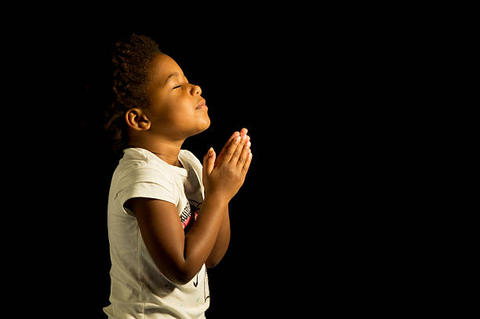
GENUINE REQUEST OF ZELOPHEHAD'S DAUGHTERS CONT’D.
Therefore, Moses brought their matter before the Lord.
God is pleased with His children who seek to know and do His will.
The Bible commands that we should ask, and it shall be given us, seek and we shall find, knock and it shall be opened unto us (Matthew 7:7).
We must take all our needs and problems to the Lord in prayer.

Slide 9
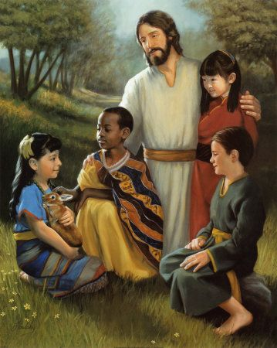
2. GOD’S ANSWER TO MOSES’ PRAYER: Numbers 27:6-11; 36:1-13
In response to the request of the children of Israel. God asked Moses to give them their father's inheritance.
This reveals to us that God reigns and rules over the affairs of men. He is loving, caring, merciful and does not discriminate.
This divine response teaches us to avoid discrimination of any kind.
Jesus loves the little children, all the children of the world: red and yellow, black and white, boys and girls, Jesus loves them all.

Slide 10

2. GOD’S ANSWER TO MOSES’ PRAYER CONT’D.
Everyone is important to God, and He has prepared an inheritance for every child who puts his/her trust in Him.
To benefit from such inheritance, boys and girls must surrender their lives to Christ by repenting and turning away from all sins.
This is the only way to have access to eternal inheritance in heaven (John 14:1-3).
Also, you must make it a point of duty to pray every day. There is assurance of answers to all our prayers.

Slide 11
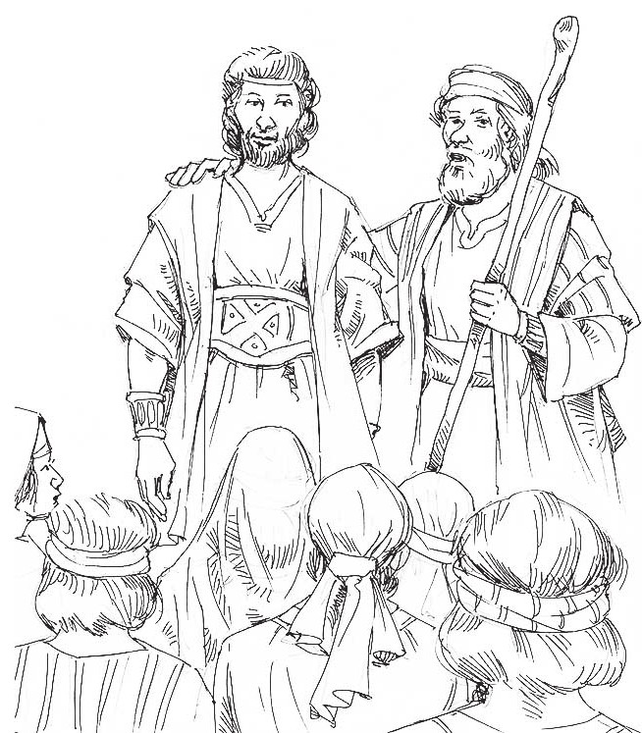
3. GUIDANCE ON THE CHOICE OF A WORTHY LEADER: Numbers 27:12-23; Acts 1:16-26; 1Timothy 3:2-12
Shortly after the review of the law of inheritance, God told Moses that it was time for him to die.
Therefore, he was instructed to prepare Joshua to replace him as the leader of Israel.
Many times, God gives to His servants notice of their time of death.
It is a great privilege for God to show anyone the time of his/her death. It will afford the person the opportunity to prepare for eternity.
However, the Bible makes it clear that even if death has not come, the rapture can happen any moment.

Slide 12
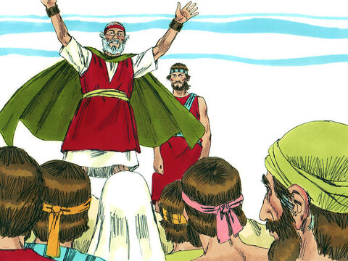
3. GUIDANCE ON THE CHOICE OF A WORTHY LEADER
This is the reason we must prepare and be ready to see Jesus any day, any time.
When Moses was informed about his death, he did not panic or become offended.
He was more concerned about God's glory and His covenant people.
God told Moses to prepare Joshua and appoint him to lead the people into the promised land.

Slide 13
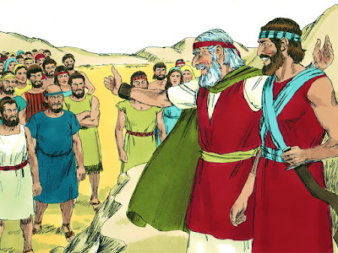
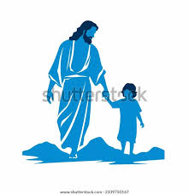
3. GUIDANCE ON THE CHOICE OF A WORTHY LEADER
God had already prepared Joshua right from his youth for the leadership position.
As a young man, Joshua followed Moses closely as his servant.
He was one of the two spies who confessed that they were well able to get into the Promised Land.
He fought the battle of the Lord and won.
He was a God-fearing and diligent young man.
All these qualities and many more gave him the privilege to be the right choice.
Children who desire to excel in all areas of life must be steadfast in their walk with God, stand for righteousness and be diligent in their studies and vocations.

Slide 14

QUESTIONS
Define inheritance?
Name the daughters of Zelophehad that asked Moses for their father's inheritance.
What should a Christian child do in times of need?
What response did God give to Moses regarding the request of Zelophehad's daughters?
What were the attributes that made Joshua to qualify for the leadership position?
What should a child who desires to excel do?

Slide 15
LESSON: God loves everyone no matter the condition
THOUGHT: I will serve the Lord all the days of my live
ACTIVITY: Using appropriate colour scheme, colour the picture in this study and make it beautiful

Slide 16
CHORUSES and HOMEWORK
CHORUSES
HOMEWORK:
1. Do not allow me, Saviour, to go empty-handed
2. I have decided to follow Jesus
3. He is Lord.
Preach to a sinful child and invite him/her to partake of the heavenly inheritance that Jesus has prepared for His friends.

Slide 17
REFERENCES
https://www.freebibleimages.org/illustrations/moses-joshua/
https://weareisrael.org/2014/08/10/daughters-of-zelophehad/
https://www.mactodd.co.nz/news-and-views/receiving-an-inheritance-during-your-relationship/
https://www.istockphoto.com/photo/praying-african-american-girl-gm453035453-25673132
https://ca.pinterest.com/pin/23503229277199547/
https://www.freebibleimages.org/illustrations/moses-joshua/
https://fundamentalbaptistchristian.blogspot.com/2019/10/moses-and-joshua-law-and-jesus-christ.html
https://ca.pinterest.com/pin/33777065945367178/
https://bible.art/gallery/numbers-27:1

