Slide 1
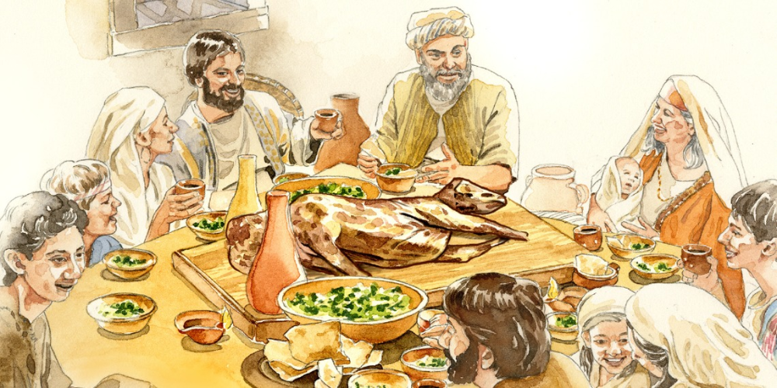
MAJOR FEASTS AND ADMINISTRATION OF JUSTICE

Slide 2

MEMORY VERSE: “Judges and officers shalt thou make thee in all thy gates, which the Lord thy God giveth thee, throughout thy tribes: and they shall judge the people with just judgment” - Deuteronomy 16:18
TEXT: Deuteronomy 16:1-22; 17:1-20

Slide 3
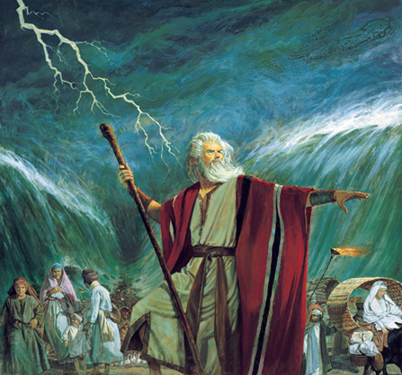
INTRODUCTION
As the children of Israel prepared to settle in Canaan, God, through Moses, their leader, instructed them to celebrate their departure from the land of Egypt.
In Egypt, they were maltreated and suffered afflictions in many ways, which made them cry unto God who sent Moses to deliver them.
There are three key words in our topic: feast, administration, and justice.
A feast means a large meal for a lot of people to celebrate a special occasion.
Administration means activities involved in managing the work of an organization.

Slide 4
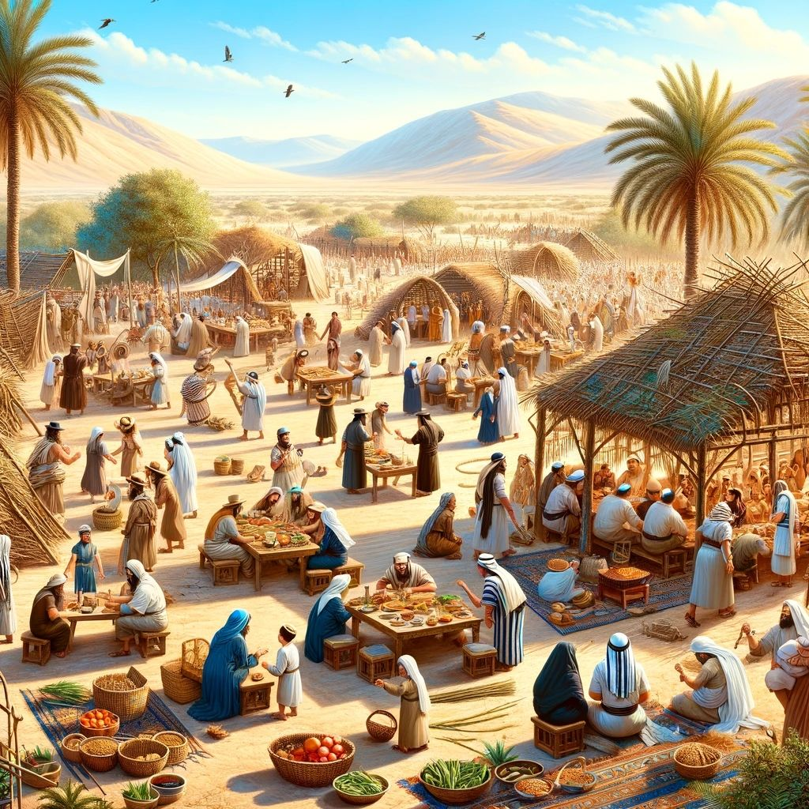
INTRODUCTION CONT’D.
Justice is the system by which people are judged in courts of law and the guilty is punished while the innocent is set free.
The children of Israel were given rules and regulations on how to celebrate their freedom from the hands of the Egyptians.
The major feasts were: The Passover, The Feast of Weeks, and the Feast of Tabernacles.
They were promised numerous blessings if only they obeyed the rules and regulations given to them by God.
The lesson here is that obedience to God, our parents, and teachers attracts bountiful blessings.

Slide 5
POINTS TO CONSIDER
1. APPROVED GUIDELINES FOR THE OBSERVANCE OF MAJOR FEASTS
2. APPOINTMENT OF JUDGES AND OFFICERS FOR MAINTENANCE OF LAW AND ORDER
3. ABIDING IN GOD’S WORD FOR CONTINUAL BLESSINGS

Slide 6
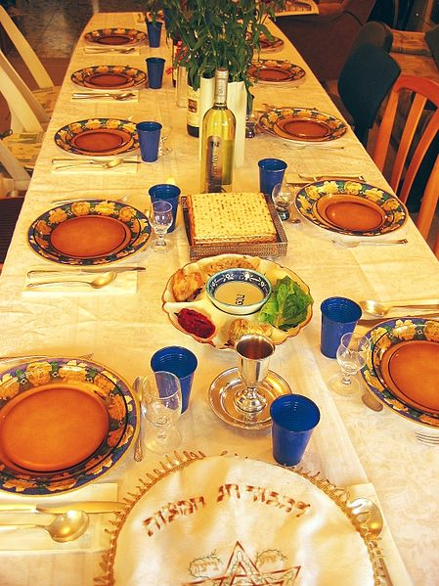
APPROVED GUIDELINES FOR THE OBSERVANCE OF MAJOR FEASTS: Deut. 16:1-17; Ex. 12:1-20, Lev. 23:15-22, 33-43
The Israelites were instructed to celebrate the Passover following laid down rules and regulations.
The Passover was to be observed on the 14th day of the month Abib, which God commanded to be the first month of the year to them (Exodus 12:1,2,6; 13:4).
During the Passover, the children of Israel were to eat only unleavened bread (bread without yeast) for 6 days.
On the 7th day, they were to observe the sabbath, which was a day of fellowship and rest.
No uncircumcised male servant or stranger among them should partake of it (Ex. 12:43-48).

Slide 7
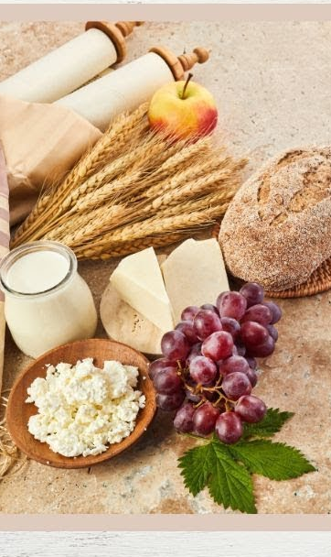
APPROVED GUIDELINES FOR THE OBSERVANCE OF MAJOR FEASTS CONT’D.
The Feast of Weeks was to be observed for 7 weeks, which should include giving a freewill offering unto God.
The Feast of Tabernacles was to be observed for 7 days.
During the Feast of Weeks and Feast of Tabernacles, they were to rejoice before the Lord with their family members, servants, the Levites, the strangers, the fatherless and widows living among them.
In all these major feasts, the children of Israel were to observe each of them three times in a year in the place where God had chosen and to give offerings to the Lord (Deuteronomy 16:16-17).

Slide 8
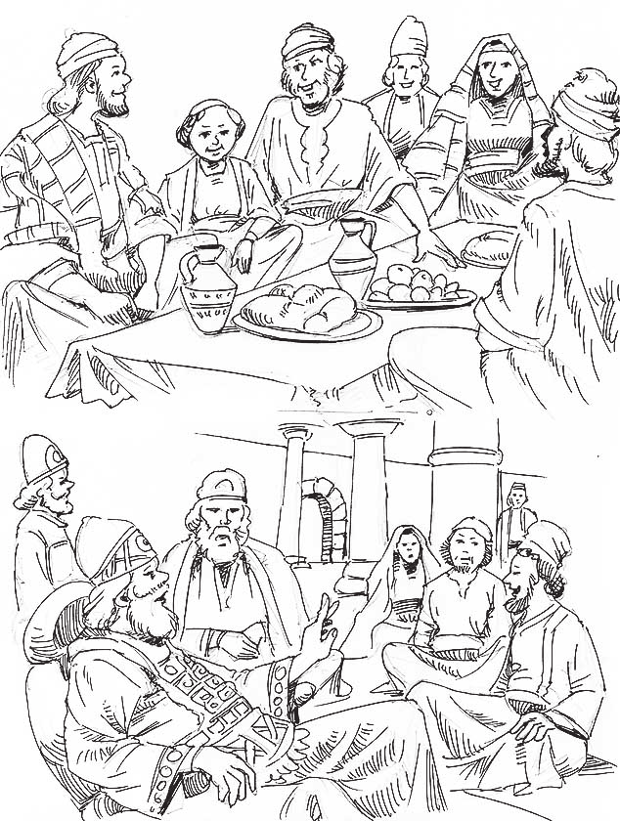
APPROVED GUIDELINES FOR THE OBSERVANCE OF MAJOR FEASTS CONT’D.
As friends of Jesus, whenever we are favoured by God, we must show gratitude to God and rejoice, following the guiding principles from our Christian teachers and the word of God.
We should not go the way of the world in their celebration by which they provoke God with their alcohol, worldly dancing, and dressing (1 John 2:15,16; Romans 12:2).

Slide 9
APPROVED GUIDELINES FOR THE OBSERVANCE OF MAJOR FEASTS CONT’D.
However, sinners are called to repent, turn from their wicked ways and accept Jesus as their personal Saviour and Lord.
Then they must offer their bodies as living sacrifices, holy, and acceptable to God.

Slide 10
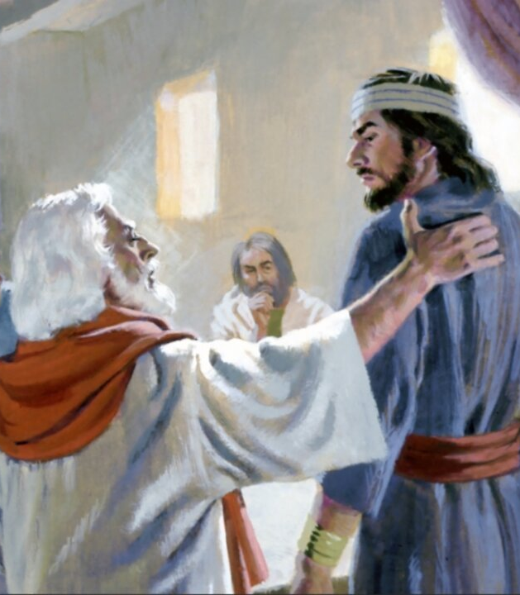
2. APPOINTMENT OF JUDGES AND OFFICERS FOR MAINTENANCE OF LAW AND ORDER: Deut. 16:18-20; 17:1-20
The people of God have grown to become a great nation.
Their population had greatly increased; hence the need for the appointment of judges and officers to maintain law and order.
God in His wisdom instructed Moses to appoint honest and faithful men to administer justice and good governance.
They were, however, given caution on how to choose their king.
It should be God-fearing people who will not lead them into idol-worship.

Slide 11
2. APPOINTMENT OF JUDGES AND OFFICERS FOR MAINTENANCE OF LAW AND ORDER CONT’D.
The judges’ duties include:
judging the people righteously and with the fear of God. There should be no partiality or miscarriage of justice (i.e. the guilty should be punished and the innocent set free).
Upholding God’s righteous standard by defending God’s word and not allow any form of corruption.
Execution of prescribed punishment for offenders.
All these are to help the people of God to fear and obey Him always.

Slide 12
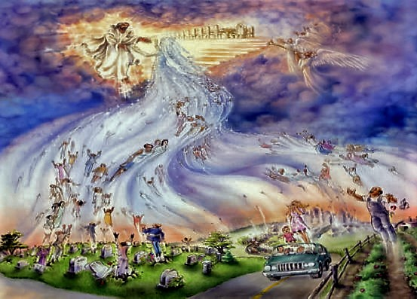
2. APPOINTMENT OF JUDGES AND OFFICERS FOR MAINTENANCE OF LAW AND ORDER CONT’D.
As children of God, we are not to be partial in whatever we do. And we should avoid every form of corruption.
God is our great and final Judge.
He will judge the world on the final day (Psalm 9:8).
When the rapture takes place, friends of Jesus will partake in the greatest feast, which is the Marriage Supper of the Lamb in heaven (Revelation 19:7-9);
while the unrepentant sinners and backsliders will be left behind on earth to suffer during the Great Tribulation.

Slide 13
2. APPOINTMENT OF JUDGES AND OFFICERS FOR MAINTENANCE OF LAW AND ORDER CONT’D.
To escape the Great Tribulation, therefore, sinful boys and girls must repent of all sins and accept Jesus Christ as Lord and Saviour, while backsliders must repent and pray for restoration.
Friends of Jesus also need to be prayerful and watchful so as to be ready for the rapture (Matthew 25:1-13).

Slide 14
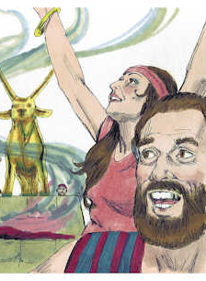
3. ABIDING IN GOD’S WORD FOR CONTINUAL BLESSINGS: Deuteronomy 16:21,22; 17:1-5, 14-20; 28:1-2
God warns His people of the consequences of choosing a king who will lead them astray.
Most of the nations surrounding Canaan were idol-worshippers.
They do not have the knowledge of the true God.
Therefore, Israel, as the people of God, must not at any time allow themselves to be corrupted by the idols of those nations.
This is the way to continue enjoying God’s promised blessings.
God hates idolatry in all its forms.

Slide 15
3. ABIDING IN GOD’S WORD FOR CONTINUAL BLESSINGS CONT’D.
The first commandment that God gave to the children of Israel in Exodus 20:3 is “Thou shalt have no other gods before me.”
This shows us that idolatry is a very grievous sin before God.
Idolatry is anything that takes the first place in your life.
Do you prioritise your academic pursuit, games, sports, and media activities above God?
If you do, that is idolatry, and you must repent today.

Slide 16
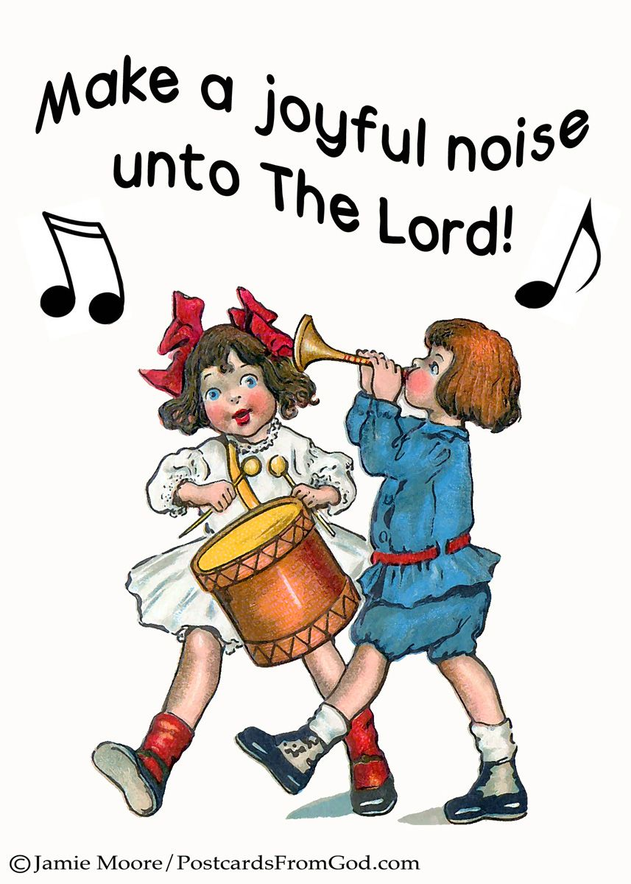
3. ABIDING IN GOD’S WORD FOR CONTINUAL BLESSINGS CONT’D.
The children of Israel served God by offering sacrifices unto Him.
God, however, condemned offering Him animals with deformities or animals that lack soundness.
This is also an abomination, and such were not acceptable to God.
Today, we worship God in praises and prayers.
Do you do that wholeheartedly?

Slide 17


3. ABIDING IN GOD’S WORD FOR CONTINUAL BLESSINGS CONT’D.
God’s word is very clear on what He demands from His children.
He wants you to do away with anything that may hinder you from serving Him wholeheartedly.
He also demands that you love Him with all your soul, heart, and mind, and serve Him in holiness and righteousness all the days of your life.
Obedience to God’s word is the key to bountiful blessings and access to sweet fellowship with Him.
You must be obedient to God’s word.

Slide 18

QUESTIONS:
Define the following words: feasts, administration, and justice.
Mention three rules given to the Israelites for the celebration of the Passover.
Mention three duties of the appointed judges.
Who is the highest and impartial judge?
What should a friend of Jesus do to enjoy God’s continual blessings?

Slide 19

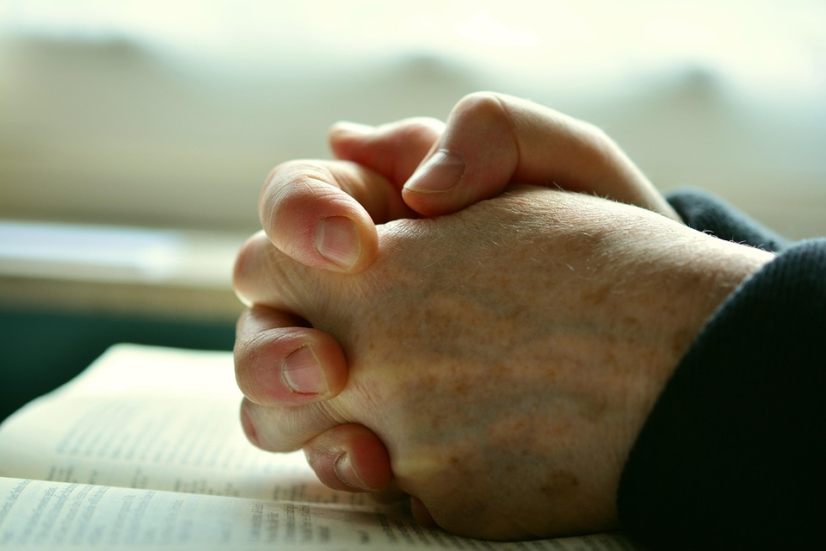
LESSON, THOUGHT, & ACTIVITY
LESSON: God demands obedience to all His commandments.
THOUGHT: I will obey God at all times.
ACTIVITY: Children should spend time and pray for themselves and the Church for revival and renewal.

Slide 20

SONGS
CONGREGATION SONG: GHS 91 – WHERE HE LEADS ME
CHORUSES:
  I am ready to obey Thy word
  Obedience is the very best way
  In my Father’s house, there are many mansions there.

Slide 21
REFERENCES
https://i.pinimg.com/originals/61/3c/9d/613c9d67968682075099d17f0784f2c4.png
https://as1.ftcdn.net/jpg/00/76/38/46/220_F_76384645_vnAmxmoZDxsc0fxJVppQ3BwETVhWUQoG.jpg
https://i.pinimg.com/originals/ca/08/71/ca08714f66feb9dbf93475f0e89dd591.jpg
https://mormonbeliefs.org/files/2015/07/moses-parting-red-sea-barrett-301889-gallery.jpg
https://globalvoices.org/wp-content/uploads/2012/04/seder-table.jpg
https://i.ytimg.com/vi/_5t1EEqD7qA/maxresdefault.jpg
https://i.pinimg.com/736x/8d/dc/09/8ddc099ed596abb17b915011c3743852.jpg
https://1a-1791.com/video/s8/1/o/M/0/p/oM0pk.qR4e-small-Exodus-Chapter-18.-Moses-ju.jpg
https://reputationtoday.in/wp-content/uploads/2024/06/CS.png
https://safety4sea.com/wp-content/uploads/2023/07/shutterstock_2170922089-750x375.jpg
https://cdn.pixabay.com/photo/2017/07/31/15/31/pray-2558490_960_720.jpg
https://4.bp.blogspot.com/-QjbGUoVLJBA/WrHITEio39I/AAAAAAAAA0A/aEZyvVZlRds2MpZ7pRNyzACUhyDhYR-hwCEwYBhgL/s1600/Rapture.jpg
https://i.etsystatic.com/40497511/r/il/697455/5587835462/il_fullxfull.5587835462_mbiw.jpg
https://i.pinimg.com/originals/2c/05/c3/2c05c398629972603b6519f60a22f1da.jpg
https://cdn.pixabay.com/photo/2013/07/12/12/43/god-146126_1280.png
https://openclipart.org/image/2400px/svg_to_png/227501/Bible-And-Cross.png

