Slide 1
PREPARATION FOR POSSESSION OF THE LAND
TEXT: Numbers 32:1-42; 33:1-56; 34:1-29

Slide 2

Memory verse
“And ye shall dispossess the inhabitants of the land, and dwell therein: for I have given you the land to possess it.” Numbers 33:53

Slide 3
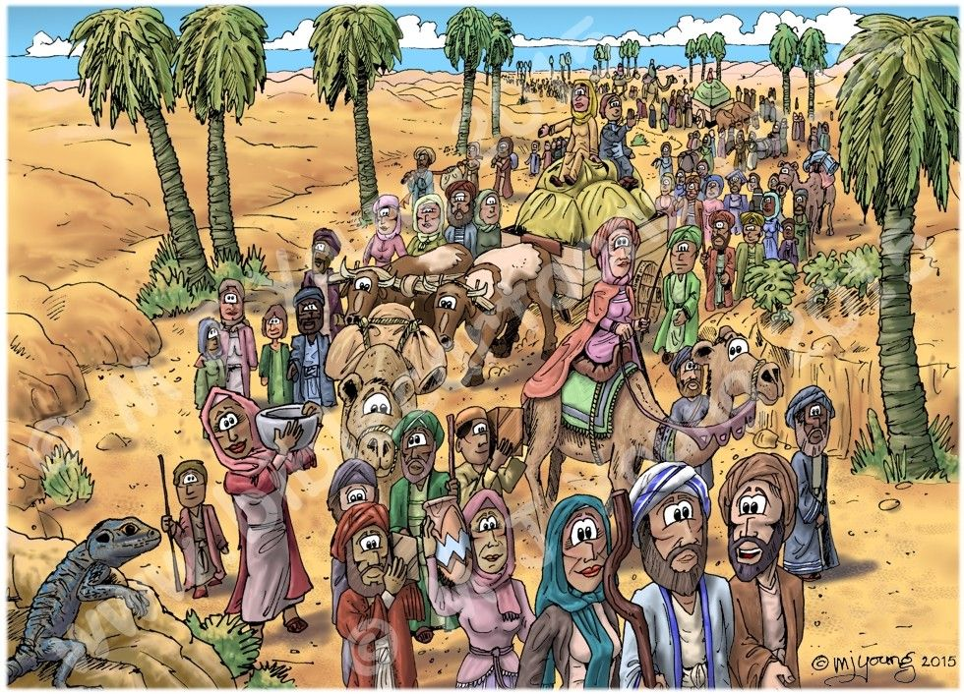
INTRODUCTION
Preparation is the act of getting ready to do something.
Before the children of Israel left Egypt, it took a long time of preparation.
Also, before they could enter Canaan, it was necessary to prepare very well.
Preparation is very important in anything we want to do.
God gave clear instructions to the children of Israel as they got ready to possess the land.

Slide 4


INTRODUCTION CONT’D…
God reminded them of their past disobedience and the trouble that came on them.
Now Moses told them how they should behave in the new land for God to bless them.
Obedience to God’s instructions was for the good of the Israelites and to prepare them to enjoy His blessings in the new land.
It was good for the children of Israel to know that if they followed the evil deeds of those who lived in this land before them, God, who is impartial in judgment, would punish and drive them away as He did to others.

Slide 5
OuR STUDY IS IN THREE PARTS:
1. THE PROMISED LAND
2. PITFALLS ON THE WAY TO POSSESS THE LAND
3. PREPARATION TO POSSESS THE LAND OF CANAAN

Slide 6
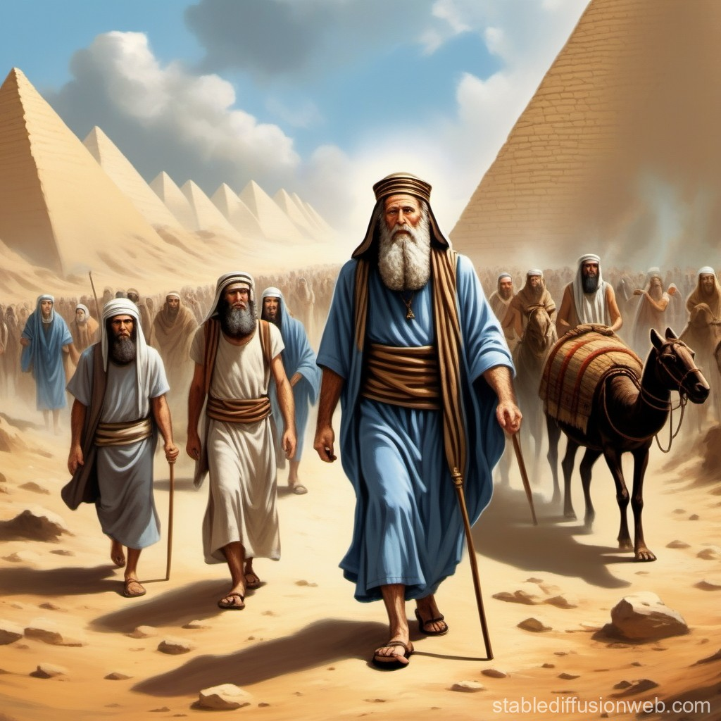
THE PROMISED LAND: Numbers 32:1-42; 34:1-2; Genesis 13:14-17; 17:7-8
God first made the promise to give the land of Canaan to Abraham and his children.
Even though many years passed, God fulfilled His promise to His friend Abraham.
God further promised to deliver the children of Israel from bondage in Egypt and take them to a land flowing with milk and honey (Canaan).
In Canaan, they would not lack anything.
At God’s appointed time, Moses and Aaron led the children of Israel out of Egypt on the way to the Promised Land.

Slide 7
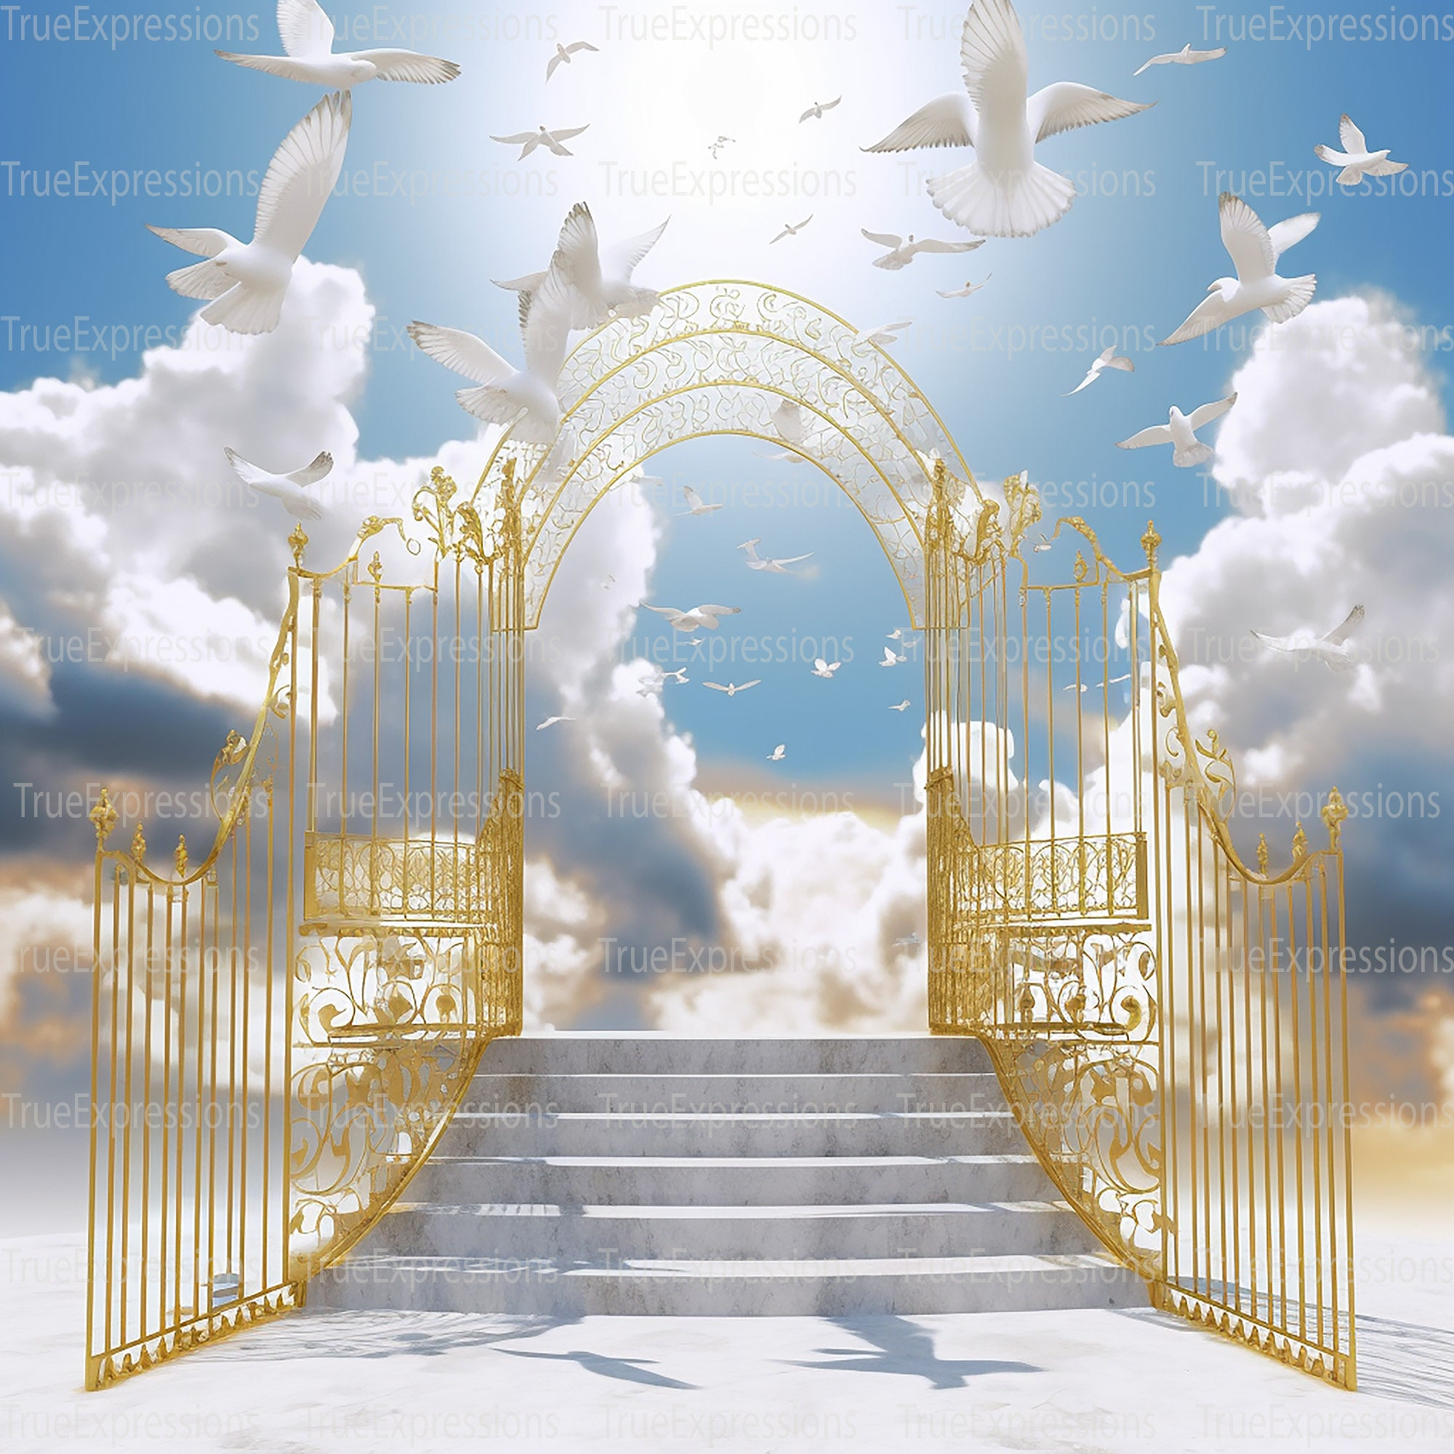
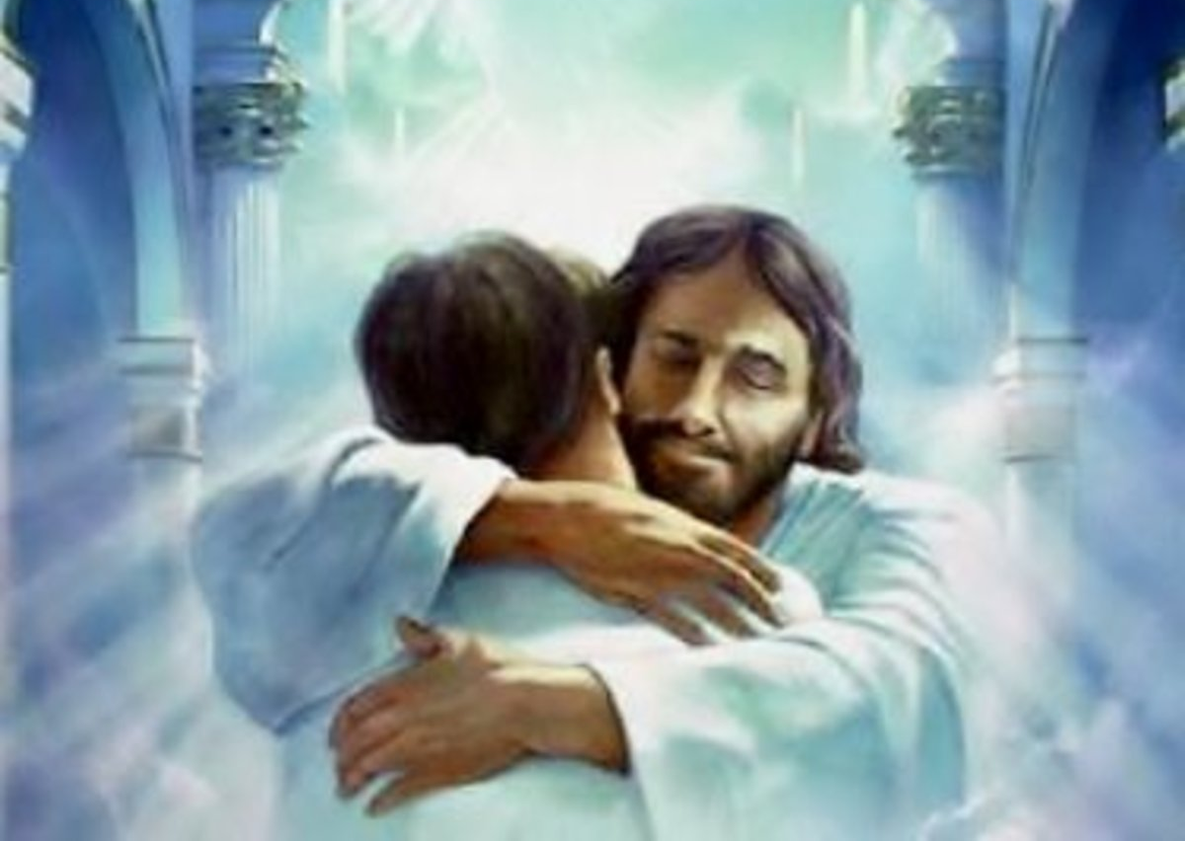
1. THE PROMISED LAND CONT’D…
In readiness to possess the land, the children of Israel were expected to prepare physically and spiritually.
The Promised Land of the friends of Jesus is not on earth.
We have our beautiful home in heaven.
We need to overcome every temptation of Satan, love and serve our Saviour in righteousness daily till we get there at last.

Slide 8
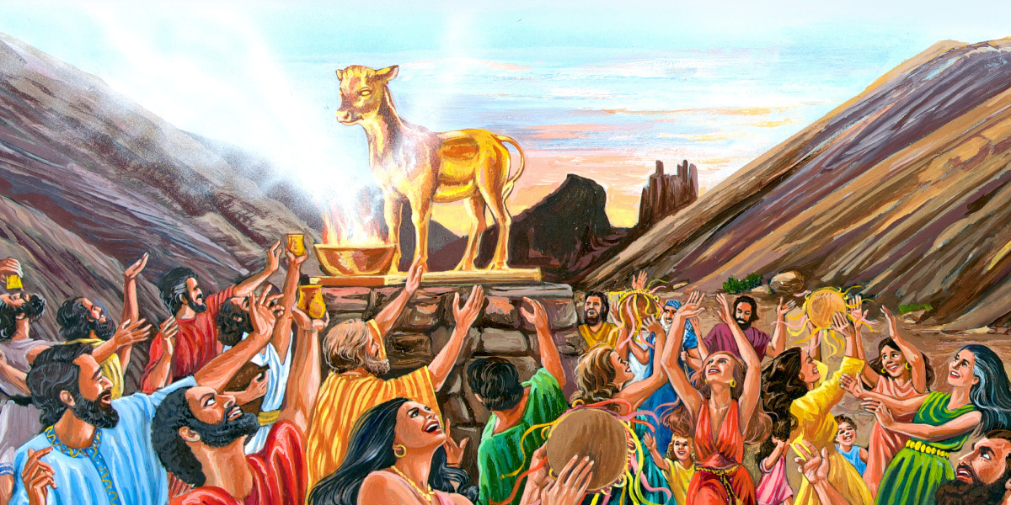
2. PITFALLS ON THE WAY TO POSSESS THE LAND: Numbers 32: 6-15; 33:1-56
The journey to Canaan that was to take Israel a few months took them forty years.
The children of Israel were the cause.
They murmured against God many times.
At one point, they even made an idol and were ready to return to Egypt.
They provoked God and His servant Moses.
They even hindered Moses from entering that Promised Land.

Slide 9
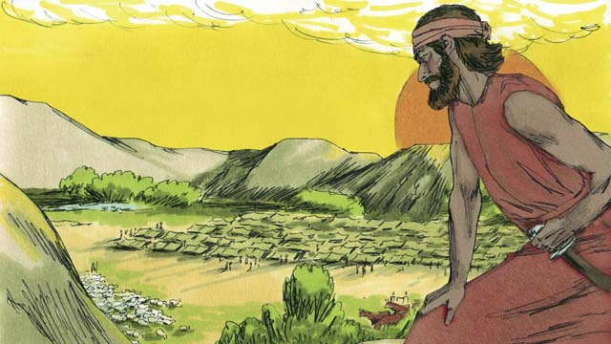
2. PITFALLS ON THE WAY TO POSSESS THE LAND CONT’D…
In our study, the children of Reuben, Gad and half of the tribe of Manasseh followed that same path of rebellion.
They asked for permission to live on the eastern side of the Jordan River when they saw that the land was good for their cattle, which were many (Numbers 32:4-5).
This was outside the land God promised to give them.
Moses rebuked them for this request, saying that they should not discourage other tribes by leaving them to fight alone.

Slide 10
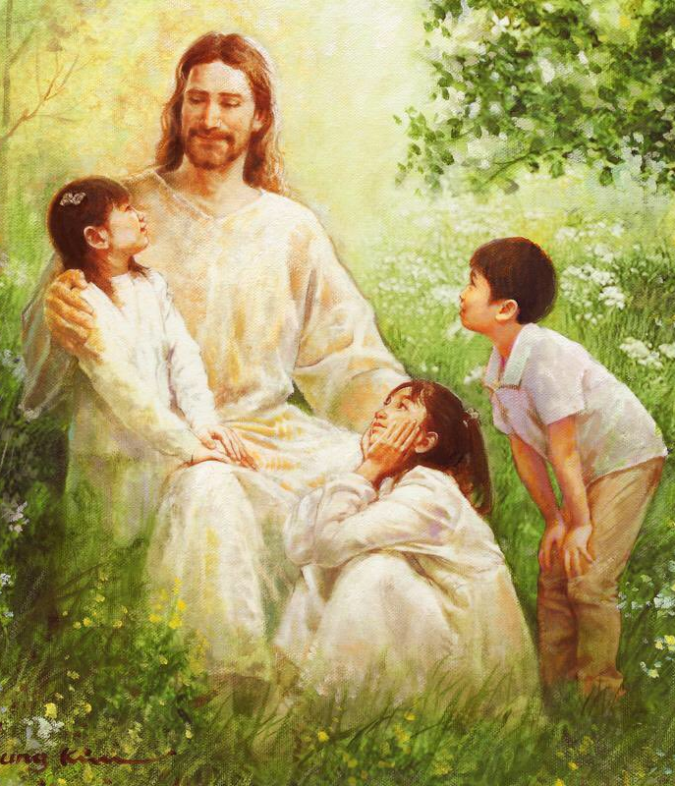
2. PITFALLS ON THE WAY TO POSSESS THE LAND CONT’D…
There are some friends of Jesus who are always looking for their personal gains instead of what will benefit everyone.
This will cause God to be unhappy with such children.
If you serve God faithfully, you will receive eternal reward from Him.

Slide 11
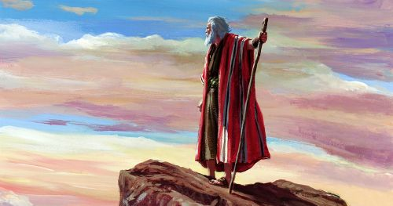
3. PREPARATION TO POSSESS THE LAND OF CANAAN: Numbers 33:1- 56; ezra 7:10
The children of Israel were now getting close to the land of Canaan.
In every activity of life, there is a need for adequate preparation before we begin the actual assignment.
In our passage, God gave the Israelites instructions through Moses on what to do when they got to the Promised Land:
They should know the battle was not over.
They must be armed for the battle to finally possess the land.

Slide 12
3. PREPARATION TO POSSESS THE LAND OF CANAAN CONT’D…
Note that the request of the children of Reuben, Gad and half the tribe of Manasseh to take possession outside Canaan was not the will of God.
They were interested in the green grass for their animals instead of obedience to God (Numbers 32:1-15).
We must avoid greed as children of God.
They were to drive out the inhabitants of the land completely, utterly destroy their idols and never worship their gods.
They were to divide the land by lot (Numbers 33:50-54). There should be no partiality in the sharing of the land.

Slide 13
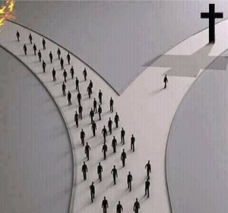
3. PREPARATION TO POSSESS THE LAND OF CANAAN CONT’D…
d) They were also to accept the decision of the men God appointed to share the land unto the children of Israel according to the approved boundaries (Numbers 34:29).
Boys and girls who have given their lives to Jesus are on a journey to heaven, which is our own Promised Land.
We must obey Jesus’ instructions daily to overcome Satan and sin, live a holy and righteous life, and strive to enter in.
We must do this through daily devotion to God in prayer, reading and meditating on His word and being watchful because the Lord is at hand.

Slide 14

QUESTIONS
Mention the two and a half tribes that first received their portion of the land.
Is it good to work in unity? YES/NO
Where is our Promised Land today?
Mention three (3) things to do before getting into heaven.
What should a sinner do in order to enter heaven?
This Photo by Unknown Author is licensed under CC BY-SA

Slide 15

LESSON, THOUGHT & ACTIVITY
LESSON: Obedience brings blessings.
THOUGHT: I will obey God’s word so as to get to heaven at last.
ACTIVITY: Go out and possess the land. Teachers are to pair the children, pray with them, then go out to preach the gospel (Psalm 2:8).

Slide 16

Congregational song & choruses
CONGREGATIONAL SONG: GHS 28 – I AM LIVING IN CANAAN
CHORUSES:
We are able to go up and take the country
Jesus conquered the world and gave us victory
When I go with the Lord Jesus into any battle, I am a winner

Slide 17
REFERENCES
https://clipart-library.com/8300/2368/12371.png
https://i.pinimg.com/736x/1e/f5/08/1ef50862f7bea46146f307bcda22e6e2.jpg
https://grace-life.org/wp-content/uploads/2020/01/Disobedience-albumart.jpg
https://imgcdn.stablediffusionweb.com/2024/3/21/7d3e20b4-938f-4a9c-8390-832105a96143.jpg
https://images.saymedia-content.com/.image/t_share/MTc2NDYyMjE5NDA3NzMwNjUw/when-god-called-you-home-a-birthday-celebration-in-heaven.jpg
https://images.saymedia-content.com/.image/t_share/MTc2NDYyMjE5NDA3NzMwNjUw/when-god-called-you-home-a-birthday-celebration-in-heaven.jpg
https://i.etsystatic.com/26056260/r/il/42a50e/4857954977/il_fullxfull.4857954977_skop.jpg
https://assetsnffrgf-a.akamaihd.net/assets/m/1101978090/univ/art/1101978090_univ_lsr_lg.jpg

Slide 18
REFERENCES CONT’D…
https://cdn.door43.org/obs/jpg/360px/obs-en-16-03.jpg
https://cdn.door43.org/obs/jpg/360px/obs-en-16-03.jpg
https://pbs.twimg.com/media/DWU1PQNVwAALSLo.jpg
https://upload.wikimedia.org/wikipedia/commons/thumb/e/ea/Red_question_icon_with_gradient_background.svg/1200px-Red_question_icon_with_gradient_background.svg.png
https://www.shutterstock.com/shutterstock/photos/1461967982/display_1500/stock-vector-kids-thinking-idea-vector-illustration-1461967982.jpg
https://img.freepik.com/free-vector/happy-cartoon-boys-girls-singing_50699-416.jpg?w=900
https://assets.ldscdn.org/e7/73/e773514b1f0afa616a37e8c1bafead2e7f3a1d08/moses_mount_nebo.jpeg
https://asses.ldscdn.org/e7/73/e773514b1f0afa616a37e8c1bafead2e7f3a1d08/moses_mount_nebo.jpeg
https://thelivingmessage.com/wp-content/uploads/2018/06/pathways.jpg?w=300

