Slide 1

PRESCRIPTIONS CONCERNING OFFERINGS AND VOWS
TEXT: Numbers 28:1-31; 29:1-40: 30: 1-16

Slide 2
MEMORY VERSE:
“Command the children of Israel, and say unto them, My offering, and my bread for my sacrifices made by fire, for a sweet savour unto me, shall ye observe to offer unto me in their due season” (Numbers 28:2).

Slide 3
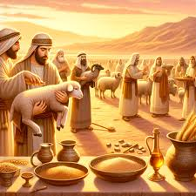
INTRODUCTION
Prescription simply means direction, instruction, an idea or suggestion on how to do something correctly
Offering is something that we give freely to God as a way of saying thank you for His goodness and care
A vow, on the other hand, is a promise to perform a specific duty unto the Lord.

Slide 4
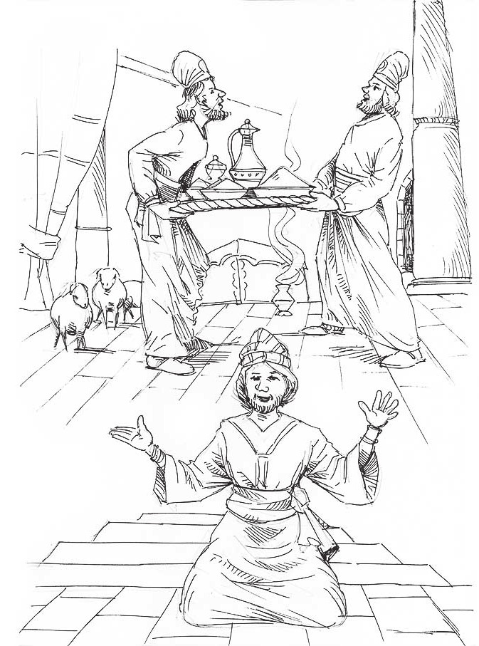
INTRODUCTION-CONTD
  A vow could be a promise to give something or do a particular thing for God’s glory in return for some blessings expected from Him.
  It could also be a promise to stay away from doing or eating something as a mark of additional devotion to God.
  The principles behind these offerings and vows are that they are to be made daily, on the weekly sabbath days, at the beginning of each month and on certain days of the holy year.

Slide 5
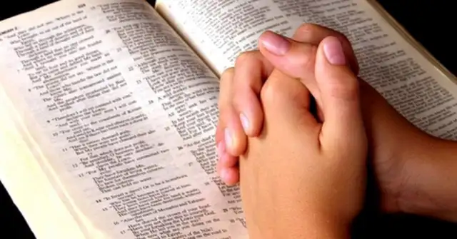

INTRODUCTION-CONTD
  This shows the need to continually draw near to God with sacrifice and increase in communication with Him so as to enjoy His presence and blessings.
  This should be the practice among friends of Jesus today.
  We are called to have intimate fellowship with God through regular observance of quiet time, prayer and study of His word.
  This will attract to us His blessings, grace and help in time of need.

Slide 6
POINTS TO CONSIDER:
1.
PURPOSE OF OFFERINGS AND VOWS.
2. PRESCRIPTIONS CONCERNING OFFERINGS AND VOWS.
3.
PROFIT OF FOLLOWING GOD- GIVEN PRESCRIPTION.

Slide 7
PURPOSE OF OFFERINGS AND VOWS
Numbers 28:1-16; 29:7,8; 30:1,2 Corinthians 9:6-15; Malachi 3:10- 12
God owns all things; yet He is pleased when we give to Him out of what He has given to us.
The children of Israel were commanded to give so that there would be enough materials for sacrifices to God.
Also, their offerings and vows were to form a major part of what the priests, the Levites and their families would eat.
Besides offering material things, they were to offer themselves for special services to the Lord.

Slide 8
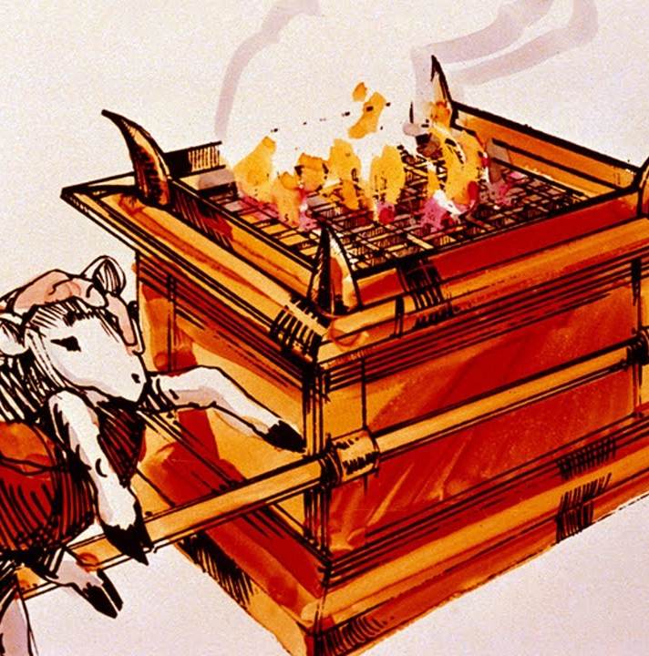
PURPOSE OF OFFERINGS AND VOWS CONT’D.
It is for our good that God commands us to give to Him.
Giving is one way of showing our love and thankfulness to God.
Offering to Him is an important part of true worship.
Friends of Jesus should learn and maintain the habit of worshipping God with their offerings and vows because:
It is a command from God (Luke 6:38).

Slide 9
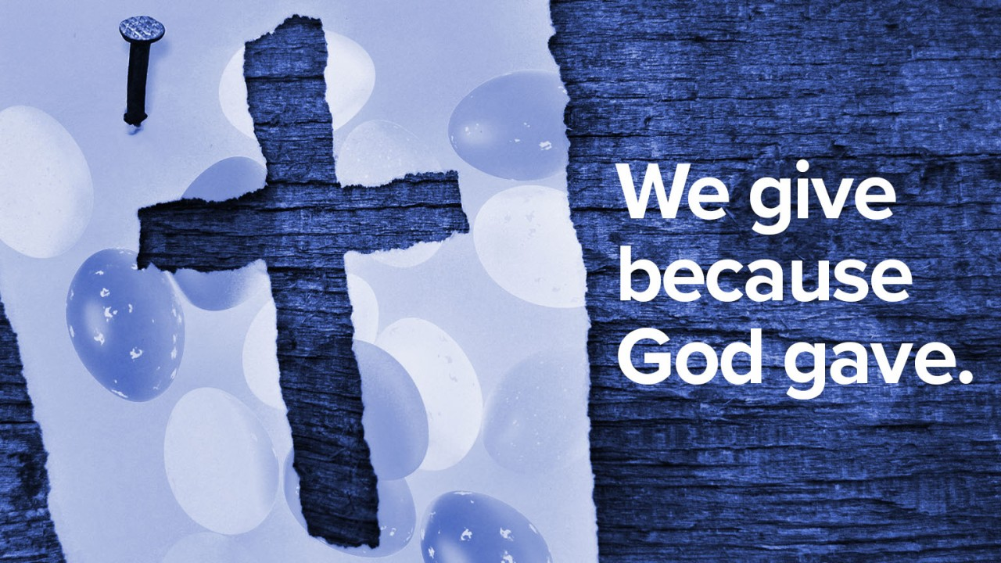
PURPOSE OF OFFERINGS AND VOWS CONT’D.
It is a sign of appreciation of God's goodness in giving His Son to die for everyone.
It shows gratitude for the daily benefits God bestows on you (Psalm 116:12).
It is to meet the needs of the church and missions.
God loves a cheerful giver, and such givers will not lack (Proverbs 19:17).
Like God, who gave His only begotten Son for us, we must give our best to the Master.

Slide 10
2. PRESCRIPTIONS CONCERNING OFFERINGS AND VOWS
Numbers 28:17-20; 29:1-40 ;
30:1,2; 2 Cor. 9:7
God gave Moses specific instructions on what the children of Israel were to offer, where to offer them, how they were to make their offerings and the time to offer them.
Offerings and vows should be given promptly with a willing and sincere heart.
They were to be offered in due season; at the right time.
For animal sacrifice, for example, a lamb of the first year, without spot or blemish, was to be used; and as for meat offerings,
The prescribed measure must be observed, as ordained at Mount Sinai.

Slide 11

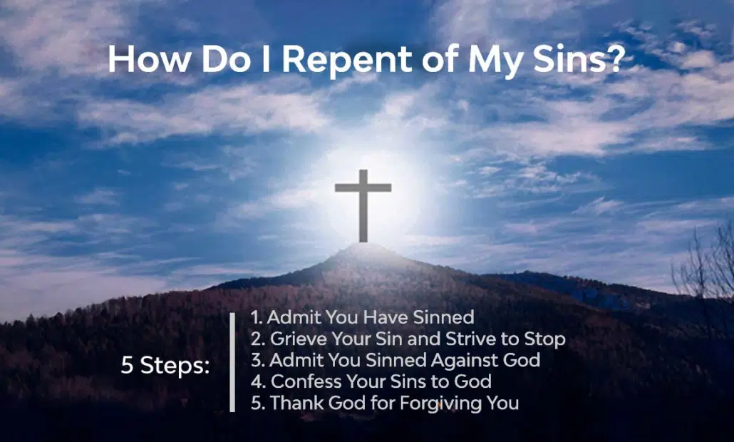
2. PRESCRIPTIONS CONCERNING OFFERINGS AND VOWS CONT’D.
No one was expected to bring what he chooses, but every offering must conform to God's standard.
Before you can give an acceptable offering or vow to God, you must have repented of your sins.
God is holy and pure. He gave us His Best by offering His only begotten Son, Jesus, as a sacrifice for our salvation.

Slide 12
2. PRESCRIPTIONS CONCERNING OFFERINGS AND VOWS CONT’D.
God deserves our best. You can give your talents, time and money to God.
Every child must be prepared from home and from his/her heart to give offerings in God's house.
Giving of offerings should be done willingly and with a cheerful heart,

Slide 13
3. PROFIT OF FOLLOWING GOD- GIVEN PRESCRIPTION
Numbers 28:1-6; Proverbs 11:25;
Luke 6:38; 2 Corinthians 9:6-8
Whoever offers according to God’s instructions qualifies for God’s blessings.
There are examples of people in the Bible who made vows and received blessings from God.
Jacob made a vow and God protected and provided for him (Genesis 28:20-22).
Hannah made a vow to offer her son, Samuel, to God, and He gave her three additional sons and two daughters (1 Samuel 1:27,28; 2:21).
Abraham offered his only son to God and He blessed him, his descendants and made him a blessing to many generations (Genesis 22:15-18).

Slide 14
3. PROFIT OF FOLLOWING GOD- GIVEN PRESCRIPTION CONTD
“But this I say, He which soweth sparingly shall reap also sparingly and he which soweth bountifully shall reap also bountifully” (2 Corinthians 9:6).
Remember, if you still do bad things, God will not accept your offering.
You must give Him your heart first by repenting from your sins and making Jesus your personal Saviour and Friend.

Slide 15

QUESTIONS:
What is the difference between offering and vow?
Why is it important to give offerings and pay our vows?
We must obey God by paying our vows and give offering in the church. Yes/No
Mention some of the blessings of giving.
How can a sinful child benefit from giving, offering, and vows

Slide 16
LESSON, THOUGHT & ACTIVITY
LESSON:
Only the person who has a clean heart can offer an acceptable offering.
THOUGHT:
I will always give my offerings and pay my vows.
ACTIVITY:
Children should make vows for the development of the children’s church. Pray and be determined to pay such vows.

Slide 17
CHORUSES:
Give, it shall be given unto you.
Running over, running over, my cup is filled.
Abraham's blessings are mine.

Slide 18
REFERENCES
https://www.linkedin.com/pulse/1-simple-way-increase-giving-easter-lauren-france
https://bible.art/p/1M1szIY5O6ucebaBrAXg/numbers-15:1-12-the-lord-said-to#google_vignette
https://reflectionsfromjohn.wordpress.com/2020/04/08/a-true-knowledge-of-god/
http://www.borntobloom.today/surrender-beautiful-and-sometimes-painful-surrender/

