Slide 1

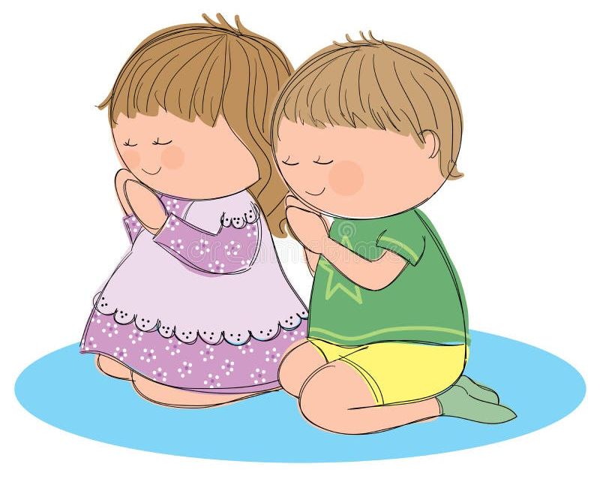

Right Attitude in Prayer

Slide 2

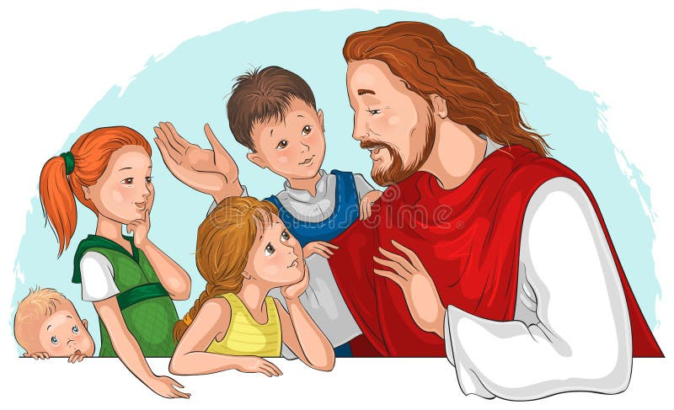

Memory Verse
“And he spake a parable unto them to this end, that men ought always to pray, and not to faint” (Luke 18:1).
Text: Luke 18:1-14

Slide 3
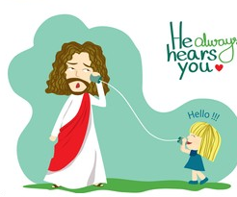
Introduction
The parables of Jesus in our Bible passage reveal some important truth about prayer that should serve as a guide to build up our prayer life.
Prayer is communion with God, and He is always willing and loves to hear us talk to Him.
God answers prayers, and He can do all things.
There are hindrances to prayers, but persistence and the right attitude will overcome such hindrances.
Persistent prayer shows our faith in God.
Our prayers should come from a humble heart. There should be no show of self-righteousness.
Sinners who sincerely repent will receive pardon and peace.
Prayer is mandatory for all friends of Jesus. They ought always to pray a faint.

Slide 4
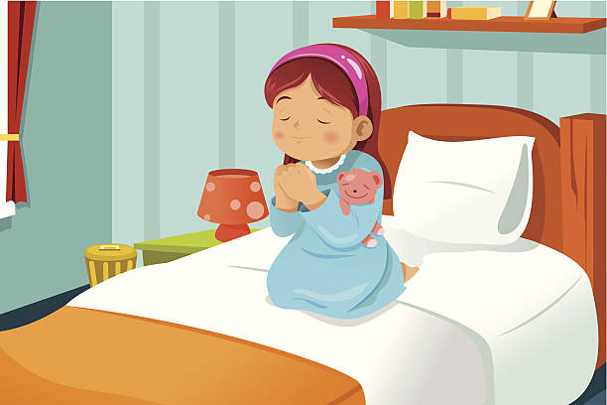
Introduction CONt'd.
How prayerful are you?
Remember that life is filled with lots of adversaries, but through prayers, you will overcome and enjoy bountiful blessings
You must consciously develop the attitude of praying. Do not spend your time playing; there is no reward for playing.
But when you pray, bountiful blessings will pour into your life.

Slide 5

3 points to consider
1. REASONS FOR PRAYING
2. RIGHT ATTITUDES IN PRAYER
3. REWARDS FOR PRAYING WITH RIGHT ATTITUDE

Slide 6
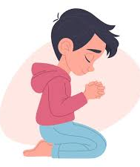
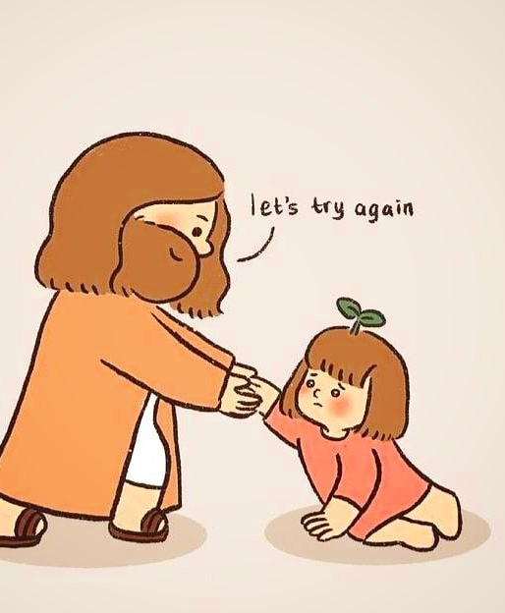
Reasons for Praying: Luke 18:1-14; Matthew 7:7,8; Eph. 6:18; Phil, 4:6; 1 Thess, 5:1
Prayer is talking to God about our needs and the needs of others.
Prayer is indispensable in the life of children of God because it is what connects us to heaven and brings blessings from God to us.
To stop praying is to stop existing..
A prayerful child is a powerful child, and a prayerless child is a powerless child.

Slide 7
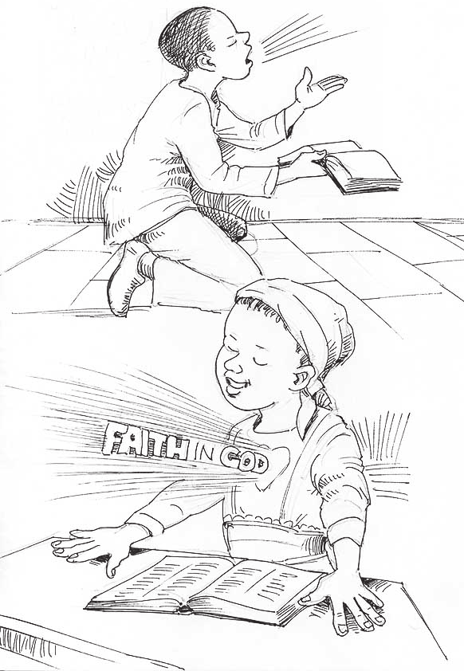
Reasons for Praying CONT’D.
The answers to these questions will help us better understand the reasons prayer is important.
Why do we pray?
We pray because God commands us to pray
The only means to connect with God is through prayer
A sinner must pray to receive Christian experiences and other blessings he/she desire.
Through prayers, we renew our trust in God’s faithfulness as we cast all our cares on Him
Also, through prayers, we receive mercy, grace and help in times of need (Hebrews 4:16).

Slide 8
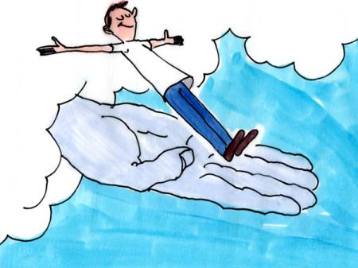
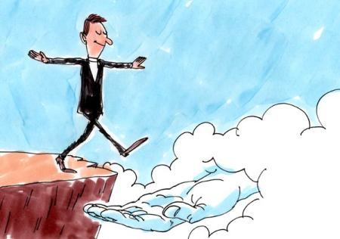
Reasons for Praying CONT’D.
How do we pray? (Matt. 6:9; Mark 11:24-26)
We pray by approaching the presence of God with humility and reverence, praising Him for what He has done for us in the past before asking Him for present needs.
We must close our eyes while praying to avoid distractions.
Pray in the name of Jesus, kneeling, sitting or standing.
Where do we pray? (1 Timothy 1:8).
We pray anywhere and everywhere. In the church, at home, at school or wherever we find ourselves.

Slide 9
Reasons for Praying CONT’D.
When do we pray? (Ephesians 6:18;1 Thessalonians 5:17).
We pray anytime and every time.
No retirement, no vacation, no resting; morning, afternoon and night.
If we do these, we should be able to quench all the fiery darts of the enemy in our lives and families in Jesus' name

Slide 10


2. Right Attitude in Prayers: Luke 18:1-14; Matt. 6:5-13; Mark 11:22-26
Right attitude means the right manner of life or the correct behavioral pattern you must possess if you want God to answer your prayers.
Almost everyone prays, but not everyone receives answers to their prayers. Why?
Because they do not possess the right attitude.
God is interested in answering our prayers because His name is glorified thereby.
But many things constitute hindrances to the answer to our prayers.

Slide 11
2. Right Attitude in Prayers CONT’D.
For God to answer your prayers, the following right attitudes must be in your life.
Be sure you are born again, and you must maintain that relationship by regularly praying, reading and meditating on God's word every day.
Do not keep offences in your heart. You must forgive anyone who offends you, even as God has forgiven you.
Be humble as you go to God in prayer.

Slide 12
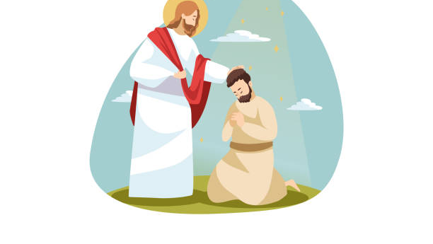
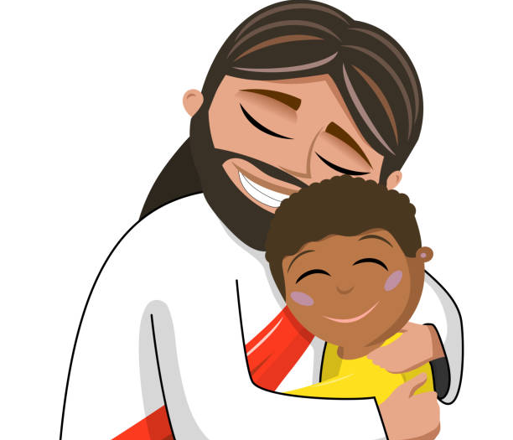
2. Right Attitude in Prayers CONT’D.
You must be persistent. Do not give up until your prayers are answered.
Pray in faith, claiming the promises of God concerning what you are asking.
Never doubt but believe that your prayers are answered, even when you have not yet experienced it.
If these things are in your life, circumstances and situations will bow before you in Jesus’ name.
But if they are not there, pray now that God should put them in your life, and He will answer your prayer in Jesus' name.

Slide 13
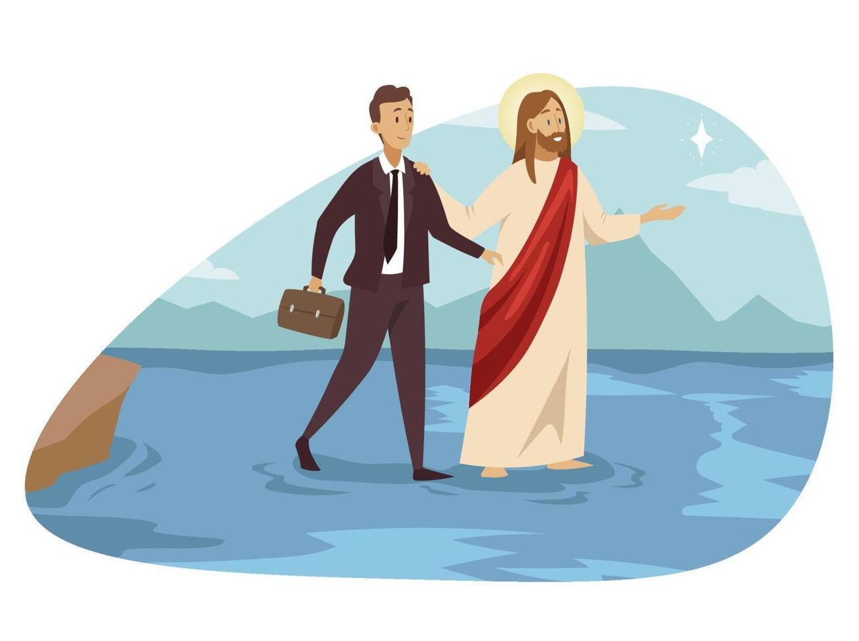
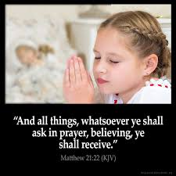
3. Reward for Praying with Right Attitude: Luke 18:7,8,14; Matthew 7:7-11
The prayer that is said with the right attitude does incredible wonders. Satan cannot withstand such prayers.
Jesus said that if we possess these right attitudes, we will say to this mountain be thou removed, and be cast into the sea, and doubt not, “we shall receive whatsoever we ask.”
Mountains of sicknesses and disease, bad luck and bad dreams, long-standing challenges, and lots of others will vanish if we possess the right attitude.

Slide 14
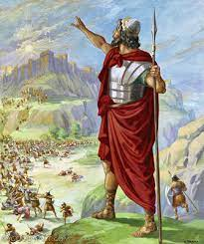
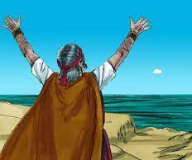
3. Reward for Praying with Right Attitude CONT’D.
The Bible is filled with testimonies of people or groups of people who displayed the right attitude in prayer and the wonderful things that happened.
Joshua prayed, and the sun and the moon stood still till the children of Israel were able to overcome their enemies.
Abraham prayed, and Lot and his two daughters were delivered from Sodom and Gomorrah.
Elijah prayed, and there was no rain for three and a half years, and he prayed again, and God sent rain.

Slide 15
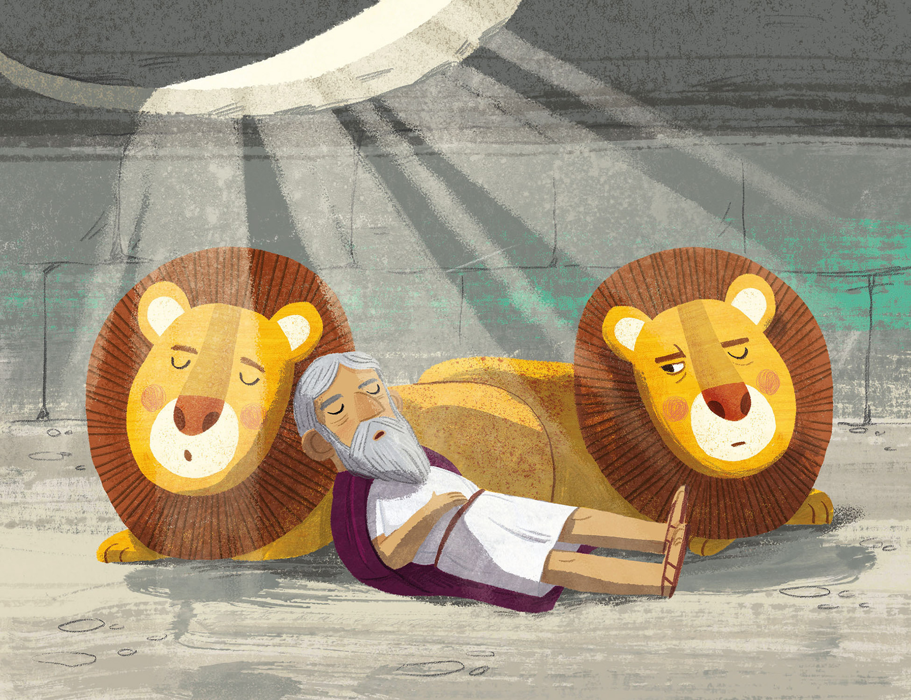
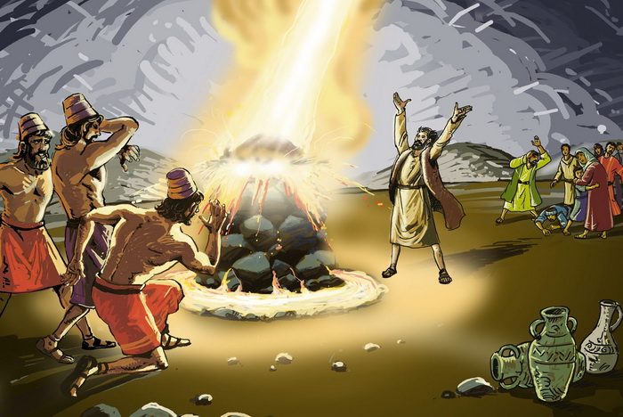
3. Reward for Praying with Right Attitude CONT’D.
Elisha 5prayed and the widow's son was raised to life.
Daniel prayed in the lions’ den, and God sent His angel to shut-up the mouths of the lions so they could not hurt him
The disciples of Jesus prayed, and multitudes were getting saved and healed. Peter was set free from prison, and he escaped the wrath of Herod.
Paul and Silas prayed and sang praises in the prison, and the prison doors opened; heir chains were loosed.

Slide 16
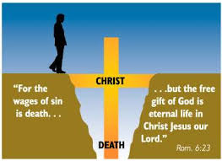
3. Reward for Praying with Right Attitude CONT’D.
Jesus calls all boys and girls to put off their sinful attitude of fighting and quarrelling, stealing, anger and bitterness, lying and keeping malice and the rest of them.
With all these in your life, your prayers will not be answered.
But put on the new man, which after God is created in righteousness and true holiness, and your prayers will be answered speedily in Jesus' name!

Slide 17

QUESTIONS
What is prayer?
What do you learn from the parable that Jesus told in our Bible passage?
Mention some right attitudes you must possess for your prayers to be answered.
Where and when can we pray?
Mention three people who prayed with the right attitude in the Bible and the miracles that happened.

Slide 18

LESSON, THOUGHT, ACTIVITY, CHORUSES
LESSON: Right attitude in prayer attracts an immediate answer from God.
THOUGHT: I will always pray with the right attitude.
ACTIVITY: The teacher should lead the children in a prayer session, searching their hearts to see those things that hinder their prayers. They should confess these things to God and pray for forgiveness from God.
CONGREGATIONALSONG: GHS 5- NEVER GIVE UP
CHORUSES:
Prayer is the key
Let us continue to pray and never be tired
When saints pray, Satan trembles.

Slide 19
References
.https://www.google.com/url?sa=i&url=https%3A%2F%2Fwww.istockphoto.com%2Fillustrations%2Fchildrenshymns&psig=AOvVaw189ekt2QYcLRtotwd895Z3&ust=1758072012273000&source=images&cd=vfe&opi=89978449&ved=0CBUQjRxqFwoTCKjFzt-O3I8DFQAAAAAdAAAAABAv https://www.google.com/url?sa=i&url=https%3A%2F%2Fwww.shutterstock.com%2Fsearch%2Fcartoon-kid-doing homework&psig=AOvVaw3bzA6zwitLh7DbogwyJbY1&ust=1758072050548000&source=images&cd=vfe&opi=89978449&ved=0CBUQjRxqFwoTCLi0i_KO3I8DFQAAAAAdAAAAABAE
https://www.google.com/imgres?q=child%20praying%20cartoon&imgurl=https%3A%2F%2Fmedia.istockphoto.com%2Fid%2F186244305%2Fvector%2Flittle-girl-praying.jpg%3Fs%3D612x612%26w%3D0%26k%3D20%26c%3DGK7De1TqqPMckCTK1hn41HlSHyDRwp18E2L2ZhWrJyg%3D&imgrefurl=https%3A%2F%2Fwww.istockphoto.com%2Fillustrations%2Fcartoon-of-the-children-praying&docid=9p1sgk7ka3i-gM&tbnid=q3tWxqtMspDlYM&vet=12ahUKEwjNj_v2idyPAxVUADQIHeG4L9YQM3oECBMQAA..i&w=612&h=408&hcb=2&ved=2ahUKEwjNj_v2idyPAxVUADQIHeG4L9YQM3oECBMQAA
.https://www.google.com/imgres?q=child%20praying%20cartoon&imgurl=https%3A%2F%2Fthumbs.dreamstime.com%2Fb%2Fpraying-children-29210097.jpg&imgrefurl=https%3A%2F%2Fwww.dreamstime.com%2Fillustration%2Fchildren-praying.html&docid=2I4bSVsGhnMfsM&tbnid=bQ8ZexDieQ8cmM&vet=12ahUKEwjNj_v2idyPAxVUADQIHeG4L9YQM3oECBcQAA..i&w=800&h=714&hcb=2&ved=2ahUKEwjNj_v2idyPAxVUADQIHeG4L9YQM3oECBcQAA
https://www.google.com/url?sa=i&url=https%3A%2F%2Fwww.dreamstime.com%2Fillustration%2Fgod-talking-to.html&psig=AOvVaw3btJCRYaWMsOgLKvDmGuGM&ust=1758067327905000&source=images&cd=vfe&opi=89978449&ved=0CBUQjRxqFwoTCPjbg7qC3I8DFQAAAAAdAAAAABAE
https://www.google.com/imgres?q=talking%20to%20God%20cartoon&imgurl=https%3A%2F%2Fwww.shutterstock.com%2Fimage-vector%2Fgirl-calling-jesus-god-that-260nw-1493183429.jpg&imgrefurl=https%3A%2F%2Fwww.shutterstock.com%2Fimage-vector%2Fgirl-calling-jesus-god-that-cartoon-1493183429&docid=fF39nxUPMqWnaM&tbnid=WBlz0amNGwSYQM&vet=12ahUKEwjY6qWl_duPAxXWyOYEHRCCMDkQM3oECB0QAA..i&w=255&h=280&hcb=2&ved=2ahUKEwjY6qWl_duPAxXWyOYEHRCCMDkQM3oECB0QAA

