Slide 1
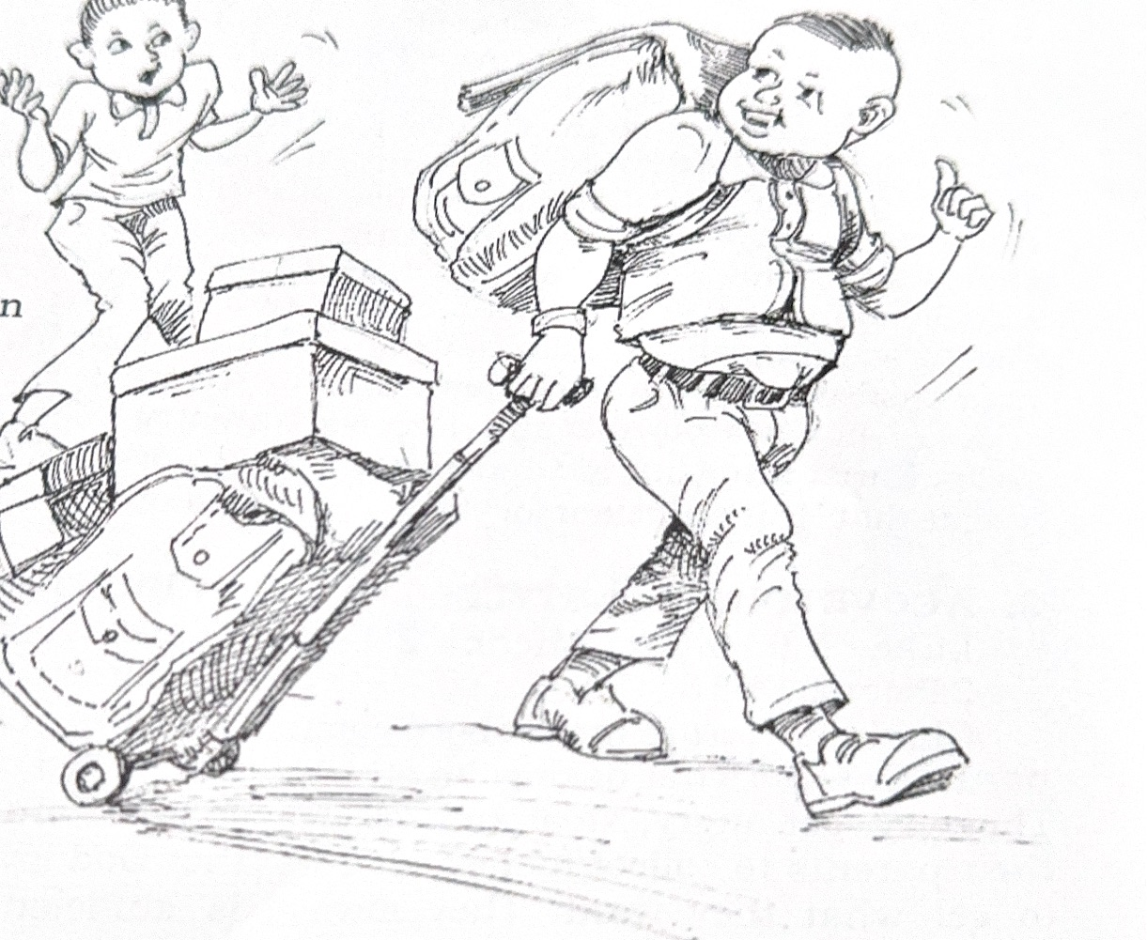
WARNING AGAINST COVETOUSNESS

Slide 2
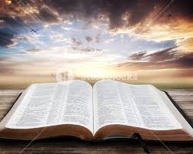
MEMORY VERSE: “And he said unto them, Take heed, and beware of covetousness: for a man's life consisteth not in the abundance of the things which he possesseth” Luke 12:15
TEXT: Luke 12:13-34

Slide 3
INTRODUCTION
Covetousness means greediness, the desire to get what you do not have and do not necessarily need at all costs.
The Greedy Dog – A Story
The story tells of a greedy dog who found a bone and, fearing he might have to share it, ran home to eat it alone. While crossing a bridge, he saw his reflection in the water and, mistaking it for another dog with another bone, tried to snatch it. When he opened his mouth to bark, his own bone fell into the river and was lost.
This teaches the lesson that greed leads to loss. The story concludes with a moral lesson from a Christian perspective: Jesus warns against covetousness and invites children to give their hearts to Him to be free from greed.

Slide 4
Three points to consider
1. CHRIST’S WARNING AGAINST COVETOUSNESS
2. A COVETOUS LIFESTYLE
3. CHRIST OUR SUFFICIENCY

Slide 5
CHRIST’S WARNING AGAINST COVETOUSNESS: Luke 12:13-21; Exodus 20:17; Ephesians 5:3–5
From our Bible passage, a man wanted his brother to share his father’s property with him, so he asked Jesus to help him out.
Jesus seized the opportunity to teach us about how bad it is for one to be covetous.
Jesus gave a parable about the rich fool. He had so much food that there was no more space for him to store them.
He planned on making a bigger barn so he could store as much crop as he could, all for himself.

Slide 6
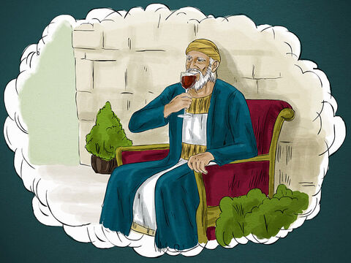
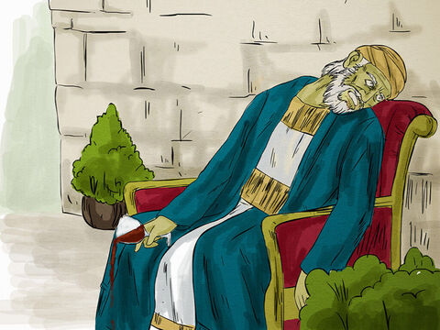
CHRIST’S WARNING AGAINST COVETOUSNESS CONT’D.
This rich man was not appreciative and satisfied with the provision that God had given him, and he was not willing to share his goods with others.
He was thinking only about himself.
God looked at his foolishness and told him that he was going to die that night. Then, who could be the owner of the crops he had gathered?

Slide 7
CHRIST’S WARNING AGAINST COVETOUSNESS CONT’D.
Life is more important than the material things that we own.
Unfortunately, many children are like the rich fool.
They are never satisfied with what their parents can provide for them.
They have no time for God and others.
They go out of their way to make sure they have what they want.
They can never be satisfied because material things can never bring satisfaction

Slide 8
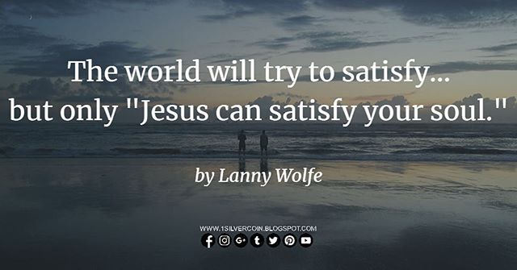
CHRIST’S WARNING AGAINST COVETOUSNESS CONT’D.
Only Jesus can give true satisfaction.
Are you a covetous child, always wanting what others have and not satisfied with what you have?
It shows that you are not yet born again.
You need to accept Jesus Christ as your Lord and Saviour, and you will find that He is sufficient for you.

Slide 9
2. A COVETOUS LIFESTYLE: Luke 12:16–21; Micah 2:1-3; 2 Peter 2:14 -16
Children who are not yet born again naturally want what belongs to others. They
They cry, get angry, steal and deceive their parents to collect money in order to get what they want.
Always want the latest clothes, shoes, bags and toys
They get envious and jealous of children who have more than they do.
They are never satisfied with what they have. They do not care if their parents cannot afford what they want; they will get it by all means.

Slide 10
2. A COVETOUS LIFESTYLE CONT’D.
Covetousness makes one trust in oneself and not in God for one’s needs.
The end of every covetous boy or girl is an unfulfilled and unsatisfied life and eternal separation from God.
The Bible has examples of people who were covetous and the consequences of it;
Achan: He died shamefully with his family because of his greed for gold and the Babylonish garment he could not wear for a day (Joshua 7:19-26).

Slide 11
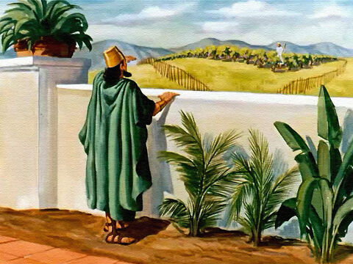
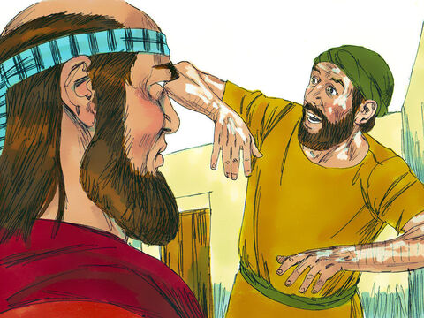
2. A COVETOUS LIFESTYLE CONT’D.
Ahab: He coveted the vineyard of Naboth. When Naboth refused to give it to him, his wife, Jezebel, planned his death (1 Kings 21:1-19). Judgment of destruction was pronounced on him and his family.
Gehazi: The servant of Elisha coveted the gifts of Naaman the leper, which he brought to Elisha when the prophet turned them down. As a result, the leprosy of Naaman came upon him (2 Kings 5:1-27).

Slide 12
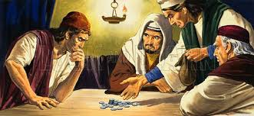
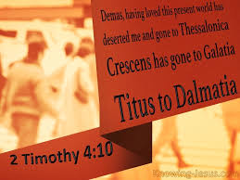
2. A COVETOUS LIFESTYLE CONT’D.
Judas Iscariot: He was one of Jesus' disciples but betrayed Christ for thirty pieces of silver. Eventually, he could not spend the money, but committed suicide (Matthew 26:14,15).
Demas: He forsook Paul in the ministry because of his love for the world. He became a backslider (2 Timothy 4:10).

Slide 13
3. CHRIST OUR SUFFICIENCY: Luke 12:22-34; Matt. 6:33-34; Hebrews 13:5-6
Jesus taught His disciples to depend on God for their needs.
As children of God, we must understand that God loves and cares about us.
He is sufficient for all our needs and promises to supply them (Philippians 4:19).
He will not withhold anything good and profitable from you (Psalm 84:11).

Slide 14
3. CHRIST OUR SUFFICIENCY CONT’D.
Some children ask God for things they do not need to satisfy their covetous minds. God will not answer such prayers (James 4:3).
To enjoy Christ’s provision, you must be His friend. You can become a friend of Jesus as you:
Accept that you are a sinner.
Believe that Jesus shed his blood to cleanse and save you from sins.

Slide 15
3. CHRIST OUR SUFFICIENCY CONT’D.
Confess your sins, repent of them and ask Jesus to come into your life as Saviour and Lord.
Have faith that you are not a new creature.
Continue to follow Jesus by praying and reading His word every day.
All you ever need is in Jesus. You must seek His kingdom and righteousness first; all other things will be added to you.

Slide 16

QUESTIONS
What is covetousness?
Why was the rich man in Jesus' parable called a fool?
Name things that can make children greedy.
Mention two Bible characters who were covetous and what happened to them.
Who gives true satisfaction?
What should a covetous child do to be satisfied?

Slide 17


LESSON, THOUGHT & ACTIVITY
LESSON: Jesus is our sufficiency.
THOUGHT: I will trust God to supply my needs and be content.
ACTIVITY: Children should write in their notebooks those things that make them covetous, ask God for forgiveness and pray to God for grace to be contented.

Slide 18

CONGREGATIONAL SONG, & CHORUSES
CONGREGATIONAL SONG: GHS 244 – All Things in Jesus
CHORUSES:
"Thank you, Lord"
"When I remember..."
"He’s a Great Lord Provider"

Slide 19
REFERENCES
https://www.freebibleimages.org/illustrations/rich-fool/
https://www.freebibleimages.org/illustrations/naboth-ahab/
https://www.freebibleimages.org/illustrations/elisha-naaman/
https://dailyverse.knowing-jesus.com/2-timothy-4-10
https://pixabay.com/images/search/question%20mark/
https://www.google.com/search?q=free+lesson+learned+images

