Slide 1

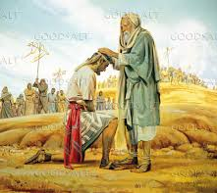
JOSHUA ASSUMES LEADERSHIP
Joshua 1:1-8

Slide 2

MEMORY VERSE
“Now after the death of Moses the servant of the LORD it came to pass, that the LORD spake unto Joshua the son of Nun, Moses’ minister, saying, Moses my servant is dead; now therefore arise, go over this Jordan, thou, and all this people, unto the land which I do give to them, even to the children of Israel” Joshua 1:1,2

Slide 3

INTRODUCTION
Joshua was one of the two spies who brought a report back when Moses sent twelve men to spy out the promised land.
These two men made it to Canaan because of their faith in God and confession of that faith.
He was eventually chosen by God to lead the children of Israel to the promised land after the death of Moses.
God chose him because he was a faithful servant.
He was also a good assistant to Moses, the man of God.

Slide 4
INTRODUCTION CONT’D
It is God who chooses leaders.
As friends of Jesus, we are to obey and respect God’s appointed leaders ( Heb. 13:17)
Disobedience to God’s instructions, which they bring to us, is disobedience to God, and it brings punishment.
Whenever there is a change in leadership, we should accept the new leader(s) with joy.
Joshua’s obedience to God’s instruction was prompt.
Our pastors and teachers in the church are appointed by God.

Slide 5
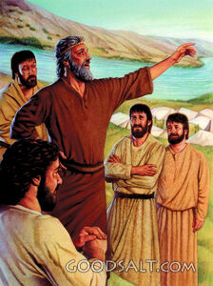
INTRODUCTION CONT’D
He, in turn, encouraged other children of Israel to obey the word of God.
His ministry was successful because he obeyed God in all things.
He led the Israelites to the promised land.
Aside from this, he had confidence in the ability of God to conquer the enemies of the children of Israel.

Slide 6
INTRODUCTION CONT’D
Children of God are not expected to fight physically; the battle we are fighting is spiritual (Ephesians 6:10-18)
Through prayer to God and putting on the whole armour of God, we are able to fight spiritual battle.
This is a guarantee of victory

Slide 7
POINTS TO CONSIDER
1. THE LIFE OF JOSHUA AND GOD’S INSTRUCTION TO HIM
2. THE LEADERSHIP OF JOSHUA
3. THE LORD’S CONDITION FOR SUCCESS

Slide 8
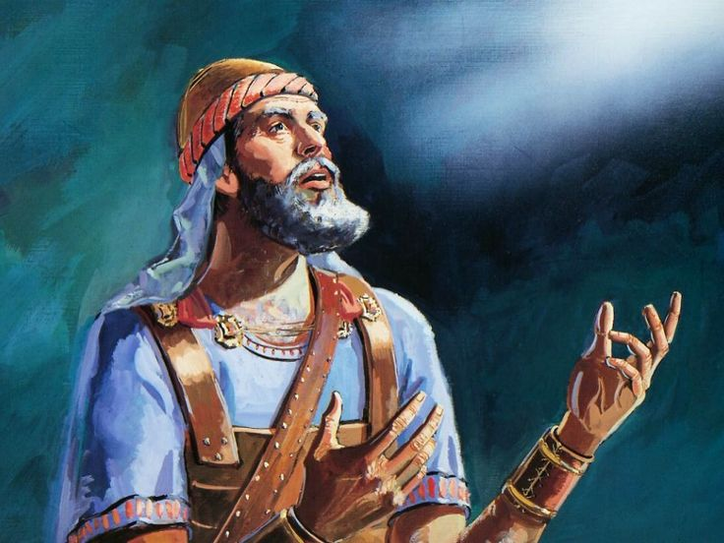
THE LIFE OF JOSHUA AND GOD’S INSTRUCTION TO HIM: Joshua 1;1-8; Numbers 27:12-23
Joshua had been an intimate and faithful assistant of Moses during the 40 years of wilderness journey (Exodus 17:8-13; 24:13; Numbers 13:8,16).
He was a young man filled with the power of the Holy Spirit.
Thus, God had commissioned him to be Moses’ successor.
Now, God was calling him to lead His people into the land of promise.
The name Joshua means “The Lord saves” or “The Lord is salvation”.

Slide 9
THE LIFE OF JOSHUA AND GOD’S INSTRUCTION TO HIM CONT’D.
Joshua is a type or representative of Jesus Christ in that he led God’s people into the promised land and to victory over their enemies.
In the first chapter of the book of Joshua, God called Joshua and specifically gave him instructions on how to lead His people to possess their inheritance.
The instructions contain:
A definite call to lead Israel into the land flowing with milk and honey
Assurance of God’s presence and help
Promised victory as they fight to take possession of Canaan.
Encouragement to remain strong, steadfast and courageous.
The call to obey all the commandments of the Lord.

Slide 10
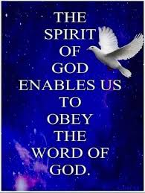
THE LIFE OF JOSHUA AND GOD’S INSTRUCTION TO HIM CONT’D.
For Joshua and the children of Israel, the possession of the promised land was realised and maintained by faith in God expressed in obedience to His word.
For us under the New Testament, the possession of salvation and God’s blessings is likewise maintained by a present living faith in Christ that is expressed in obedience to His word.
God has given us His sure promise that He will be with us as long as we remain under His control.

Slide 11
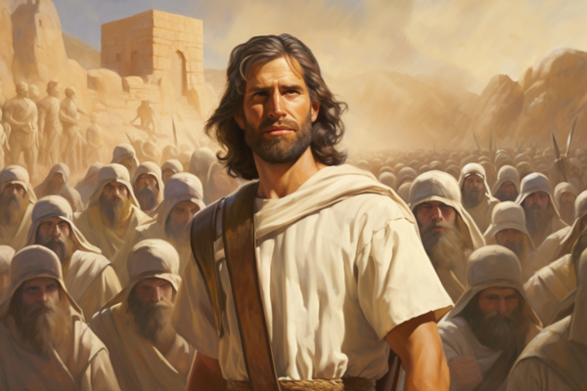
2. THE LEADERSHIP OF JOSHUA: Joshua 1:1-8; Numbers 27:18-23; Deut. 31:1-8
Joshua, the son of Nun, was Moses’ minister.
He was very loyal to the leadership of Moses.
He was a man of faith who trusted and believed in God.
He was one of the two spies who believed that they were able to possess the land when sent as spies by Moses to view the land of Canaan (Numbers 14:6-9).
Joshua encouraged the children of Israel to believe that God could save them from their enemies and make them possess their possessions.

Slide 12
2. THE LEADERSHIP OF JOSHUA CONT’D.
He was eventually chosen by God to be the leader to take Israel to the land of promise.
He took over from Moses, and God was with him as He was with Moses.
Joshua was accepted by all the people because he was God’s choice.
We should not grumble or fight against God’s appointed leaders.
The Bible records that Israel served God all the days of Joshua as their leader.
He was an exemplary leader because God was with him.
As children, we must also serve God faithfully and encourage others to do so.
It pays to serve God.

Slide 13

3. THE LORD’S CONDITION FOR SUCCESS: Joshua 1:5-9; Psalm 1:1-3
God promised Joshua unlimited success as he continued to serve Him.
Firstly, he was to be bold and courageous.
He was also instructed to carefully study, meditate on and obey the word of God, putting it first before anything.
So also, as children, we are to be strong and courageous when we are faced with problems of life, be it difficult subjects in school, choice of career, financial or health challenges.

Slide 14
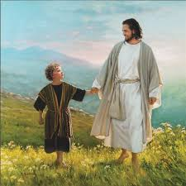
3. THE LORD’S CONDITION FOR SUCCESS CONT’D.
As God was with Moses and Joshua, He will always be with us and see us through all life’s challenges if we continue to walk daily with Him, trusting His word.
As you can see from the lives of Moses and Joshua, obeying the instructions of God, following Him as He leads the way, and total surrender, guarantees success in life.

Slide 15
3. THE LORD’S CONDITION FOR SUCCESS CONT’D.
The requirements for prosperity and success are:
Be strong, courageous and diligent
Make God’s word your authoritative guide for all your actions.
Study and meditate daily on God’s word.
Determine to always seek the presence of God throughout your life.
The instruction to Joshua provides us with a set of general principles for successful living.
Therefore, you must take the word of God as your best companion.
Make a commitment to read it every day, meditate on its instructions (precepts), obey it fully and teach others too
Become a special child of God through the blood of Jesus, shed on the cross at Calvary.
You will enjoy unending blessings and success in life.

Slide 16

QUESTIONS
Who was Joshua?
Why did God choose him to succeed Moses?
State three things contained in the instructions God gave Joshua
Joshua was obedient to God’s call. Yes/No?
Mention three things required to succeed in God’s work.
What must a sinner do to be appointed as God’s servant?

Slide 17
LESSON, THOUGHT AND ACTIVITY
LESSON
Faithfulness and obedience bring promotion.
THOUGHT
I will be faithful and obedient to God in all things.
ACTIVITY
Children should pray to God (now and always) that God should make them obedient children who will faithfully serve God like Joshua

Slide 18
SONGS
CONGREGATION SONG: GHS 41–ONWARD, CHRISTIAN SOLDIERS
CHORUSES:
i. I am in the Lord’s army
ii. I have decided to follow Jesus
iii. Following Jesus, every day by day

Slide 19
REFERENCES
What It Means to Live a Truly Successful Life - https://i0.wp.com/www.markcole.ca/wp-content/uploads/2025/06/success.png?ssl=1
Question Mark - https://pixabay.com/illustrations/question-mark-question-response-1019993/
What’s Your View of the Bible?- https://thepreachersword.com/2013/03/28/whats-your-view-of-the-bible/\
Important Points To Consider - https://www.sytian-productions.com/blog/web-design/7-important-points-to-consider-when-redesigning-a-website/
Joshua-Portrait of the Man God Uses- https://www.preceptaustin.org/joshua-portrait-of-the-man-god-uses
Joshua: The Faithful Leader Who Brought Israel Home - https://theisraelbible.com/joshua-prominent-figure-in-leading-the-jewish-people/
Joshua Becomes the Leader - https://www.goodsalt.com/joshua-becomes-the-leader-lfwas0594?srsltid=AfmBOorRQ2n7rXmnESwcBZCzKPobbxf8cN97NknbG6q_swVSRltECrPh

