Slide 1


Youth Search the Scriptures
Lesson 116

Slide 2
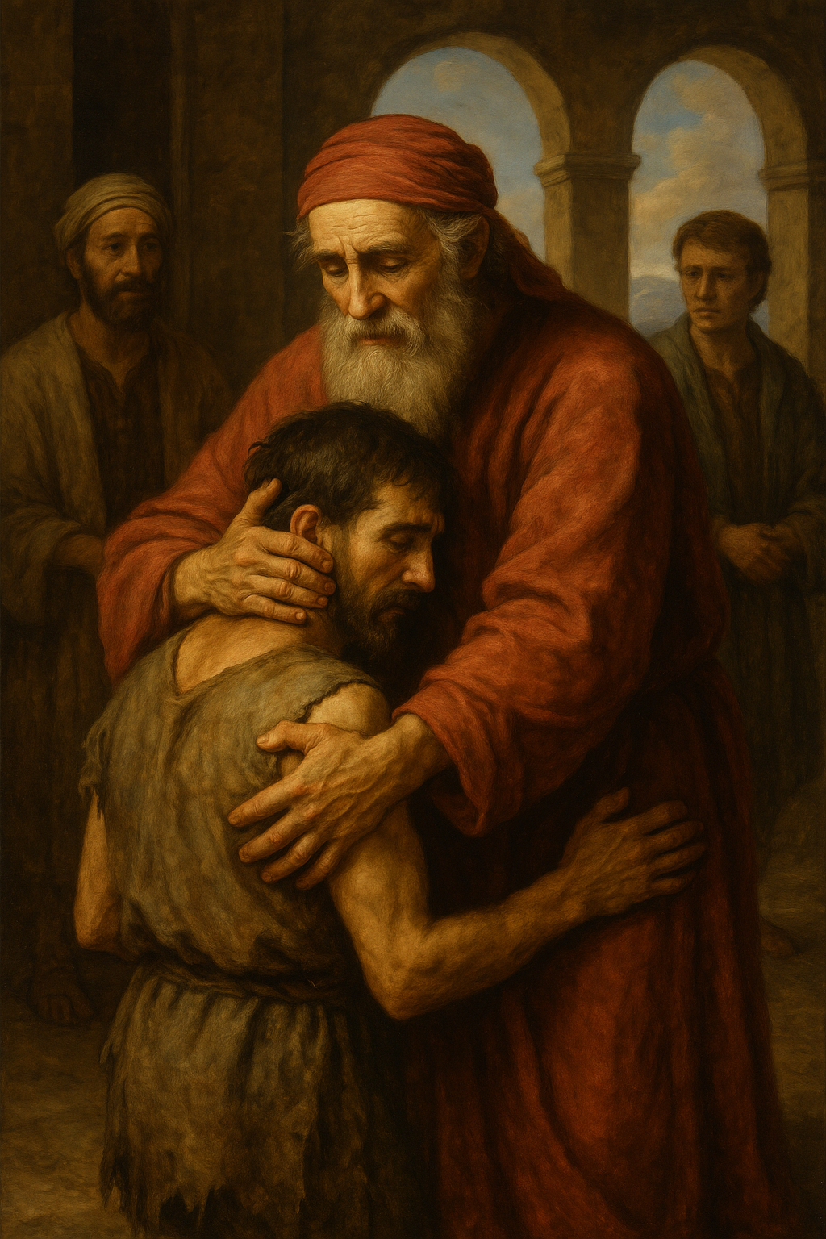
THE PRODIGAL SON
MEMORY VERSE: And he arose, and came to his father. But when he was yet a great way off, his father saw him, and had compassion, and ran, and fell on his neck, and kissed him” (Luke 15:20)
TEXT: Luke 15: 1- 32

Slide 3
Introduction
The text today contains three parables, each of which illustrates God's joy over the repentance of sinners.
The Parable of the Lost Sheep- A shepherd leaves 99 sheep to find one that is lost. Lost sheep is like a sinner (Luke 15:4-7).
The Parable of the Lost Coin- A woman searches diligently for a lost silver coin. Luke 15:8-10
The Parable of the Prodigal Son - A younger son who wasted his inheritance, reckless and thoughtless, returns home. God cares deeply about those who are lost and rejoices when they turn back to Him.

Slide 4
SUB TOPICs
ONE: THE PERVERSE CHOICE OF THE PRODIGAL SON
TWO: THE PITIABLE CONDITION OF THE PRODIGAL SON
THREE: THE PRAYER AND CONTRITION OF THE PRODIGAL SON

Slide 5
Point1: THE PERVERSE CHOICE OF THE PRODIGAL SON
Luke 15:1-13,30; Deut 30:19; 32:15,18; Gen 13:10,11; Proverb 5:1-13; Joshua 7:21
From the parable of the prodigal son, two groups of youths can be identified
The Godly, Holy, and purposeful youth
The sinner, the hypocrite, and the prodigal youths
The prodigal son took several steps that led to his troubles :
He chose the path of rebellion. Luke 15:12, Absalom- 2 Samuel 15:1.
He ran away from parental control, guidance and authority (Luke 15:13; Proverbs 21:16) Samson
He wasted his resources,inheritance with riotous living, immorality,youthful lusts. (Luke 15:13, Proverbs 31:13), Solomon

Slide 6
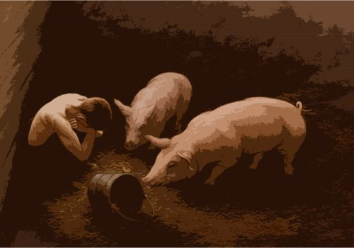
Point 2: THE PITIAble CONDITION OF THE PRODIGAL SON
Luke 15:14-16,24; 2 Samuel 18:9; Romans 3:12; Proverbs 29:1; 14:12
The prodigal son paid dearly for his actions (Luke 15:15). Sin makes a youth waste his treasures and talents, which he would have profitably utilised for personal, family, community and God's service.
The Consequences of Sin:
Leads to trouble
Waste gifts and talents
Sin ruins life
Reduce strength to serve God
Divides attention
Increase difficulties
Eventually leads to perdition in hell.

Slide 7
Point 3: THE PRAYER AND CONTRITION OF THE PRODIGAL SON
Luke15:17-32; 18:10-13; Psalm 34:18; Isaiah 53:6
The prodigal chose to return home, seeking to be a hired servant. His father welcomed him back with open arms, celebrating his return with a feast.
Lessons:
1. The moment of realization- he soon realized his wretchedness, sinfulness, total depravity, and helplessness. “…And when he came to himself” (Luke 15:17).
2. Repentance - This signifies a concrete choice to forsake sinful objects, relationships, pleasures, friends, places and practices. “I will arise and go to my father” (Luke 15:18).
3. Forgiveness: The prodigal son was accepted back to the family. the boundless mercy and forgiveness offered by God await every contrite sinner and backslider who would return to the heavenly Father

Slide 8
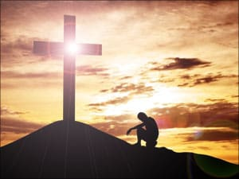
conclusion
Today, a warm reception, forgiveness and restoration await every contrite sinner and backslider who would return to the heavenly Father. God will forgive all the past sins he may have committed, irrespective of the gravity of the offense, if he repents genuinely.

Slide 9

Q &A
9
Question 1. Who is termed a “Prodigal Son”?
Question 2. (a) Mention the two categories of youths in the world according to the parable of the prodigal son.
(b) What are the characteristics of the prodigal son that Christian youths must avoid?
Question 3. What are the consequences of sin and rebellion against God?
Question 4. Mention the steps the prodigal son took before being restored to fellowship with the father.

