Slide 1
STS Lesson 125 FORGIVENESS, FAITH AND GRATITUDE ENJOINED TEXT: Luke 17:1-19

Slide 2

MEMORY VERSE: Luke 17:3,4
“Take heed to yourselves: If thy brother trespass against thee, rebuke him; and if he repent, forgive him. And if he trespass against thee seven times in a day, and seven times in a day turn again to thee, saying, I repent; thou shalt forgive him”

Slide 3

Introduction
This passage from Luke 17 highlights four key teachings:
Offences are inevitable among believers (Luke 17:1)
Severe judgment awaits those who harm the innocent (Luke 17:2)
Daily, unconditional forgiveness is commanded (Luke 17:3–4)
Extraordinary faith and gratitude are essential (Luke 17:11–19)
The study emphasizes a threefold Christian character that every Christian youth should cultivate:
Forgiveness - freely and consistently, knowing offences will come.
Faith - trusting Jesus in all circumstances especially to forgive
Gratitude - maintaining a thankful heart for God’s blessings
Rather than harboring resentment or fear, Christian youths are called to live with grace, courage, and spiritual maturity
This Photo by Unknown Author is licensed under CC BY-SA-NC

Slide 4
FORGIVENESS
GRATITUDE
FAITH

Slide 5
POINTS
Divine Charge To Forgive Offenses
The Need For Increasing Faith Enjoined
Encouragement To Show Gratitude Always

Slide 6

DIVINE CHARGE TO FORGIVE OFFENSES (Luke 17:1-4; Genesis 50:17; Exodus 32:32; Matthew 6:12,14,15; 2 Chronicles 7:14)
This teaching on forgiveness is directed specifically at born-again youths, not unbelieving youths. Jesus emphasizes:
Offences are inevitable among believers, but those who cause them especially to young or vulnerable Christians will face severe judgment (Luke 17:1–2)
The term “brother” (Greek: Adelphas) refers to fellow disciples, regardless of gender, highlighting that forgiveness must be practiced among Christian youths (Luke 17:3)
Differences in upbringing and perspectives can lead to misunderstandings, even among Christian youths
A believer who becomes spiritually careless may fall and act harmfully toward others, but deliberate offenders who damage the faith of others are warned of God's judgment

Slide 7
DIVINE CHARGE TO FORGIVE OFFENSES (Luke 17:1-4; Genesis 50:17; Exodus 32:32; Matthew 6:12,14,15; 2 Chronicles 7:14)
Avoid those who sow division and spiritual harm (Romans 16:17), and never become a tool of Satan like Judas, whose betrayal led to destruction
Believers must remember that Jesus died for our offences (Romans 4:25; 5:16), and we are called to extend that grace to one another
Forgiveness is not optional – it is a divine command for all who have received grace. True Christian character is shown in how we respond to offences: with love, caution, and unwavering commitment to unity

Slide 8
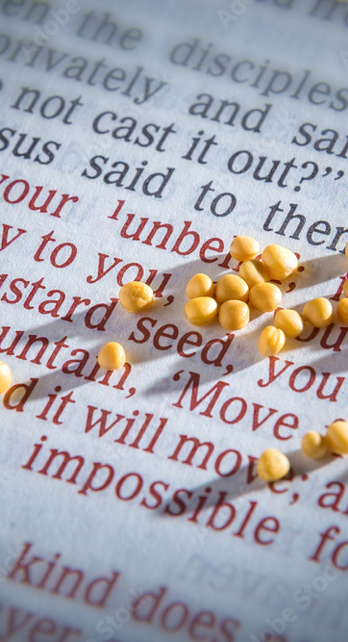
THE NEED FOR INCREASING FAITH ENJOINED (Luke 17:5-10; Acts 13:38,39; Colossians1:14; Hebrews 4:2)
When Jesus taught about habitual forgiveness, His disciples recognized their need for greater faith; not just to understand the teaching, but to live it out (Luke 17:5)
Jesus responded by emphasizing that even small faith, like a mustard seed, can produce powerful results (Luke 17:6; Matthew 17:20).
This shows that great acts of forgiveness do not require great fait - just genuine faith
Key Lessons:
Forgiveness requires faith, especially when it is difficult or repeated offenses
Modern tendencies toward revenge contrast sharply with Jesus’ call to forgive and pray for one’s enemies
True forgiveness begins with salvation - only youths who have received Christ’s redemption (Colossians 1:14) can extend grace to others

Slide 9
THE NEED FOR INCREASING FAITH ENJOINED (Luke 17:5-10; Acts 13:38,39; Colossians1:14; Hebrews 4:2)
Redemption leads to righteousness, and righteousness enables Christian youths to forgive sincerely (Romans 10:9–13)
Jesus instructs Christian youths to rebuke with love and forgive upon repentance (Luke 17:3)
Forgiveness is not a feeling; it’s a faithful response rooted in salvation and spiritual maturity. Saved youths should reflect Christ’s mercy, praying for their offenders and trusting God to work through even the smallest seed of faith

Slide 10
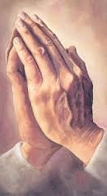
ENCOURAGEMENT TO SHOW GRATITUDE ALWAYS (Luke 17:11-19; Leviticus 13:46; Colossians 3:15; Romans 1:21; Psalm 100:4)
Jesus encountered ten lepers outside a village who cried out for mercy
He instructed them to show themselves to the priest, and as they obeyed, they were miraculously healed
However, only one returned to thank Jesus - a Samaritan. Jesus acknowledged his gratitude and confirmed his healing, highlighting the spiritual depth of thankfulness
Important Lessons for Christian Youths:
Gratitude is rare but powerful. Nine lepers received physical healing, but only one received a deeper spiritual blessing through thanksgiving
Ungratefulness is a sign of spiritual decline, especially among youths who overlook acts of kindness from others
True appreciation should be shown to those who support us like our friends, family, church leaders and most importantly, to God.
Thankfulness opens the door to greater blessings, and it reflects a heart that truly understands grace

Slide 11
ENCOURAGEMENT TO SHOW GRATITUDE ALWAYS (Luke 17:11-19; Leviticus 13:46; Colossians 3:15; Romans 1:21; Psalm 100:4)
The best way to show gratitude to Christ is by accepting His sacrifice, obeying His Word, and serving Him faithfully
Gratitude is not just good manners; it is a spiritual posture that invites deeper healing and divine favor

Slide 12

QUESTIONS
What are the threefold qualities a Christian youth should possess?
Why are there offences among believing youths?
What is the connection between forgiveness and faith?
Who are the people that deserve our appreciation?
In what ways can youths show appreciation to Jesus for all He has done for them?
This Photo by Unknown Author is licensed under CC BY-NC

Slide 13
References
https://memoryos.com/article/how-to-increase-working-memory-the-art-of-remembering
https://experiencelife.lifetime.life/article/the-art-of-forgiveness/
https://stock.adobe.com/ca/images/mustard-seeds-on-a-open-bible-page-illustrating-the-verse-if-you-have-faith-as-small-as-a-mustard-seed-matthew-17-20/137119462
https://psecotc2014.wordpress.com/group-11/niharika/

