Slide 1
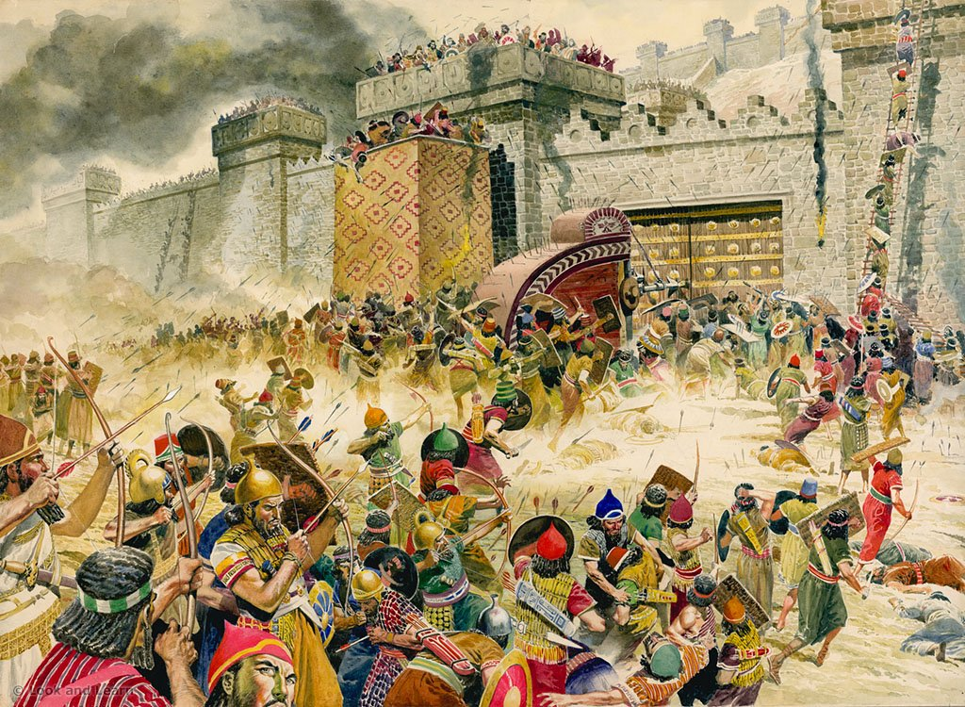

YOUTH Search the scriptures lesson 120 DEFEAT OF THE MIDIANITES AND DEATH OF BALAAM

Slide 2
MEMORY VERSE
“And they slew the kings of Midian, beside the rest of them that were slain; namely, Evi, and Rekem, and Zur, and Hur, and Reba, five kings of Midian: Balaam also the son of Beor they slew with the sword” (Numbers 31:8).
TEXT - Numbers 31:1-54

Slide 3
INTRODUCTION
“Though hand join in hand, the wicked shall not be unpunished” Proverbs 11:21a. It is now the time for the Midianites to receive the just recompense reward of the evil they have done in luring Israel to immorality and idolatry. The present study, therefore, gives the details of the fulfillment of this word of judgment on the Midianites. This shows the gravity of the judgment of God on sinners and backsliders. Every sinner will reap the reward of his/her actions except there is genuine repentance and turning away from sins, for God requireth that which is past (Ecclesiastes 3:5).

Slide 4
“Dearly beloved, avenge not yourselves, but rather give place unto wrath: for it is written, vengeance is mine; I will repay, saith the Lord” (Romans 12:19).
The war against Midian in the Old Testament was divinely ordered and authorized by God to fulfill a divine purpose. It was not a human retaliation; rather, it was a divine retribution on a sinful nation that caused the people of God to sin against Him. From the above, anyone who teaches, counsels, or seduces others to sin against God will receive great punishment from Him. Christian youths are not to be involved in fighting and unruly disagreement; rather, they should pray and preach to sinners.

Slide 5
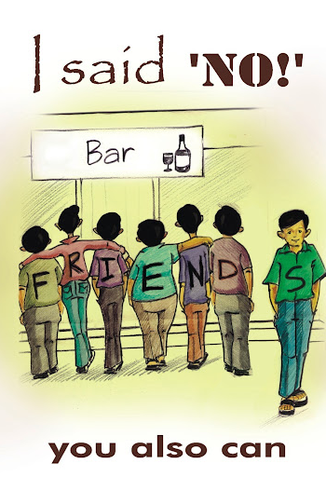
Lessons for Christian Youths:
Avoid being a stumbling block - Never encourage or lead others into sin; God holds such actions accountable.
Stay pure and separate from worldly influences that promote immorality and idolatry.
Let God handle justice - resist the urge to retaliate or seek revenge, and leave all judgment to Him.
Be ambassadors of truth and love - respond to evil with godly actions like praying, witnessing, and living as Christ would.

Slide 6
1. DIVINE COMMISION FOR HIS SERVANT
Numbers 31:1-18; Exodus 17:14-16; 1 Samuel 15:1-3; Numbers 33:50-56; 1Samuel 15:7-23; 2 Corinthians 6:14-18
The Midian were descendants of Abraham (Genesis 25:2) but corrupted themselves in an idolatrous alliance with Moab. Their confederacy with Moab lured Israel to immorality through their women. The war against the Midianites, commanded by God in Numbers 31:1-2, was a divine judgment for their role in leading Israel into immorality (Numbers 31:16). Although Israel was not to possess the land of Moab (Deuteronomy 2:9) but deliberate act of Moab in leading Israel to sin which brought divine punishment on Israel was the cause of the Midian’s imminent destruction. God told Moses to “Avenge the children of Israel of the Midianites”, and Moses told the people, “avenge the LORD of Midian” (Verse 3). This command is to be carried out as Moses’ final act of obedience before his death. This judgment underscores God's intolerance for sin, especially that which causes others to stumble, as seen in the destruction of Midianite cities and the killing of Balaam.

Slide 7
1. DIVINE COMMISION FOR HIS SERVANT CONTD
Numbers 31:1-18; Exodus 17:14-16; 1 Samuel 15:1-3; Numbers 33:50-56; 1 Samuel 15:7-23; 2 Corinthians 6:14-18
Though Balaam had desired to end up as a righteous “Let me die the death of the righteous, and let my last end be like his!” (Numbers 23:10), but greed and compromise (Numbers 31:10, 8; 2 Peter 2:15) caused him to die as a backslider. The way of Balaam is the way of prostitution, immorality, and idolatry. It is the way of those who trade spiritual gifts for worldly gains, which they may never possess or enjoy. Christian youths are reminded (1) To serve God faithfully to the end (Psalm 119:112; Joshua 24:15,29; 2 Timothy 4:1-8) (2) To maintain total separation from worldliness and sin (James 4:4; 2 Corinthians 6:17; Colossians 3:5-6) (3) To learn from these events as written for our instruction and hope (Romans 15:4).

Slide 8
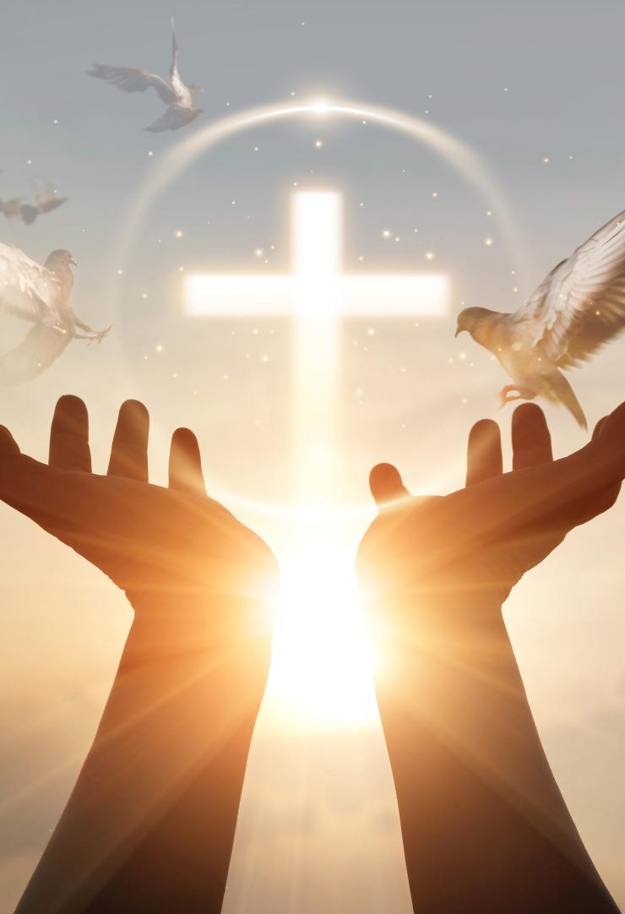
Lessons for Christian Youths:
Influencing others to sin brings divine consequences
Greed and compromise destroy spiritual destiny
Spiritual gifts must not be traded for worldly benefits
1. DIVINE COMMISION FOR HIS SERVANT CONTD

Slide 9
2. DIVINE COMMAND FOR THE CLEANSING OF THE SINFUL
Numbers 31:19-24; Leviticus 11:44,45; 1 Thessalonians 4:1-4,7; 1 Peter 1:14,15; 2 Timothy 2:22
The cleansing ordinance given by Eleazar in Numbers 31:21,19 emphasizes that holiness and righteousness are divine requirements, not human traditions. God has always called His people to purity, as seen in His command to Abraham (Genesis 17:1) and in Jesus' teaching on perfection (Matthew 5:48). This call to holiness is essential for seeing the Lord (Hebrews 12:14), and it points directly to the importance of salvation and sanctification through the sacrifice of Jesus. Salvation is freedom from evil and sin through repentance and faith in the death of Christ. It is freedom by grace through faith (Ephesians 2:8,9). On the other hand, sanctification is the gracious work of the Holy Spirit whereby the believer is freed from inward sin. Just as fire and water were used in the Old Testament for cleansing (Numbers 31:23), the Holy Spirit (fire) and the Word of God (water) cleanse believers today (Malachi 3:2-4; John 15:3; Ephesians 5:25-27). Christian youths must therefore seek these experiences through prayer, repentance, and full surrender to God for a life of true holiness.

Slide 10
3. DIVINE CHARGE FOR THE DISTRIBUTION OF THE SPOILS
Numbers 31:25-54; 1 Samuel 30:18-31; Ephesians 4:7,8; Psalm 96:6-9; 2 Chronicles 20:1-30; Acts 4:23-31; Hebrews 13:15
As the Lord’s commission neared completion, He instructed Moses to count and divide the spoils of war into two parts: one for the warriors and the other for the rest of Israel. From each group’s share, offerings were to be given, from the warriors to Eleazar the priest and from the congregation to the Levites who served in the tabernacle (Numbers 31:30,47). Moses obeyed exactly as commanded. In response to God’s goodness and protection, the officers voluntarily offered from their own gains in gratitude, and their gifts were preserved in the tabernacle as a memorial before the Lord (Numbers 31:50-52; Malachi 3:16).

Slide 11
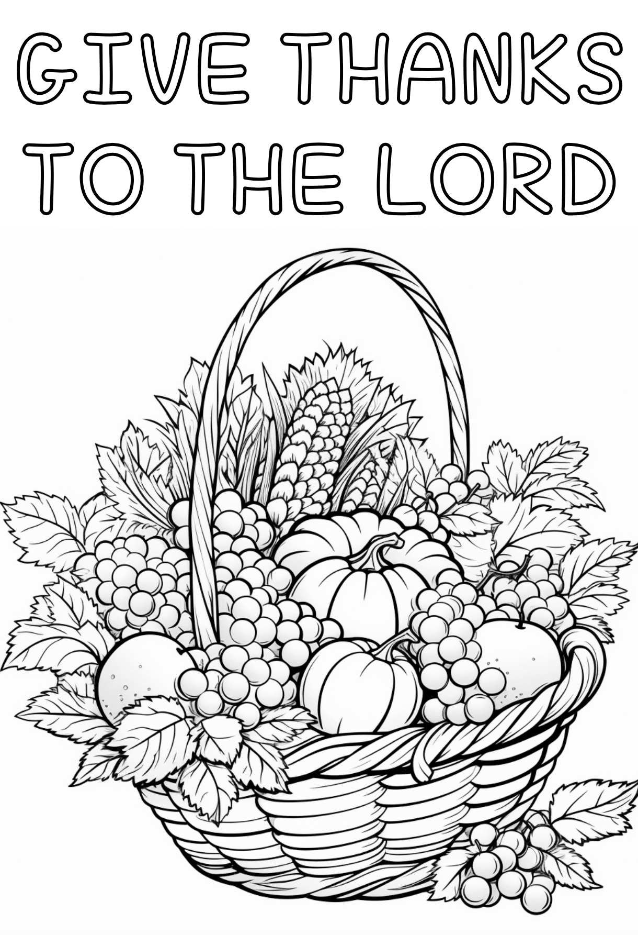
Lessons from this distribution:
Everyone should give to the Lord (Exodus 23:15; 34:20; Deuteronomy 16:16).
Everyone is qualified to share in the blessings of the Lord (Ephesians 4:7,8).
Giving should be done willingly and cheerfully (2 Corinthians 9:6,7).
Through this process, God meets the needs of His ministers (Numbers 31:29,30).
We should be obedient to the command of the Lord (Malachi 3:10; 1 Corinthians 16:2).

Slide 12

Questions:
Does God allow Christian youths to retaliate when offended?
What are the reasons for the dreadful destruction of Midian?
What can you learn from God’s vengeance against Midian?
What can we learn from the death of Balaam?
What experiences can produce righteousness and holiness in our lives?
What can you learn from this distribution?

Slide 13
References 1. Youth Search the Scriptures Volume 3 pg 94-99 DLCM Publication 2.https://www.google.com/url?sa=i&url=http%3A%2F%2Fgodswarplan.com%2Fdestruction-of-midian-numbers-31-balaams-donkey-vengeance-on-the-midianites-and-moabites

