Slide 1

The Charge and Portion of The Priests and Levites
STS
Volume 3 - Lesson 105

Slide 2

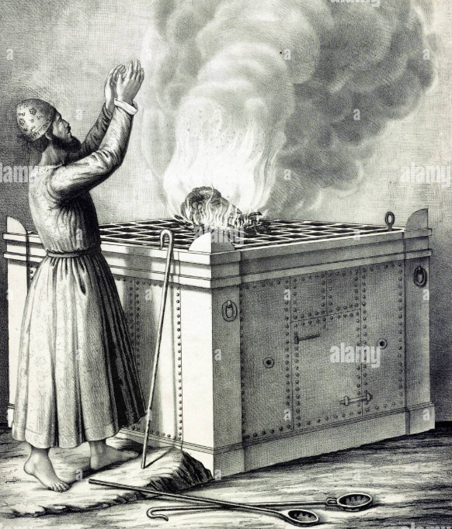
Memory Verse:
Numbers 18:12
"All the best of the oil, and all the best of the wine, and of the wheat, the firstfruits of them which they shall offer unto the Lord, them have I given thee.”".
Text: Numbers 18:1-32

Slide 3
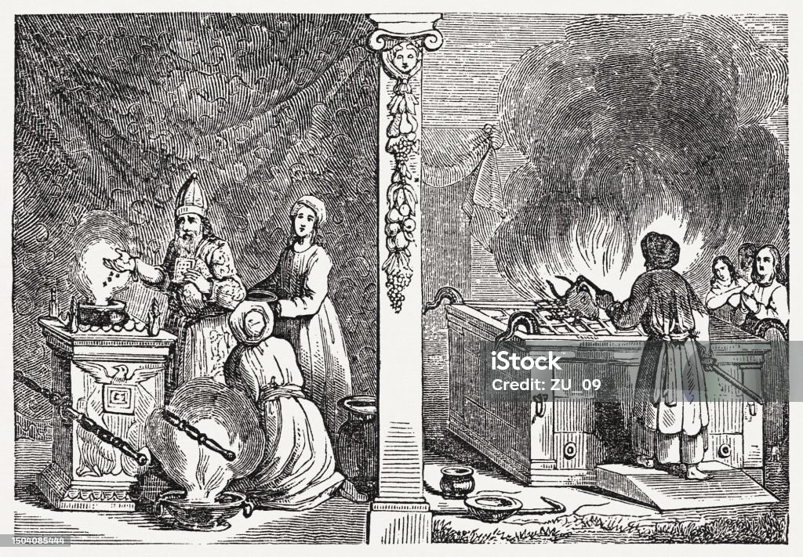
Introduction
Today’s lesson covers the specific responsibilities of the Priests and Levites in the service of the temple and how provisions were made for them through offerings and tithes.
However, in the previous study, God honoured Aaron by making his rod bud and blossom, showing divine approval, while others’ rods remained lifeless (Numbers 17:13).
Also, God warned of the danger of approaching the tabernacle unlawfully, emphasizing that unauthorized access would lead to death.

Slide 4
Introduction Contd.
God assigned special responsibilities to the priests and Levites. Their main charge was to serve in the tabernacle and protect the people from approaching God in an unworthy manner.
God showed that serving Him comes with great honour and responsibility. He therefore emphasized that anyone who would bear such honour must do it within divine specifications.
Sinning youths could be members of the physical church, but they are not members of the invisible church of Jesus Christ. So, our lesson pointed out who the priests and the Levites were and should be.
Service to God is orderly and specific, not ambiguous and secularized. Therefore, God’s instructions are final and not subject to human protests.

Slide 5
1. DUTIES OF THE PRIESTS AND THE LEVITES
(Numbers 18:1-7,22, 23, 32; 3:3-37; 1 Samuel 6:15; 1 Kings 8:3,4; 2 Corinthians 5:18-20; 1 Peter 2:19; Ecclesiastics 9:10)
God established a clear order for leadership among the Israelites. Aaron and his descendants were chosen as priests with special responsibilities.
The Levites were selected to assist the priests in the tabernacle duties. Their service was focused on maintaining the holiness of the sanctuary.
Unauthorized individuals were forbidden from performing priestly duties. God warned that approaching the tabernacle improperly would lead to death.
Leadership among God's people required strict obedience to His instructions. Serving in the tabernacle was both an honor and a serious responsibility.
The priests and Levites acted as mediators between God and the people. God's arrangement emphasized His holiness and the need for reverent service.

Slide 6
1. DUTIES OF THE PRIESTS AND THE LEVITES - contd
(Numbers 18:1-7,22, 23, 32; 3:3-37; 1 Samuel 6:15; 1 Kings 8:3,4; 2 Corinthians 5:18-20; 1 Peter 2:19; Ecclesiastics 9:10)
The priests were responsible for offering sacrifices and handling sacred duties in the tabernacle. The Levites assisted the priests by doing the service work around the tabernacle, but could not offer sacrifices themselves.
Priests had to ensure that no unauthorized person came near the holy things or the altar. The Levites guarded the tabernacle and prevented outsiders from approaching unlawfully.
Both priests and Levites bore responsibility for any offences committed in connection with the tabernacle service. Priests supervised and directed the work of the Levites in all their service duties.
The Levites maintained the tabernacle's structure, furnishings, and transportation during movements. The priests taught the people God's laws and ensured the proper practice of worship.
Unauthorized access to sacred areas could result in death, emphasizing the seriousness of their duties. God appointed the priests and Levites as a gift to Israel for the proper worship and service of His sanctuary.

Slide 7
2. Divine Provision for the Priests and Levites. (Numbers 18:8-19,21,24-31; Matthew 19:27-29; Exodus 23:25-27; Hebrews 6:10; Philippians 4:19; Malachi 3:8-12) “
The Priests and the Levites were not allowed to do any other work than the one God had committed into their hands.
The priests had divine provisions, which were connected to their service to God in the tabernacle. This allowed them to be fully consecrated and focused on their assignments.
The Levites also received the tithes from the children of Israel of which they were also to pay the tenth to the Priests.
Lesson: We are to give tithes of the pocket money, or the gift received. It sets up apart as disciples, who understand that sacrificial giving is akin to project execution in the church.

Slide 8
3. Dependable Covenant with His Servants
(Numbers 18:19; 25:13; Deuteronomy 28:1,2: Malachi2:4-7; Heb 6:10
God gave the Priests an assurance of continuous provision which He called the “Covenant of Salt”
The "covenant of salt" symbolized God's promise of ongoing provision for the priests. It emphasized salt's role as a preservative, representing the lasting nature of the covenant and serving as a safeguard against spiritual decay, as long as it was upheld.
The covenant also reminds us of our position in Christ and the World. Christian youths are the salt of the earth.(Matt 5:13) We are to engage in constant evangelism to save the world from destruction.
Christian youths are to preserve holiness in this corrupt world.

Slide 9

Questions
Why did God command the children of Israel not to approach the tabernacle?
What challenge do youths receive from Aaron and his sons being priests of the Lord?
State some consequences of allowing unqualified people to become workers in the church?
List some of the areas saved youths can serve the Lord in the church today.
What provisions did God make for the priests and Levites as a reward for their services?
What is tithes? Should the Levites pay tithes?

Slide 10

References
DLBC - Youth Search The Scriptures Book – Volume 3

