Slide 1
Lesson 146
FIRST FRUITS
AND TITHES

Slide 2
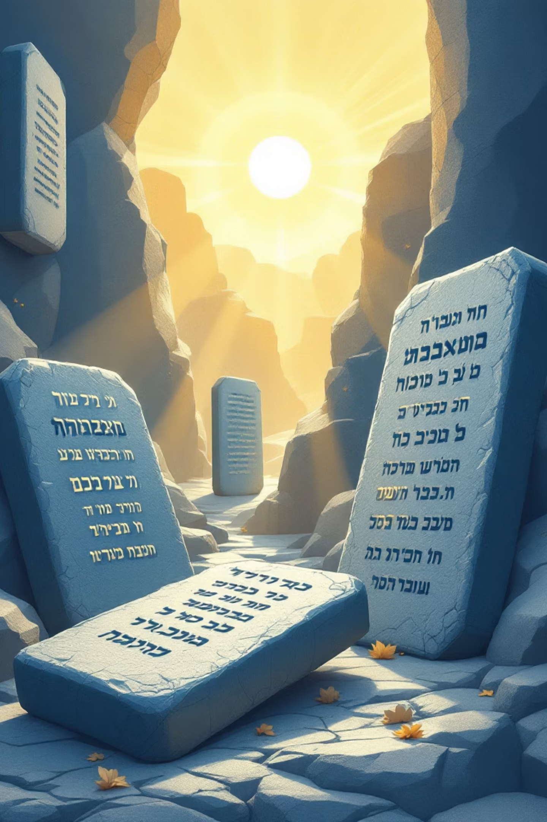
MEMORY VERSE:
“And now, behold, I have brought the first fruits of the land, which thou, O LORD, hast given me. And thou shalt set it before the LORD thy God, and
worship before the LORD thy God” (Deuteronomy 26:10).
TEXT:
Deuteronomy 26:1-19.

Slide 3
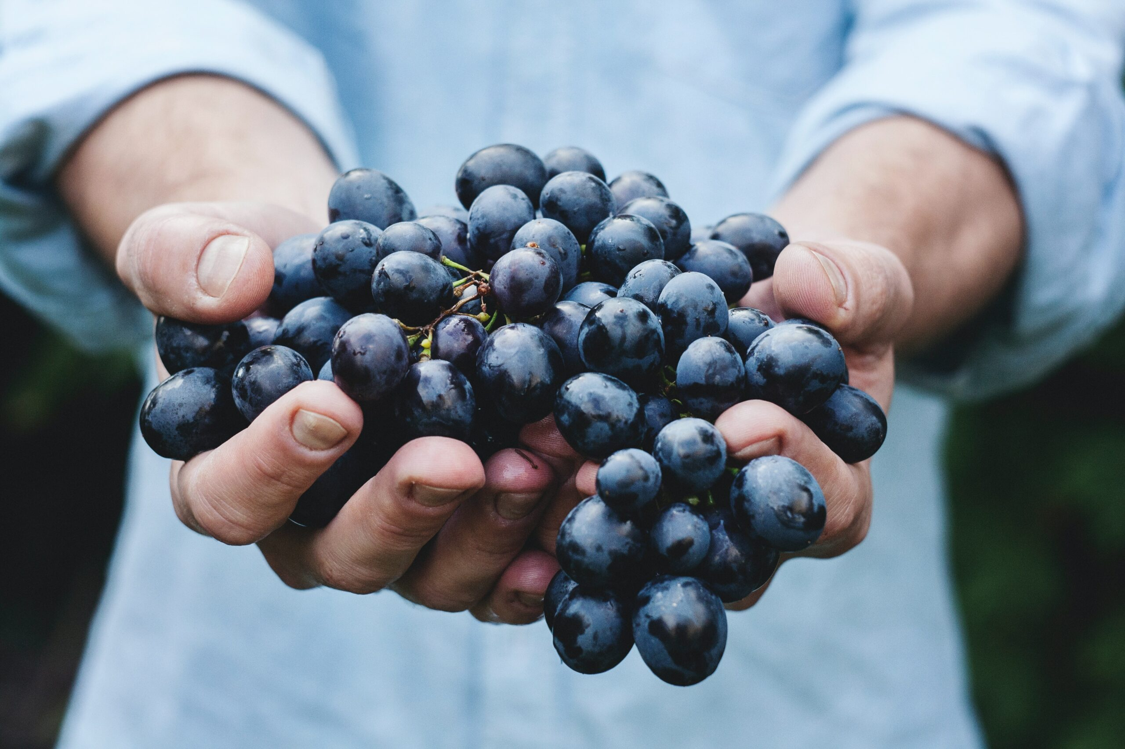
INTRODUCTION
God gave Israel the laws on first-fruits and tithes which they must observe when they get into the Promised Land.
These commands serves 2 main purposes:
Provide for the Priests and Levites who were servants of God
Provide means for the maintenance of God’s Sanctuary.
Deuteronomy 18:2

Slide 4
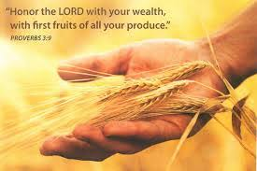
Today, the great commission needs speedy expansion. This will be possible not only through prayer and preaching but also through financial support.

Slide 5


Point 1:OFFERING: AN APPRECIATION OF GOD'S REDEMPTIVE
BLESSINGS
Deuteronomy 26:1-11; 18:4,5; Psalm 96:6-9; Proverbs 3:9,10
(i) Command regarding first fruits (Deut 26:1,2)
God’s commanding regarding first fruits was to be done when they got into the Promised Land. God was more interested in their entering into the land of Canaan which He promised them. Hence, they were pre-informed of the law.
(ii) Condition for giving. (Proverbs 15:8)
Redemption is the only entering point for sinning youths into the kingdom of God. God is more interested in repentance of souls from sins than sacrifice and offering. God loves obedience to His words more than the gifts sinners offer.
(iii) Reason for giving (Deut 26:2,3)
Honor and appreciation for divine multiplication of their seeds.
Appreciation for His merciful redemption for them and their multiplication while in Egypt.

Slide 6
Point 1 (contd.)
    Appreciation of their deliverance from the bondage in Egypt.
    His faithfulness to bring them into the Promised Land and the blessings of God (Deuteronomy 26:4-11)

Slide 7
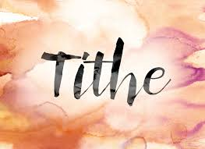
Point 2: OFFERING: MEANS OF ASKING FOR MORE OF GOD'S
BLESSINGS
Deuteronomy 26:12-15; Leviticus 27:30-32; Deuteronomy 14:22; 2 Chronicles 31:5; Luke 6:38; Malachi 3:8-12
The Specification on the Law of offering and First fruit. Deuteronomy 26:2
Looking at the law on first fruit, there is no specification on
the quantity to bring to the Lord
(ii) God’s Commandment on Tithe(Deuteronomy 14:22, 24, 25)
The law of God to Israel on tithe is different from that of the
first fruit. God commanded them to pay tithe on their harvested crops or pay the monetary value of the crops or wages through labor.
As Christian youths we are expected to pay tithe of our pocket money. The divine specification is 10% of our gross income as salary earners or gift.

Slide 8
(iii) The Necessity of Tithe (1 Corinthians 9:13)
The necessity of tithe to the Lord cannot be undermined for the following reasons:
It is God's own design to cater for His ministers.
It is also a way through which the house of God is maintained and mission work financed.
Means of providing for the poor and needy in the church.
(iv) Blessing through Tithe. (Proverbs 3:9,10)
After offering our tithe, God expects us to make our request to Him and He promised to reward our Obedience through:
Open window of divine abundance (Malachi 3:10)
Rebuke the devourer on your behalf by divinely protecting us from natural pestilence and sickness. (Malachi 3:11)
God will make us rich that everyone will notice it and call us blessed
Men shall give to us abundantly (Luke 6:38)
Divine Promotion

Slide 9

Point 3: OBSERVING DIVINE COMMANDS AND ENJOYING GOD'S
BLESSINGS
Deuteronomy 26:16-19; 28:1-13; Isaiah 1:19; Proverbs 3:9
(i) Manner and Heart Condition for Giving. Deuteronomy 26:16, 17
God was concerned with the manner in which His commandment is obeyed. God does not accept a gift when they are given grudgingly, and the unwilling giver is denied His blessings. Seeing the precious commands of God, and the benefits of doing them, youths should make the promise to observe them with all their hearts. This is the only condition in which God's full blessings can be received.
(ii) Blessings for Obedience. Deuteronomy 26:16
Some of the blessings of God for obedient children as revealed in our text are:
Making them His peculiar people (verse 18)
Divine exaltation above all nations
Making them holy for Himself, Obedient Christian youths are made heirs of God and joint-heirs with Christ. (Romans 8:17)

Slide 10

Conclusion - Key Takeaways
First fruit, Tithe and offering as commanded by God
Reasons for Giving
Obedience to God must be prompt and cheerful
Blessings for Giving.
As Christian youths, we should count it as a privilege to be partakers in God’s vineyard through obedience to the commandments of giving. We should therefore obey these commands cheerfully and so we can be partakers in Christ’s inheritance here on earth and with Him in eternity.

Slide 11
QUESTIONS
1. What qualifies a youth to give to God?
2. What is God's specification on the law of tithe?
3. What are the blessings the Lord will bestow on His children who give tithe to Him?
4. From our text, what are some of the promised blessings of the Lord for the obedient children?

