Slide 1


Youth Search the Scriptures
Lesson 152

Slide 2
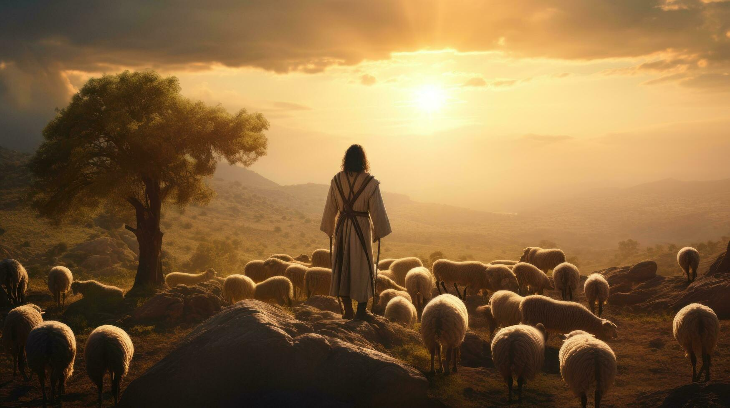
The Good Shepherd
Text: John 10:1-42
Memory Verse: “I am the good shepherd: the good shepherd giveth his
life for the sheep” (John 10:11).

Slide 3
INTRODUCTION
Jesus in our text used the parable of the Good shepherd to differentiate His Life and ministry from that of the false shepherds (the Pharisees and the religious leaders).
Only Jesus, the Son of God can occupy the office of the Good Shepherd. John 10:9
What are parables? The use of symbolic pictures as a means of presenting deep spiritual lessons.

Slide 4
SUBTOPICS
ONE: THE TRUE AND FALSE SHEPHERDS
TWO: THE TRUSTED AND FAITHFUL SHEPHERD
THREE: THE TRUSTED AND FAITHFUL SHEPHERD

Slide 5
1. THE TRUE AND FALSE SHEPHERDS John 10:1-8; Isaiah 40:11; Hebrews 13:20; Psalm 78:70-72; Malachi 4:4; Jeremiah 35:15; 23:30-40
Can a Shepherd Be Both Good and Bad? In his teaching, Jesus wants His hearers to know the difference between Him (the true shepherd) and false shepherds (hirelings).
Who is a Bad or False Shepherd?
A false shepherd seeks personal gain over service and quickly abandons responsibility in times of crisis or challenges.
Who is a Good and True Shepherd?
A true shepherd works joyfully and tirelessly to provide for the sheep, knowing and caring for each one personally.
He selflessly protects and supports the flock, defends the weak, and ensures all are nurtured and fulfilled.
Today, God is seeking faithful shepherds to lead His flock. Will you make yourself available, like His faithful servants—Moses, Samuel, Isaiah, Jeremiah, and many others?

Slide 6
2. THE TRUSTED AND FAITHFUL SHEPHERD John 10:9-18, 27-30; Psalm 23:1-6; Matthew 9:35-38; 1 Peter 5:1-4
“The thief comes only to steal, kill, and destroy, but I have come that they may have life, and have it more abundantly” (John 10:10).
Do you know the good shepherd?
Jesus offers not just salvation, but a life of fullness—calling us to experience God and be conformed to His image
The closer we walk with God through prayer and His Word, the more we experience His abundant life.
Jesus is the Door (vs 7), he is the Good Shepherd who laid down His life, the Chief Shepherd (1 Peter 5:1-5), the Great Shepherd (Hebrews 13:20,21), and the Bishop of our souls (1peter 2:25)

Slide 7
2. Cont’d
Benefits of Following the Good Shepherd
Pardon from sins (verse 9)
Prosperity and success(verse 10)
Personal relationship with the saviour (verse 14)
Profitable walk with the sustainer (verse 27)
Protection and security (verse 28)
Preservation and strength (verse 29)
We have the Call to Reach Others “Other sheep I have… they also must be brought” (John 10:16), Every sinner is a potential believer/sheep; we are called to pray, share the gospel, and bring them into the fold.

Slide 8
3. THE TRUSTED AND FAITHFUL SHEPHERD John 10: 19-26,31-42; Hebrews 3:1,2,5,6; 2 Timothy 3:10-13; Jeremiah 36:16-26
Jesus Christ, the Faithful Shepherd, revealed Himself through His works, yet many still rejected Him.
Despite His miracles, He was falsely accused, misunderstood, and opposed by religious leaders.
Persecution is part of the Christian life for those who live godly in Christ – Jeremiah
The word of God is powerful and brings salvation, sanctification, strength, and spiritual growth.
Study God’s Word consistently, prayerfully, patiently, and meditatively— for a fruitful Christian life.

Slide 9
Q & A
Question 1: What is a parable?
Question 2: Differentiate between a true and false shepherd.
Question 3: How can we experience and enjoy abundant life in Christ?
Question 4: What are the characteristics of a good shepherd?
Question 5: What are the benefits of accepting Jesus as the Good Shepherd?

Slide 10
Q & A cont’d
Question 6: Answer True or False:
1. Christian youths suffer persecution because of their past sins.
2. Christian youths suffer persecution because of believing in Christ and living a righteous life.
3. Christian youths should stop preaching the gospel because of persecution.
4. Christian youths will receive a crown of life for suffering persecution because of Christ.
5. Christian youths should stop praying and reading the Bible because of persecution.

