Slide 1

CONTROVERSY CONCERNING CHRIST
Youth Search the Scriptures Lesson 142

Slide 2
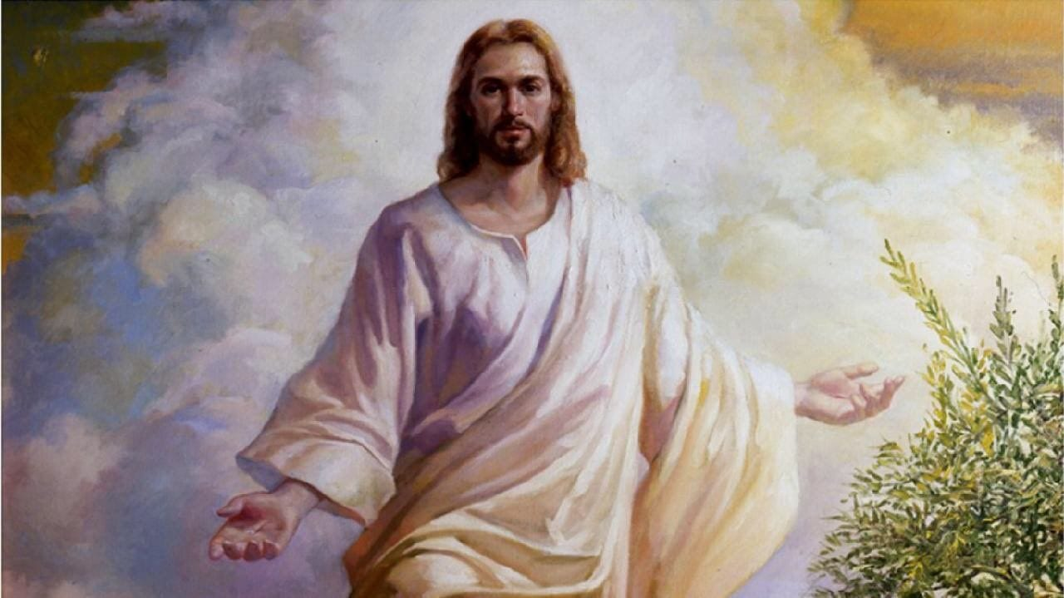
TEXT: John 7:1-53
MEMORY VERSE: “And many of the people believed on him, and said, When Christ cometh, will he do more miracles than these which this man hath done?” John 7:31

Slide 3
INTRODUCTION
It’s the Feast of Tabernacles.
One of the three feasts of solemnity in Israel.
A time meant for worship.
A memorial gathering of the children of Israel.
Jesus was expected to attend to manifest.
Before now, Jesus has been going everywhere teaching.
His teachings were unique, unequalled and undistorted.
His messages were direct, discerning and divine.
While some people were delighted in His teaching (verses 40-44).
Others desired to kill Jesus.
Jesus chose not to attend because of the plot to kill Him for envy's sake.
Jesus’ brethren could also not understand Jesus’ preaching and miracles.

Slide 4
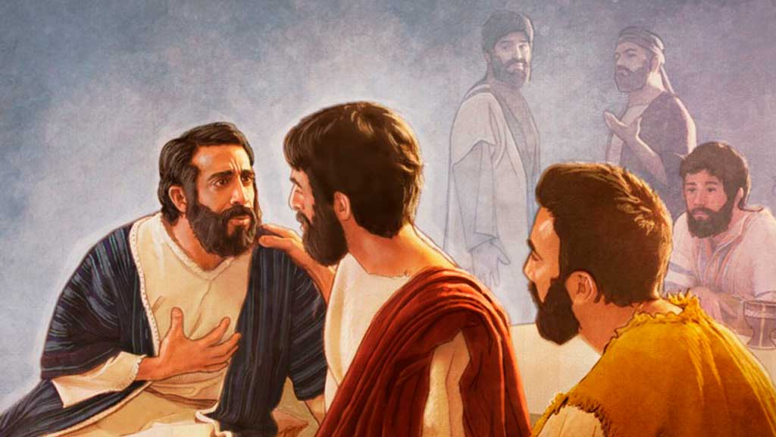
1. CHRIST DIALOGUES WITH HIS BRETHREN - John 7:1-13; Lev. 23:33-36; Matt. 23:27-31; 1 Peter 2: 11; 2 Cor. 10:3-5; Matt. 10:36; 1 Tim. 3:2; John 10:37-40; Eph. 5:15
The Bible says that “the heart of a man is deceitful above all things, and desperately wicked: who can know it?” (Jeremiah 17:9)
Though Jesus had done things worthy of commendation and honour, yet the Jews sought to kill Him.
The world is constantly at enmity with the Spirit of God and true prophets of God.
The Feast of the Tabernacles days were meant to be a time of prayer, reconciliation and renewed commitment to the Lord.
Yet, the Jews sought for an opportunity to kill Jesus.

Slide 5
1. CHRIST DIALOGUES WITH HIS BRETHREN Cont’d
Highlights
The opposition Jesus faced during His earthly ministry reflects the reactions some youths display toward believers today.
Many unsaved youths mock, insult, and speak abusively against Christians.
Some spread false accusations, distance themselves from believers, and, at times, deny them certain rights.
Persecution may also come from unbelieving parents, teachers, relatives, and friends.
Therefore, Christian youths are encouraged to remain steadfast and committed to the Lord, despite the persecutions they may face.
Lessons
Youths who have experienced persecution in the past, especially in the course of evangelism, should remember that Jesus warned us of the coming assaults against the Church.
The world will always oppose and contend with the Church, yet believers are encouraged to remain steadfast—standing firm in faith, love, and obedience to Christ despite every challenge.
“Therefore, my beloved brethren, be ye stedfast, unmoveable, always abounding in the work of the Lord, forasmuch as ye know that your labour is not in vain in the Lord” (1 Corinthians 15:58)

Slide 6
1. CHRIST DIALOGUES WITH HIS BRETHREN Cont’d
Highlights
When Jesus Christ saw the intents of the heart of the Jews, He applied wisdom and prudence in withdrawing Himself from them (Proverbs 22:3).
In military strategy, retreat is a tested strong weapon of battle used by many experienced generals.
Jesus being omniscience knew the best way to handle this plan of the Jews to kill Him.
He decided to retreat so that He will be able to fulfil His ministry.
“Wisdom is the principal thing; therefore get wisdom: and with all thy getting get understanding” (Proverbs 4:7).
Lessons
Christian youths should also apply this great wisdom in every area of their lives.
When there is rioting, wisdom demands that we withdraw.
When a religious fellow wants to get us into unnecessary argument, we ought to withdraw.
When people we trust or look up to begin to preach against the true word of God, wisdom demands that we withdraw.
When “converts” of the opposite gender begin to pull some irrelevant behaviours, withdraw immediately.

Slide 7
1. CHRIST DIALOGUES WITH HIS BRETHREN Cont’d
Jesus finally went to the feast where He ministered the Word to the people.
His words were so convincing that the people marvelled, wondering how He understood so much of the word.
His going to the feast was not with pressure or under the influence of anyone but as He was led by the Spirit of God.
Lessons
We should learn to listen to the Spirit of God rather than heeding to our flesh or anyone who wants us to do anything contrary to what God wants.
Comments of people should never deter Christian youths from preaching the gospel.
When led by the Spirit of God to preach, we should do so, not minding the rejection of the gospel.
Christian youths should know that Christ has overcome the world

Slide 8


2. CHRIST AT THE FEAST OF TABERNACLE - John 7:14-44; Matthew 26:3,4; 13:15; 11:1; Mark 4:1; Psalm 10:4; Jeremiah 44:4, 5; Ezekiel 33:31; Luke 4:14,15
Jesus eventually went to the feast in the temple and taught the people as His manner was.
He never allowed opposition to distract His ministry of teaching and preaching the gospel of the kingdom, pointing the Jews’ attention to God.
God was with Him, confirming the word.
No wonder, the Jews “marvelled, saying, how knoweth this man letters, having never learned?”
Lessons: Every Christian youth and gospel minister are to point the attention of people to God and the Saviour, not to self. When you are praised or commended, remain humble and return all glory to God (John 7:18).

Slide 9
2. CHRIST AT THE FEAST OF TABERNACLE - John 7:14-44; Matthew 26:3,4; 13:15; 11:1; Mark 4:1; Psalm 10:4; Jeremiah 44:4, 5; Ezekiel 33:31; Luke 4:14,15
Some Jews admired the teaching of Jesus – John 7:26
Some youths attend church programs because of admiration and fun fare but never willing to accept the teachings into their lives.
Some other youths allow undue familiarity with God’s word and His ministers to deprive them of the blessings of God during Church services and programmes.
Lessons: We are admonished to received the word of God with sincerity and believe on Christ for full salvation and supernatural blessings. Youths should know that time is short, make a wise decision to follow Christ today before it is too late.

Slide 10
2. CHRIST AT THE FEAST OF TABERNACLE – Cont’d
Jesus described the baptism in the Holy Spirit as rivers of living water.
But before you can benefit from this, you must have experienced:
Genuine salvation through Christ (John 1:12); and
A sanctified heart (Matthew 5:6).
The sanctified believer who desires to be baptized in the Holy Ghost must:
Consecrate himself to God,
Desire it
Pray and exercise faith in the unfailing promise of God

Slide 11
3. OFFICERS’ TESTIMONY AND THE JEWS’ UNBELIEF - John 7:45-53; Eph. 3:8; Col. 1:15-19; 1 Cor. 1:24; Heb. 1:1-14;Matt. 28:18-20; 2 Tim. 4:1,2; Col. 1:28; Romans 1:24-32
“The Pharisees heard that the people murmured such things concerning him; and the Pharisees and the chief priests sent officers to take him” (John 7:32)
Persecutors and opposers of the gospel are always disappointed in their efforts to stop the preaching of the gospel (Acts 4:14; 5:17-28; 9:1,2).
They sought to take the Lord and kill Him because of their hatred. The officers gave an unbiased testimony of Jesus saying: “Never man spake like this man” (verse 46) - a personal testimony of what they heard and saw.
Jesus Christ is incomparable - He spoke with authority, persuasiveness, conviction, transparency, wisdom, unlimited power, grace and boldness.
It is only Christ with the Spirit of God without measure that can earn such a remark from those who opposed Him (John 3:34,35).
All boys, girls, men and women, including angels, must worship Jesus the Lord of all.

Slide 12

3. OFFICERS’ TESTIMONY AND THE JEWS’ UNBELIEF – Cont’d
“That I may know him, and the power of his resurrection, and the fellowship of his sufferings, being made conformable unto his death” (John 7:32)
Your perception of Jesus determines the depth of the revelation you receive from God.
As Christian youths, Jesus could be:
Our Advocate with the Father,
the Bright and Morning Star,
Counsellor,
The Door to the heavenly City,
Emmanuel – God with us,
A Friend of repentant sinners,
The Good Shepherd,
High Priest,
our Intercessor,
The Judge of the whole world,
The King of kings and the Lord of lords,
The Lamb of God
The Name which is above every name,
The only Mediator between God and men,
The Only Begotten of the Father,
The Prince of peace,
The Quickening Spirit,
The Rock of Refuge,
The Saviour of the world,
A Teacher come from God,
The Unsearchable riches of heaven,
The Vine,
The Word of God,
The ‘express’ image of the Father,
The Yours Faithfully to every need, and
The divine Zeitgeist of all ages.

Slide 13
3. OFFICERS’ TESTIMONY AND THE JEWS’ UNBELIEF – Cont’d
The Pharisees had always contradicted what could bring honour to Christ – calling Christ a deceiver.
Their hatred was great and strong against Him – they never saw or said anything good about Him.
Christian youths should be careful, fear God and avoid speaking against God, Christ, Holy Spirit, the word of God and His ministers – they should not join unbelieving boys and girls to nick-name ministers of God or any other person.
By the Spirit and the word of God, Christ is not and will not be a deceiver.
The Devil and the Pharisees are the deceivers.
The Pharisees rejected Christ and His message, hence were spiritually dead and remained in perpetual confusion (Proverbs 21:16).

Slide 14
3. OFFICERS’ TESTIMONY AND THE JEWS’ UNBELIEF – Cont’d
The message of Christ produced different effects on different people:
Some responded with prejudiced, filled with hatred
Others were well disposed towards Him.
In spite of these, Christ remained focused on His divinely appointed ministry.
Nicodemus, (a secret disciple) was one of them who turned away the prejudice against Christ by appealing to their law but was reproached by the Pharisees –John 7:52,53).
The assembly of the chief priests and the Pharisees broke in confusion, and every man went his own way.
This is how God fought for His Son, Jesus.
As Christian youths, we should not be afraid of any opposition to preach the gospel. The God who fought for His children in the past generations is still alive. Be courageous and bold for your God.

Slide 15

What were the bases of the controversies the Jews had with Jesus?
What are the various ways persecution come to Christian youths today?
What lessons do we learn from Jesus’ restraint from openly attending the feast?
How can christian youths preach the gospel in spite of persecutions and trials?
What should be the attitude of Christian ministers when commended?
Why do some youths attend programmes without any transforming testimony?

Slide 16
References
https://hnojatl.org/wp-content/uploads/2019/02/Jesus.jpg
https://www.jesuschristformuslims.com/wp-content/uploads/2016/09/Who-are-Jesus-brothers-Clear-your-doubts-about-Jesus-Christ.jpg
https://bibleiq.bibletruth.info/images/whoIsJesus.png
https://i.ytimg.com/vi/DwGPTRh-gko/maxresdefault.jpg
https://www.incimages.com/uploaded_files/image/1920x1080/getty_152846930_9706449704500115_72090.jpg

