Slide 1

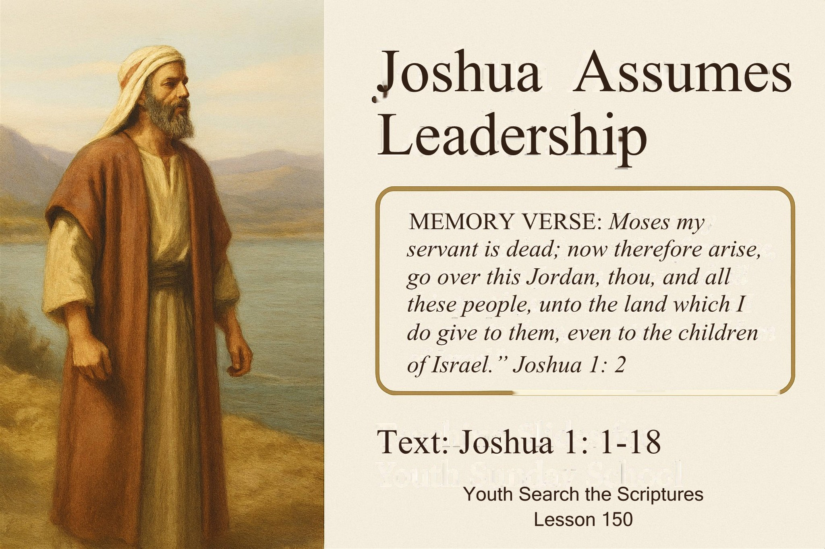

Slide 2
Introduction
Moses had died, as God had earlier told him (Numbers 27:12-14).
Joshua, Moses’ aide, had been prepared to take leadership.
No one knew Moses’ burial place, so Joshua waited for God’s direction.
God called and commissioned Joshua to lead Israel into the Promised Land.

Slide 3
Lessons from Joshua
He waited for God’s instruction.
He did not push himself forward.
He respected God’s timing and order.
He responded immediately when God called.
Application: Youths should avoid rushing into duties without clear instruction and authority.

Slide 4
THREE POINTS TO CONSIDER
THE CALL AND COMMISSION OF JOSHUA
THE COMMAND TO THE CONGREGATION BY JOSHUA
THE COMMITMENT OF THE CONGREGATION TO JOSHUA

Slide 5
Point 1: The Call and Commission of Joshua (Joshua 1:1-9; Exodus 3:7-10;18:21,22; Matthew 28:18-20; Mark 16:15-20; 2 Timothy 4:1-5)
Joshua mourned Moses but was called to continue the mission.
God told Joshua (Verses 1&2):
Moses is dead — now arise.
Lead Israel across Jordan.
Possess the land.
Divide it as inheritance.
Christians Youths: We are also called to serve God.
Mark 16:15 – Preach the gospel to all people.

Slide 6
What Joshua Needed to Succeed
Courage and Strength — to lead boldly (Joshua 1:6).
Obedience to God’s Word — not turning left or right (Joshua 1:7).
God’s Presence — the true guarantee of success (Joshua 1:9).
Application: Leaders today need discipline, obedience to Scripture, and strong godly character.

Slide 7
Point 2: The Command to the Congregation by Joshua Joshua 1: 10-15, 1Corinthians 9:24-27, 2Timothy 2:5, Hebrews 12:1-4 Proverbs 27:17
Joshua instructed the officers to prepare the people.
They would cross the Jordan in three days.
The people were told to prepare food for the journey.
He also reminded the Reubenites, Gadites and half tribe of Manasseh to:
help the rest of Israel fight for their inheritance and
they were to leave families behind to avoid distractions.
Preparation prevents distraction.

Slide 8
Lessons for Youth Leaders
Good leaders prepare their people.
They remove distractions.
They remind people of previous commitments.
They encourage unity and teamwork.
Application: Youth leaders should guide youths to prepare for heaven, avoiding distractions and sin.

Slide 9
Preparing for the Christian Race
Hebrews 12:1–2 teaches believers to lay aside sin.
1 Corinthians 9:24–27 — Run to win.
2 Timothy 2:5 — Follow the rules of spiritual race.
Run the race with patience.
Focus on Jesus, the author and finisher of our faith.

Slide 10
Point 2:The Commitment of the Congregation to Joshua Joshua 1:16-18; 1 Corinthians 5:11; Hebrews 13:7,17
The people said: (Joshua 1:16–18)
“We will obey you.” – They accepted Joshua as their leader.
“We will go wherever you send us.” - They promised to obey his instructions.
“We will remain loyal, as we were to Moses.” - They pledged loyalty like they gave Moses.
And not just these only, they also encouraged Joshua: “Only be strong and courageous.”

Slide 11
Attitude Toward Leaders
Obedience to godly instructions.
Respect for spiritual authority.
Loyalty and cooperation.
Encouraging them and praying for them.
Not supporting rebels or critics.

Slide 12
Final Lessons for Youths (Key Takeaways)
Wait for God’s timing and direction.
Build courage through God’s Word.
Follow instructions from spiritual leaders.
Support your leaders with loyalty and prayer.
Prepare spiritually for heaven.

Slide 13
CLOSING CHALLENGE
Are you ready to arise and follow God’s call like Joshua?
Will you obey God’s Word?
Will you support your leaders?
Will you always live a life that is prepared for eternity?
God can use YOU — just like Joshua

Slide 14
Questions
What lesson do we learn from Joshua’s attitude towards assuming the leadership of Israel?
Mention three major things that Joshua would need in order to succeed.
What can we learn from the admonition of Joshua?
What attitude does God expects us to exhibit towards our leaders?

